Slide 1
VGH Noon Report
June 5, 2026
Jae Lee, IM PGY-2

Slide 2
Case: Ms. HC
You are a XC Junior on call, and you are asked to see a 19-year-old female who presents with 3 days of N/V in the background of chronic fatigue

Slide 3
Case: Ms. HC
PMHx
Hypothyroidism (Hashimoto’s)
Celiac disease (confirmed on biopsy)
Medications
Synthroid 175mcg PO qAM
Allergies: NKDA
Social History:
Entering university soon, living with family. No TB contacts.
No substance use.
Family History:
Hashimoto’s thyroiditis in paternal grandfather, both maternal grandparents
Grave’s disease in paternal grandmother
Brother: vitiligo
Maternal uncle: Psoriasis, Crohn’s

Slide 4
Case: Ms. HC
What would you like to know on H&P?

Slide 5
Case: Ms. HC
History:
Acute nausea and vomiting x3 days, in the background of months of chronic fatigue attributed to her hypothyroidism
Positional dizziness
10lbs weight loss in the past year
Denies salt craving, but does wonder about hyperpigmentation and “easy tanning” lately
On exam:
Afebrile, HR 90, BP 130/80 mmHg, weight 54kg
No mucosal hyperpigmentation noted, but darker complexion than mother

Slide 6
Case: Ms. HC
Lab results on presentation:
WBC 12.0, Lymphocyte 3.9
Na 125
K 5.7
VBG 7.16/39/14
TSH 26.9 fT4 14.2 fT3 5.5
What test would you like to order?

Slide 7
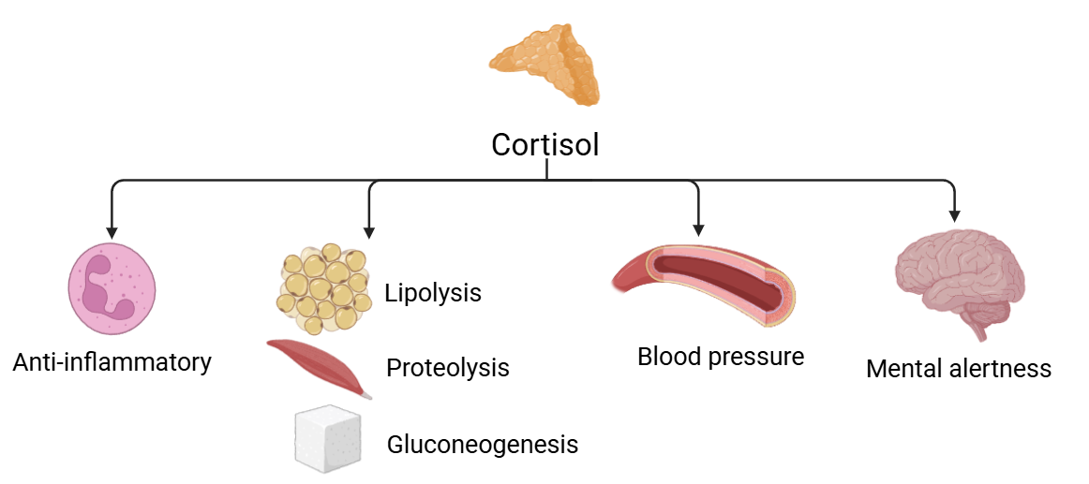
Cortisol Physiology
Notes:
Cortisol, commonly called a “stress hormone”, has many functions (including but not limited to):
Anti-inflammatory
Catabolic effects: lipolysis, proteolysis (protein breakdown), gluconeogenesis
Maintains blood pressure through upregulation of a1 adrenergic receptors that cause vasoconstriction
Promotes mental alertness

Slide 8
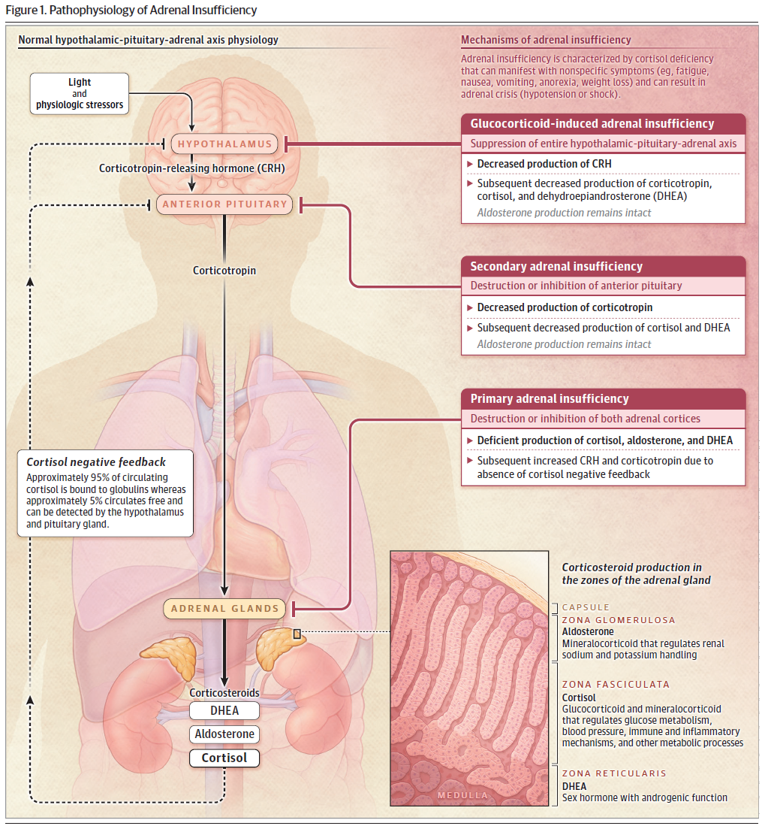
Pathophysiology
Notes:
HPA Axis
Light or physiologic stressors stimulate the hypothalamus to release CRH
CRH acts on anterior pituitary to release adrenocorticotrophic hormone (ACTH), which then stimulates the adrenal cortex (zona fasciculata) to produce cortisol
Adrenal insufficiency
Problems in any of these steps of the HPA axis can cause adrenal insufficiency
Primary: at the level of the adrenal cortex
Secondary: at the level of the anterior pituitary
Tertiary: HPA axis suppression
Image: https://jamanetwork.com/journals/jama/article-abstract/2835391

Slide 9
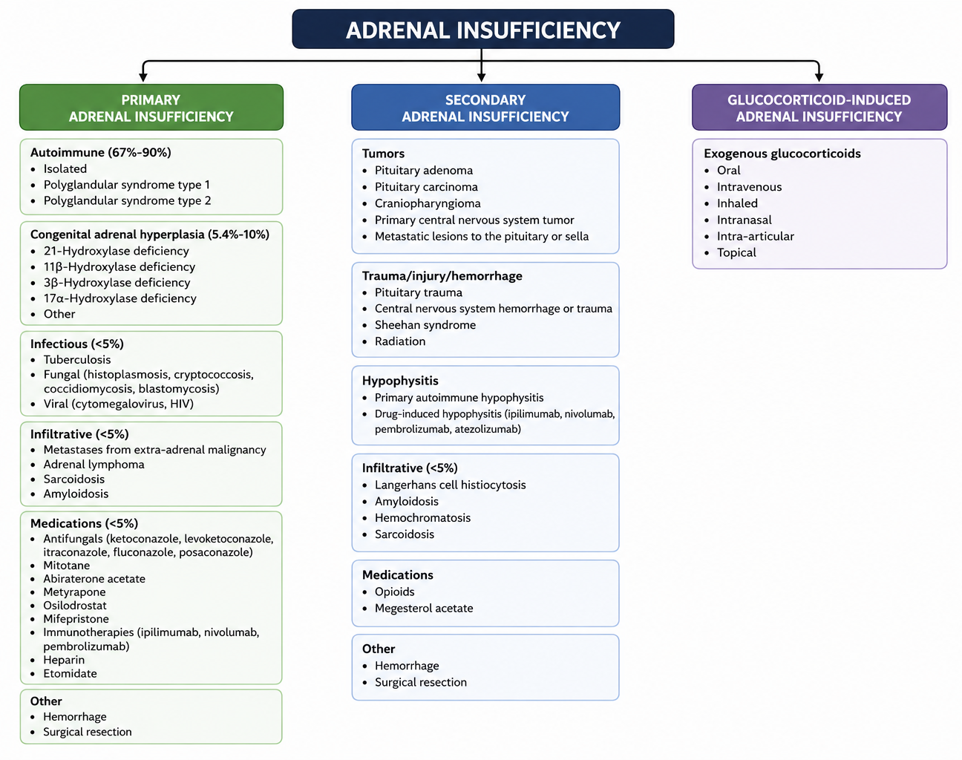
Etiology
Notes:
Primary:
Addison's (autoimmune adrenalitis) is the most common cause of primary AI (typically earlier onset, age 20-50)
CAH, most commonly secondary to 21-hydroxylase deficiency
In TB-endemic countries, TB should be higher on the differential
Medications, notably antifungals (-azoles). Note that with increase of checkpoint inhibitors, we are seeing a rise in adrenal insufficiency secondary to this
Secondary:
- Tumors causing mass effect
ICI-induced hypophysitis causing AI also increasing, typically 2-8 months after initiation of treatment
Opioids are also a major consideration in secondary adrenal insufficiency, though the likelihood HPA axis suppression is less predictable
Tertiary:
- Most common cause of AI is glucocorticoid-induced (1-3% of adult population prescribed glucocorticoid therapy)
- Daily dose of 5mg or greater of prednisone (or equivalent) for >3 weeks can induce AI

Slide 10
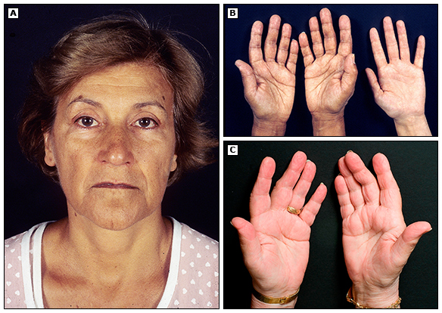
History & Physical
Non-specific:
Fatigue
Nausea, vomiting, abdominal discomfort
Anorexia, weight loss
Arthralgia, myalgia
Postural dizziness
Personal/family autoimmune history
Suggestive of primary AI:
Hyperpigmentation (ACTH co-secreted with melanocyte stimulating hormones)
Salt craving (mineralocorticoid deficiency)
Physical exam:
Orthostatic hypotension
Hyperpigmentation
  Gingival/buccal mucosa
  Skin folds (Ex. Palmar creases)
  Sun-exposed areas
Cushingoid features
Notes:
Most patients present with months to years of non-specific symptoms, therefore often goes undiagnosed.
Symptoms more suggestive of primary AI:
Salt craving (mineralocorticoid deficiency)
Hyperpigmentation (ACTH is co-secreted with melanocyte stimulating hormones)
Orthostatic hypotension may be more pronounced in primary AI (also due to mineralocorticoid deficiency) than secondary/tertiary
Examine for cushingoid features that may suggest chronic exposure to exogenous steroids
Image: UpToDate “Hyperpigmentation in Addison’s Disease” https://www.uptodate.com/contents/image?imageKey=ENDO%2F74922

Slide 11
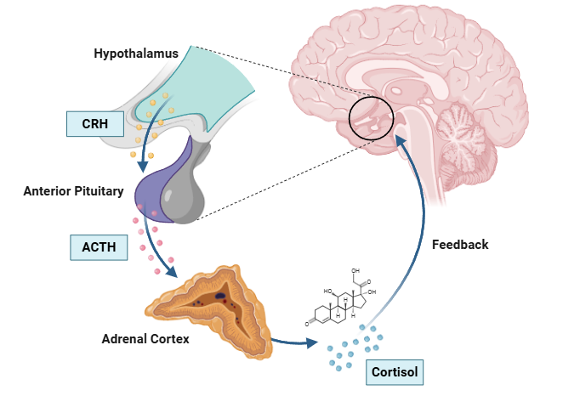
Investigations
CBC:
  Lymphocytosis
  Eosinophilia
Basic metabolic panel/VBG:
  Hyponatremia
  Hyperkalemia (primary AI)
  Metabolic acidosis (primary AI)
  Hypoglycemia
Notes:
When under stress, cortisol is produced and this typically decreases eosinophil and lymphocyte count; therefore, in adrenal insufficiency you may note increased lymphocytes and eosinophils disproportionately to neutrophils (which don’t demarginate as much in absence of cortisol)
Caveat: not always present, and more likely absent if steroid-induced AI
Hyponatremia can be present in both primary and secondary adrenal insufficiency, but more pronounced/common in primary
In primary AI, this is due to mineralocorticoid deficiency
In secondary AI, mineralocorticoid is not affected but cortisol normally decreases vasopressin synthesis and secretion from vasopressinergic neurons; therefore, absence of cortisol leads to increased vasopressin => inappropriate water retention
Hyperkalemia, metabolic acidosis suggests primary adrenal insufficiency, due to concurrent aldosterone deficiency
Rarely hypercalcemia (not mentioned in slide as it is uncommon)

Slide 12
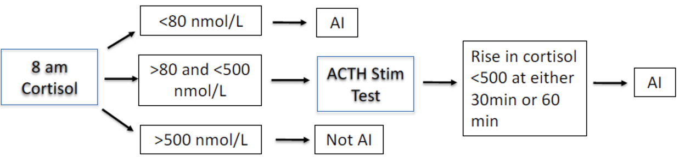
Investigations
Step 1: 8AM cortisol, ACTH (confirming diagnosis and localizing etiology)
Step 2: If indeterminate 8AM cortisol level, pursue ACTH (250 mcg) stimulation test
Clinical pearl: AM cortisol assumes normal sleep pattern with no major sleep disruption recently; consider dynamic testing or testing after normalization otherwise
Notes:
Step 1 if suspecting diagnosis is to complete a morning cortisol
<80 nmol/L cutoff has 99.7% specificity for AI
>275 nmol/L cutoff in newer assays have 98.8% sensitivity for detecting AI (100% in Calgary local data), though some centers may use a stricter cutoff of 500. Use local lab cutoff
https://onlinelibrary.wiley.com/doi/10.1111/cen.70102
AM cortisol assumes patient has normal sleep pattern and no major sleep disruptions recently. If not, consider testing after normalization (ex. Night shift worker), or use dynamic testing
Step 2 cosyntropin (ACTH) stim test
If serum cortisol between 80 – 275 nmol/L, should do ACTH 250mcg stimulation test
Note that Endo Society 2016 Primary AI guidelines recommend this as confirmatory test regardless to diagnose AI
If stim test is <500 nmol/L at 60 min, this is diagnostic for AI. But newer assays suggest that 350 should be the cutoff (https://pubmed.ncbi.nlm.nih.gov/28192125/)
Note that this is sensitive in primary AI, but could miss patients with secondary AI of shorter duration (since adrenals have not yet atrophied, therefore stimulates appropriately)
ACTH helps determine the level of defect (more on next slide)

Slide 13
Investigations: Interpretation
Clinical pearl: Some conditions may impact total cortisol (ex. OCP, cirrhosis), therefore, confound serum cortisol measurement
  Consider salivary free cortisol or serum free cortisol in these cases
 | Primary | Secondary | Glucocorticoid
AM cortisol | Low | Low | Low
ACTH | High | Low/normal | Low/normal
Aldosterone | Low | Normal | Normal
Renin | High | Normal | Normal
Notes:
For ACTH, typically much elevated (>20 pmol/L, often in the hundreds) in primary AI
Endo Society 2016 guidelines mention >2-fold increase to be consistent with primary AI
Often <4 pmol/L in secondary or tertiary AI

Slide 14
Case: Ms. HC
 | Baseline (4PM) | 30 min | 60 min
Cortisol nmol/L | 16 | <14 | 15
ACTH | 422
Confirming diagnosis of primary adrenal insufficiency!
In combination with her Hashimoto’s thyroiditis…
Notes:
Testing in our patient was highly suggestive of primary adrenal insufficiency, even without anti-adrenal antibodies

Slide 15
Autoimmune Polyglandular Syndrome
A combination of autoimmune adrenal insufficiency and other autoimmune endocrine disorders
In primary AI, patients are at higher risk and need annual screening for:
Autoimmune thyroid disease (TSH)
Type 1 diabetes (HbA1C)
Premature ovarian insufficiency
Celiac disease (anti-tTG)
Autoimmune gastritis (CBC, vitamin B12)
Type | APS-1 | APS-2 (aka. Schmidt Syndrome)
Etiology | Monogenic (AIRE mutation) | Polygenic
Prevalence | Less common | More common
Diagnostic criteria | 2 or more of: Hypoparathyroidism Chronic mucocutaneous candidiasis Primary AI | 2 or more of Autoimmune thyroid disease T1DM Primary AI
Other |  | More often a/w Celiac disease
Notes:
Concurrent thyroid disease (Hashimoto’s) and new diagnosis of primary (later confirmed autoimmune) AI makes this diagnosis APS-2.
Regardless of APS, a part of management of primary AI is monitoring for other autoimmune conditions given increased risk:
Thyroid disease (TSH) - 50% of females, 25% males
Diabetes (A1C) – 10%
POI - varies between 8-20%
Celiac disease (anti-tTG) - 5%
Autoimmune gastritis (B12, CBC)
There is no clear evidence to support specific duration, but guidelines recommend annual.

Slide 16
Investigations
Additional investigations to determine etiology:
Etiology | Primary | Secondary | Glucocorticoid
Lab | 21-hydroxylase antibodies (i.e. anti-adrenal antibodies) 17-OHP or very-long chain fatty acids in select cases | Test for other pituitary deficiencies | None
Imaging | If lab negative, CT adrenal | MR Sella
Notes:
Primary AI:
21-OH antibody; can consider other lab tests in select cases (CAH, adrenoleukodystrophy) which we will not cover today
CT adrenals to assess infiltrative/hemorrhage/infectious causes if lab negative
Secondary AI:
MR Sella; test for other pituitary hormone deficiencies

Slide 17
Management: Pharmacological
Glucocorticoid replacement
  Hydrocortisone 15-25mg PO in 2 divided doses
  2/3 dose in the morning, remaining in early afternoon (ex. 10mg at 0800h, 5mg at 1400h)
  Monitor response via symptoms, weight, postural blood pressure, and clinical features of hypercortisolism
Specifically for primary AI
  Fludrocortisone 0.05 – 0.1mg PO daily (starting dose)
    Titrate based on electrolytes and exam (volume status, edema, weight, orthostatic hypotension)
  DHEA: consider in women with low libido and/or depressive symptoms despite optimal glucocorticoid therapy
    Discontinue if no response in 6 months
Notes:
Glucocorticoid replacement
Prednisone 3-5mg daily is also an alternative, especially if adherence is a concern
Will not mention: patients with underlying concurrent central DI may be unmasked once adrenal insufficiency treated
- Cortisol decreases vasopressin synthesis and secretion from vasopressinergic neurons in the paraventricular nucleus, leading to increased free water clearance. (https://www.ncbi.nlm.nih.gov/books/NBK538239/)

Slide 18
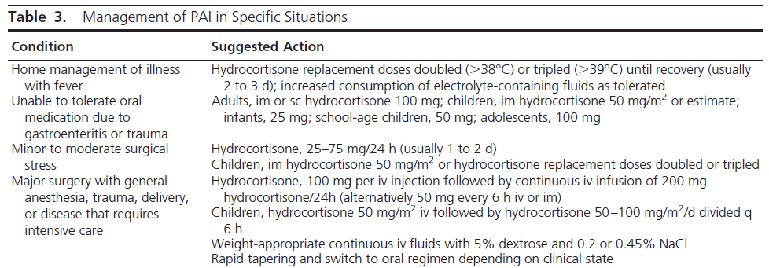
Management: Education
Stress dosing education (see below)
Provide prescription for emergency injection kit (hydrocortisone 100mg IM/SC)
Notes:
Table taken from Endo Society 2016 Primary AI Guideline. Simple rule would be double dose for two days for mild illness, triple dose for three days for moderate illness.
If unable to tolerate oral medications, should present to hospital (hydrocortisone IM can be a bridge in the meantime)
Please provide patients with stress dosing education handout

Slide 19
Case: Ms. HC continued..
Feeling better with IV fluids (received empiric antibiotics and 1L of IVF thus far).
But..
Soon after your initial assessment, before starting steroids:
HR 120 BP 85/49 (MAP 63)
Feeling more drowsy

Slide 20
Adrenal Crisis
Life-threatening emergency triggered by stressors, often with:
Hypotension/shock, often not responsive to fluids
Severe hyponatremia
aLOC
Management
Hydrocortisone 100mg IV STAT, then 50mg IV q6h
  Don’t wait for lab results to start treatment!
IV fluids (dextrose-containing if hypoglycemic)
Identify and treat precipitating cause
Clinical pearl: In patients presenting with overt hypothyroidism or myxedema coma, ensure no concurrent adrenal insufficiency before starting thyroid replacement to avoid precipitating adrenal crisis
Notes:
A common mistake that we also made in this case was waiting too long to give hydrocortisone
Up to 50% of patients with primary AI experience at least 1 adrenal crisis prior to diagnosis of AI, therefore again emphasize importance of educating patients on sick day med management

Slide 21
Case Conclusion
Discharged 2 days later, with hemodynamic stability and symptom improvement on:
  Hydrocortisone 10mg at 0800h and 5mg at 1400h
  Fludrocortisone 0.05mg daily
Several months later, presented with adrenal crisis thought to be secondary to stressors from university – reinforced sick day management

Slide 22
Case Conclusion
Anti-adrenal antibodies positive
Anti-GAD65 also positive on recent follow-up!

Slide 23
Learning Objectives
Review adrenal physiology and pathophysiology behind adrenal insufficiency
Discuss pertinent findings on H&P for adrenal insufficiency
Understand the approach to diagnosis and work-up to determine etiology
Review the pharmacological and non-pharmacological management of adrenal insufficiency
Discuss an approach to identifying and managing adrenal crisis

Slide 24
References
1. Bornstein SR, Allolio B, Arlt W, Barthel A, Don-Wauchope A, Hammer GD, et al. Diagnosis and Treatment of Primary Adrenal Insufficiency: An Endocrine Society Clinical Practice Guideline. J Clin Endocrinol Metab. 2016 Feb 1;101(2):364–89. doi:10.1210/JC.2015-1710 PubMed PMID: 26760044.
2. Vaidya A, Findling J, Bancos I. Adrenal Insufficiency in Adults: A Review. JAMA. 2025 Aug 26;334(8):714–25. doi:10.1001/JAMA.2025.5485 PubMed PMID: 40522647.
3. Kline GA, Buse J, Krause RD. Clinical implications for biochemical diagnostic thresholds of adrenal sufficiency using a highly specific cortisol immunoassay. Clin Biochem. 2017 Jun 1;50(9):475–80. doi:10.1016/j.clinbiochem.2017.02.008 PubMed PMID: 28192125.
4. Symonds CJ, Leung AA, Kline GA. ACTH Stimulation Testing Is Often Unnecessary After Appropriate Patient Preparation Prior to Screening Cortisol Measurement. Clin Endocrinol (Oxf). 2026 Jun 1;104(6):567–73. doi:10.1111/CEN.70102

