Slide 1
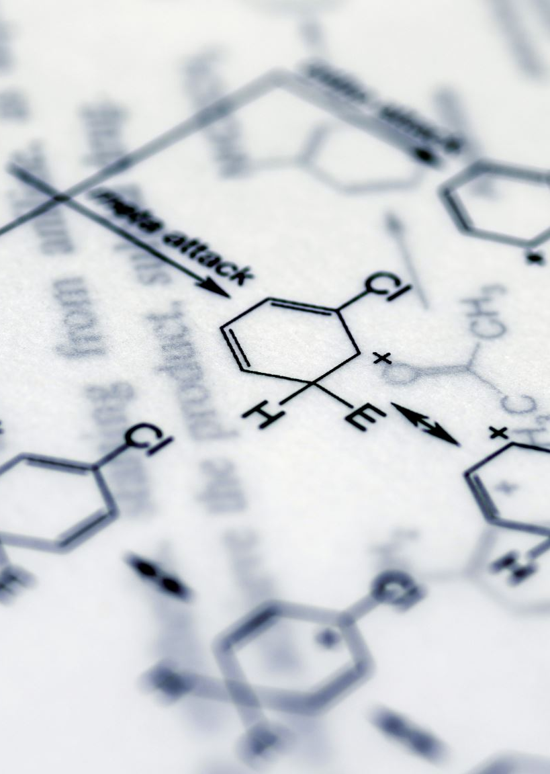
VGH NOON ROUNDs
Sajad Niyyati (IM R3)
March 27, 2026

Slide 2
Case Presentation
27-year-old male with a recent diagnosis of testicular germ cell carcinoma, presenting with palpitations.
Medications:
Tylenol 650mg PO QID
Melatonin 3mg PO qhs PRN

Slide 3
What do you want to know?

Slide 4
HPI:
Diagnosed 1 month prior, waiting for Medical Oncology appointment
Episodes occur randomly 1-2 times daily without any prodrome.
Clothes fit looser but denies fever and night sweats. No recent illnesses.
Review of Systems:
Denied hyperdefacation, tremor, diaphoresis, heat intolerance, anxiety, insomnia.
No new stressors
No new medications
Social History:
Immigrated to Vancouver 6 years ago from Mexico, vapes nicotine, no alcohol, no substance use.
Negative Family history

Slide 5
Physical Exam
Vitals:
Temp 37.1, HR 87, BP 127/56, MAP 80, RR 16, 96% on RA
On inspection, appears slim, not in distress, alert and oriented.
CARD: S1, S2 normal. No abnormal sounds or murmurs.
RESP: Good air entry bilaterally.
ABDO: Soft, non-tender.

Slide 6
What investigations would you order for this patient?

Slide 7
Investigations
Labs:
WBC 11.7 (Neut 8.5), hbg 140, plt 277
Lytes normal, LFTs normal. Glucose 9.8
Cr 70, GFR 123
ECG: Normal, sinus rhythm, rate of 90
Urinalysis bland, serum and urine toxicology screen negative
Blood culture negative after 2 days
Beta-hCG level 1,079,969 IU/L
AFP elevated
TSH < 0.01 mU/L free T4: 38 pmol/L free T3: 6.2 pmol/L

Slide 8
Summary STATEMENT

Slide 9
Summary STATEMENT
27-year-old male with a recent diagnosis of testicular germ cell carcinoma, who presents with 2-week history of palpitations, found to have undetectable TSH and elevated free T4 and T3, consistent with hyperthyroidism.

Slide 10
Approach to hyperthyroidism
Name some causes of hyperthyroidism, especially as it pertains to this patient

Slide 11
Causes of hyperthyroidism
Grave’s disease
Subacute thyroiditis
Toxic adenoma (hot nodule)
Rare causes:
  Follicular thyroid carcinoma
  Elevated Beta-hcg
  Medication-induced (amiodarone, immune check-point inhibitors, lithium, etc.)

Slide 12
How would you assess for these?
Grave’s disease
Subacute thyroiditis
Toxic adenoma
Rare causes:
  Follicular thyroid carcinoma
  Elevated Beta-hcg
  Medication induced (amiodarone, immune check-point inhibitors, lithium, etc.)

Slide 13
Investigations to order
Grave’s disease: TRAb, RAI or technetium uptake
Subacute thyroiditis: RAI or technetium uptake
Toxic adenoma: RAI uptake or technetium uptake
Rare causes:
  Follicular thyroid carcinoma: Imaging and/or uptake scan
  Elevated Beta-hcg: B-hcg, RAI uptake or technetium uptake
  Medication induced (amiodarone, immune check-point inhibitors, lithium, etc.)

Slide 14
CAUTION!!
When ordering RAI reuptake scans, be aware of unreliability due to recent exposures to Iodine (amiodarone, contrast) or lithium.
Technetium scans are more reliable in these situations, but availability is center dependent!

Slide 15
Updated Investigations
Labs:
Beta-hCG level 1,079,969 IU/L
Thyroid panel: TSH < 0.01 mU/L free T4: 38 pmol/L free T3: 6.2 pmol/L
TSH Receptor Antibody <1.1 Thyroperoxidase Antibody <7
Thyroid Ultrasound:
Thyroid is normal in size and echotexture. The right lobe measures 1.5 x 1.4 x 4.1 cm.
Left lobe measures 1.2 x 1.5 x 3.9 cm. No thyroid nodules or abnormal vascularity. No cervical lymphadenopathy.

Slide 16
What is likely causing this hyperthyroidism?

Slide 17
Updated DDx
Beta-hCG mediated hyperthyroidism
Subacute thyroiditis
Graves' Disease

Slide 18
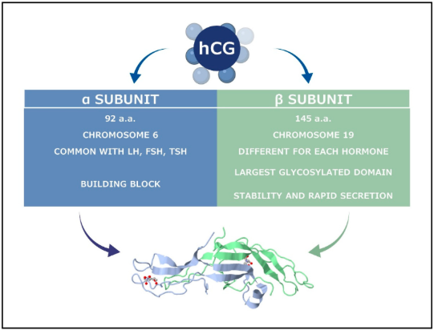
Human chorionic gonadotropin molecule
HCG molecule - (modified from d’Hauterive et al.)¹

Slide 19
Pathophysiology
The beta-subunit of HCG and TSH are highly homologous, can cross-react with TSH receptor.
Non-seminomatous germ cell tumors may secrete HCG
  often used as off-label tumor marker

Slide 20
Who is at risk
Patients with non-seminomatous germ cell tumors and those with HCG >50,000 IUL/L
As per International Germ Cell Consensus Classification:³
Patients with HCG levels >50,000 IU/L are defined as high risk
Patients with HCG levels >5,000 but <50,000 IU/L are defined as intermediate risk

Slide 21
Prevalence
In a 144 NSGCT patient cohort, 10 patients had HCG levels >50,000 IU/L.²
Of those, 5 patients (50%) were diagnosed with hyperthyroidism.²
  3.5% of the NSGCT cohort
  In another case series of 17 NSGCT patients, of those with Of those with HCG levels >50,000IU/L, 41% were diagnosed with hyperthyroidism.²

Slide 22
Approach to management
As per reported case reports and case-series:^{6,7}
  Dexamethasone to address tumour
  Propranolol as needed to address symptoms of hyperthyroidism
  Anti-thyroid medication to temporize until chemotherapy and/or tumour resection
    Taper to stop once HCG levels drop <50,000

Slide 23
case conclusion
Patient received Dexamethasone 4mg IV BID x 5 days (as per Med Onc)
Started on Methimazole 15mg PO daily
Thyroid function test assessed after 1 week:
TSH 0.03 fT4 14.6 fT3 3.6
Patients transferred to BCCA for chemotherapy induction with TBD orchiectomy
Methimazole stopped after first round of chemotherapy

Slide 24
d’Hauterive, S. P., Close, R., Gridelet, V., Mawet, M., Nisolle, M., & Geenen, V. (2022). Human Chorionic Gonadotropin and Early Embryogenesis: Review. International Journal of Molecular Sciences, 23(3), 1380.
Oosting, S. F., De Haas, E. C., Links, T. P., De Bruin, D., Sluiter, W. J., De Jong, I. J., ... & Gietema, J. A. (2010). Prevalence of paraneoplastic hyperthyroidism in patients with metastatic non-seminomatous germ-cell tumors. Annals of Oncology, 21(1), 104-108.
Wilkinson, P. M., & Read, G. (1997). International Germ Cell Consensus Classification: a prognostic factor-based staging system for metastatic germ cell cancers. International Germ Cell Cancer Collaborative Group.
Lempiäinen A, Hotakainen K, Blomqvist C, Alfthan H, Stenman UH. Increased human chorionic gonadotropin due to hypogonadism after treatment of a testicular seminoma. Clin Chem. 2007 Aug;53(8):1560-1.
Yoshimura K, Nakashima Y, Sugiyama K, Kohei N, Takizawa A. Supposed pituitary-production of human chorionic Gonadotropin induced by androgen deprivation therapy. Int Braz J Urol. 2019 Jan-Feb;45(1):38-44.
Arnold A 2017 Primary hyperparathyroidism: molecular genetic insights and clinical implications. Presented at Society for Endocrinology BES 2017, Harrogate, UK. Endocrine Abstracts
Sotello D, Rivas AM, Test VJ, Lado-Abeal J. Choriocarcinoma presenting with thyrotoxicosis. Proc (Bayl Univ Med Cent). 2016 Jan;29(1):42-3.

