Slide 1
Noon Report
Mo Alfadhalah
VGH LMR

Slide 2
82 M presents with SOB
Notes:
How would you approach this common problem?

Slide 3
Dyspnea
Pulmonary
Cardiac
Chest wall
Toxic/Metabolic
Parenchymal/Pleural
Airway
Vascular
PE,PHTN
PNA, Effusion, Malignancy
COPD, Asthma
MI
Heart Failure
Arrhythmias
Sepsis
DKA
Notes:
Anything you want to ask on history?

Slide 4
History
Exertional dyspnea, last few months, worsening
Now NYHA 4, orthopnea, PND, LL edema, weight gain
No CP, pre-syncope, cough, fever

Slide 5
82 M with SOB
PMHx:
HFrEF (EF 35%)
Severe TR
HTN
DLD
CAD medically managed
Social Hx:
Uses 2ww to ambulate
50pack year smoking hx,
Baseline NYHA 2-3
Meds:
Furosemide 40mg PO q24hr
ASA 81mg PO q24hr
Atorvastatin 40mg PO qH.S.
Ramipril 5mg PO q24hr
Dapagliflozin 10mg PO q24hr,

Slide 6
Labs:
Na 135 K 4 Cr 132 eGFR 40 Mg 1
Hb 145 Plt 222 A1c 6.2 LDL 2.1 Non HDL 2.3
NT Pro BNP 2400 Trop 7
U/A bland, Cultures prelim negative
Notes:
Cr is off his baseline, highlight NT Pro BNP for age (50-75 >900, >75 >1800)

Slide 7
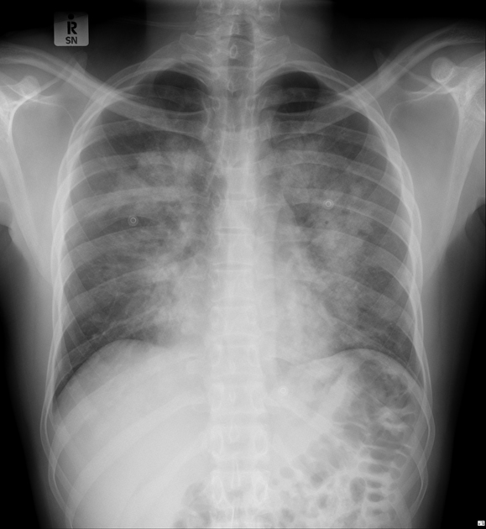

Slide 8
Diagnosis and one liner

Slide 9
How would you treat?
82 year old M with known ICM (EF 35%, presents with orthopnea, PND, exertional dyspnea, LL edema and weight gain, labs show an elevated BNP and AKI, CXR showed congestion, overall clinical picture is suggestive of a heart failure exacerbation
Notes:
Started on Lasix 40mg IV BID

Slide 10
Labs the Next Day
Na 132 K 3.3 Cr 164 eGFR 30 Cl 89 HCO3 30
Hb 145 Plt 222

Slide 11
Would you increase/decrease? Stop? CSM?
Notes:
How would you approach this?
It was decided to hold diuresis for one day

Slide 12
Outcome
Creat continued to rise, sharply
CICU contacted, required Lasix infusion, inotropes and eventual CRRT
Notes:
Despite reintroducing lasix at higher doses

Slide 13
Refresher on RBF and eGFR
RBF=20% CO, differences in renal arterial and venous pressures
GFR=number of functioning glomeruli + hydrostatic/colloid osmotic pressure differences between glomerular capillaries and Bowman’s space
Filtration Fraction=GFR/RBF, this preserves GFR

Slide 14
Deletrious Effects of HF on Diuresis
In HF, decreased number of functioning glomeruli, increased neurohormonal activation decreases RBF, increased abdominal pressure, decreased splanchnic capacitance and congestion decrease GFR
01
In HF, Na and water and reabsorbed, increased FF means more proteins in the tubules, and NH activation (AG2) more Na reabsorption at the proximal tubule
02
At the loop of Henle: Less tubular fluid will be provided, NH activation, poor blood flow means less excretion of Na
03

Slide 15
Diuresis: Overview
Effective diuresis 4 steps: Ingestion and GI absorption, delivery to the kidney, secretion into tubule lumen, binding to transport protein
Absorption: Furosemide follows “flip flop kinetics”-absorption is slower than half life elimination, bioavailability 50% (bumetanide, toresamide 80%), loop diuretics have steep dose-response curves-once threshold is reached, quickly reaches a ceiling
Once ceiling is reached, increasing the dose will not increase the maximal rate of natriuresis. In theory, dose increase will keep diuretic concentrations above the threshold for longer only
Delivery: NKCC binding in thick ascending loop. Bound to proteins (albumin) so need to be secreted by proximal tubules (OAT1 and OAT3)

Slide 16
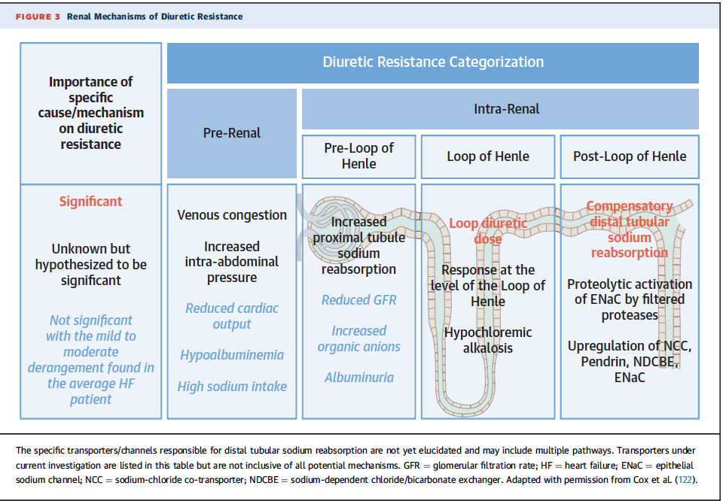
Notes:
Hypochloremic Alkalosis: Loop diuretics inhibit NKCC2, when less Cl- is delivered to the lumen, reduced inhibition loops are less effective.
Also enhanced distal sodium reabsorption (Pendrin is upregulated Cl-/HCO3 exchanger in the collecting duct)
RAAS is activated! Low Cl- at the macula densa stimulated renin release independent of sodium
Dont forget Cl- is a permissive anion for diuresis, without it sodium is reabsorbed with bicarb or via alterate pathways!

Slide 17
Tips for Dosing:
Initial dosing: Long term loop diuretics, x2.5 home dose. If naive, 40-80mg IV BID reasonable starting. BID bc of post-diuresis Na retention
Adjustment of dosing: guided by clinical response, UOP measured within 2hr, double the dose if not effective. Can monitor urine Na (if high ie more than 70, you have the right dose, increase frequency)
Increase in serum creatinine: varies, clinical context key, current data shows this is transient and associated with similar or even better long term outcomes in the setting of effective decongestion
Resistance: Combination nephron blockade, thiazide like diuretic (metolazone), beware of electrolyte imbalances

Slide 18
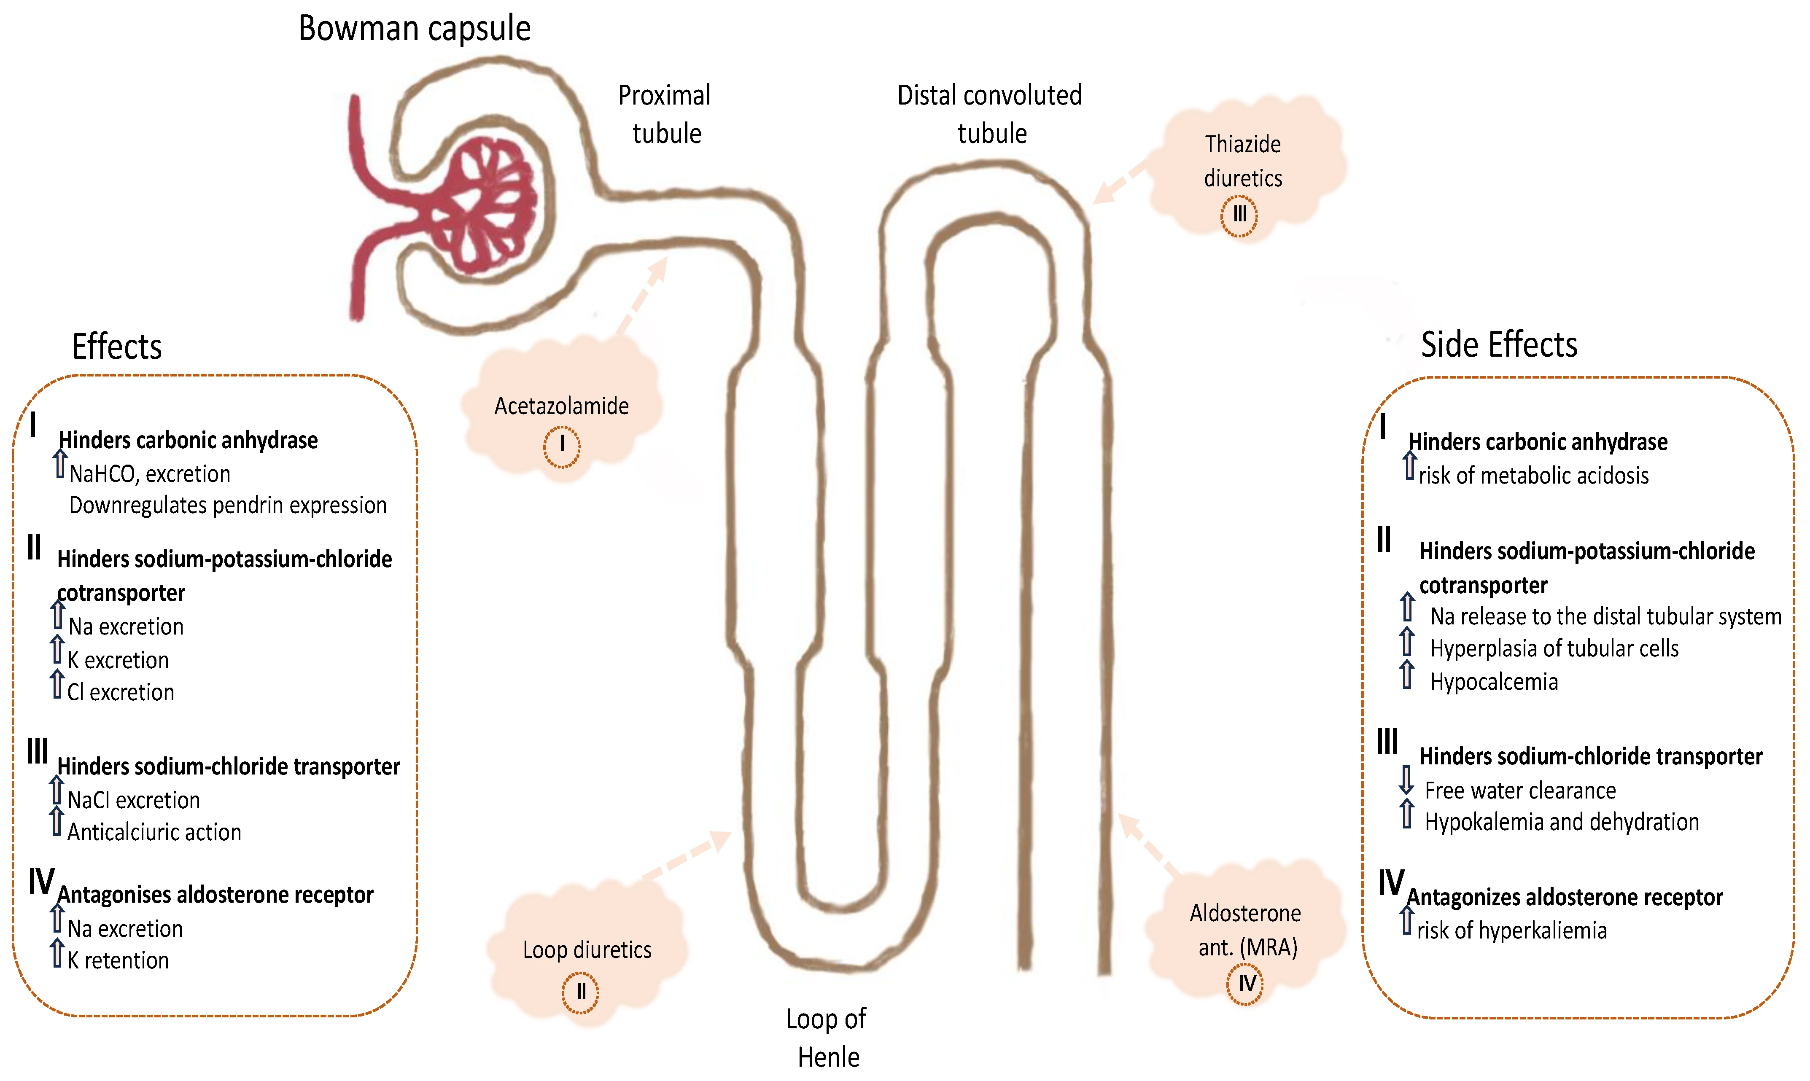

Slide 19
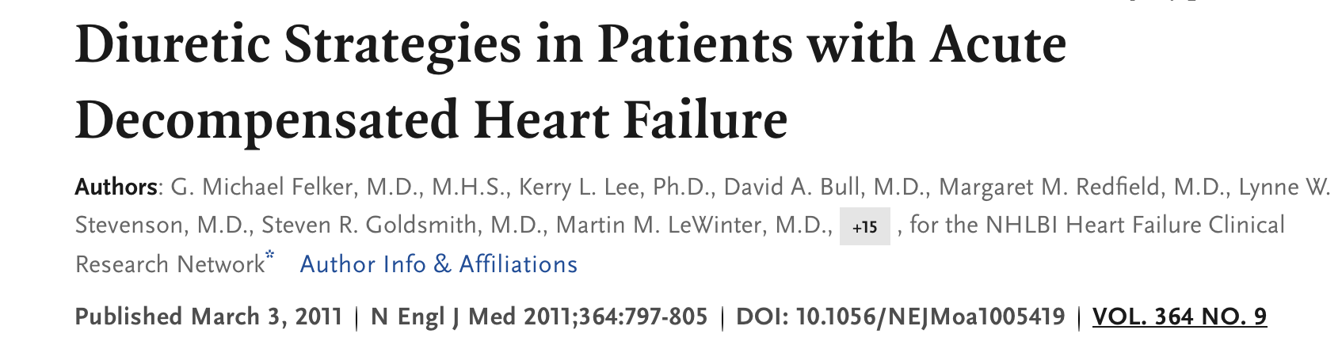

Slide 20
DOSE Trial Overview:
Study arms: 1. Dosing strategy, Low dose-group (IV dose loop diuretic equal to the prehospital oral dose). High dose-group (IV dose x2.5 times higher than their home dose) 2. Administration method: bolus group (BID) vs. infusion
Primary endpoints: Global assessment of symptoms 72hrs, change in serum creatinine at 72hrs
Key findings: High dose>symptom relief, High dose>elevation in serum creat, but this was transient and associated with better decongestion and better overall outcomes, High dose>fluid and weight loss, as well as better reduction in NT-pro BNP. No difference in continuous infusion vs. bolus dosing
Notes:
Randomized double blind controlled trial, 308 patients hospitalized with AHF and signs of congestion.

Slide 21
Dose Trial Conclusions:
High dose diuretic strategy> symptom relief and fluid removal in HFe patients.
Continuous infusion dose not provide additional benefits over intermittent dosing
Aggressive approach to dosing, despite transient increase in serum creatinine, can lead to better decongestion and improved clinical outcomes

Slide 22
Take Home Messages
MSI: Approach to SOB, basic prinicples of diuretics
Juniors: How to dose and adjust diuretics
Seniors: Recognizing and managing diuretic resistance

