Slide 1
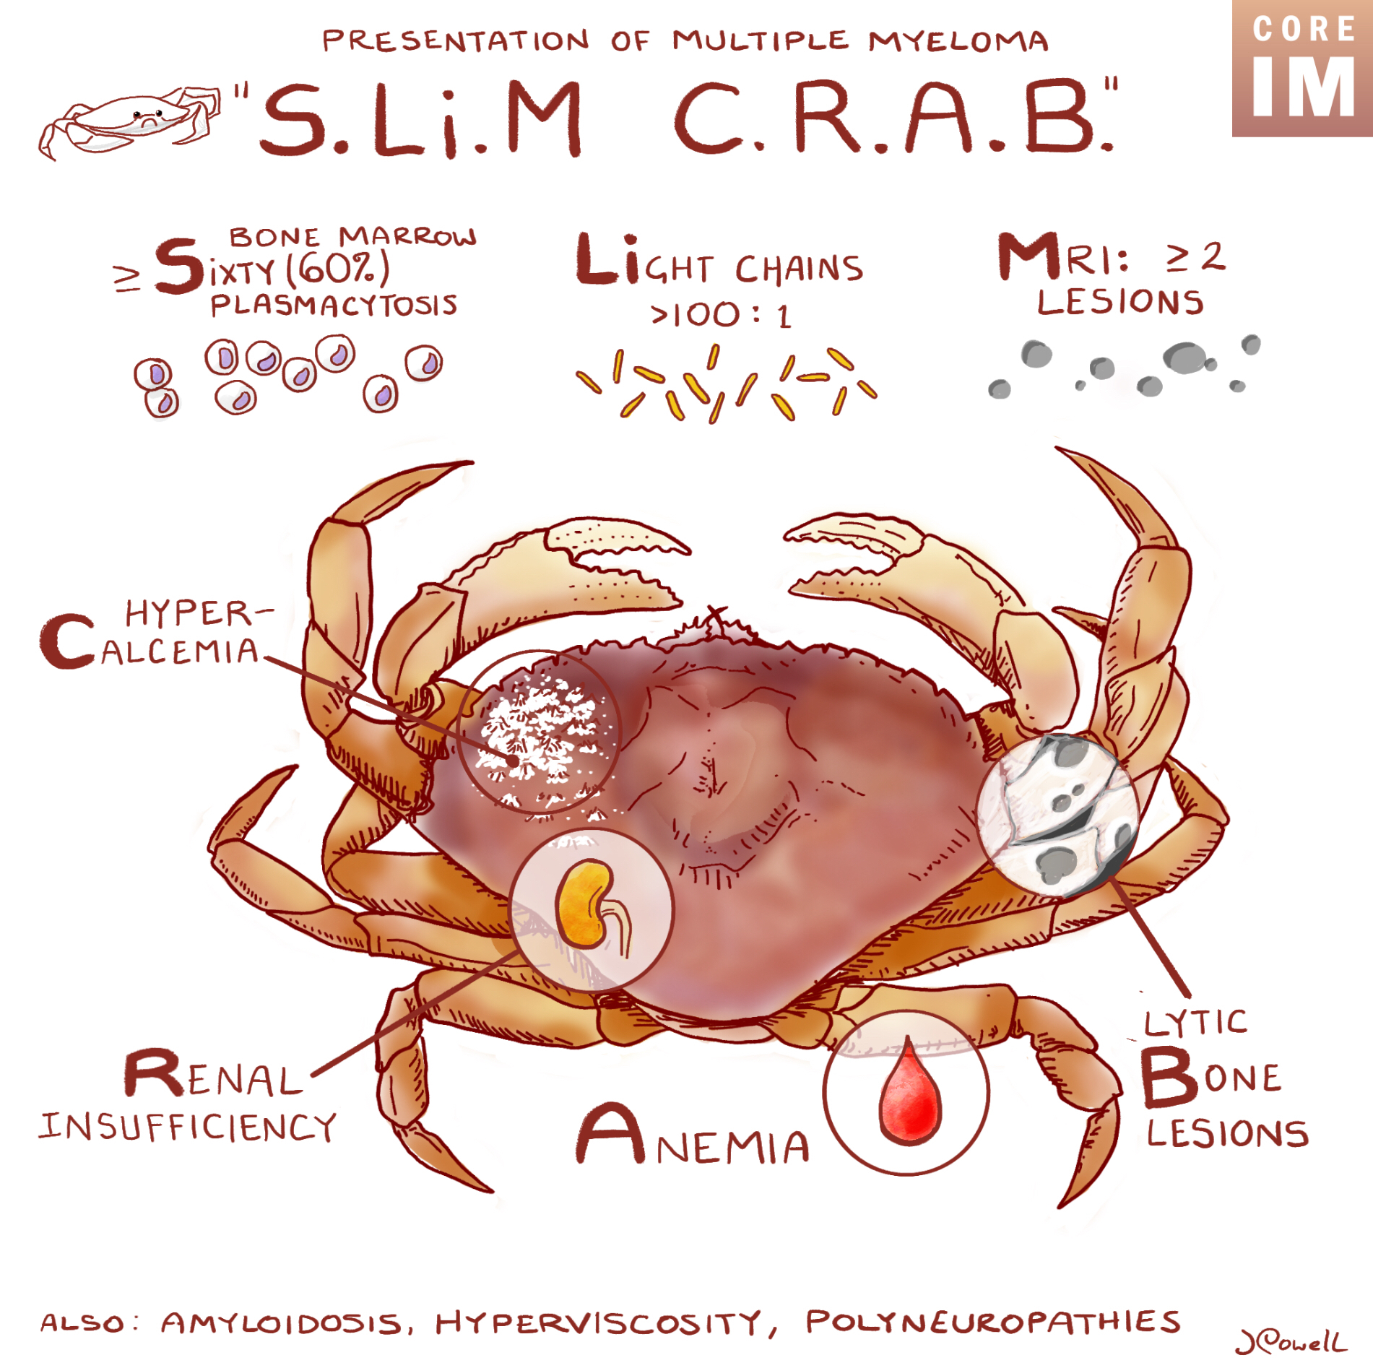
VGH CTU High Yield Series:
Multiple Myeloma
Mo Alfadhalah
VGH LMR

Slide 2
Introduction:
Heme malignancy→abnormal clonal plasma cells in the bone marrow
Uncontrolled growth causes destructive osseous bone lesion, AKI, anemia and hypercalcemia
Mean age at diagnosis is 69, >63% are older than 65

Slide 3
Epidemiology
Most prevalent in those >65
2017 surveillance study showed increasing incidence with age, from 8.2 per 100,000 persons aged 50-54, up to 50.6 per 100,000 persons aged 80-84 years

Slide 4
Pathophysiology
Clonal plasma cells responsible for MM are derived from postgerminal center B cells
In a healthy person, naïve B cells are produced following antigen exposure, give sustained antibody production and reside in the bone marrow comprising healthy humoral immunity
In MM patients, the abnormal B cells mimic the above but prodice excessive amounts of intact Ig
Notes:
In simpler terms there is an excess production of a single antibody and its associated light chain (kappa or lambda)

Slide 5
Pathophysiology
In almost all patients, MM begins as a monoclonal gammopathy of undetermined significance (MGUS)
  MGUS is present in 3-5% of people >65, and 10% in those >80
MGUS→MM at a rate of approximately 1-2% per year
  20 year risk of progression to MM approx. 18%

Slide 6
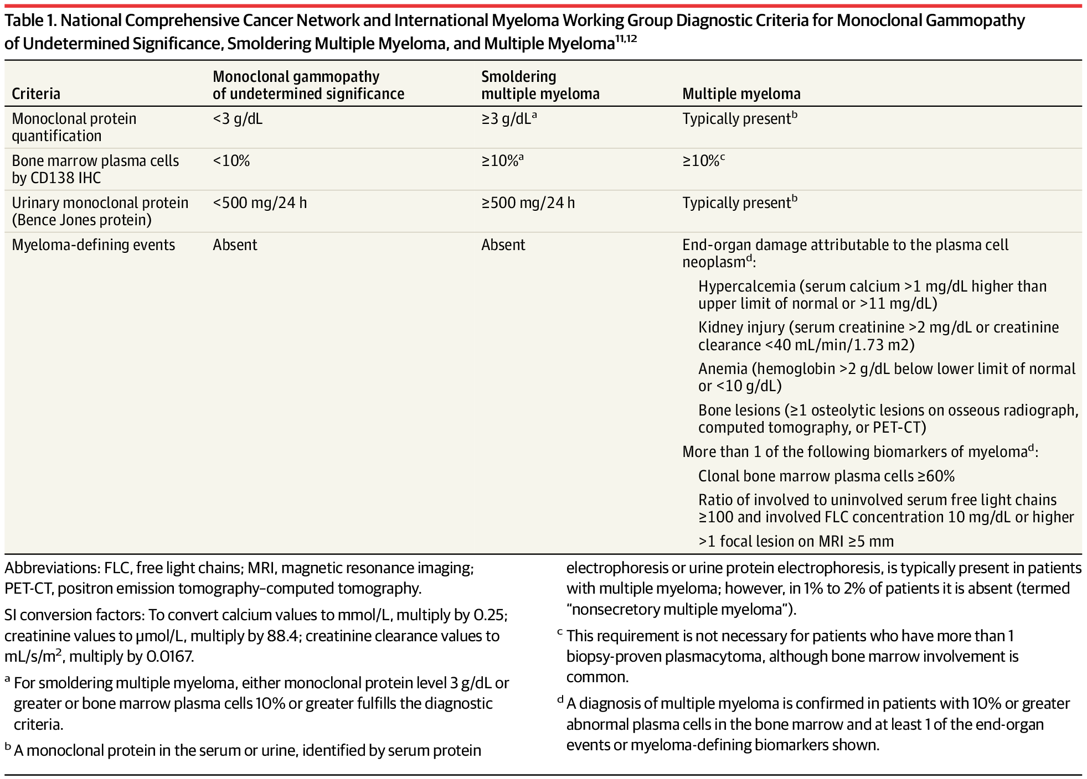
Definitions:

Slide 7
Multiple Myeloma Criteria: BM plasma cells 10% or more + any SLiM CRAB =Myeloma

Slide 8
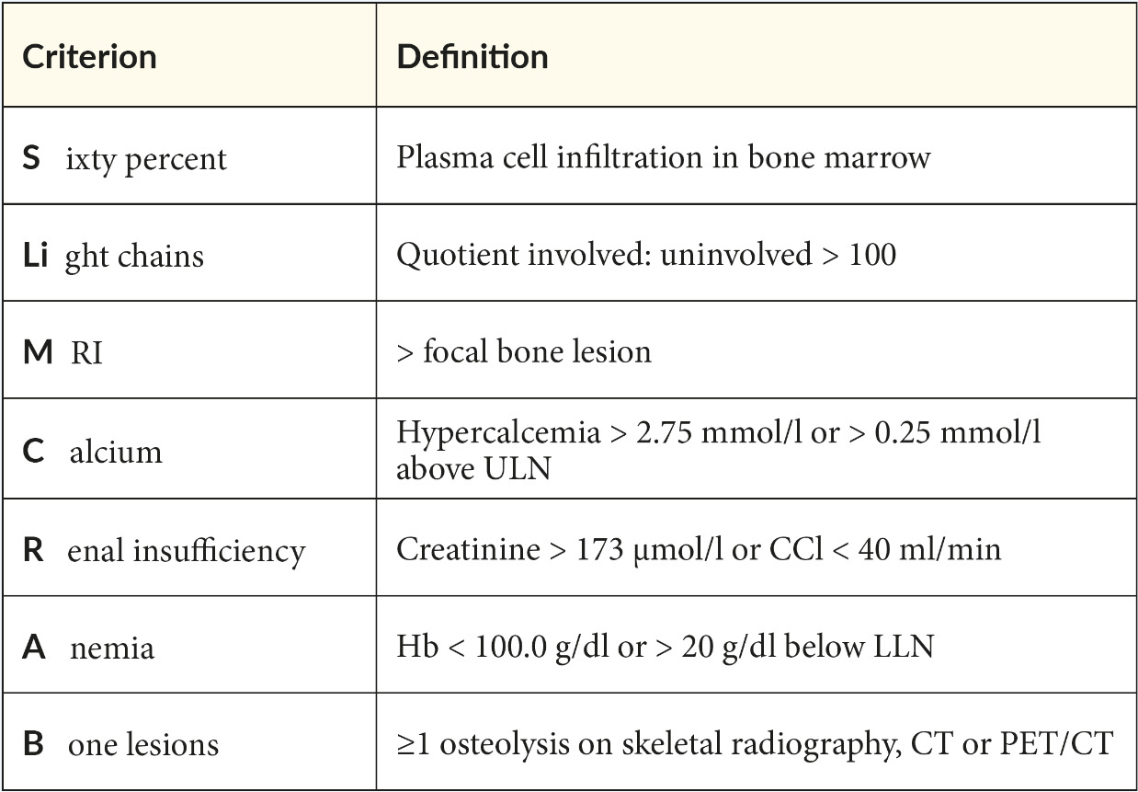

Slide 9
Presentation
Majority present with anemia
Lytic lesions (79%)
High serum creatinine (20%)
Hypercalcemia
Lymphadenopathy
Leukopenia
Thrombocytopenia
Notes:
Fatigue, bone pain

Slide 10

Presentation – Extramedullary Disease
Approx. 3% present with extramedullary disease
Definition: 1 or more extraosseous plasmacytomas on cross sectional imaging, CNS involvement or plasma cell leukemia
CNS involvement is generally leptomeningeal disease or cranial nerve involvement, very poor prognosis
Plasma cell leukemia: 20% or more plasma cells in the peripheral blood
Notes:
CNS is where we think about intrathecal chemotherapy
Survival may be only 7 months
Plasma cell leukemia survival is generall around 30% in 4 years even with Autologous HSTC

Slide 11
Presentation - Amyloid
10-15% are diagnosed with concurrent AL Amyloid
Consider in those with the following:
  Nephrotic range proteinuria (>3.5g)
  Macroglossia
  Periorbital ecchymosis
  Submandibular gland enlargement
  Unexplained cardiomyopathy
  Autonomic Dysfunction
  Peripheral neuropathies-->bilateral carpel tunnel
Once suspected →bone marrow/fat pad biopsy stain with Congo red
Notes:
And the treatment is similar to myeloma

Slide 12
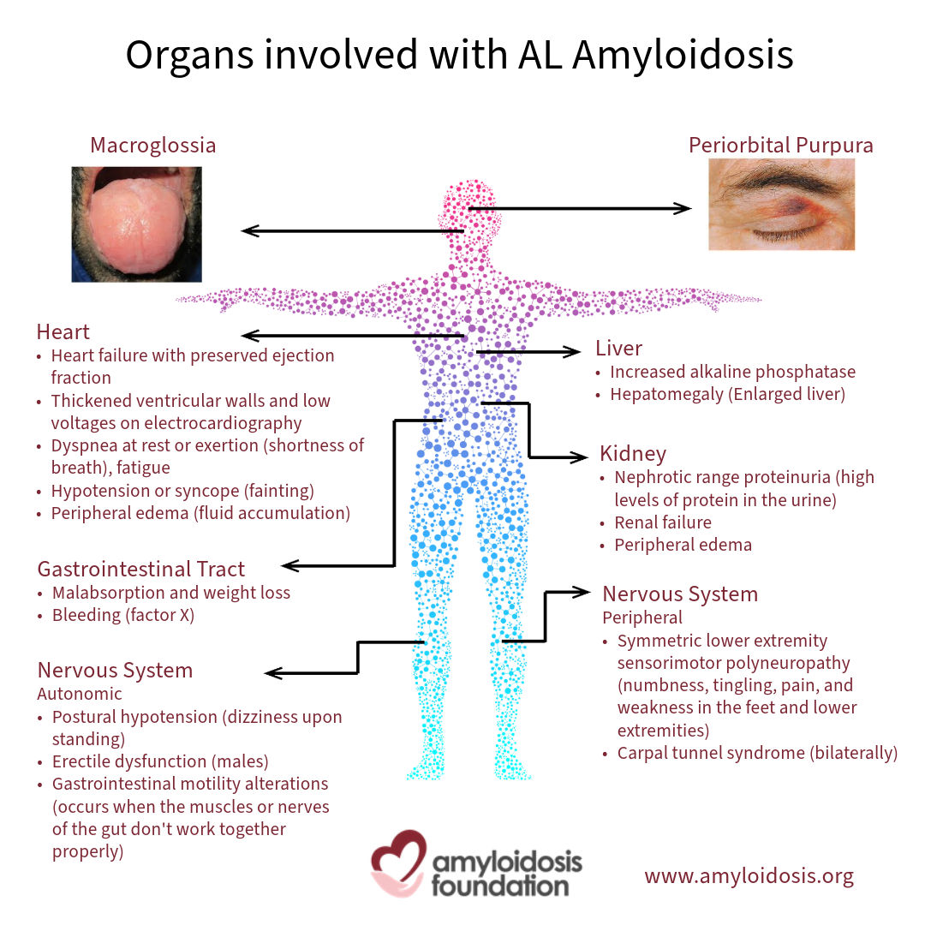

Slide 13
Diagnosis
Everyone gets the following:
CBC + differential, blood film
Serum creatinine
Serum calcium
Albumin
LDH
SPEP(Quantity of M protein)/UPEP with immunofixation (Qualitative, type of M protein)
  86% will reveal a monoclonal spike, also used to get a baseline of FLC ratio and burden of disease and monitor response to therapy
B2-microglobulin levels (for prognostic purposes)
Notes:
24 urine collection important for detecting secondary AL Amyloid and to get a baseline urine protein assessment
Only 1% have absence of measurable serum or urine marker “non secretory MM”

Slide 14
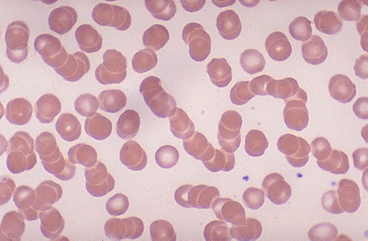
Notes:
Increased RBC aggregation
Associated with disease progression
Found in 60% of new active MM cases and 90% of relapsed cases
Can be found in Waldenstroms macrogloubulinemia, chronic infections and inflammatory states like CTDs, CLD, can also be found in pregnancy

Slide 15
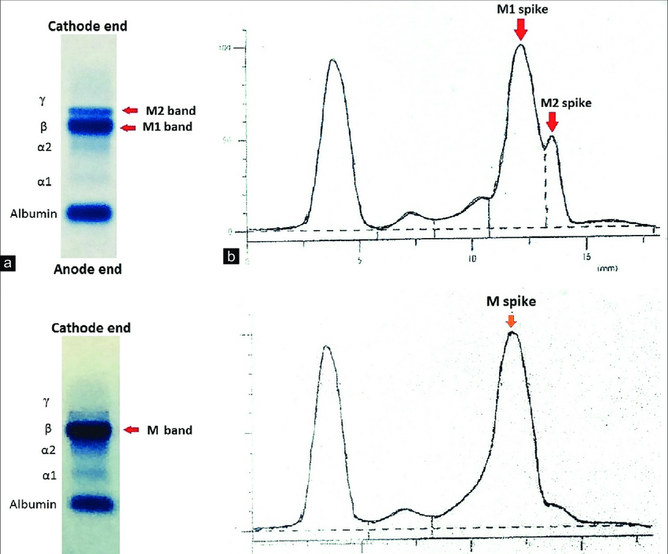
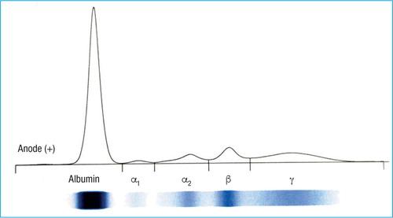

Slide 16
Diagnosis BM Bx:
For all those suspected of having MM
Aspirate is analyzed for quantification of plasma cells by a number of techniques, including fluorescence in situ hybridization, and conventional cytogenetics

Slide 17
Imaging:
Imaging documents compression fractures, lytic lesions and pathologic fractures
Baseline whole body low dose CT
  Detects lytic lesions specifically
Whole body PET CT
  Presence, extent and metabolic activity of osseus and extra-osseus manifestations
Whole body MRI
  This would include evaluation of the bone marrow
Notes:
If you want to distinguish SM from MM start with CT, if negative go for MRI to detect more than one focal lesion in the bone marrow

Slide 18
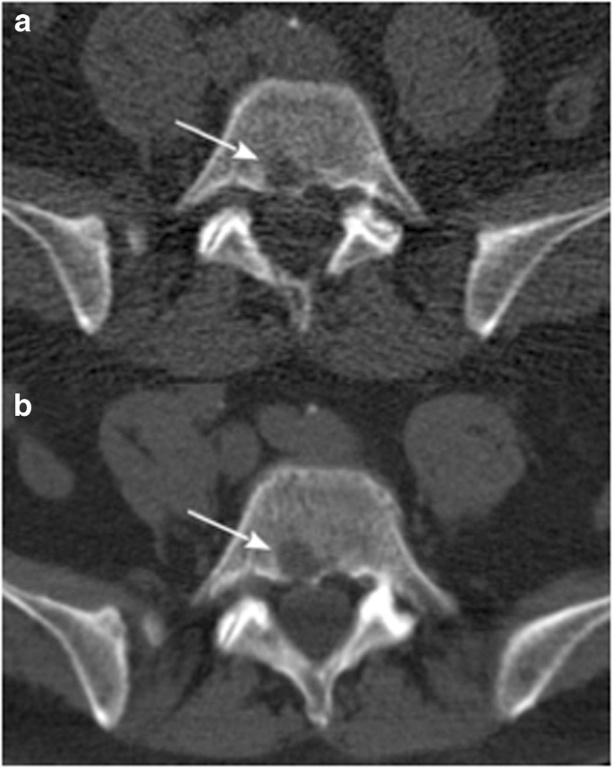

Slide 19
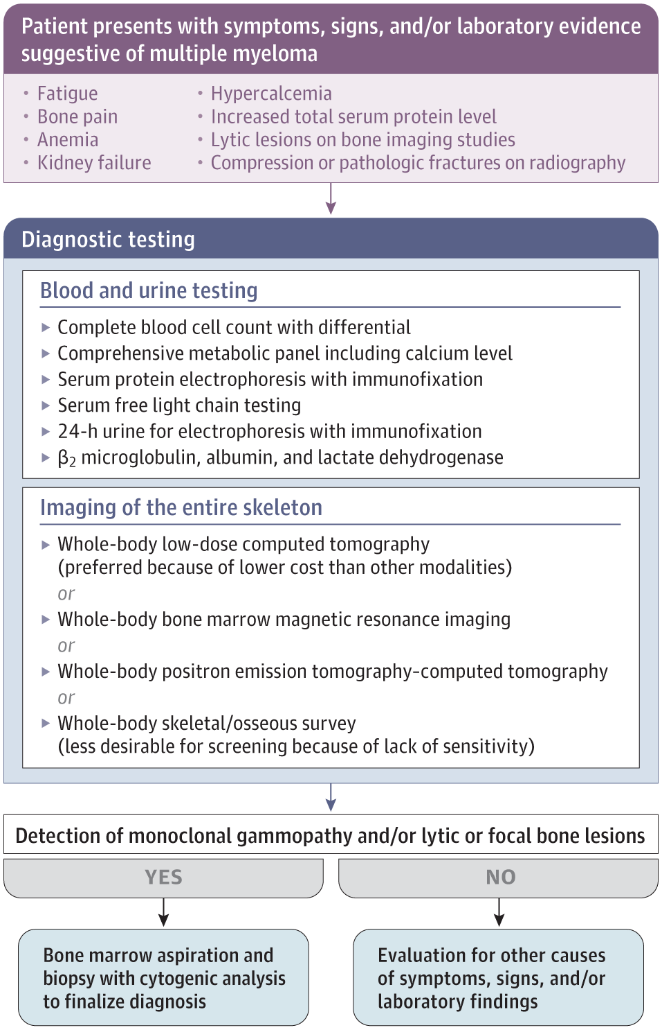

Slide 20
Prognosis
Therapies have drastically advanced in the last 25 years
Life expectancy in those newly diagnosed and on appropriate therapy is expected to be around 126 months
It used to be only 30 months
Despite these advances in therapy, approximately 20% of those newly diagnosed have substantially worse outcomes

Slide 21
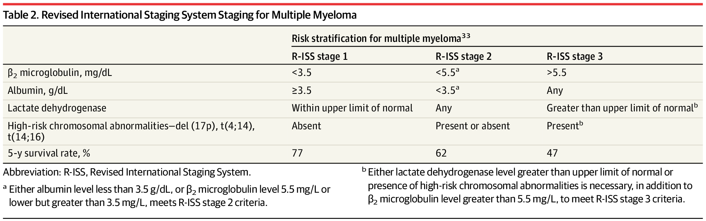

Slide 22
Treatment
No cure, but therapies are significantly and rapidly advancing
Transplant (auto HSCT) eligible if they are less than 70 and fit:
  Chemotherapy→auto HSCT→maintenence therapy

Slide 23
Treatment
Most significant advancements include the following:
proteasome inhibitors (bortezomib etc)
Immunomodulatory agents (thalidomide, lenalidomide, etc)
Monoclonal antibodies (daratumumab, elotuzumab)
Autololgoous hematopoietic stem cell transplant
First line in BC (not transplant eligible): Daratumumab, Lenalidomide and Dexamethasone

Slide 24
What do we watch out for when caring for these patients as Internists?

Slide 25
Bone Health
40-50% risk of developing fractures or bone pain requiring palliation
RCTs have shown benefit in bisphosphonates and RANKLi (Denosumab) to reduce the risk of skeletal related events
  Always watch for hypocalcemia, ON of the jaw, AVN and adjust for kidney function (see next slide)
For patients with pathological fractures, vertebroplasty, or intramedullary nail fixation may be necessary (improve pain and functional status)

Slide 26
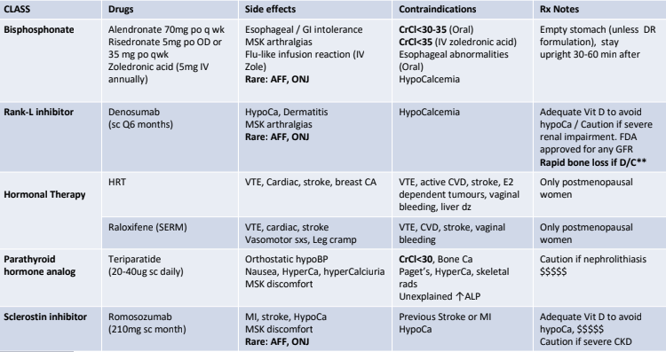

Slide 27
Infections
Patients with MM have increased rate of infections
This is due to myeloma-related immunodeficiency (B and T cell), along with the use of immunosuppressing treatment
  Those on proteasome inhibitors (bortezomib) or monoclonal antibody therapy (daratumumab) should be given acyclovir/valacyclovir to prevent reactivation of varicella zoster and shingles
  In select, esp. with multiple comorbidities, abx prophylaxis with levofloxacin can be considered
Growth factors, filgrastim and EPO are used in therapy-related neutropenia and anemia

Slide 28
VTE
Patients with MM are at an increased risk of venous and arterial thromboembolism, especially in those receiving immunomodulatory drugs (Lenalidomide)
VTE ppx with ASA, LMWH or DOAC should be considered depending on risk

Slide 29
Palliative Radiation
If you admit a patient who comes in with pain, attributed to painful lytic or extramedullary lesions, consider involving radonc to provide radiation therapy to palliate symptoms

Slide 30
Thank You

