Slide 1
VGH CTU HIGH YIELD SERIES: PE
Mo Alfadhalah VGH LMR

Slide 2
Case
52 year old gentleman presents with a three week history of SOB. He recently completed a course of abx for presumed PNA and was discharged home from ED. He tells you that he woke up this morning with sharp right sided chest pain which prompted. Him to present to the emergency department.

Slide 3
Case continued…
Vitals showed HR 98 bpm and regular, BP 150/90mmHg, Afebrile, RR 20, O2 sat 95% on room air.
Auscultation of his chest EBAE no adventitious sounds, heart Ns1+s2 no added sounds or murmurs
LL showed no signs of DVT or edema
Labs: CBC normal, Chem 7 normal, trop negative, BNP normal, D-dimer 3,000

Slide 4
Outline Your Approach

Slide 5
Objectives
Recognizing PE early, prompt diagnosis
Risk stratification of PE
Disposition of patients
Treatment of PE

Slide 6
Introduction to the Problem
The annual incidence of pulmonary embolism worldwide is approximately 1 in 1000 persons
Almost 20% of patients who are treated for pulmonary embolism die within 90 days
Approximately half the patients who receive a diagnosis of pulmonary embolism have functional and exercise limitations 1 year later (known as post–pulmonary-embolism syndrome)
Therefore the timely diagnosis and expert management of pulmonary embolism are important
Notes:
Although the true incidence of death is probably closer to 5% for undiagnosed PE if we factor out the comorbidities like malignancy that these patients have
health-related quality of life for patients with a history of pulmonary embolism is diminished as compared with that of matched controls

Slide 7

Pathophysiology

Slide 8
Risk Factors
Modifiable
Immobilization (major trauma or surgery, recent long airplane or car trips),
Malignancy
Estrogen-containing oral contraceptives
Pregnancy, and postpartum status.
Non-Modifiable
Older age
Thrombophilias
Familial history of VTE
COPD and HF

Slide 9
Clinical Presentation
Non-specific, identifying it can be challenging! Only 5% of those undergoing investigation for PE in the US end up actually having a PE
Suspect in those with pleuritic CP and/or SOB with otherwise no other obvious explanation
Approximately 5% to 10% of patients presenting to the emergency department report chest pain and dyspnea as their primary symptom
Tachycardia, hemoptysis, findings in LL suggestive of DVT all increase likelihood of PE
Unexplained syncope not common
Incidental finding on imaging

Slide 10
Diagnostics
Standard diagnostic strategies for PE consist of of 3 main steps:
  Evaluating clinical probability
  D-dimer testing when indicated
  Chest imaging

Slide 11
Evaluating Clinical Probability
Is it low, moderate or high?
  Low probability <15%
  Intermediate 15-40%
  High >40%
Two validated scores for estimating probability: Wells and the Revised Geneva Score, you can also use the PERC score
In low or intermediate clinical probability: D-dimer<500 ng/mL (adjust for age) is associated with a post-test probability of PE that is less than 1.85%, therefore, PE can be excluded without chest imaging.
  If your pretest probability is high, do not order a D-dimer, it will skew the negative predictive value→ proceed to imaging!

Slide 12
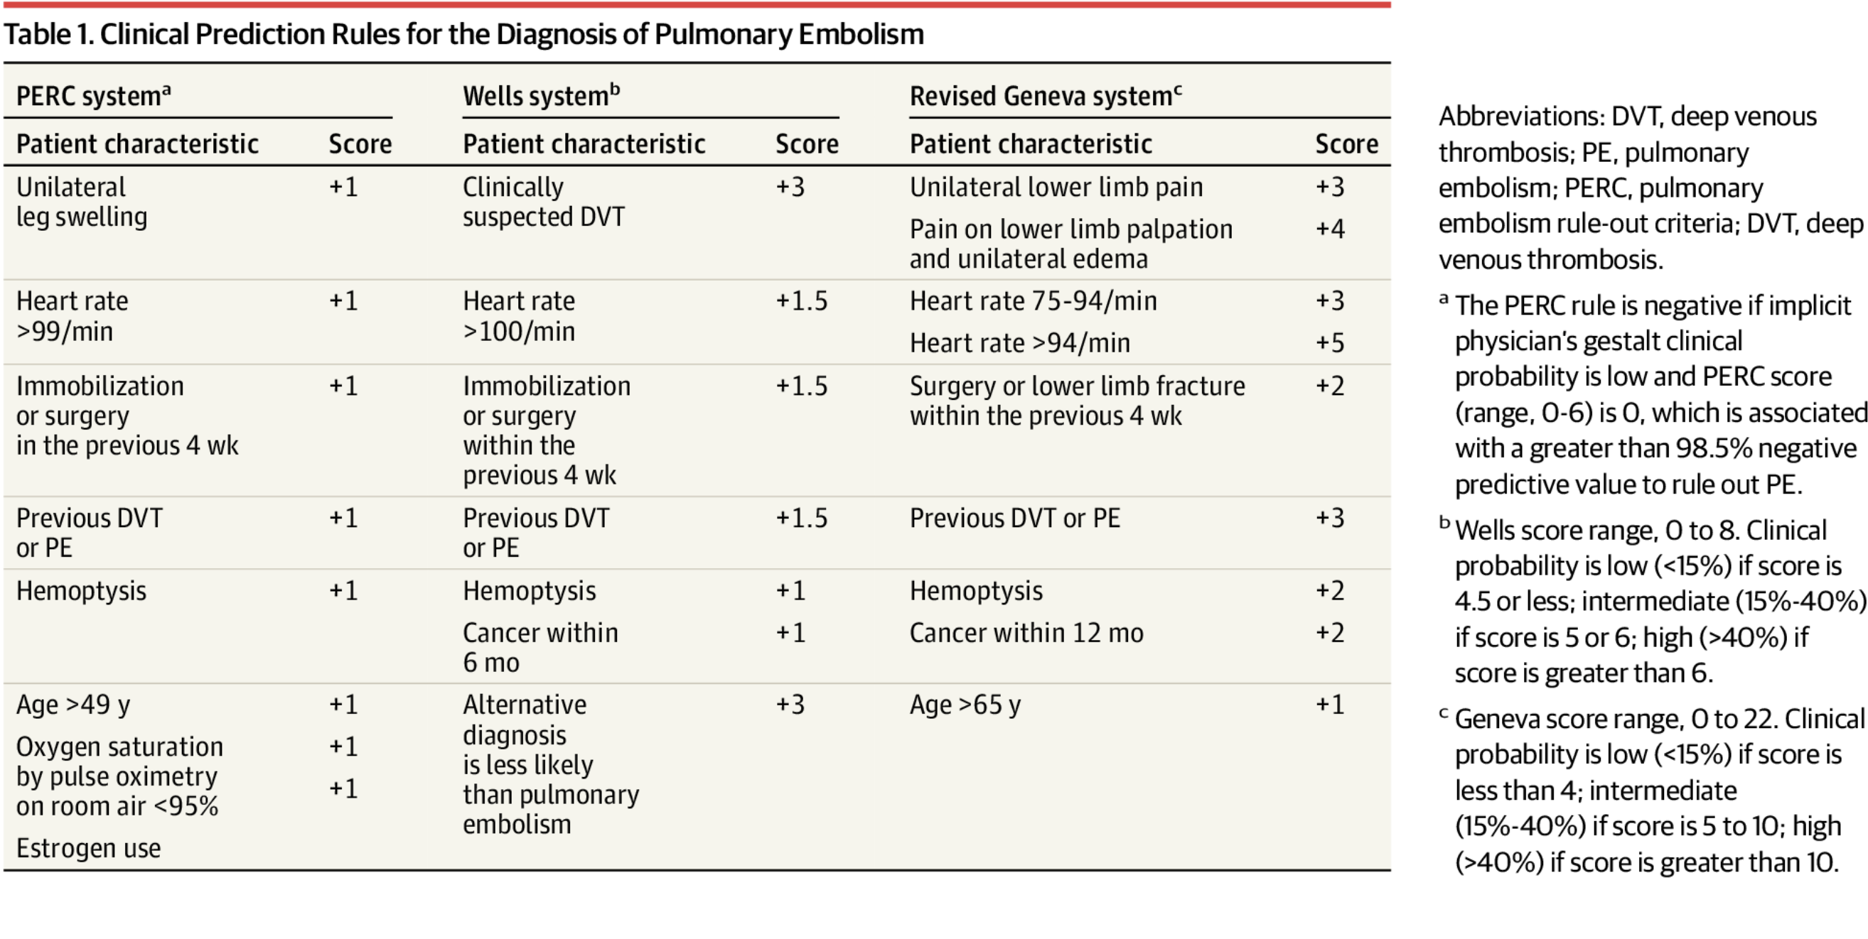

Slide 13
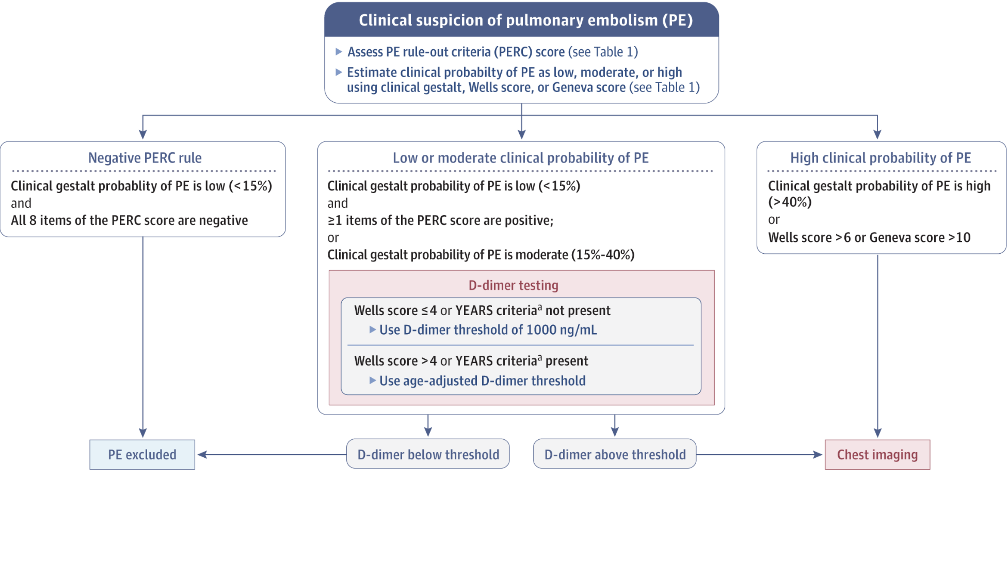

Slide 14
Diagnostics Continued
Labs: Basic labs, don’t forget troponin and NT-Pro BNP
ECG and CXR
  Sinus tachycardia is the most common finding (50%), right ventricular strain pattern may find Afib/Aflutter (provoked), S1Q3T3 not common!
The imaging modality of choice is a CTPE/PA→gives you other alternative diagnosis, 94% sensitive
Bedside echo, especially in those with hemodynamic instability (defined as SBP<90mmHg >15 min with end organ hypoperfusion), non specific findings
  RV dilation (RV/LV ratio >1)
  flattened septum
  McConnell's sign (mid-RV akinesis, apical hyperkinesis)
  reduced TAPSE
  dilated IVC that is non collapsable
  potential visible thrombus in RV/PA.
V/Q scan: Not as readily available as CTPE/PA, sensitivity lower (56-98%), cannot give alternate diagnoses
Don’t forget B/L LL U/S

Slide 15
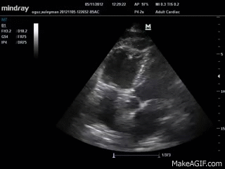
McConell’s Sign
Notes:
Echo NPV only 50%, normal does not mean no PE!!!

Slide 16
Treatment
Always start with risk stratification (low, intermediate or high risk)
  Use the sPESI score, if only one item is positive then they are not at low risk
Use a combination of the following factors when determining risk: Hemodynamic stability, troponin, NT Pro BNP as well as RV dysfunction signs on imaging
  sPESI 0→outpatient management
  SPESI >1, SBP>90→obtain cardiac biomarkers and imaging (for RV dysfunction), if non are positive they are deemed intermediate low risk, if any/all positive they are deemed intermediate high risk, both require admission
  Hemodynamic instability high risk! CALL ICU FOR LYSIS!!

Slide 17
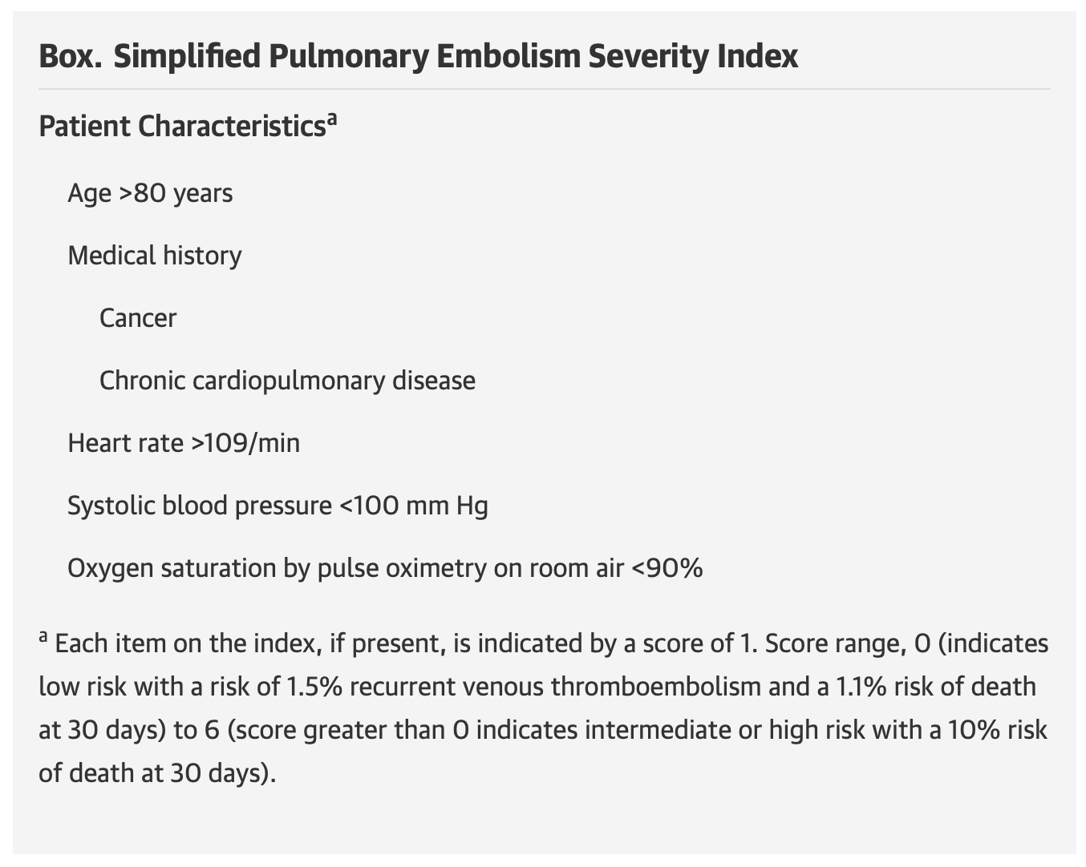

Slide 18
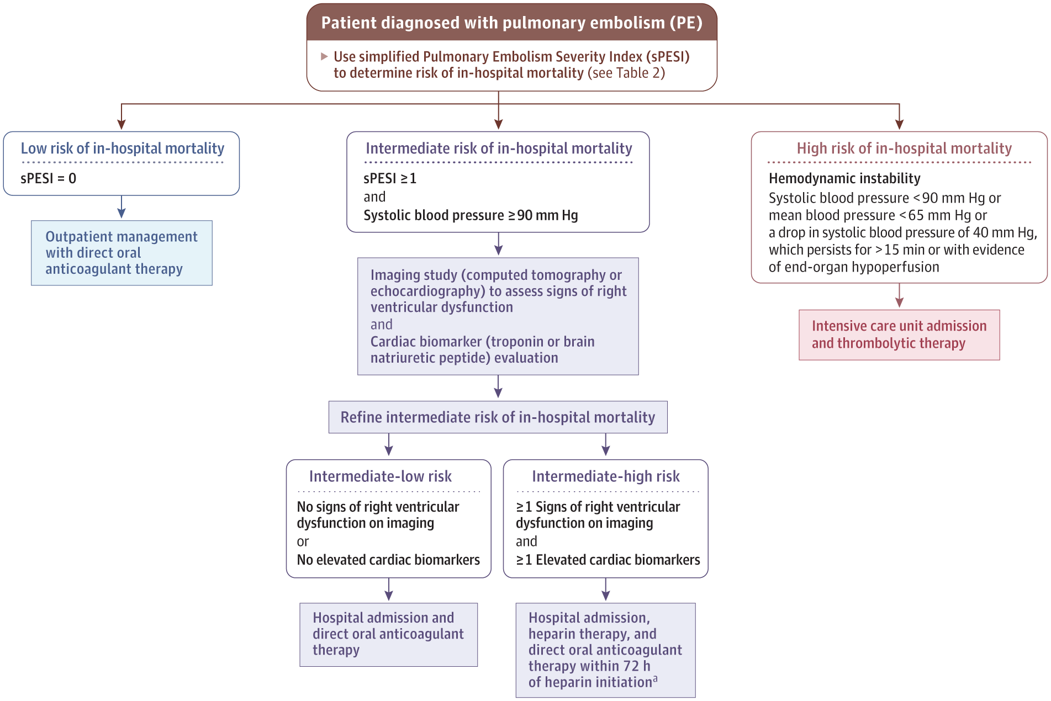

Slide 19
Treatment
Low risk→DOAC (don’t forget your loading doses, see slide 22 for details)
Low intermediate risk→Admit, DOAC
High intermediate→Admit, LMWH then AC with DOAC (or VKA if indicated)
  Do not give fibrinolysis for intermediate risk patients, risk of bleeding outweigh benefits
High risk→Call ICU, they need fibrinolysis
Notes:
Admit because 1 in 20 may develop shock
PEITHO Trial, 1005 patients, TNK + hep vs Hep, 3% reduction in death vs. 5% increase in major extra cranial bleeding, no sig difference in death at days 7 and 30

Slide 20
High Risk
Hemodynamic instability, defined as SBP <90mmHg for >15 minutes OR end organ hypoperfusion
Approximately 20% risk of 30 day mortality (compared with 5% in non high risk groups)
Thrombolytics*
Other options are catheter based interventions (fragmentation or aspiration) or surgical embolectomy if lysis contraindicated

Slide 21
Duration of Treatment
Non cancer associated (DOAC 1st line):
  Provoked→minimum 3 months up to 6 months
  Second provoked event, depends on the cause, if two strong causes, you can retry 3-6months, if they are weak then indefinite
  Unprovoked→Indefinite, minimum 3-6 months of treatment then reassess bleeding risk, prognostic models can be used like DODS. Consider dose reduction at 6-12months (ex apix 2.5BID)
Cancer associated (LMWH or DOAC 1st line) :
  At least 6 months, if acceptable bleeding risk then indefinite while having active cancer or on systemic treatment

Slide 22
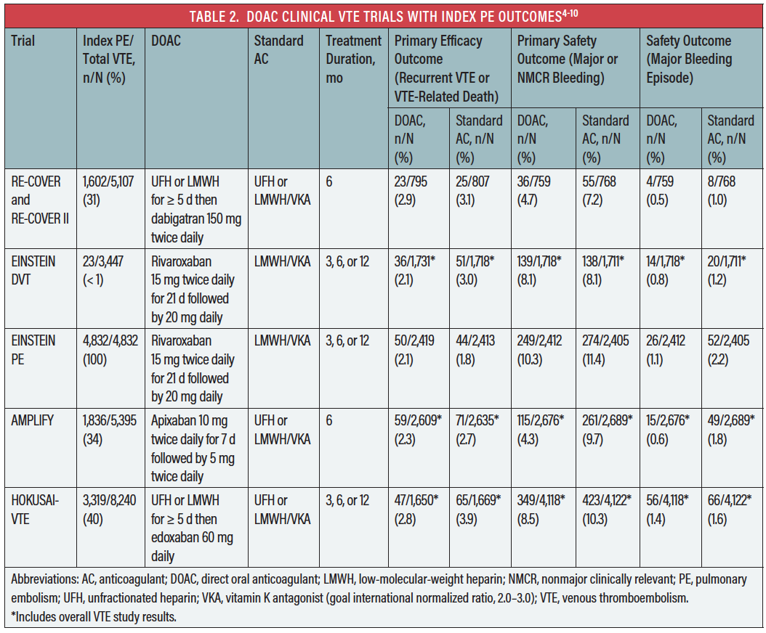

Slide 23
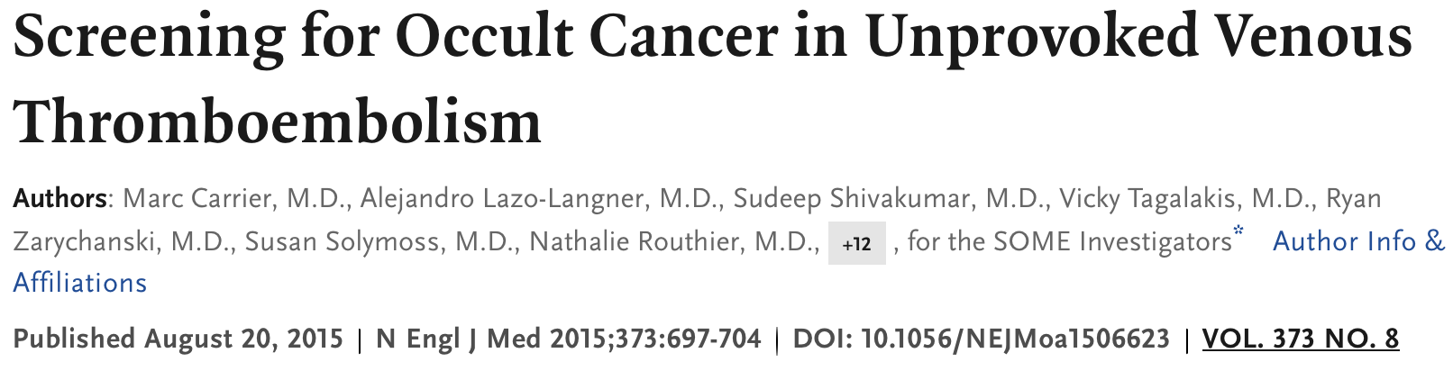

Slide 24
Malignancy Screening, SOME trial!
Question: Does adding CT abdomen/pelvis to limited screening detect more occult cancer after a first unprovoked VTE?
RCT of patients with first unprovoked DVT/PE
Limited screening (H&P, basic labs, chest X-ray, age-appropriate cancer screening)
vs Limited screening + CT abdomen/pelvis
Results:
  No difference in cancer detection at 1 year
  No difference in missed cancers, time to diagnosis, or mortality
  CT led to more imaging without clinical benefit
Bottom Line
Routine CT A/P is NOT recommended after unprovoked VTE
Use focused evaluation + age-appropriate cancer screening
Reserve further imaging for symptoms or high suspicion

Slide 25
New Evidence: COBRRA Trial
NCT03266783
Design: Randomized, open-label, head-to-head trial in acute symptomatic VTE
Bleeding: Lower clinically relevant bleeding with apixaban
~3% apixaban vs ~7% rivaroxaban
↓ major and clinically relevant non-major bleeding
Efficacy: Similar rates of recurrent VTE between groups
Mortality:Low and comparable in both arms
Conclusion: Apixaban = similar efficacy, better safety vs rivaroxaban for acute VTE

Slide 26
Bleeding on AC
Always ask yourself, is the bleed life-threatening or not?
DOACS:
  Non life threatening: Supportive
  Life threatening:
    Dabigatran-->Idaracizumab 2.5g x2 doses, it is also dialyzable! (65% removal in 4 hours) (REVERSE-AD Trial: Dabi reversal almost 100% in 4hrs!)
    Apixaban/Rivaroxaban/Edoxaban→4 factor PCC (Octaplex) 2000 units, Adnexanet alpha can be used, not widely available due to cost
LMWH/UFH
  Non life-threatening: Supportive
  Life threatening→protamine sulfate, for LMWH give 25-50mg, UFH calculate based on last admin (call your pharmacist!)
Warfarin
  Non life-threatening→IV Vit K and supportive
  Life threatening, depends on INR, give IV Vit K and PCC-->INR 1.5-3 1000u, 3-5 2000u, >5 3000u

Slide 27
Thank you!

