Slide 1
Vgh ctu high yield series: afib
Mo Alfadhalah VGH LMR

Slide 2
Case
You are the senior on call for XC, you get paged for a patient on the ortho ward, they are a 65 year old F known have HFnrEF (55%), reason for page: tachycardia and desaturation.

Slide 3
Case
You see the patient, they are having chest discomfort, vitals showed the following: HR 172 bpm/irregularly irregular, BP 120/80, O2 sat 93% on 5L oxygen, afebrile, RR 30
Exam findings were positive for the following: coarse crackles in the lungs, diffuse bilateral, variable S1+normal S2 no murmurs, LL no edema, JVP at the angle of the jaw
POCUS: Lung→diffuse, symmetric vertical artifacts (B-lines) with normal looking pleural lines from L1/R1 down with a gradient, small effusions at the bases in keeping with probable cardiogenic pulmonary edema, EF on PLAX and PSAX difficult to interpret given tachycardia, IJ at the angle of the jaw, IVC 2.7cm with <50% collapsibility on deep sniffing

Slide 4
Case
Labs: Hb 110, Plt 150, Cr 70, TSH normal, K 4, Na 130, Mg 1 , pH 7.35, HCO3 22, CO2 35
ECG: Afib RVR
CXR: Bilateral opacities, diffuse, cephalization of vessels

Slide 5
Pathophysiology and Risk Factors
Recall that there are three main arrhythmic mechanisms:
  Abnormal Automaticity
  Reentry
  Triggered Activity: abnormality during repolarization, early and delayed afterdepolarization
In Afib, there are insults/alterations that cause cells to spontaneously depolarize, either secondary to enhanced automaticity or triggered activity from after depolarizations (esp. in Calcium handling)
  Inflammatory signals are key in promoting afterdepolarization generation
Rapid discharges originate from the pulmonary veins
  Shorter AP duration, lower resting membrane potential and non uniform myofibril arrangements, all make these region vulnerable for triggered reentry and micro-reentry
Abnormal remodelling leads to atrial dilation and gives anatomic substrate

Slide 6
Pathophysiology and Risk Factors
HTN(the most significant modifiable RF)
  Activation of the sympathetic and RAAS, structural and electrophysiological remodeling
DM
  Structural and autonomic remodeling
Tobacco
  Nicotine alters atrial conduction and refractoriness, inflammation and oxidative stress

Slide 7
Pathophysiology and Risk Factors
Alcohol
  Increased sympathetic activity/impairment of vagal tone and atrial fibrosis
Obesity
  Weight related structural changes, atrial fibrosis, remodeling, inflammation
OSA
  Negative intrathoracic pressures, increased venous return (LA volume loading) and hypoxia induced pulmonary vasoconstriction
Valve disease
Thyroid Disease, physical inactivity, age, CM

Slide 8
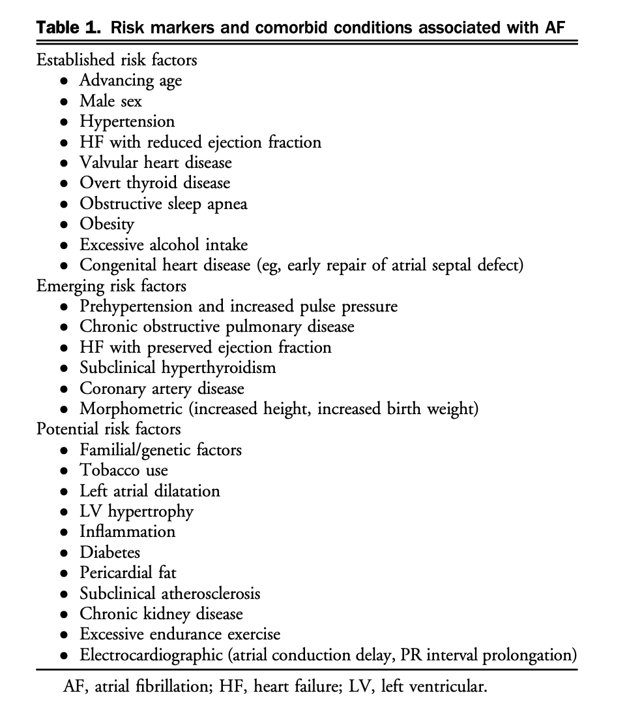

Slide 9
Clinical Classification
Paroxysmal AF – continuous AF episode lasting more than 30 seconds, <7 days
Persistent AF – continuous AF episode > 7 days but < 1 year
Long standing persistent – continuous AF > 1 year in duration
Permanent AF – continuous AF for which a therapeutic decision has been made not to pursue sinus rhythm

Slide 10
Pathophysiologic Classification
Primary AF
Secondary AF
Provoked
Reversible
Notes:
On the basis of on going risk of recurrence and subtrate

Slide 11
Investigations – For All
ECG– needs to be documented! Also helpful to detect LA enlargement, LVH, preexcitation, conduction disease, evidence of ischemia
TTE – LVH, systolic dysfunction, significant valvular disease, LA enlargement (this is a very important parameter to look at! Gives prognostic info about recurrence or progression to persistent AF)
Labs – CBC, coags, LFTs, Cr, electrolytes, A1c, lipid profile, don’t forget TSH!
Extended monitoring of needed – Holter, wearable patch monitors, CIEDs
Sleep study should be considered for most to r/o OSA

Slide 12
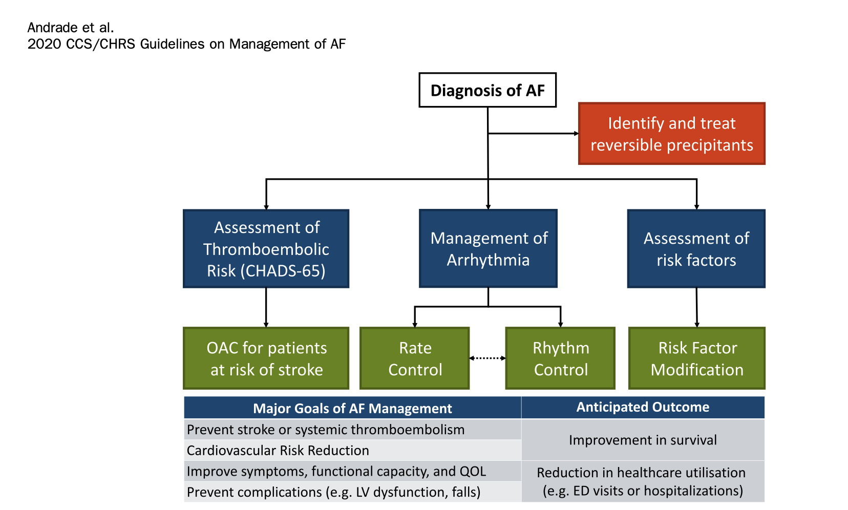

Slide 14
Treatment Principles
Determine if AF is the primary concern, or if it is secondary to an underlying illness
Determine if AF is causing hemodynamic stability (requires DCCV)
  ACS, hypotension, or pulmonary edema
Determine your strategy, rate or rhythm?
Determine if they need admission
Determine the need for OAC
Early follow up

Slide 15
Acute Rate Control
Always address the secondary cause if present! Ex: Overloaded, diurese
First line options:
  Evidence based beta blockers – Metoprolol, carvedolol, bisoprolol
  NDHP CCB – Verapamil, Diltiazem
    Make sure the EF>40% when you start
  Can be IV or oral, if IV watch for hypotension, always try and start oral agents as soon as possible after IV
Second line options: To be used if patient is hypotensive or has significant LV dysfunction
  IV Amiodarone
    Can precipitate hypotension, beware of possibility of conversion to sinus when patient is not anticoagulated!
  Digoxin
    Always make sure the K is normal, and adjust the dose for kidney function to prevent toxicity!
Notes:
Target generally <100, not studied in secondary AFib

Slide 16
Acute Rhythm Control
If unstable→DCCV (150J)
  In hemodynamically stable patients, may be reasonable to pursue, see next slide (90% effective in ED, reduces length of stay significantly)
Pharmacologic options
  Procainamide (class Ia)
  Flecainide and Propafenone (class IC)
    Avoid in ischemic heart disease or SHD, always give AVNB agent (BB CCB) > 30 minutes before to avoid 1:1 conduction!
  Amiodarone
    Keep in mind it takes around 8hrs to convert, SE: hypotension, bradycardia, can prolong QTc but indicence of TdP is rare
  Vernaklat
  Ibutilide

Slide 17
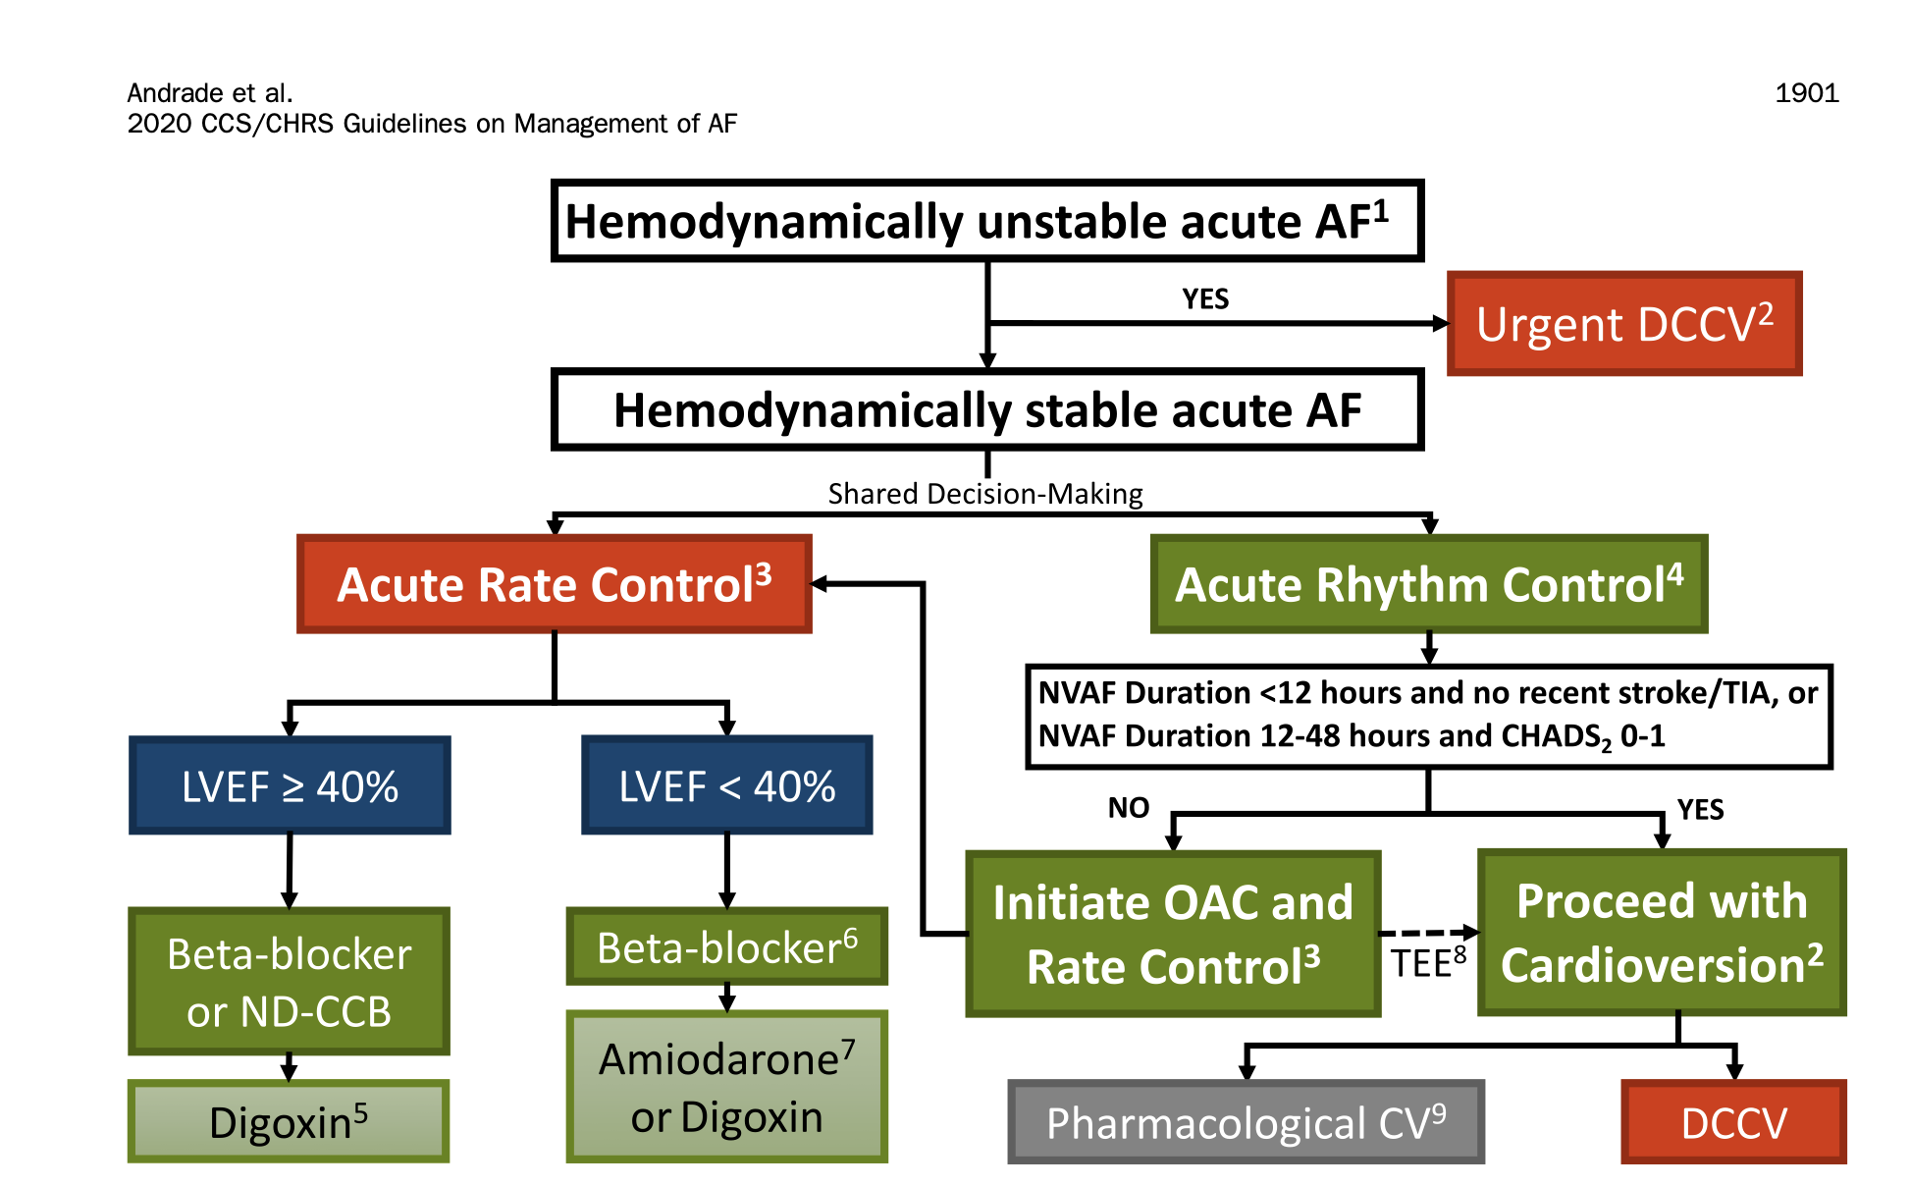

Slide 18
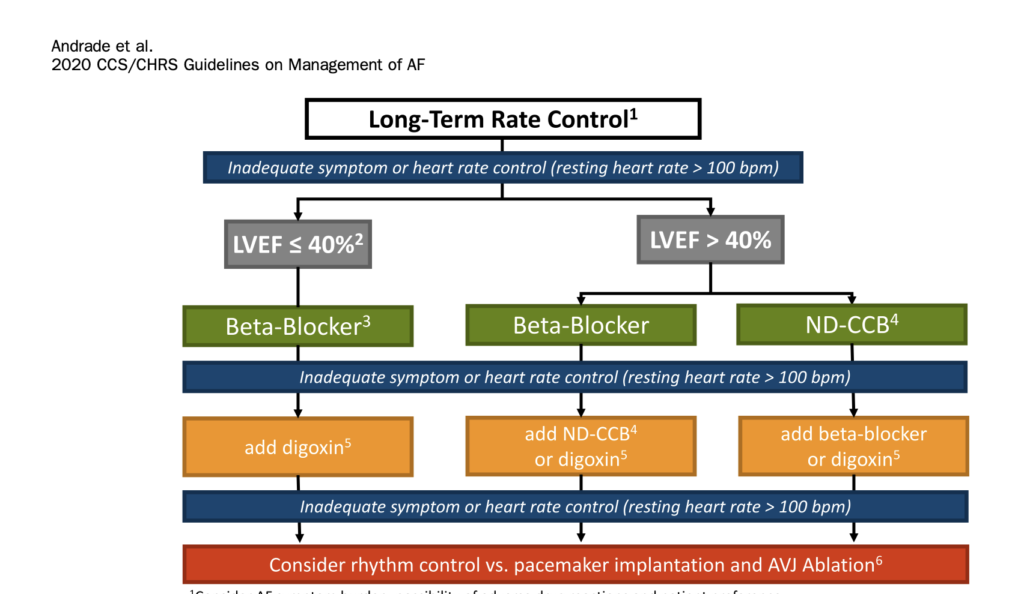

Slide 19
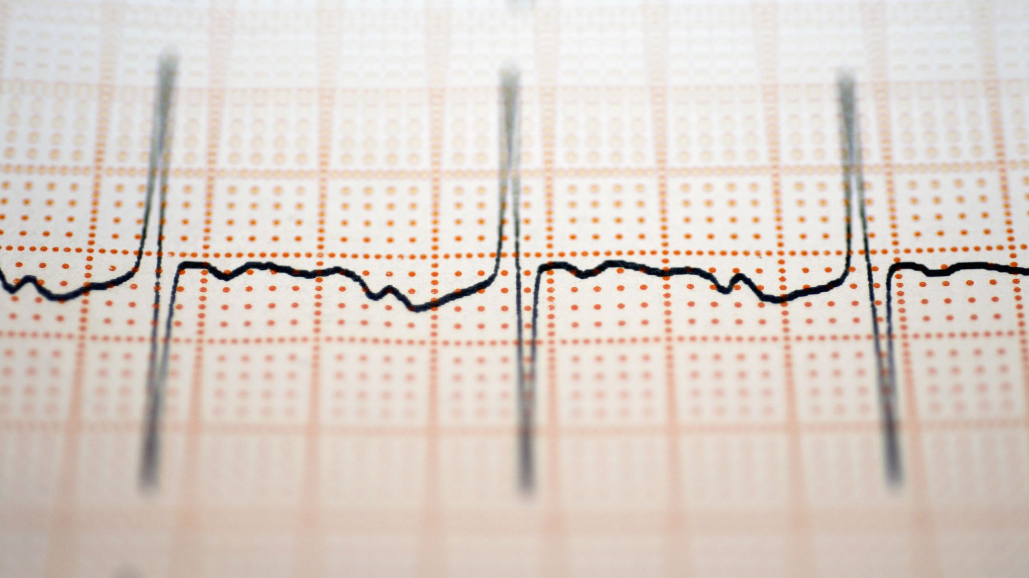
Long Term: Rate or Rhythm?

Slide 20
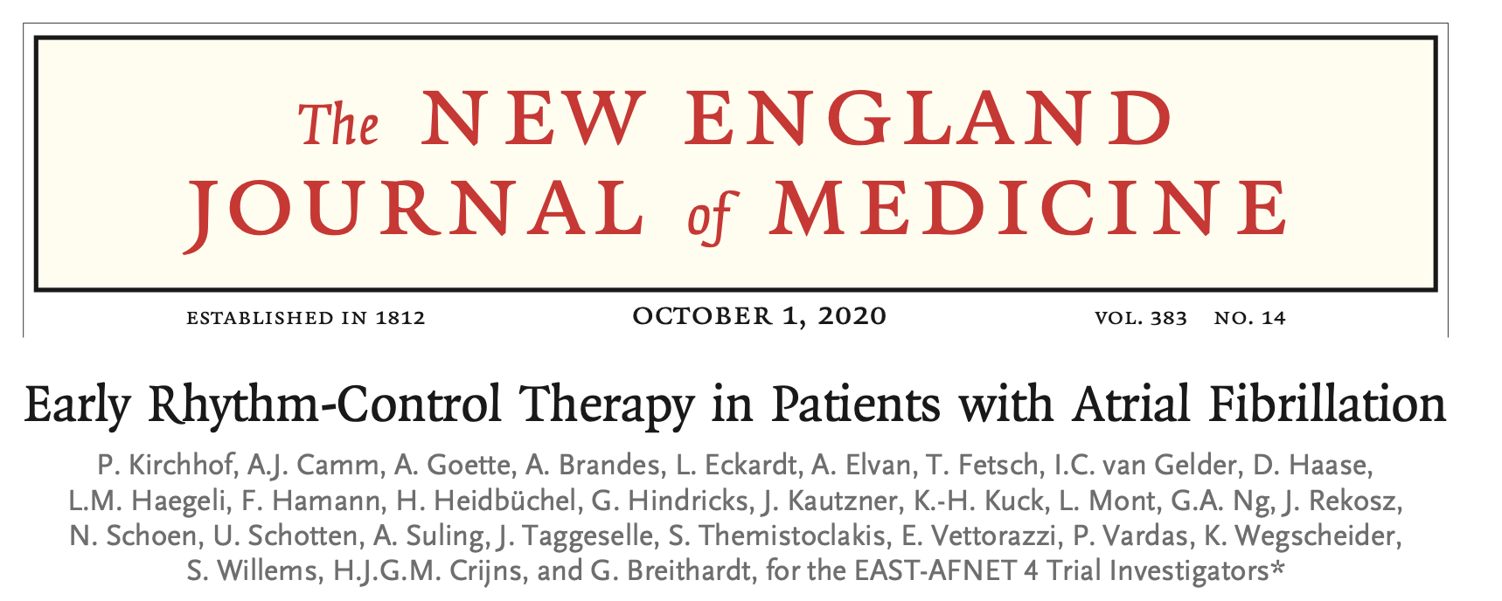

Slide 21
EAST-AFNET-4
Question: Does early rhythm control improve outcomes in newly diagnosed AF?
Population: AF ≤12 months, mean age ~70, high CV comorbidity
Intervention vs Control:
  Early rhythm control (AADs ± ablation)
  Usual care (rate control first; rhythm for symptoms)
Primary Outcome: CV death, stroke, HF hospitalization, ACS
Result: Early rhythm control ↓ composite CV outcomes (~20% RRR)
Take-home: Rhythm control early is disease-modifying, not just for symptoms

Slide 22
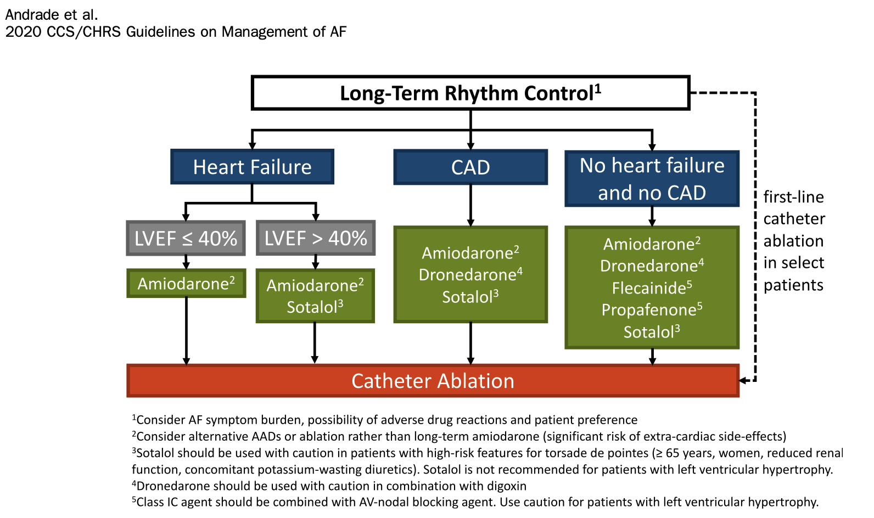
Notes:
Point attention to catheter ablation, mention EARLY AF, who are the select patients?

Slide 24
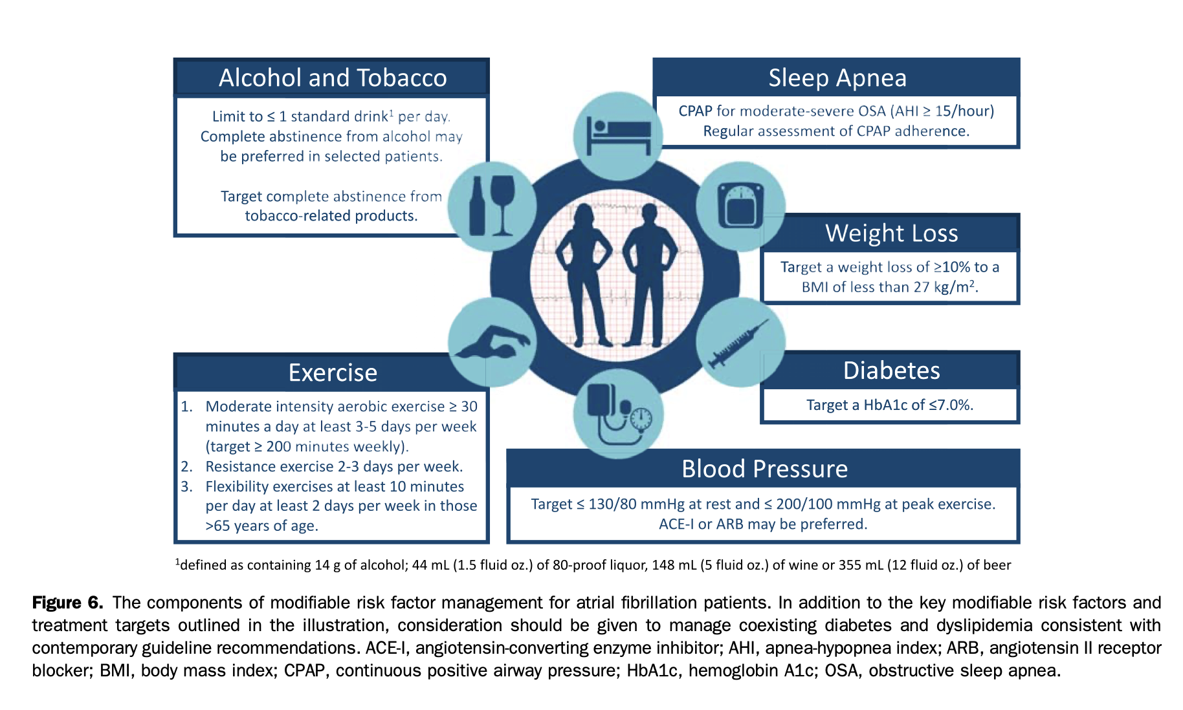
Notes:
ARREST AF Trial: single-centre cohort study showed that patients who chose
to undergo aggressive risk factor modi cation had better
QOL and symptom control, a signi cant reduction in AF
burden, and greater arrhythmia-free survival after catheter
ablation compared with those who did not

Slide 26
AC:
Indicated when CHADS65 score >1
Your choice between DOAC vs VKA will depend on whether is valvular or non valvular Afib:
  Mod– severe MS, Rheumatic MS, Mechanical Valve = Valvular
DOACs are first line for NVAFib
Always assess risk vs benefit with respect to bleeding and stroke prevention (CHADS2Vasc), remember the consequences of a stroke in the context of Afib, can be as high as > 50% death/disability!

Slide 27
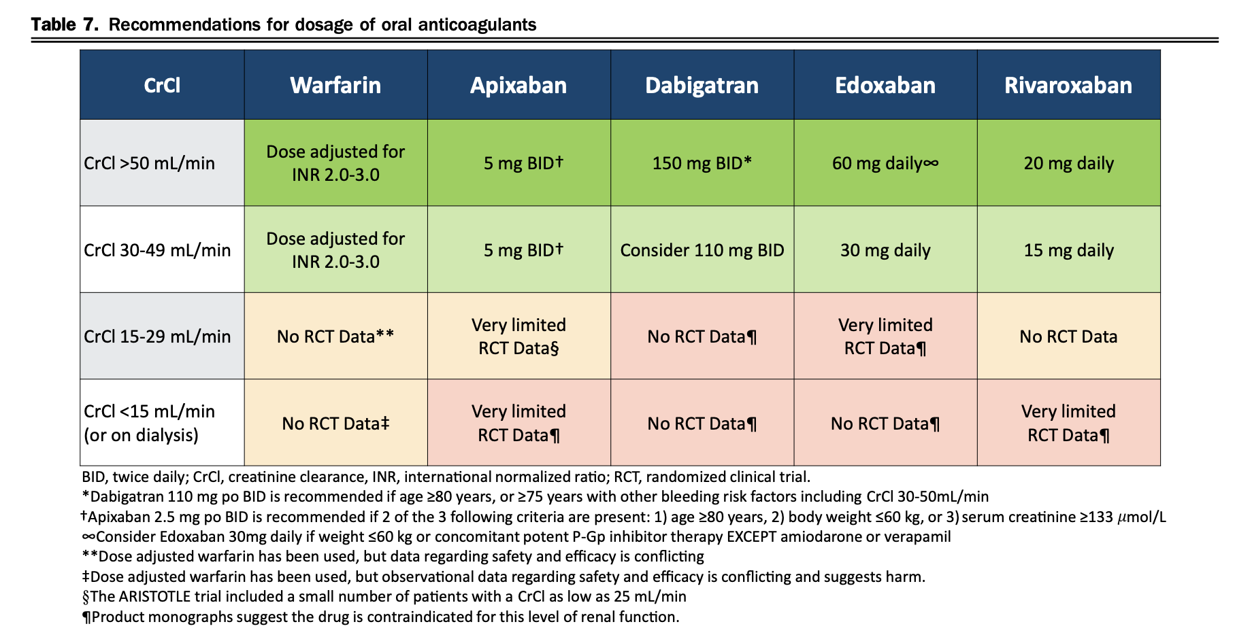

Slide 28
Bleeding on AC:
Always ask yourself, is the bleed life-threatening or not?
DOACS:
  Non life threatening: Supportive
  Life threatening:
    Dabigatran-->Idaracizumab 2.5g x2 doses, it is also dialyzable! (65% removal in 4 hours) (REVERSE-AD Trial: Dabi reversal almost 100% in 4hrs!)
    Apixaban/Rivaroxaban/Edoxaban→4 factor PCC (Octaplex) 2000 units, Adnexanet alpha can be used, not widely available due to cost
LMWH/UFH
  Non life-threatening: Supportive
  Life threatening→protamine sulfate, for LMWH give 25-50mg, UFH calculate based on last admin (call your pharmacist!)
Warfarin
  Non life-threatening→IV Vit K and supportive
  Life threatening, depends on INR, give IV Vit K and PCC-->INR 1.5-3 1000u, 3-5 2000u, >5 3000u

Slide 29

Back to the Case!

Slide 30
Thank You!

