Slide 1
Noon report
Mo Alfadhalah VGH LMR

Slide 2
26 year old male, previously heathy, with 3 week history of intractable headaches, fatigue, generalized malaise, rigors, and nausea

Slide 3
Approach?

Slide 4
Further History
First presentation 12-JAN he was assessed to have a tension type headache and given hydration education, ibuprofen, and acetaminophen. On 14-JAN he re-presented w/ AKI and headache NYD.
They are described as feeling like "two stripes", primarily at the back of his head close to his neck, and that it varies between throbbing and constant. It spreads behind his eyes and across his temples. He notes that his pain is worse when he attempts to sit upwards. Headache is not positional: he denies worsened pain when lying down, and denies worsened pain w/ valsalva. He is unable to identify other aggravating factors; the only alleviation to his headaches have been pain medications. He endorses a similar-onset back pain.
He has developed associated photophobia, and general malaise. He has been feeling nauseous, with no vomiting. His appetite and intake have subsequently decreased to 50% of his baseline. He denies any prior sick contacts. He denies any infectious symptoms such as cough, rhinorrhea. Although he denies fever, he notes feeling subjectively cold, with chills, and that he has had been layering up with several clothes as he is very cold when he sleeps.
He denies any aLOC, loss of consciousness, head injury, or focal deficits such as gait difficulty, ataxia. Denies any new numbness, tingling, weakness. Denies any visual changes, although notes sometimes blurry but no diploplia or sudden visual loss. Denies any myalgias, joint pains, or other pains.

Slide 5
Investigations
WBC 14.3 Hb 139 MCV 71 Plt 279
Na 135 K 3.6 Cr 137 eGFR 61 CRP 36
INR 1.1 PTT 32

Slide 6
Further Investigations
CT Head w/o contrast: No acute intracranial abnormality
CTV: “New prominence of the left superior ophthalmic vein and vasculature in the left orbit and superior nasal region. Differential considerations would include AV fistula versus cavernous sinus thrombosis. Cavernous sinuses are suboptimally opacified on this study, making cavernous sinus thrombosis difficult to exclude”

Slide 7
Further Investigations
LP Results: WBC 372 RBCs <500 Glucose 3.2 (N) Protein 0.73 (H)

Slide 8
DDx?

Slide 9
Summary

Slide 10
CNS Infections
Two main diagnoses to think of: Meningitis and Encephalitis
  Meningitis predominantly starts with a headache, neck stiffness and fever, aLOC may come later
  Encephalitis starts with aLOC and mental status changes as well as fever, you may see them develop seizures as it is inflammation of the brain parenchyma. Focal neurological signs may be associated with this condition

Slide 11
Meningitis
Physical exam, from “JAMA: Does this adult patient have acute meningitis?”
  Meningitis ruled out 99% if fever, neck stiffness and aLOC all absent
  Jolt accentuation, high sensitivity (up to 97% in one study)
  Kernig’s and Brudzinski’s signs, high specify, poor sensitivity

Slide 12
Meningitis Investigations
Blood cultures before abx
LP for all if no contraindications:
  Local infection
  Plt <50
  Suspicion of increased ICP, papilledema

Slide 13
Who Gets a CT Before LP? IDSA:
Patients who are immunocompromised (HIV infection, taking immunosuppressants, or after transplantation)
Patients with a history of central nervous system disease (mass lesion, stroke, or focal infection)
Patients with new onset of seizure within one week of presentation
Patients with papilledema on fundoscopy
Patients with an abnormal level of consciousness
Patients with a focal neurologic deficit

Slide 14
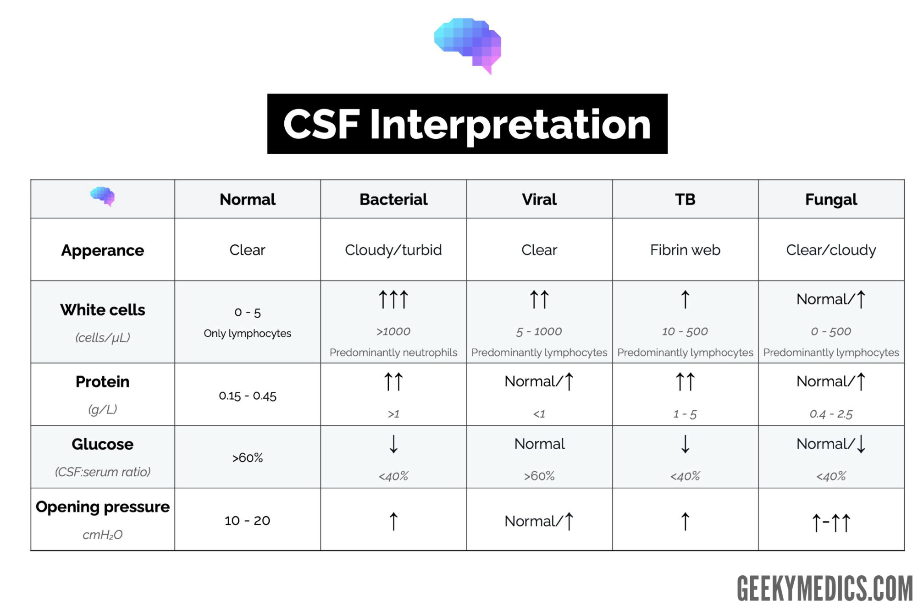

Slide 15
Common Pathogens
Age 18-50:
  S. Pneumonia, N. Meningitidis, H. influenza
Age >50 or immunocompromised:
  S. Pneumonia, N. Meningitidis, H. influenza, L. Monocytogenes

Slide 16
CSF Gram Stains
Gram positive diplococci→S. Pneumoniae
Gram negative diplococci→N. Meningitidis
Gram negative bacilli→H. Flu
Gram positive bacilli→L. Monocytogenes

Slide 17
Treatment-Empiric
Vancomycin
Ceftriaxone 2g IV BID
Dexamethasone 0.15mg/kg IV q6 for 4 days prior to or with the first dose of abx
  Cochrane review (2015): steroids strongly associated with decreased mortality for meningitis secondary to S. Pneumoniae, decreased hearing loss and short term neurological sequelae in high income countries for all pathogens
  Stop if CSF non pneumococcal, or non bacterial
  Do not start if abx already given to your patient
If age >50 or immuncompromised, start ampicillin 2g IV q4hr
Can add Acyclovir if there is a suspicion of viral encephalitis

Slide 18
Treatment Durations
S. Pneumo--> 10-14 days (CTX)
N. Meningitides, h. Flu→ 4-7days (CTX)
L. Monocytogenes→ 21 days (with ampicillin)

Slide 19
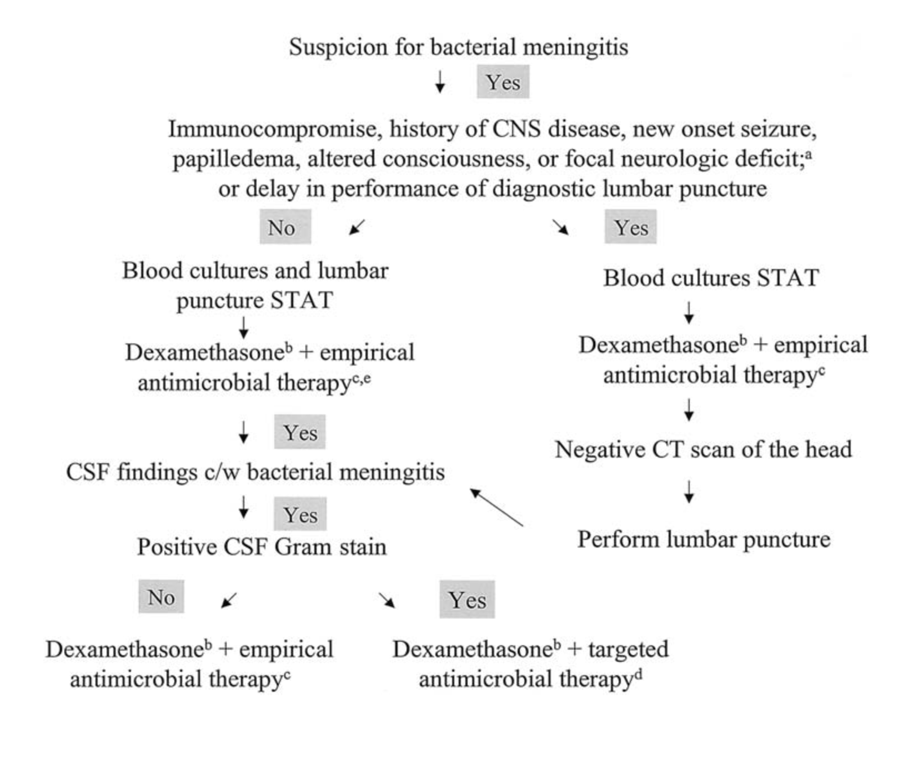

Slide 20
Bacterial Meningitis Complications
Seizures
Raised ICP
Hydrocephalus
CVT
Cerebral Edema
Sepsis
DIC

Slide 21
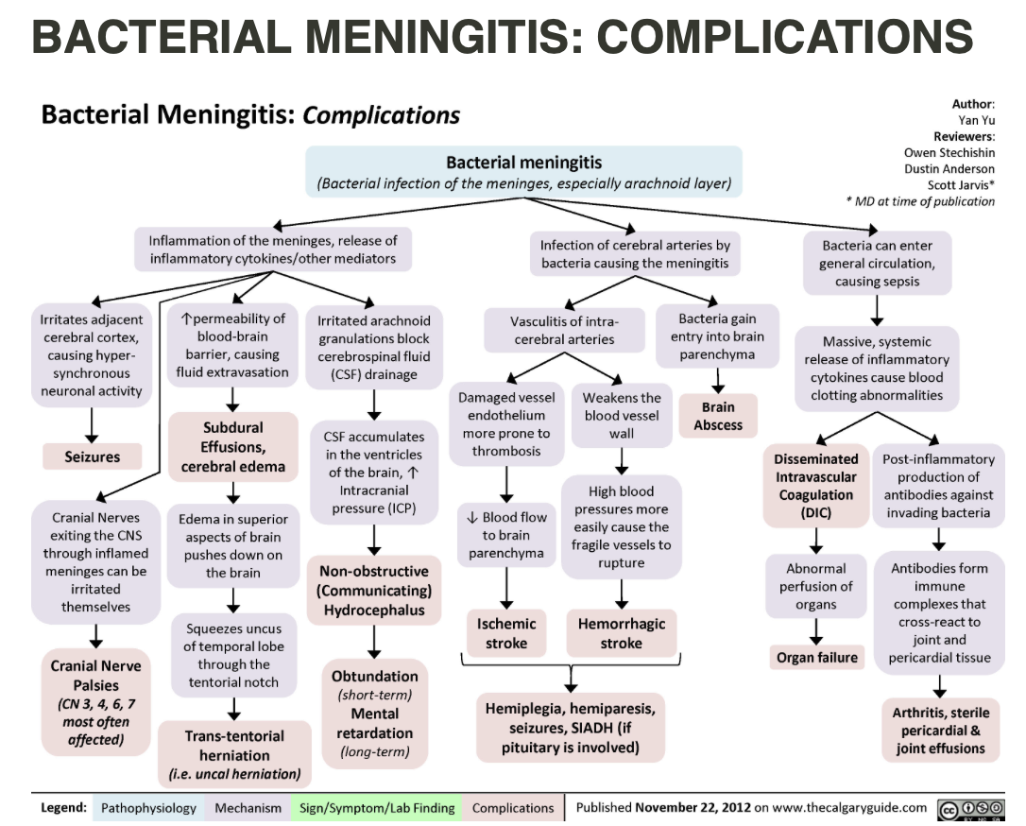

Slide 22
More on the Case
One day into admission, in the evening nurse calls MD on call for worsening GCS, he was found to be febrile, aLOC, his mother states that this is not his usually self
Abx were restarted, CTV repeated and showed no changed from prior
He eventually settled in the am

Slide 23
More on the Case:
EEG demonstrates mild to moderate diffuse cerebral slowing indicating mild to moderate diffuse cerebral dysfunction of unknown etiology
Moderate L>R temporal slowing, indicating moderate focal cerebral dysfunction likely due to structural or functional abnormality
HSV workup negative, autoimmune screen (NMDA, GABA) negative
Neurology have seen, his sudden decompensation is still unexplained
Ophthalmic vein prominence deemed anatomical variant, diplopia occurred as a result of underlying illness, CTA did not show a carotid cavernous fistula

Slide 24
A Word on Encephalitis
MCC is viral, usually an extension of meningitis, either reaches the brain hematogenously or in a retrograde manner from nerve endings
  HSV is the most common infection associated with viral encephalitis, those who live and work in warm humid environments are at risk for arboviruses because of the presence of mosquitous
Other causes to think of are AI/paraneoplastic diseases like anti-NMDA receptor encephalitis, brain abscess, TB, drug induced delirium, neurosyphilis, bacterial, protozoal, fungal encephalitis

Slide 25
Viral Encephalitis Treatment
HSV→Acyclovir 10mg/kg IV q8hr for 14-21 days
Varicella--> Acyclovir 10mg/kg IV q8hr for 14-21 days , can consider adjunct steroids
CMV→ganciclovir 5mg/kg IV q12 and Foscarnet 60mg/kg IV q8hr for 21 days
Be aware of increased ICP in these patients, they may require steroids or mannitol

Slide 26
Take Home Message
MSIs: Approach to aLOC
Juniors: Meningitis diagnosis, management
Seniors: Management and recognition of complications of meningitis

Slide 27
Thank You

