Slide 1
VGH CTU High Yield series: oncological emergencies
Mo Alfadhalah VGH LMR

Slide 2
Case
73 year old M with known pancreatic ca with mets to the liver, received a dose of chemotherapy 5 days ago. He has a history of HTN and T2DM on Rampril and Metforming. He comes into the ED with a temperature of 38.5. On exam he has a BP of 125/75mmHg, HR 76bpm and regular, RR 18, SPO2 97% on RA. He tells you he lives 10 minutes away from the hospital, with a reliable caregiver.
Labs were significant for an ANC of 0.3

Slide 3
Febrile Neutropenia
Definition:
  Temp Criteria: Single temp of >38.3, OR >38 for more than one hour
  ANC Criteria: ANC<1
    Moderate: 0.5-1
    Severe <0.5
    Don’t forget, the nadir of neutropenia occurs 7-14 days after chemo

Slide 4
Standard Work Up For All
CBC, Chem-7 and LFTs
Blood culture x2, peripheral and from any central lines
Urine C/S
CXR
As needed:
  Skin exam, sputum c/s, stool sample +/- C.Diff (if diarrhea)
  Additional imaging as needed

Slide 5
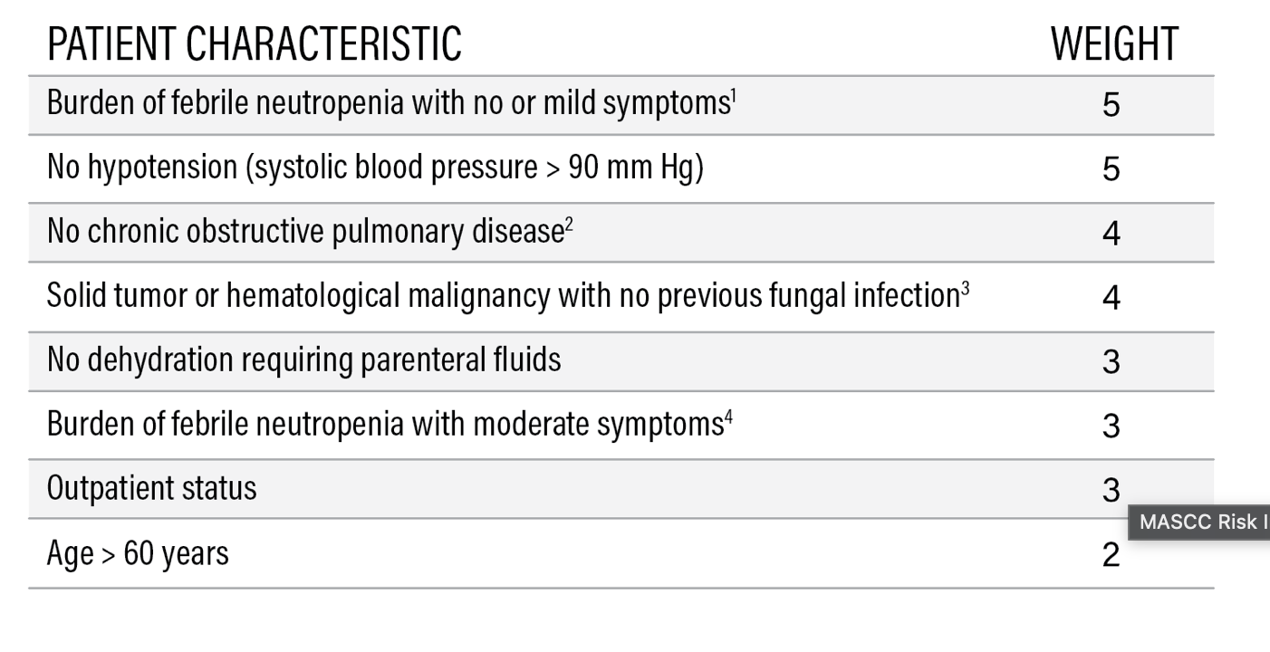
Deciding on Admission
Use the MASCC score:
If >21→Low/OP
If <21→High/Admit

Slide 6
Management
Inpatient: Initiate broad spectrum abx immediately after cultures are taken
  Piptazo IV (Anti- pseudomonal dosing)
  If still febrile after 72hrs→start vancomycin (also per BCCA if they have PNA), can consider Vanco for oral mucosa lesions
  G-CSF does not improve outcomes!
Outpatient: Risk stratify with the MASCC score, administer abx within one hour of triage
  Ciprofloxacin + Amoxicillin/Clavulanate or Clindamycin (if penicillin allergy)

Slide 7


Slide 8
Case
62 year old F with known squamous cell Ca of the lung, presents with increased thirst, generalized body pains and confusion. On exam her vital showed a BP of 130/80mmHg, HR 78bpm and regular, afebrile and satting comfortably 97% on RA. Physical exam was unremarkable. Her lab work was sent and was significant for a Creat of 320, eGFR 23, Hb 110 MCV 80, Plt 240, Calcium 3.2, a PET/CT was ordered and showed lytic bone mets.

Slide 9
Hypercalcemia of Malignancy
Etiology:
  Lytic bone destruction→Breast ca, melanoma
  PTHrP production→ Squamous cell Ca (not small cell ca)
  1,25-dihydroxy vitamin/calcitriol production→Lymphoma

Slide 10
Work Up
You always want to send the following labs:
  Serum Calcium (total and ionized with albumin for correction)
  Phosphate
  PTHrP (takes a while to come back), 25-hydroxyvitamin D and 1,25-dihydroxyvitamin D (calcitriol)
  Renal function
  You will know early on if it is a PTH dependent or independent cause

Slide 11
Work Up
Lytic bone lesions:
  PTH suppressed
  Calcium elevated
  Phosphate variable
  Use surrogate markers for bone turnover→Alk phos and imaging to confirm the lesions
PTHrP Production
  PTH suppressed
  PTHrP elevated
  Calcium elevated (usually above 3-3.5mmol/L)
  Phosphate is low to normal
Calcitriol overproduction
  PTH suppressed
  Calcium elevated
  1,25-OH2VitD elevated
  Phosphate can be high
Notes:
Hypercalcemia arises from local osteoclast activation by tumor factors, there is no systemic hormone driven process driving renal wasting of phosphate
PTHrP acts like PTH promotinh renal phosphate excretion (like primary hyperparathyroid)
Increased intestinal absorption of phosphorus with calitriol

Slide 12
Work Up
Confirm it’s real, remember its severe if >3.0mmol/L
Start with intact PTH to see if PTH dependent or independent
If PTH is high/normal it is a PTH dependent process
If PTH is low→measure PTHrP and calcitriol next as well as phosphate

Slide 13
Treatment
IV fluids!!
Bisphosphonates, especially Zoledronic acid IV x1, max effect is 4-7 days post infusion, in BC we use Pamidronate as it is more accessible, adjust for kidney function!
Calcitonin IM/sc, this is for severe hypercalcemia, quick onset (4-6hrs) but tachyphylaxis by 48hrs (use a bridge for bisphosphonates)

Slide 15
Case
A 34 year old M presents to the ED after being sent by his GP for new unexplained anemia and leukocytosis. A peripheral smear was done and showed blasts. The rest of his lab work was otherwise unremarkable. He was admitted under Internal Medicine in a community center and, under the direction of the BMT service, was urgently started on chemotherapy. You order labs and they come back with the following results: K 5.7, PO42.7, Uric Acid 675, Ca 1.8

Slide 16
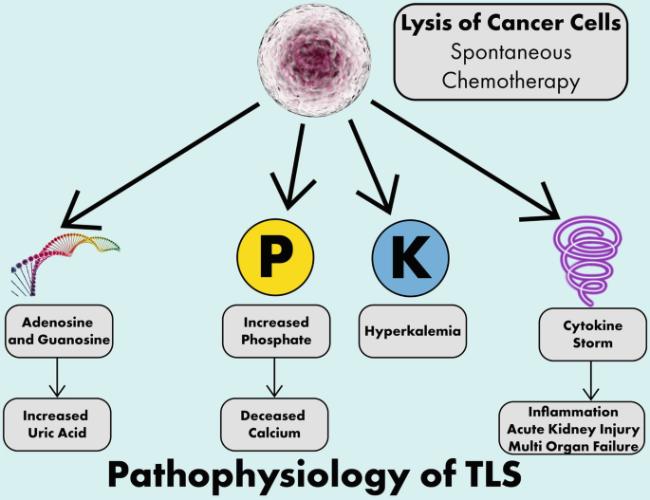
Tumor Lysis Syndrome
Etiology: Rapid Cellular Breakdown
  Rapidly proliferating malignancies (leukemia, lymphoma), high tumor burden– spontaneous TLS
  Chemo/Steroid sensitive malignancies (lymphoma) – post treatment TLS

Slide 17
Diagnosis
Requires at least two lab abnormalities within 7 days post chemo:
  HyperK – muscle weakness, ECG changes, arrythmias, sudden death
  HyperPO4 – AKI, secondary hypocalcemia, N/V, lethargy, seizures
  Hyperuricemia – AKI (renal tubule deposition), flank pain (stones), N/V, anorexia
  HypoCa – Tetany, paresthesias, mental status changes

Slide 18
Treatment
Manage hyperK, correct extended lytes
IVF (2ml/kg/hr UOP)
Allopurinol or Rasburicase if the following:
  AKI, high uric acid (>535), no response to allopurinol, check G6PD level
  Ie if they have established TLS, start Rasburicase
Dialysis if refractory to above measures for the fatal electrolyte disturbances

Slide 20
Case
A 75 year old man presents to the ED with a complaint of headaches, SOB, facial swelling/erythema and new onset hoarsness. He is known to have NSCLC. The emergency physician order a CT head, neck and chest with contrast and there is a concern for possible SVC syndrome. You are called to come see the patient.

Slide 21
SVC Syndrome
Etiology: Malignancy up to 90% of the time, half of which are NSCLC, other causes included thrombosis and fibrosis
Symptoms: Facial and arm edema, distended neck and chest veins, dyspnea, cough, facial plethora, horseness, stridor, neuro symptoms (confusion/aLOC)
Diagnosis: CT Head, Neck and Chest w/ contrast, consider venography as well

Slide 22
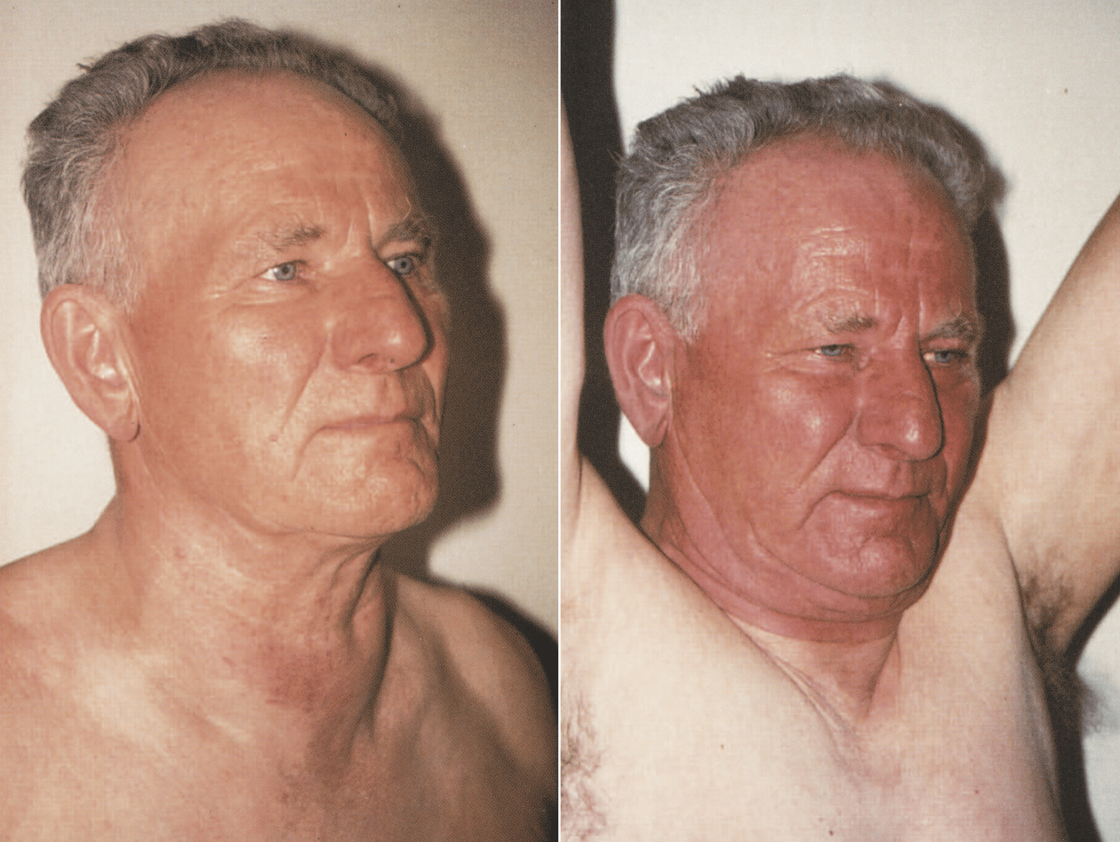
Pemberton Sign

Slide 23
Treatment
First thing you do is call IR and rad onc
Options for management depend on if it is life threatening or not:
  Life threatening (confusion/obtunded, stridor, hemodynamic compromise, syncope, hypotension:
    Urgent stent
    Steroids if not able to stent or if there is steroid responsive histology like lymphoma, practically start for all
    Radiation to temporize, but always consider stenting first
  Non life threatening:
    Obtain tissue diagnosis to guide treatment for more targeted therapy

Slide 25
Case
A 67 year old gentleman with known prostate ca currently undergoing treatment, presents to the ED with back pain. You go to see him and your physical exam is significant for obvious bilateral leg weakness, sensory loss and saddle anesthesia, his LL findings are suggestive that they are LMN in nature.

Slide 26
Spinal Cord Compression
Etiology:
  Vertebral fracture due to mets (breast, lung, prostate, MM)
  Tumor pushing into the thecal sac (mets or primary tumor like lung)
Symptoms: EARLY RECOGNITION!!
  Back pain is often the first sign
  Leg weakness, sensory loss
  Urinary retention, bowel incontinence
  If at the level of the spinal cord→UMN
  If Cauda Equina Syndrome→LMN findings and saddle anesthesia
Diagnosis: MRI Whole Spine

Slide 27
Treatment
Call Spine Surgery urgently as well as Rad onc
Steroids: Dexamethasone, 10mg IV x1, then 4mg PO/IV QID ongoing until definitive therapy
Pain control

Slide 29
Thank You

