Slide 1

Noon Report
Fiddler’s Green
Adam Pietrobon
VGH Lead Medical Resident
Notes:
Song is a clue
Only get what you ask
Participate :)

Slide 2
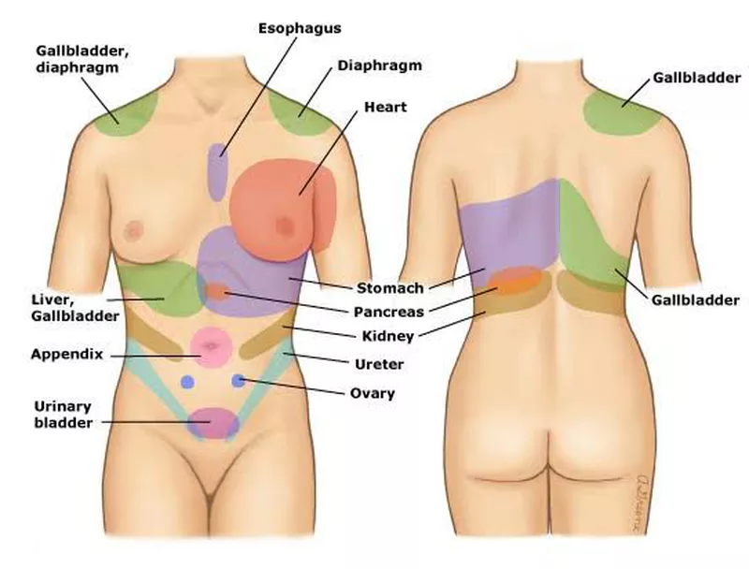
Approach to acute abdominal pain
Determine the location
(and consider consider non-intra-abdominal referred pain)
Rule out an acute abdomen
Assess for associated symptoms
(e.g. bowel habits, bleeding, fever, urogynecological)
Consider patient risk profile

Slide 3
Location | System | Non-exhaustive examples
Upper abdominal pain RUQ | Biliary | Cholecystitis, cholangitis
 | Hepatic | Acute hepatitis, liver abscess, Budd Chiari
Upper abdominal pain Epigastric | Cardiac | ACS, pericarditis
 | Pancreatic | Pancreatitis
 | Gastric | Gastritis
Upper abdominal pain LUQ | Splenic | Splenic infarct, abscess, rupture
Lower abdominal pain | Bowel | Appendicitis, diverticulitis, colitis
 | Urological | Pyelonephritis, urinary retention, prostatitis
 | Scrotal | Torsion, epididymitis
 | OBGYN | Torsion, rupture, pregnancy
Diffuse | Structural | Obstruction, perforation, ischemic, SBP
 | Non-structural | Many causes

Slide 4
Non-structural (imaging negative) abdominal pain
Metabolic
  DKA, hypercalcemia, adrenal insufficiency, thyroid disorders, acute intermittent porphyria
Toxins
  ~ Any toxidrome (opioid, anticholinergic, cannabinoids, etc.), heavy metal poisoning
Central/Motility
  IBS, abdominal migraine, gastroparesis
True structural problem, but not yet visualized
  Endometriosis, fibroids
Other
  Angioedema, allergy, familial mediterranean fever

Slide 5
A foray into clinical reasoning and metacognition
Problem representation
Diagnostic schema
Patient demographics
Base rate
Population profile
Pertinent positives
Discriminatory features
Pertinent negatives
Provisional diagnosis &
differential diagnoses
Notes:
Brief vignette on clinical reasoning

Slide 6
Pancreatitis
Diagnosis requires ≥ 2 of
Characteristic abdominal pain
Lipase ≥ 3X ULN
Radiographic evidence of pancreatitis
Management
Diet - early enteral feeding reduces infection (mortality benefit)
Fluids - prn to volume status
Analgesia
Antibiotics - only if evidence of infection
Monitoring - clinically, only image if concern for complications

Slide 7
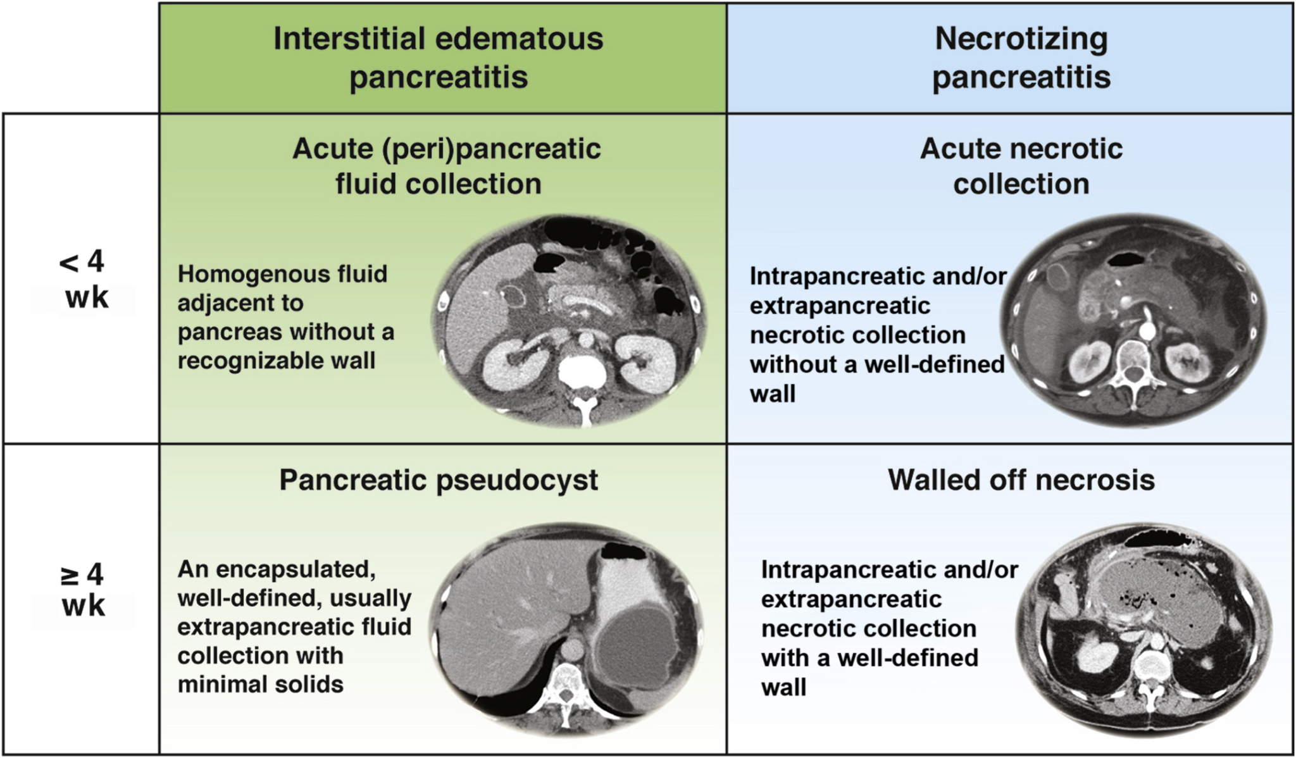

Slide 8
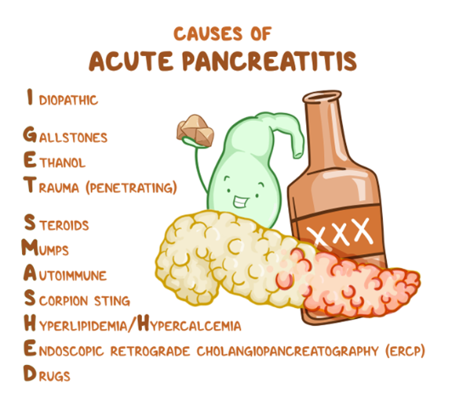

Slide 9
CFTR related disease - overview
CFTR-RD describes conditions caused by partial dysfunction of the cystic fibrosis transmembrane conductance regulator (CFTR) but do not meet diagnostic criteria for CF
Typically characterized by single organ involvement, milder phenotypes, and non-classic/borderline diagnostic testing (milder or heterozygous mutations)

Slide 10
CFTR related disease - clinical phenotypes & diagnosis
Phenotypes consistent with the organ systems where CFTR acts
Congenital bilateral bilateral abscess of the vas deferens
Disseminated bronchiectasis with CFTR dysfunction
Idiopathic chronic/recurrent pancreatitis
Other (e.g. sinusitis, electrolyte abnormalities)
Diagnosed via
CFTR related clinical phenotype
AND
Evidence of CFTR dysfunction below typical CF levels (e.g. sweat chloride testing, CFTR genotyping, physiologic testing)

Slide 11
CFTR related disease - treatment
Guided by specialised clinics (CF clinic)
Supportive therapies based on phenotype
Some mild mutations respond to CFTR modulators

Slide 12
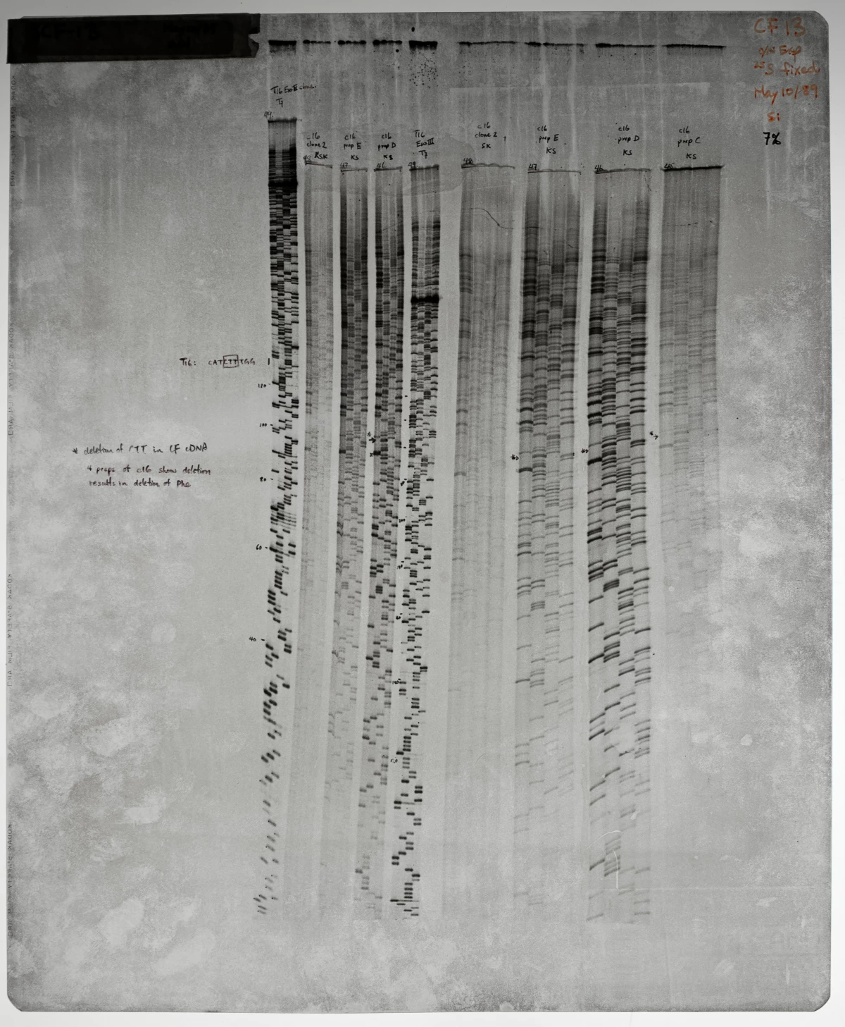
CFTR related disease - A Canadian claim to fame
In 1989, after an intense international research endeavour to identify the causative gene for cystic fibrosis, Dr. Lap-Chee Tsui’s groups was finally successful
Dr. Lap-Chee Tsui’s laboratory was based out of The Hospital for Sick Children in Toronto, Ontario.
The Tragically Hip was a longtime fundraiser for children’s hospitals, including SickKids. The song Fiddler’s Green is about Gord Downie’s Nephew who tragically passed away when he was a young boy.

Slide 13
Noon Report
Fiddler’s Green
Adam Pietrobon
VGH Lead Medical Resident
Notes:
Song is a clue
Only get what you ask
Participate :)

Slide 14
Why was her mutation testing not initially positive?
The “pancreatic panel” sent to to Blueprint Genetics only tests for coding regions and select intronic regions of the CFTR gene
The 5T repeat is seen in intron 8 and was not covered by the Blueprint Genetics panel
Always know the limitation of your testing!

Slide 15
Learning
MSI3
Approach to abdo pain
JR/MSI4
Pancreatitis
SRs
CFTR related disease

