Slide 1
Adult metabolic diseases for the general internist
Trudy Nasmith, MDCM, MSc, FRCPC
Clinical Assistant Professor
Division of General Internal Medicine, UBC

Slide 2
disclosures
Nothing to disclose

Slide 3
overview
What is the AMDC?
Metabolic myopathies
Encephalopathy

Slide 4
amdc
Multidiciplinary clinic focusing on metabolic diseases (inborn errors of metabolism)
  3 Dieticians
  4 nurses
  5 doctors (medical geneticist, adult medical biochemist, pediatric medical biochemist, neuromuscular disease neurologist, and me)
  1 genetic counsellor
  1 social worker
  3 fabulous MOAs

Slide 5
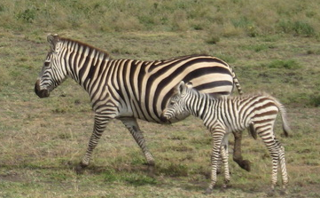
A Case for zebras
45M with hemoptysis, hematuria and antibodies to GBM
56M with hematuria, sinusitis and rapidly progressive renal insufficiency with positive ANCA
34F with altered LOC, hyperammonemia and no liver disease
Anti-GBM – 1/500 000
GPA – 1/50 000
UCD – 1/30 000
Slide courtesy of Sandra Sirrs

Slide 6
Case 1
21M hospitalized for rhabdomyolysis (CK peak 230 000), Cr N, after demolishing a house (works in construction)
Prior episode in Alberta after playing ball hockey for 3 hours, hospitalized for 15 days
Muscle cramps and soreness after exercise, feels better after a short warm up
Baseline CK 200s
No illicit drugs preceding episodes

Slide 7
Metabolic myopathies
Glycogen-storage disease
  McArdle disease/GSD 5 (myophosphorylase deficiency)
  Tarui disease/GSD 7 (phosphofructokinase deficiency)
  GSD 9 (phosphorylase b kinase deficiency)

Slide 8
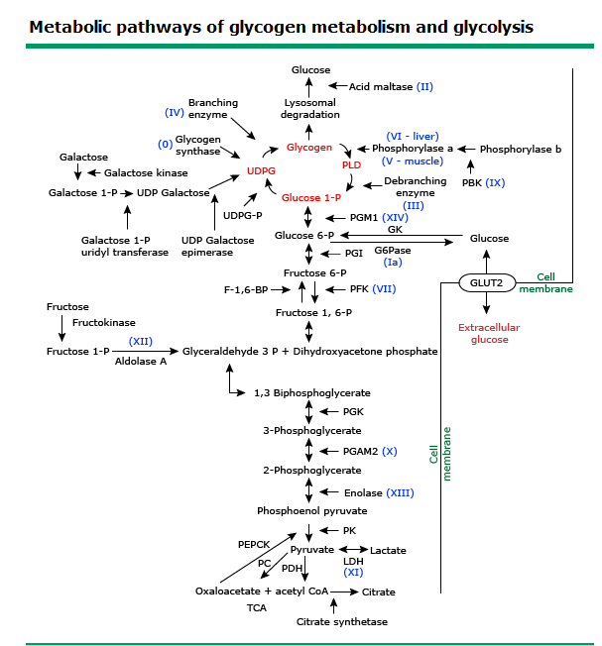

Slide 9
Glycogen storage disorders
Glycogen = main E source for high-intensity muscle activity (substrates for ATP generation)
Exercise intolerance, recurrent myoglobulinuria
”Second wind” phenomenon

Slide 10
Fatty Acid Oxidation Disorders
Carnitine palmitoyltransferase II deficiency (CPT2 def, most common)
Trifunctional protein deficiency
Very-long chain acyl-coenzyme A dehydrogenase deficiency (VLCAD deficiency)

Slide 11
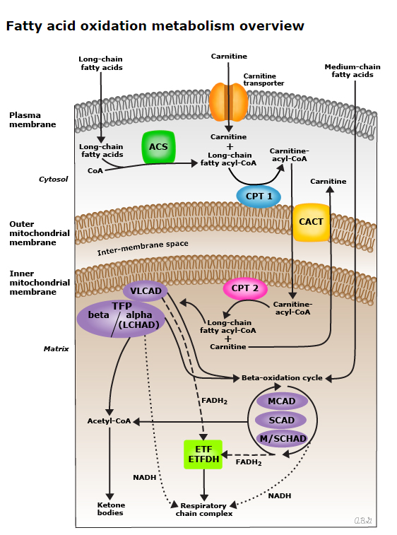

Slide 12
faod
Symptoms usually induced by infections, fever, prolonged/intense exercise, or prolonged fasting
No true muscle cramps or contractures
No second wind phenomenon
Involved the following tissues (dependent on FAO):
  FA = major source of E for heart and liver during fasting (glycogen and glucose stores depleted)
  Resting muscle and exercising muscle during mild to moderated prolonged exercise derive most of required E from FAO

Slide 13
Mitochondrial disorders
Mitochondrial myopathy
  MELAS
  MERRF
  CPEO
  Kearns-Sayre syndrome
  Complex IV deficiency
  Cytochrome b mutations
  Cytochrome c oxidase mutations

Slide 14
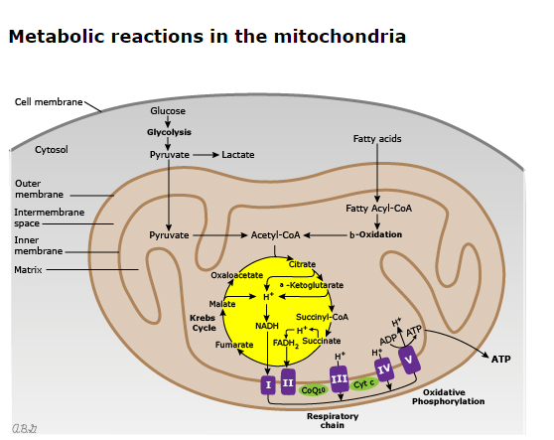

Slide 15
Mitochondrial disorders
Exercise intolerance due to premature fatigue
Intolerance > muscle weakness
No muscle cramps, no second wind
Exercise intolerance often dates back to childhood

Slide 16
How to distinguish?
History
  Rhabdo/pigmenturia
  Myalgia>cramps with endurance sports
  Shortness of breath with endurance sports
  Myalgia/cramps with power/sprint sports
  Symptoms triggered by fasting or superimposed illness
  N/V with exercise
  Multi-system involvement
Notes:
GSD, FAOD, mitochondrial
FAOD, mito myopathies
Mito
GSD
FAOD, mito
Mito
Mito

Slide 17
How to distinguish?
Family history:
  X-linked → certain GSDs
  Maternal → mitochondrial
  AR/consanguineous → CPT2 def, most GSD

Slide 18
How to distinguish?
Elevated CK between episodes
  Fairly specific for McArdle’s disease
Acylcarnitine profile:
  Abnormal in FAOD (although sometimes only during acute episode)
Urine organic acids panel:
  May be elevated in FAOD
Lactate:
  Can be elevated in mitochondrial disorders

Slide 19
Case 1
Physical exam unremarkable
CK 562
Lactate normal
Acylcarnitine profile unremarkable
TSH normal
Vitamin D 20 (low)

Slide 20
Thoughts?
What do you think of low vit D?
Notes:
Vitamin D involved in muscle health and performance; vitamin D receptors on muscle cells that affect muscle functon.
Association with statin-associated myalgias.
Increase risk of rhabdomyolysis if vitamin D deficient.

Slide 21
Case 1
Metabolic myopathy gene panel:
  Heterozygous for 2 pathogenic variants for McArdle disease
  Family testing – mom is heterozygous for one of the pathogenic variants → therefore variants likely trans (not cis)
  Qualifies as having McArdle’s

Slide 22
encephalopathy
Common presentation to CTU
General approach:
  Drugs: Withdrawal or toxicity
  Infection
  Metabolic: High or low Na, high Ca, uremic encephalopathy, hepatic encephalopathy, TSH, B12
  Structural: Stroke, bleed, seizures, masses…
  Retention: Urinary or fecal

Slide 23
Case 2
An accountant in his late 20s is brought to the ED by his family and fiancé with encephalopathy and vomiting.
Bloodwork just shows mild-mod transaminase elevations
Internist is consulted
An NH3 is checked: 219 umol / L. (10X normal). Normal HCO3, no acidosis
Lactulose and moderate IV hydration given.
More alert next morning.

Slide 24
hyperammonemia
Causes?
  Hepatic failure and portosystemic shunting
  Medications (valproic acid, capecitabine, 5-FU, carbamazepine, acetazolamide)
  Inborn errors of metabolism
  Distal RTA
  Multiple myeloma
  Post-gastric bypass surgery
  Infections (Proteus, Corynebacterium, Klebsiella, Enterobactericaea, Enterococcus, Ureaplasma in post-lung Tx)

Slide 25
Case 2 continued
AMDC is consulted. Stat plasma amino acids show high glutamine, low citrulline. Urine organic acids show mild orotic aciduria.
Urea cycle disorder is likely (OTC deficiency).
Discharged straight to AMDC appt; started on citrulline and modest protein-restricted diet (DRI).

Slide 26
Filipino ethnicity
Sudden death, age 44
Flu symptoms,
then progressive confusion.
Found walking in traffic.
In a coma shortly after arrival in hospital
Died 9 days later, age 59
Family told may have been viral encephalitis
Obligate carrier
Precautions with stressors
OTC deficiency diagnosed after encephalopathy
Headaches after large meals
Positive on testing
One episode of mild delirium with flu
But testing showed unaffected
Brothers died one year apart in their 20s, after episodes of confusion, then coma. Family told may have been drugs, although all testing was negative.
Obligate carrier
Precautions with stressors
Transient elevated NH3 postnatally
Obligate carrier
Precautions with stressors
Autism
No decompensations
Slide courtesy of Anna Lehman

Slide 27
Urea cycle disorders
Most often will be diagnosed in infancy/childhood HOWEVER can present in adulthood
Diagnosis made by
  1) Plasma amino acid panel
  2) Urine organic acid panel
  3) Genetic testing guided by above

Slide 28
UCD Cont’d
Triggers for hyperammonemia:
  Infection
  Surgery
  Acute protein/calorie deprivation
  IV steroids
  IV amino acids (i.e. TPN)
  GI bleed
  Chemotherapy
  Sodium valproate
  Uterine involution

Slide 29
Ucd cont’d
Treatment
  STOP CATABOLISM → give calories in form of dextrose and lipids
  Protein deprivation x24h, restriction x 48h
  Ammonia scavengers if necessary
  Arginine
  Dialysis if unable to get NH4+ down with other mechanisms (CRRT preferable to IHD due to higher flow rates and concern for cerebral edema)

Slide 30
Common NH4+ consult from psych
My patient on epival for bipolar disorder has an NH4+ of 60… what do I do?
  Ensure collected properly (i.e. repeat, without tourniquet, on ice, run in lab stat)
  Rule out liver dysfunction/portosystemic shunt, infections, other meds
  Is NH4+ <75 on repeat?
    Yes → advise to switch meds if possible, but likely due to epival
    No → send off plasma amino acid panel, urine organic acids, acylcarnitine profile and consider sending them to AMDC

Slide 31
Metabolic causes of hyperammonemia
Urea cycle defects (primary)
  OTC deficiency most common to present in adulthood
  Consider in patients with developmental delay
Fatty acid oxidation defects (secondary)
  Most will not present with encephalopathy in adulthood, but with myopathy
Organic acidemias (secondary)
  Most of these will have been diagnosed in childhood
  Consider them if concomitant lactic acidosis
  Maple syrup urine disease might present in adulthood

Slide 32
Metabolic causes of hyperammonemia
High NH3
Acidosis
N pH/alkalosis
Organic aciduria, pyruvate metabolism
Hypoketosis, hypoglycemia
N glucose
Plasma AA
Urine orotic acid
FAOD
Hi citrulline,
ASA present
Hi citrulline, no ASA
Low/no citrulline
N/low
High
Citrullinemia
ASA
CPS def
OTC def
Notes:
ASA: argininosuccinic aciduria
CPS def:
OTC def:

Slide 33
Take home points
Some of these “rare” conditions more common than you think
When to consider metabolic myopathies?
  Recurrent rhabdomyolysis with no clear provoking cause
  You can send off some initial workup
Encephalopathy
  Don’t forget about ammonia!!

Slide 34

Questions

Slide 35
references
Darras, Basil. “Approach to metabolic myopathies.” UpToDate. https://www.uptodate.com/contents/approach-to-the-metabolic-myopathies?search=glycogen%20storage%20disease&topicRef=2941&source=see_link. Last updated Dec 15, 2020. Accessed June 16, 2021.
Glueck, C and Conrad, B. Severe vitamin D deficiency, myopathy and rhabdomyolysis. N Am J Med Sci. 2013 Aug; 5(8): 494-95.
Hollak, C and Lachmann, R. Inherited Metabolic Disease in Adults: a clinical guide. Oxford University Press 2016.
Merritt II, J Lawrence. Myophosphorylase deficiency (gsd V, McArdle Disease). UpToDate. https://www.uptodate.com/contents/myophosphorylase-deficiency-glycogen-storage-disease-v-mcardle-disease?search=glycogen%20storage%20disease&source=machineLearning&graphicRef=81164#graphicRef81164. Last updated Jun 29, 2020. Accessed Jun16, 2021.
Merritt II, J Lawrence and Vockley, Jerry. “Overview of fatty acid oxidation disorders.” UpToDate. https://www.uptodate.com/contents/overview-of-fatty-acid-oxidation-disorders?search=fatty%20acid%20oxidation%20disorders&source=search_result&selectedTitle=1~33&usage_type=default&display_rank=1. Last updated Sept 18, 2020. Accessed May 28, 2021.
Tarnopolsky, M. Metabolic myopathies. Continuum (Mineap Minn) 2016; 22(6): 1829-51.
Tchan, M. Hyperammonemia and lactic acidosis in adults: Differential diagnoses with a focus on inborn errors of metabolism. Reviews in Endocrine and Metabolic Disorders (2018) 19:69-79.

