Slide 1

Noon Report
100 Bad Days - AJR
Adam Pietrobon
VGH Lead Medical Resident
Notes:
Song is a clue
Only get what you ask
Participate :)

Slide 2
Overview of frailty
Defined as an aging-related syndrome of decline in physiological reserve, conferring vulnerability to adverse health outcomes, including
  Increased burden of symptoms
  Medical complexity
  Reduced tolerance to medical and surgical procedures
Frailty is associated with increased morbidity and mortality
There are two major conceptual frameworks for frailty
  Physical frailty - focuses on signs and symptoms that are most closely connected to adverse outcomes (e.g. fatigue, low activity, weight loss, slow gait)
  Deficit accumulation framework - focuses on cumulative comorbidities and functional impairments as the marker of frailty

Slide 3
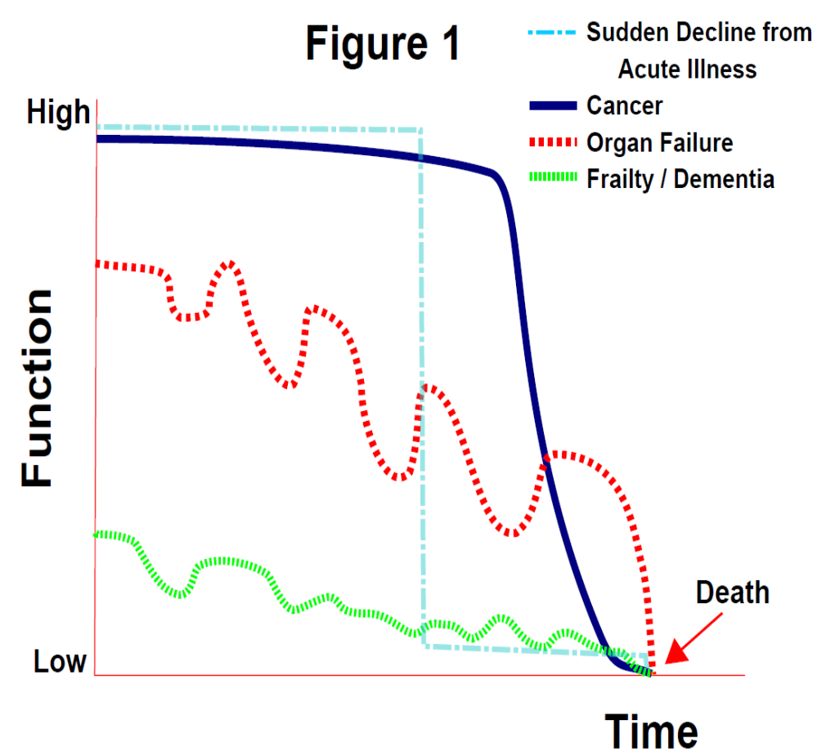

Slide 4
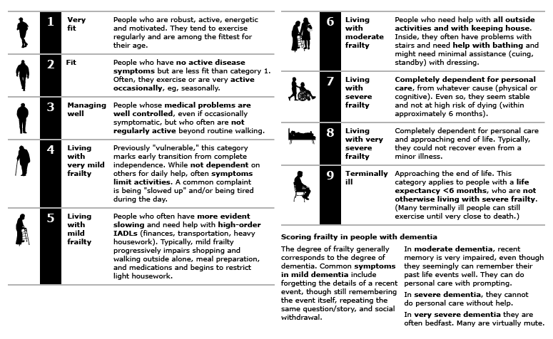
No gold standard to diagnose, but multiple tools to measure

Slide 5
Strategies to mitigate frailty
Evolving domain
Multipronged approach preferred
Specific interventions with favourable effect
  Physical exercise
  Nutritional supplementation
  Cognitive training

Slide 6
A foray into clinical reasoning and metacognition
Problem representation
Diagnostic schema
Patient demographics
Base rate
Population profile
Pertinent positives
Discriminatory features
Pertinent negatives
Provisional diagnosis &
differential diagnoses
Notes:
Brief vignette on clinical reasoning

Slide 7
A foray into clinical reasoning and metacognition
Anemia
Microcytic vs Normocytic vs Macrocytic
35F, active
Base rate
Primary care
Menstruating
Discriminatory features
No other bleeding
Dx: Iron deficiency anemia DDx: Athleticism, nutritional
Notes:
Brief vignette on clinical reasoning

Slide 8
A foray into clinical reasoning and metacognition
Schema-based fails when a singular problem cannot be used as an anchor.
Problem representation
Diagnostic schema
Patient demographics
Base rate
Population profile
Pertinent positives
Discriminatory features
Pertinent negatives
Provisional diagnosis &
differential diagnoses
Notes:
Brief vignette on clinical reasoning

Slide 9
Enter… hypothetico-deductive reasoning
A strategy for generating diagnostic hypotheses and test each one against features of the case
Iteratively refine diagnoses based on
  Probability
  Fit with clinical features
  New data that arises
An analytical, but slow method of clinical reasoning
Can strive for one singular diagnosis (Occam's razor) or multiple diagnoses (Hickam's dictum)

Slide 10
Hypothetico-deductive reasoning in practice
Diagnoses
Generated from base rate…
CAP
Generated from risk profile…
Myositis flare
Features of the case
Fall
Acute weakness
Subacute weight loss
Constipation
Hypoventilation
Bibasilar opacities
Cough
Anemia
Neutrophilia

Slide 11
Hypothetico-deductive reasoning in practice
Diagnoses
Generated from base rate…
CAP
Generated from risk profile…
Myositis flare
Features of the case
Fall
Acute weakness
Subacute weight loss
Constipation
Hypoventilation
Bibasilar opacities
Cough
Anemia
Neutrophilia

Slide 12
Hypothetico-deductive reasoning in practice
Diagnoses
Generated from base rate…
CAP
Generated from risk profile…
Myositis flare
Features of the case
Fall
Acute weakness
Subacute weight loss
Constipation
Hypoventilation
Bibasilar opacities
Cough
Anemia
Neutrophilia

Slide 13
Hypothetico-deductive reasoning in practice
Diagnoses
Generated from base rate…
CAP
Generated from risk profile…
Myositis flare
Features of the case
Fall
Acute weakness
Subacute weight loss
Constipation
Hypoventilation
Bibasilar opacities
Cough
Anemia
Neutrophilia

Slide 14
Leukemia
Lymphoma
Other
Monoclonal
Lymphocytosis
Polyclonal
Infectious
Non-Infectious
Drug hypersensitivity
Stress
Asplenia
Thymoma
Infectious Mononucleosis Syndrome
EBV
CMV
Acute HIV
Toxoplasmosis
HHV-6 & HHV-7
Other Syndromes
Cat scratch
TB
Brucellosis
Pertussis
Syphilis
Babesiosis
Rickettsial
Other Viral
HTLV-I
Mumps
Rubella
Measles
Influenza
Hepatitis
Adenovirus
Coxsackie virus
Poliovirus

Slide 15
Approach to lymphocytosis
Is this a chronic process?
If yes, suggestive of monoclonal etiology or non-infectious etiology (e.g. asplenia)
Peripheral blood smear → flow cytometry
If no, more commonly this is a reactive, polyclonal process. Then ask, are there localizing features of a specific infection (e.g. infectious mononucleosis syndrome)?
If yes, investigate appropriately
Serology, NAT, trending
If no, consider work-up for etiologies that may have no other discriminatory features (e.g. CMV, EBV, HBV, HCV, HIV, Syphilis)

Slide 16
Overview of Pertussis
Pertussis, also known as “whooping cough”, is a highly contagious, acute respiratory illness caused by Bordetella pertussis
The hallmark symptoms (below) can be absent in adults and present as a more non-specific prodrome
  Paroxysmal cough
  Inspiratory whoop
  Posttussive emesis
Classically presents in three phases
Catarrhal phase (1 - 2 wks): Nonspecific symptoms including generalized malaise, rhinorrhea, and mild cough. Early suggestive features is excessive lacrimation and conjunctival injection.
Paroxysmal phase (0.5 - 3 months, untreated): Paroxysmal cough and posttussive emesis
Convalescent phase (1-2 wks): Gradual lessening of symptoms

Slide 17
Pertussis mechanism
Pertussis releases a few toxins which have interested biological effects
Block lymphocyte extravasation into lymph nodes → absolute lymphocytosis (develops ~ 1 - 3 wks)
Thus, not due to an increase in production of lymph nodes
Kill ciliated respiratory cells (takes weeks to regenerate) and causes significant local inflammation → loss of mucociliary clearance and accumulation of thick mucus and debris
Hypersensitive airways with significant debris triggers repeat severe coughing → after coughing fit patient forcefully inhales to produce the “whoop”

Slide 18
Pertussis diagnosis and treatment
Diagnosis
Can make presumptive clinical diagnosis, but confirmatory testing as follows:
  Symptom onset < 4 wks: NP culture + PCR
  Symptom onset > 4 wks: Serology (not widely available)
Treatment
Primarily to reduce transmission
Indicated for adults if
  Symptoms onset < 3 wks: All
    Rationale: Beyond this, likely no active infection but a response to tissue damage
  Symptoms onset < 6 wks: If at risk of severe disease (age > 65, immunocompromised, pregnant)
Azithromycin x5 days

Slide 19
Classically known as “Whooping Cough” but also known by another name due to the long disease course….
100 Day Cough

Slide 20
Noon Report
100 Bad Days - AJR
Adam Pietrobon
VGH Lead Medical Resident
Notes:
Song is a clue
Only get what you ask
Participate :)

Slide 21
Why did our patient not “whoop”?
This is speculative, but a few possibilities:
Pertussis often presents atypically in adults
She had such significant generalized weakness she probably couldn’t generate enough inspiratory effort to “whoop” (recall: chronic respiratory acidosis)
She also didn’t produce the typical heavy lacrimation due to her baseline sicca symptoms.
Always reflect
“Common presentation of uncommon disease”
“Uncommon presentation of common disease”

Slide 22
Learning
MSI3
Frailty
JR/MSI4
Approach to lymphocytosis
SRs
Pertussis infection
Everyone
Hypothetico-deductive clinical reasoning
Know thy patient!

