Slide 1
Noon Report
Mohammad Alfadhalah PGY3 IM

Slide 2
39 F presents post cardiac arrest

Slide 3
39 F post cardiac arrest
PMHx:
?EDS
Asthma
NSAID Allergy
Social Hx:
She has an MA in creative writing.
She taught a yoga and was a transcriptionist until 2016
She is from Singapore in early childhood and is Chinese from a Malayan background.
Parents deny hx of substance use or smoking,
Meds:
None

Slide 4
Physical Exam
HR 95 regular, afebrile, BP 100/70
CNS: Intubated, sedated on assessment, pupils 4mm BIL, reactive to light
CVS: Regular rate and rhythm. Normal S1, S2 sounds. No appreciable murmurs or EHS.
Resp: Equal bilateral air entry. No adventitious breath sounds. PEEP 5, PS 8, FiO2 40%
GI: Abdo soft, non-distended, non-tender. OG for feeds.
Peripheries: Peripheries cool
Lines: 3 PIVs, foley, IO left knee
Skin: Erythematous, macular rash over abdomen
POCUS: JVP 2cm ASA on POCUS. IVC >50% resp collapse. Regional wall motion abnormality noted on bedside ultrasound. EF grossly normal to mildly reduced on POCUS.

Slide 5
HPI
Her parents report that she has been experiencing neck pain related to a MVA 3 weeks ago and that she had been experiencing neck pain earlier in the day. She took ASA to alleviate neck pain between 2300hr and 0000hr, then began to complain to her parents of airway tightening and GI disturbance. She used her ventolin puffer to attempt to relieve her airway tightness but this was unsuccessful. Her parents note that she demonstrated tonic clonic seizure activity (1.5 min) prior to cardiac arrest at approximately 0030hr.
She was found by her parents with altered LOC and agonal respirations. She was GCS 8 upon EHS arrival. She demonstrated ~1.5 minutes of reported tonic clonic activity prior to cardiac arrest, witnessed by EHS.
She was found to be in vfib arrest (Total down time 10 mins), shocked for vfib x3, receiving 2mg epinephrine. During this time, she was intubated; she received 30mg of ketamine, a 30mg propofol bolus, then a propofol infusion (initially 10mcg/kg/min, increased to 20). She was placed on mechanical ventilation on arrival to ED

Slide 6
Investigations
WBC 22.1 (N 16.1) Hb 129 Plt 382
Na 134 K 3.1 CL 108 Ca 2.02 Mg 0.7
Cr 95 ALT 150 GGT 50 Lactate 6.6
pH 7.25 PCO2 36 HCO3 16

Slide 7
DDx?

Slide 8
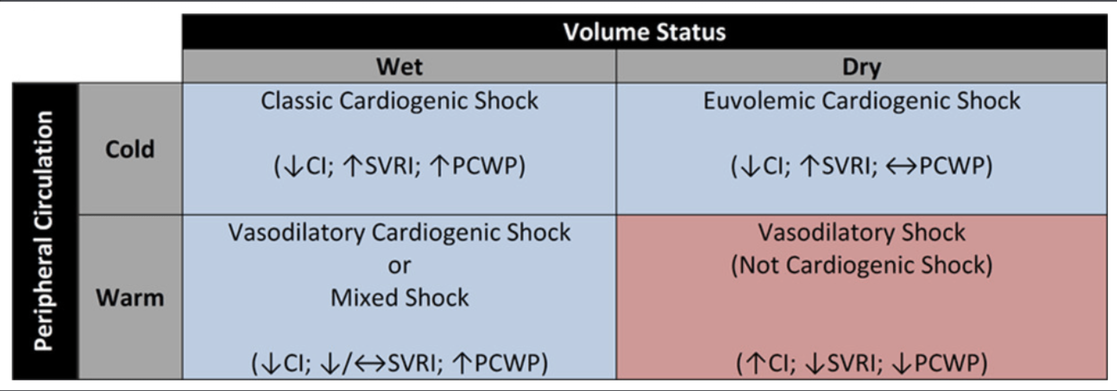

Slide 9
Admitted under ICU as a case of post arrest 2/2 anaphylactic shock

Slide 10
Afebrile
BP 80/40
HR 110

Slide 11
Cardiac POCUS
EF<25%
Significant RWMAs
No significant valvular abnormalities
Acute change

Slide 12
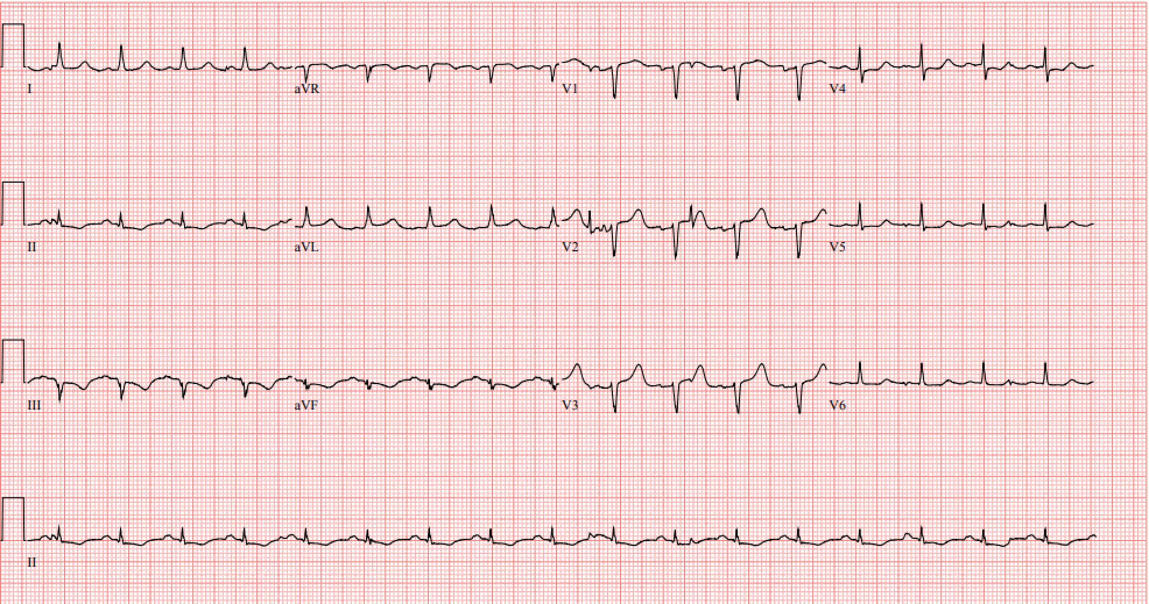

Slide 13
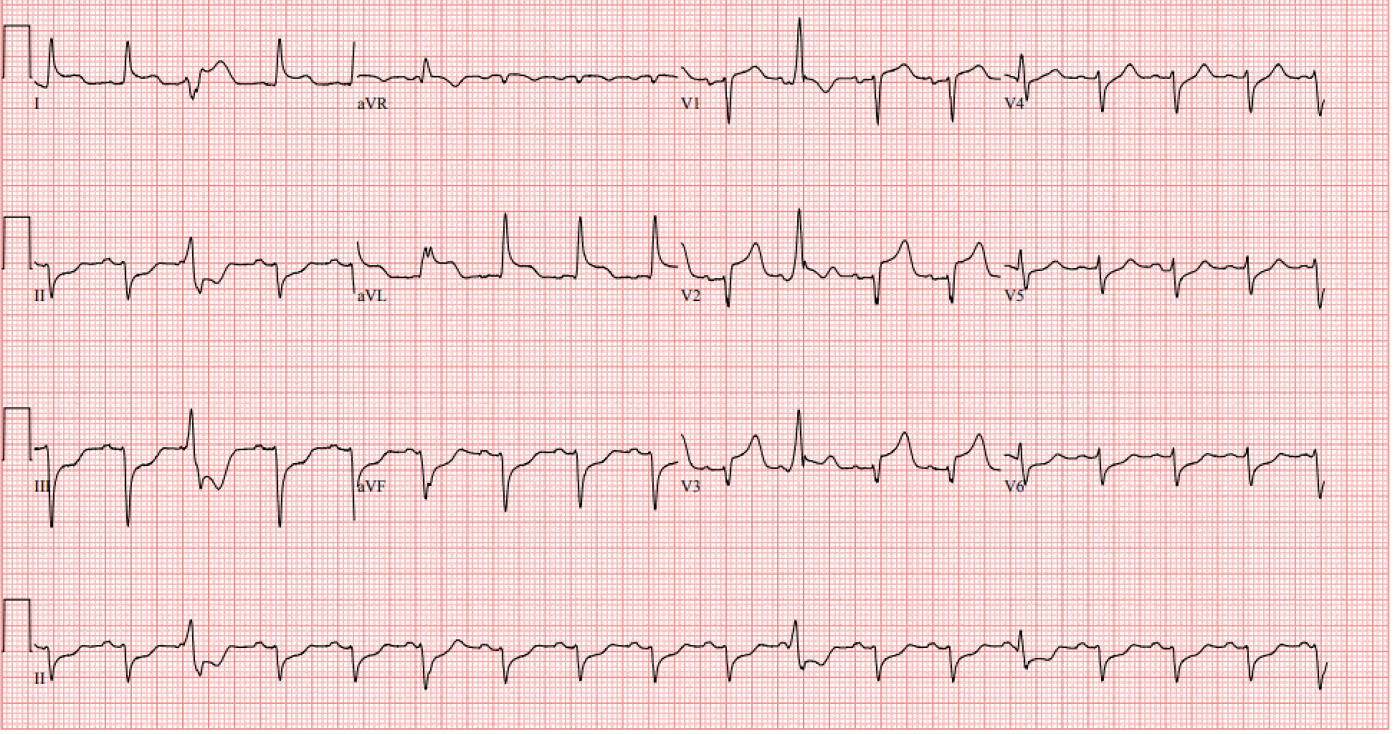

Slide 14
Ddx?

Slide 15
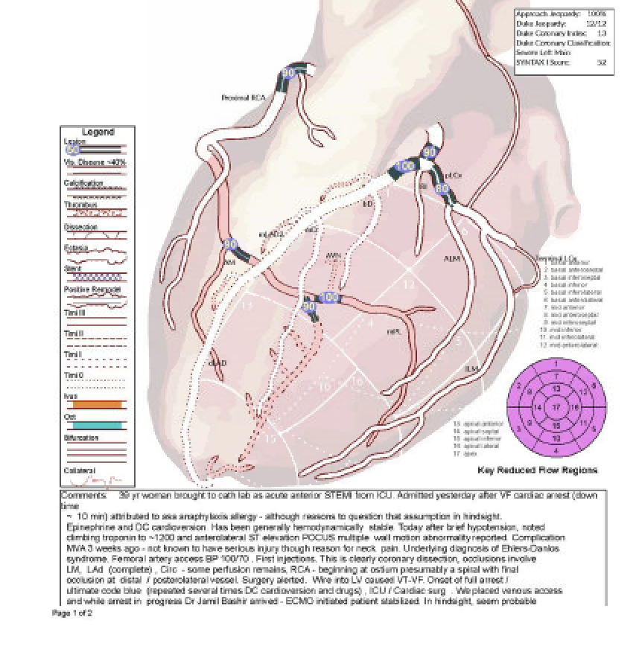

Slide 16
39 year old F with known EDS, asthma, NSAID allergy presents after a witnessed arrest in the context of ASA use to alleviate neckpain, confirmed vfib arrest shock x3, admitted as anaphylactic shock, developed hypotension and anterolateral STEMI, cath showed quadruple SCAD

Slide 17
SCAD
Non atherosclerotic, non traumatic cause of ACS
Well recognized clinical entity as part of MINOCA
”Typical” SCAD patient is a middle aged woman with few traditional RF
Observed from late teens to the ninth decade of life
Sex hormone fluctuations (pregnancy!), underlying arteriolopathies, genetics, environmental, physical emotional triggers are well described in the literature

Slide 18
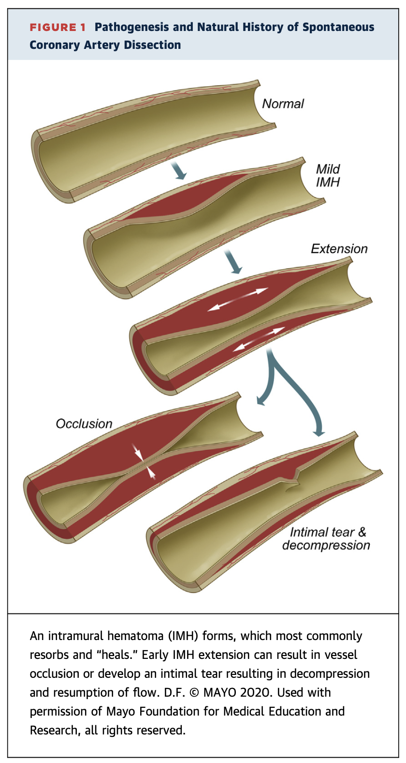

Slide 19
Presentation
Similar to atherosclerotic ACS, diff patient phenotype
CP, elevated trop +/-STEs→STEMI, NSTEMI
Ventricular arrhytmias
CS
Sudden cardiac death
MUST HAVE HIGH INDEX OF SUSPICION

Slide 20
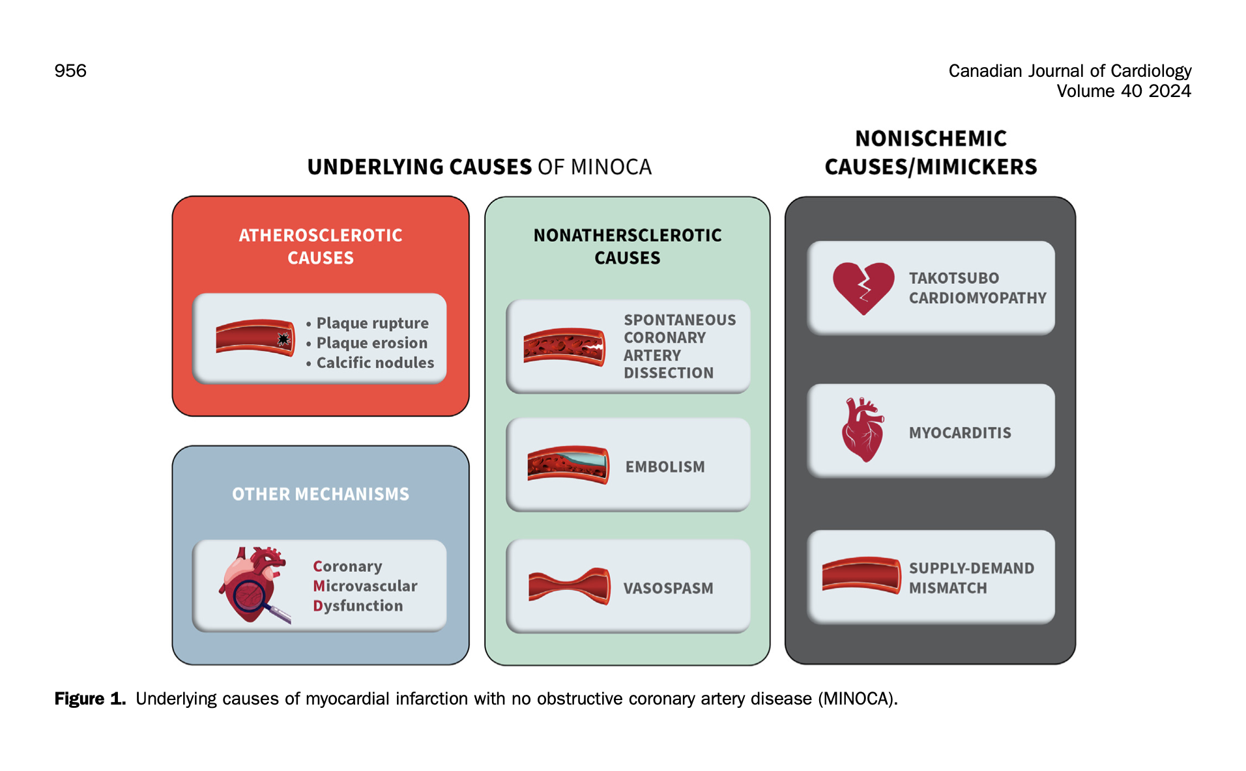

Slide 21
Treatment
Majority of conservatively managed SCAD recover normal coronary architecture, often within 30 days, most interventionalists adhere to an "as conservative as possible” approach to revascularization
CABG when PCI fails or is too high risk
PCI with stents-APT as per atherosclerotic patients
Pharm management

Slide 22
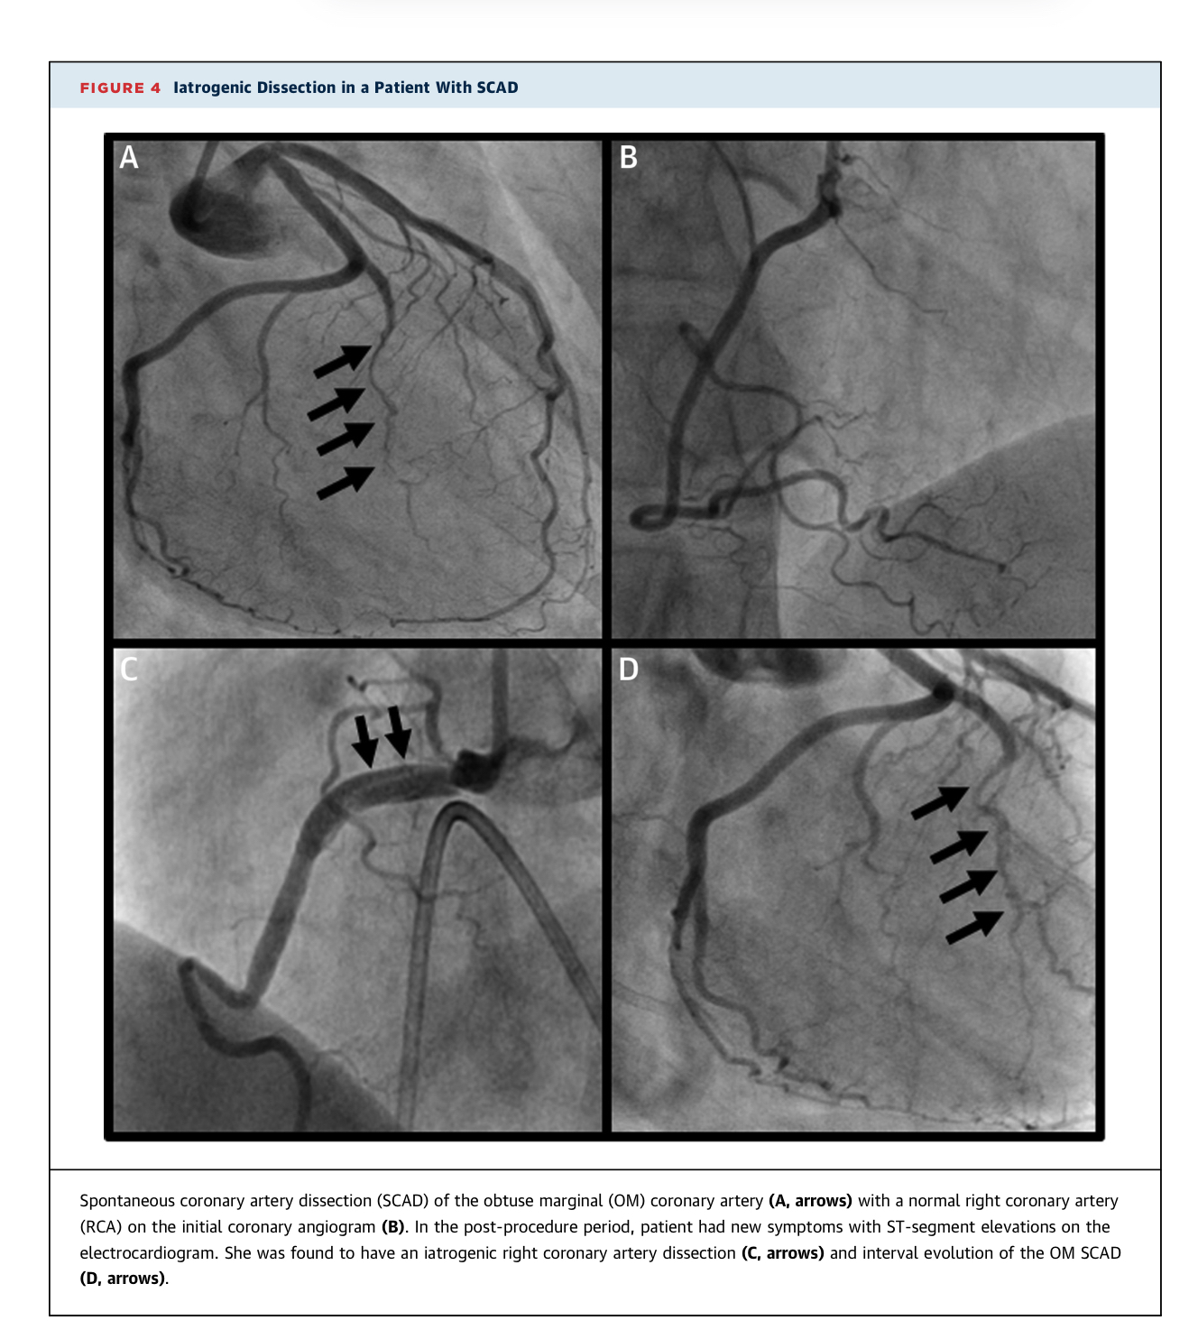

Slide 23
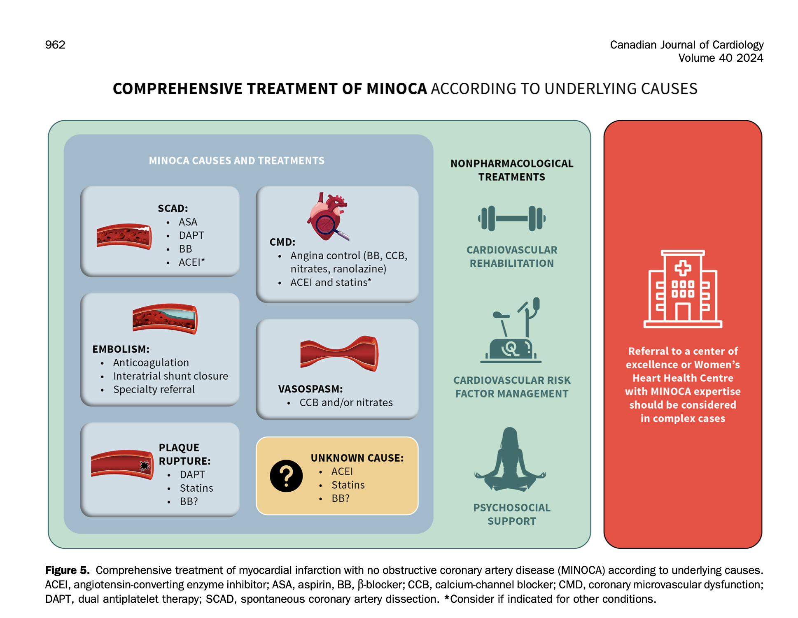

Slide 24
Objectives:
MSIs: Different shock types
Juniors: Approach to a patient in shock
Seniors: DDx STEMI on ECG

