Slide 1

Noon Report
Flesh and Blood
Adam Pietrobon
VGH Lead Medical Resident
Notes:
Song is a clue
Only get what you ask
Participate :)

Slide 2
Transient loss of consciousness
Transient loss of consciousness (TLOC) != syncope
Syncope is TLOC due to decreased cerebral perfusion. It is characterized by rapid resolution (within seconds) because horizontal position allows cerebral flow.
Presyncope are the prodromal symptoms of syncope and should be evaluated similarly to syncope, as they confer a similar prognosis.

Slide 3
Transient loss of consciousness
Not syncope
Syncope
Seizures PNES TBI Narcolepsy
Orthostatic
Reflex
Vasovagal
Situational
Carotid sinus hypersens
Cerebrovascular
Vertebrobasilar insufficiency
Subclavian steal syndrome
Cardiac
Baroreflex intact (↑ HR ≥ 30)
Deconditioning
Hypovolemia
Cardiac – structural
Either
Medications
Baroreflex dysfunction (↑ HR < 30)
Polyneuropathy
e.g. DM, B12 def, alcohol
Neurodegenerative
e.g. Parkinson’s Plus
Structural
Valvular stenosis > regurg
Severe cardiomyopathy
Obstructive
Cardiac – HOCM, tamponade
Non-cardiac – severe PE, dissection
Electrical
SA node disease
e.g. sick sinus, tachybrady
Infra-AV conduction dz
e.g. AV 2o type II, AV 3o
Tachyarrhythmias

Slide 4
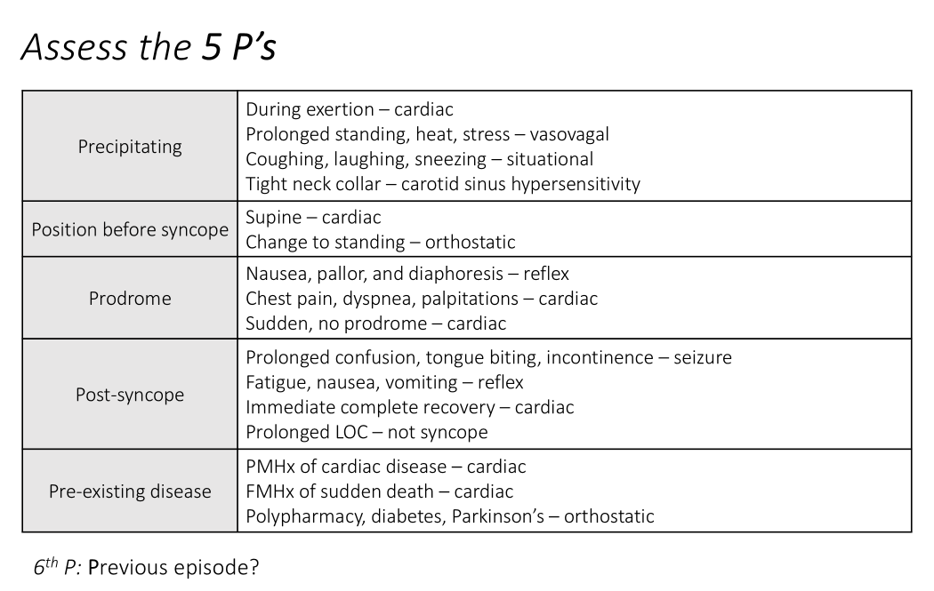
Goals of a syncope assessment
Is this true syncope?
Is the history suggestive of specific type of syncope?
Are there features that raise concern for cardiac syncope?

Slide 5
High yield clinical pearls on syncope
Spell duration and post-event recovery primarily distinguishes syncope vs other TLOC
Twitching != seizure, and can be seen in syncope
Features concerning for cardiac cause include: sudden with no clear trigger, supine, exertional, FMHx or Hx of cardiac disease
History is critical for determining cause of syncope, and not all patients require further work-up
Orthostatic hypotension is not a diagnosis, it is a sign – you need to figure out the cause

Slide 6
Degenerative
Bradyarrhythmia
Not degenerative
Acute
Chronic
Common
Drugs
Ischemia
Electrolytes
“DIE”
Uncommon
Hypoxemia
Hypothermia
Hypoglycemia
Raised ICP
Endo (TSH, AI)
Infectious
IE
Syphilis
Lyme
Infiltrative
Amyloidosis
Heterochromatosis
Sarcoidosis
Genetic

Slide 7
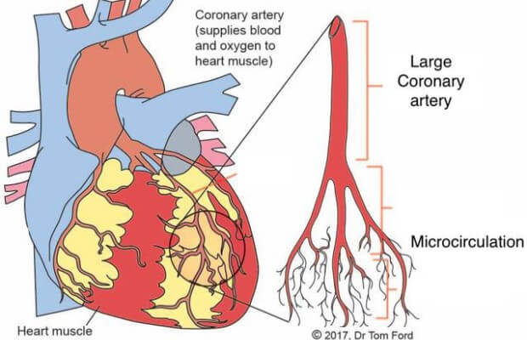
Microvascular angina
Microvascular is angina-like symptoms or ischemia in patients with ~normal epicardial coronary arteries (generally <30% obstruction of CAD)
Presumed due to microvascular dysfunction, but still carries a higher CVD risk compared to unaffected patients

Slide 8
Microvascular angina
Diagnosis
Usually just anginal symptoms + normal coronaries
Definitively confirmed with functional testing (abnormal coronary microvascular response to provocation testing)
Diagnosis is supported based on coronary perfusions studies
Management
Risk reduction: Atherosclerosis treatments (pharma and non-pharm)
Symptoms: Nitro → BB and/or CCB
Importantly, microvascular angina can result in transient ischemia but typically not infarction (i.e. no scar or necrosis)

Slide 9
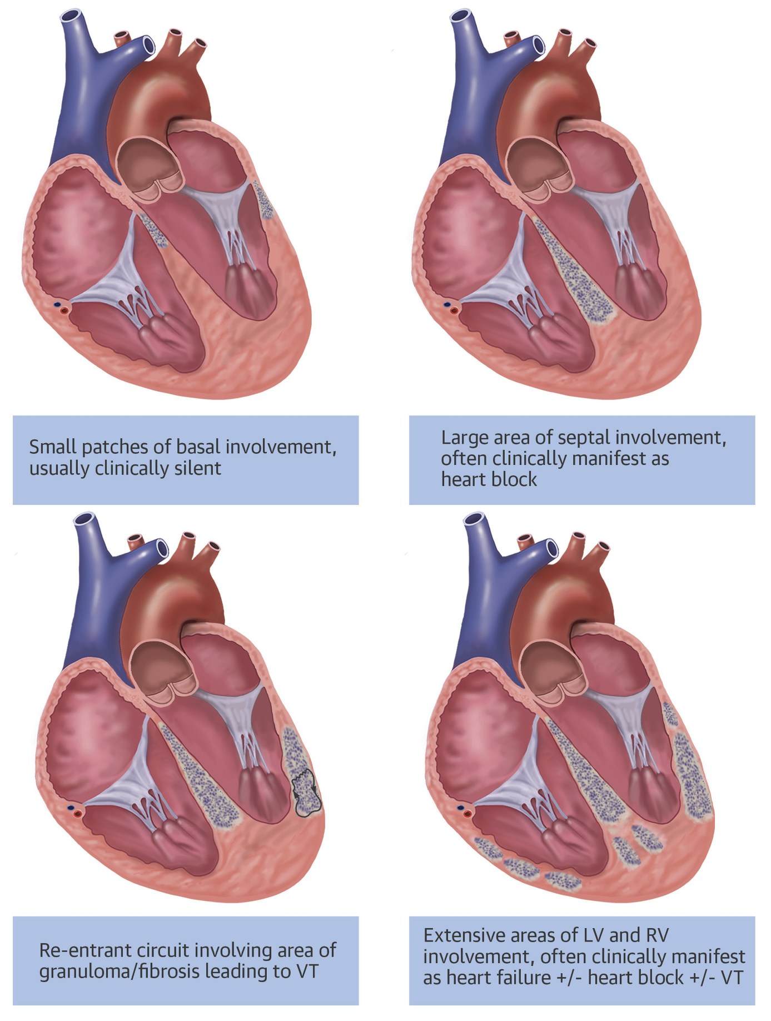
Cardiac sarcoidosis
Sarcoidosis is a heterogeneous disorder of unknown etiology; signature lesions are noncaseating granulomas
5 - 20% of sarcoidosis patients have cardiac involvement, but ¼ cardiac sarcoidosis cases are isolated cardiac involvement
Manifestations of cardiac sarcoidosis is AV block & conduction disease, VT, cardiomyopathy → HF

Slide 10
Cardiac sarcoidosis
When to consider:
Age < 60 with unexplained conduction disease
Unexplained sustained monomorphic VT
Unexplained cardiomyopathy
How to diagnosis:
Definite is via endomyocardial biopsy is “gold standard” but low yield (20% sensitivity)
Commonly clinical + imaging (cardiac MRI and/or CT-PET) → challenging diagnosis as imaging is Sn but not Sp

Slide 11
Cardiac sarcoidosis
Management uncertain, but usually:
Immunosuppression
  Glucocorticoids
  Steroid-sparing agents (e.g. methotrexate)
ICD implantation (some indications for 1o prevention)
The term sarcoidosis was termed by Dr. Cæsar Boeck, a Norwegian dermatologist, based on the appearance of sarcoid skin lesions, which looked like sarcomas (i.e. skin-like)
The term “sarcoid” in Greek means “flesh”.

Slide 12
Learning
MSI3
Finding the localizing symptom
ECG interpretation
JR/MSI4
Approach to TLOC & syncope
Approach to bradyarrhythmia etiology
SRs
Microvascular angina
Cardiac sarcoidosis

