Slide 1
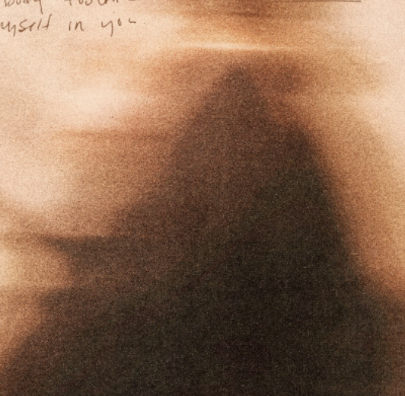
Noon Report
BEEF - Laura Roy
Adam Pietrobon
VGH Lead Medical Resident
Notes:
Song is a clue
Only get what you ask
Participate :)

Slide 2
A foray into clinical reasoning and metacognition
Problem representation
Diagnostic schema
Patient demographics
Base rate
Population profile
Pertinent positives
Discriminatory features
Pertinent negatives
Provisional diagnosis &
differential diagnoses
Notes:
Brief vignette on clinical reasoning

Slide 3
A foray into clinical reasoning and metacognition
Anemia
Microcytic vs Normocytic vs Macrocytic
35F, active
Base rate
Primary care
Menstruating
Discriminatory features
No other bleeding
Dx: Iron deficiency anemia DDx: Athleticism, nutritional
Notes:
Brief vignette on clinical reasoning

Slide 4
Infective endocarditis - overview
Infection of the endothelium of the heart, including cardiac valves.
When to suspect
Bacteremia with typical pathogen
Cardiac mass, query vegetation
Sequelae of IE
Risk factors
Valvular disease
Intravascular seeding
(e.g. dialysis catheter, IVDU)
Immunosuppression
Presentation
Constitutional symptoms
Valvular insufficiency (i.e. CHF)
Embolic events
  Right-sided: Lung abscess
  Left-sided: brain abscess, renal infarcts, Janeway lesions, mycotic aneurysms, etc.
Immunological phenomena
  Osler Nodes, Roth Spots, immune-complex GN

Slide 5
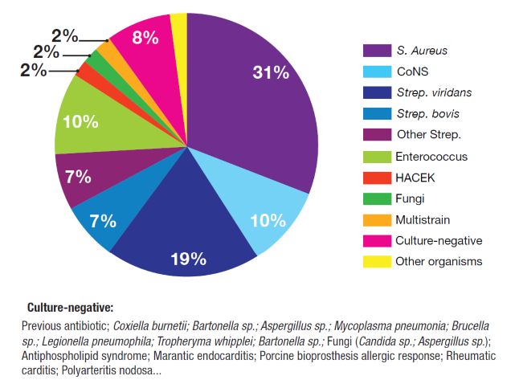
Infective endocarditis - organisms

Slide 6
Infective endocarditis - diagnosis via Duke’s Criteria
Major criteria
Positive microbiology
Positive imaging
Positive direct surgical visualization
Minor criteria
Predisposing state
Fever
Vascular phenomena
Immunologic phenomena
New valvular insufficiency
Positive micro not meeting major
Positive PET not meeting major
Definite IE
2 major OR 1 major + 3 minor OR 5 minor
Possible IE
1 major + 1 minor OR 3 minor
Major imaging criteria (any of)
New vegetation, valve/leaflet perforation or aneurysm, abscess, pseudoaneurysm, fistula, prosthetic valve dehiscence, or new significant valve regurgitation

Slide 7
Cardiac mass diagnostic schema
Tissue | Degenerative | Thrombus | Vegetation | Anatomic variant
Benign tumor Myxoma Lipoma Rhabdomyoma Malignant tumor Sarcoma Metastasis | Calcification | Stagnant blood Low EF AF Hypercoagulable Malignancy Autoimmune APS | Infective endocarditis | Lots here…

Slide 8
Arterial clots FYI
When to think about an “extended” work-up for arterial clots
Clot in an uncommon patient demographic (e.g. stroke in young)
Clot in an uncommon location (e.g. renal infarction)
Multiple clots, especially if both arterial and venous

Slide 9
Clot diagnostic schema (FYI)
Arterial clots
Thrombus
Atherosclerotic plaque rupture
Non-atherosclerotic disease (e.g. vasculitis, dissection)
Embolic
Venous clot with PFO
Cardioembolic (g. AF, LV thrombus, IE, PFO)
Artery-to-artery
Unusual (e.g. fat emboli, cholesterol emboli, air emboli)
Vasospasm
Arterial and/or venous clots
Hypercoagulable states
Thrombophilia (Antiphospholipid syndrome)
Myeloproliferative disorders (ET, PV, CML) and PNH
Malignancy (hematological and solid organ)
DIC, TMAs, HIT
Auto-immune (e.g. SLE, vasculitis)
Venous clot with PFO
Venous clots
Inherited thrombophilia
Genetic testing (Factor V Leiden, Prothrombin mutation)
Activity testing i.e. deficient (Protein C, Protein S, Antithrombin)
Inflammatory states
E.g. Severe sepsis, COVID-19

Slide 10
Culture negative infective endocarditis
Typical organism, but blood cultures drawn after antibiotics
Organisms that cannot be readily isolated in conventional culture
  Fastidious organisms
    Fungi
    Mycobacterium
    Bacteria: Brucella spp, Mycoplasma spp, Legionella spp)
Note: “HACEK” organism are no longer considered fastidious (should be isolated after 5 days of conventional culture)
  Intracellular organisms that ~cannot be cultured
    Coxiella burnetii, Bartonella spp, Tropheryma whipplei, Chlamydia spp
Non-bacterial thrombotic endocarditis (aka marantic endocarditis aka Libman-Sacks endocarditis aka verrucous endocarditis)
  Malignancy
  Autoimmune (SLE, RA)
  APS

Slide 11
Culture negative IE work-up & management
TEE better characterizes and confirms abscess
CSx determined not a surgical candidate, for medical management alone
Fungal culture negative, mycoplasma culture negative
Bartonella serology negative
Coxiella burnetii serology reactive at 1:512
(usually takes > 1 mo, was actually sent on first hospitalization)
Coxiella viral PCR negative

Slide 12
Coxiella burnetii infection - pathogenesis
Coxiella burnetii is an obligate intracellular Gram-negative bacteremia that leads to a zoonotic infection
The host reservoir is farm animals (sheep, goats, cattle) → shed in urine, feces, milk, and birth products → transmission to humans is commonly via inhalation of aerosolized spores
In the host cell it infects monocytes and macrophages → survives in the phagolysosome

Slide 13
Coxiella burnetii infection - clinical manifestations
Manifests as an acute disease and/or chronic disease
Acute disease in only 50% patients, usually self-limited and mild
  Non-specific febrile illness
  Atypical pneumonia
  Acute hepatitis
Chronic disease develops months-years later in <5% infections
  Endocarditis
  Vascular infection (mycotic aneurysm, graft infections)

Slide 14
Coxiella burnetii infection - diagnosis & treatment
Diagnosis
Obligate intracellular bacterium → cannot be grown in conventional culture
Diagnosis is predominantly via serology
  Acute infection demonstrates high Phase II IgG > Phase I IgG
  Chronic infection demonstrates high phage I IgG (usually very elevated, e.g. >1:800)
PCR helpful in early acute infection
Treatment
Acute: Doxycycline x14 days
Chronic: Doxy + hydroxychloroquine for prolonged course (2 -3 years)

Slide 15
Coxiella burnetii infection - history
Coxiella infection is also called Q fever
Q stands for “query” as it initially referred to an unknown febrile illness
First described in 1935 in Queensland, Australia, after Dr. Edward Derrick noticed an febrile illness outbreak amongst cattle slaughterhouse workers

Slide 16
Noon Report
BEEF - Laura Roy
Adam Pietrobon
VGH Lead Medical Resident
Notes:
Song is a clue
Only get what you ask
Participate :)

Slide 17
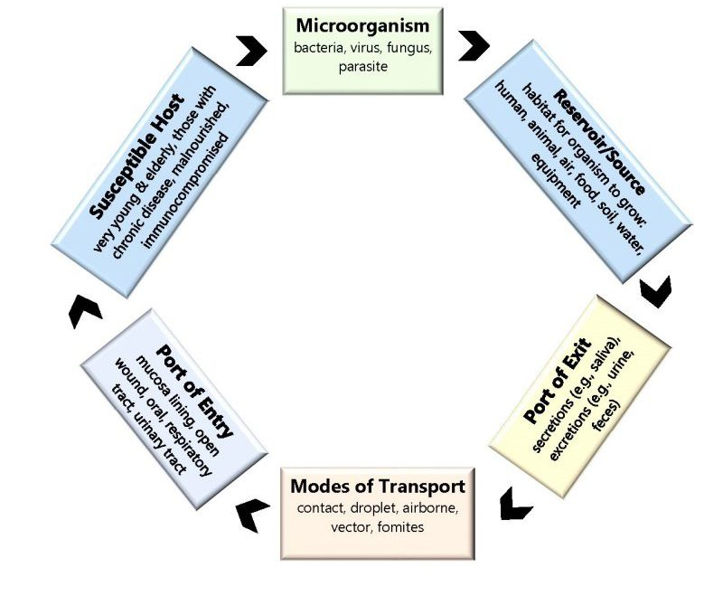
Chain of infection

Slide 18
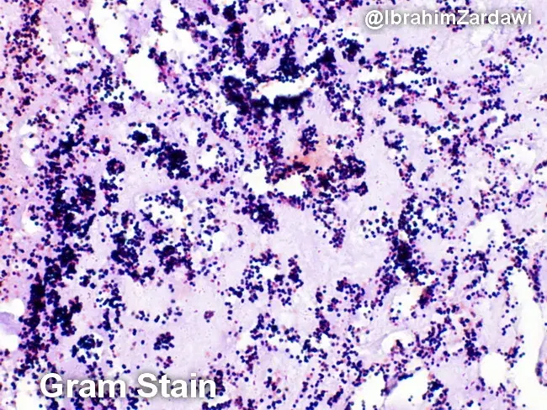
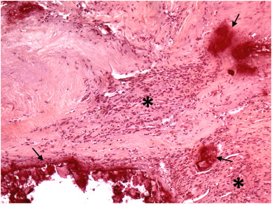
Why did it look like a thrombus initially?
 | Typical IE (e.g. S aureus) | Coxiella burnetii (Q fever) IE
Morphology | Large & friable | Small & fibrotic
Composition | Dense colonies of extracellular bacteria with inflammatory exudate (neutrophil predominant) | No extracellular organisms, granulomatous inflammation from infected macrophages
Embolization | Higher | Lower
Imaging | Heterogeneous texture, destructive features (e.g. valve perforation) | Early on has homogenous fibrotic texture, valve thickening & calcification

Slide 19
Learning
MSI3
Comprehensive past medical history
Infective endocarditis
JR/MSI4
Clinical reasoning and metacognition
Culture negative IE
SRs
Coxiella burnetii infection
Connecting pathophysiology to radiographic findings

