Slide 1
Biliary Diseases
By: Solomon Sasson PGY3 IM

Slide 2
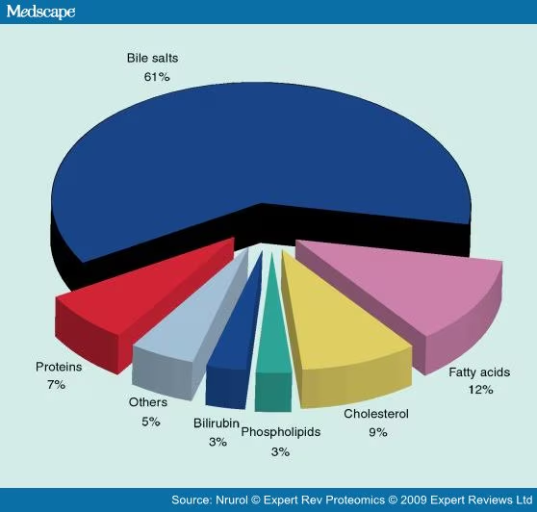
Bile salts are primarily cholesterol

Slide 3
Types of Stones
Cholesterol Stones: Most common
Black Pigment Stones: Composed of primarily calcium salts of bilirubinate (unconjugated bilirubin combined with calcium). Occurs in hemolysis.
Brown Pigment Stones: Associated with bacterial or parasitic infections of the bile ducts. They can also develop in the ducts following a cholecystectomy.

Slide 4
Risk Factors
Increasing age
Female: 2-3x more likely <50 years old
Pregnancy:
  Estrogen increases cholesterol composition
  Progesterone delays gallbladder emptying
Diabetes
Obesity
Rapid weight loss
Ceftriaxone: 40% excretion via bile
Oral contraceptives and Hormonal therapy

Slide 5
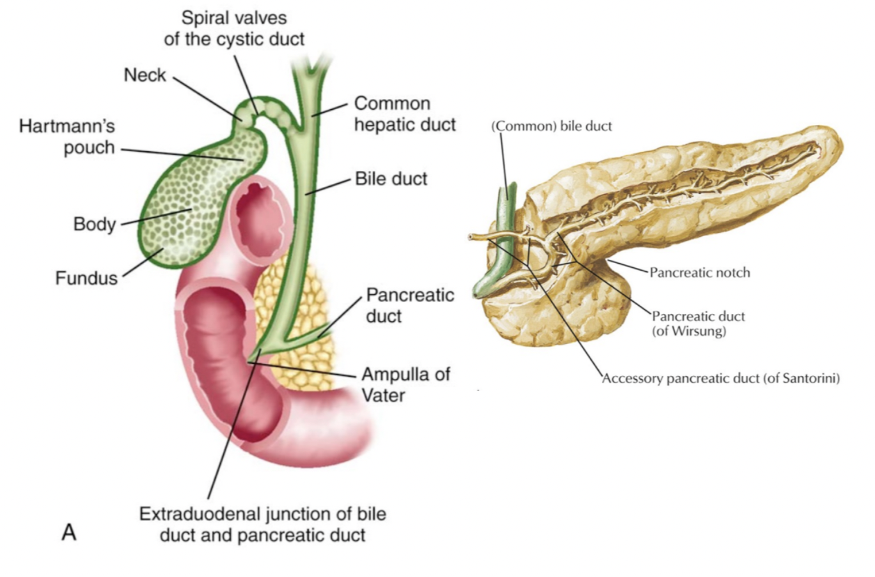

Slide 6
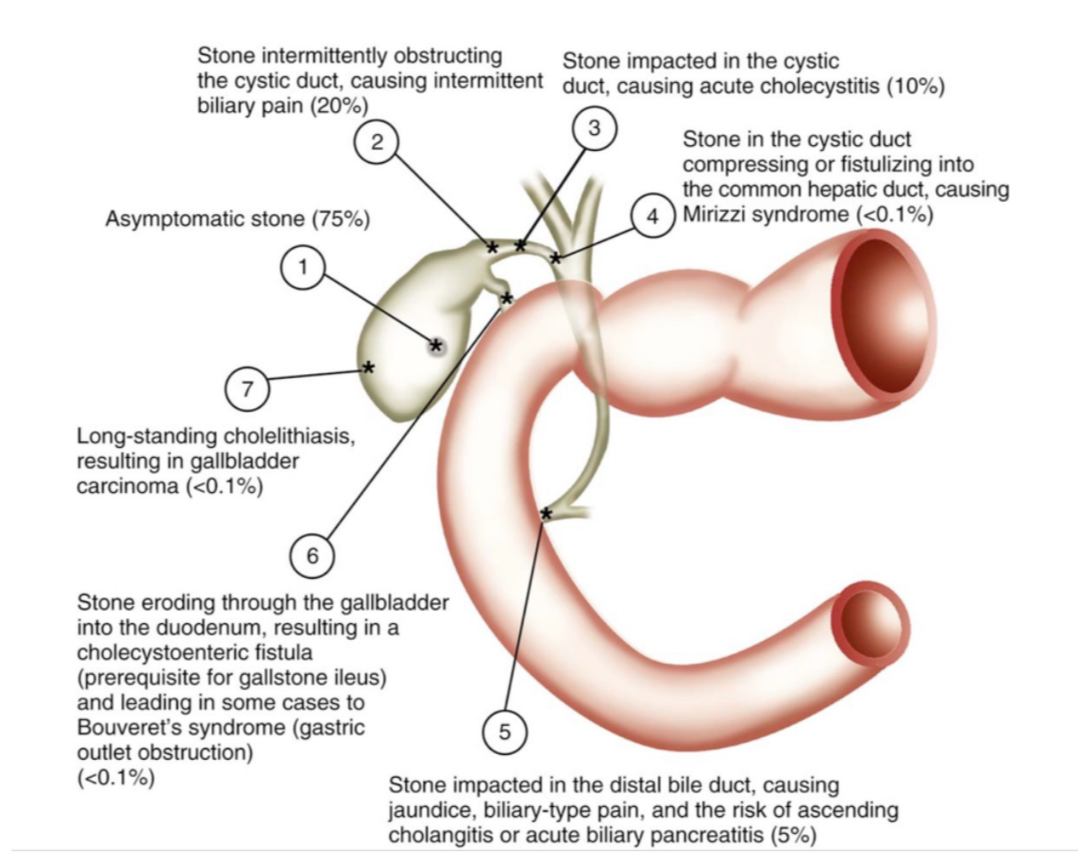
Background
Anatomy drives pathophysiology
Cholelithiasis (1)
Biliary Colic (2)
Cholecystitis (3)
Mirizzi Syndrome (4)
Choledocholithiasis (5)
  Gallstone pancreatitis
  Cholangitis

Slide 7
Cholelithiasis
Pathophysiology: Hepatic hypersecretion of biliary cholesterol promotes cholesterol gallstones (80%)
Prevalence: In women: 5% - 20% ages 20- 50 and >25% in ages >50.
Presentation:
Asymptomatic (incidental) - 1-2% per year will develop biliary colic
Symptomatic (Biliary colic): RUQ pain radiating to the back (<6 hours), +/- N/V. Normal bilirubin/liver enzymes. If they had one episode, there is a 50% chance of recurrent episodes.
Diagnosis:
U/S: Sensitivity 84%, Specificity 99% . Smaller stones may be missed. Sensitivity falls to 50% if <3mm.
CT: Sensitivity 75-80%. Specificity 90-95%.
Management: If asymptomatic - watch. If symptomatic - offer cholecystectomy.

Slide 8
Calculous Cholecystitis
Pathophysiology: Impacted stone in cystic duct → Acute inflammation of the gallbladder, secondary bacterial infection in up to 50%
Prevalence: 10% of patients with biliary colic will develop cholecystitis
Presentation:
Constant RUQ pain. N/V. Low grade fever. Inspiratory arrest.
Mild WBC/Bili/LE elevation
Diagnosis:
U/S: Sensitivity 90%. Specificity 80%
CT: Sensitivity 90%. Specificity 60%
HIDA: Sensitivity 95%. Specificity 93%
Management: Cholecystectomy. Percutaneous cholecystostomy. EUS-guided GB drainage

Slide 9
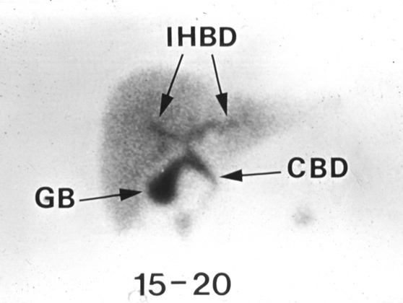
HIDA Scan
Cholescintigraphy using 99mTc-hepatic iminodiacetic acid
GB not visualized at 30 minutes → highly suggestive of cholecystitis

Slide 10
Choledocholithiasis
Pathophysiology: Stone in the bile duct causing biliary obstruction
Presentation:
Similar to biliary colic although more prolonged (lasts longer than 6 hours). Typically will see elevated liver enzymes and bilirubin.
If fluctuating LEs → Ball valve effect
If resolving LEs → Passed stone
Diagnosis:
U/S: Sensitivity 70% (Gas obscures the distal CBD)
EUS/MRCP: Sensitivity 95%
Management: ERCP + Cholecystectomy, PTBD, EUS biliary drainage
Complications: Gallstone pancreatitis, Cholangitis

Slide 11
Bile Duct Size
Normal: <6-7mm
+1 mm per decade above 60 years of age
>10mm post-cholecystectomy

Slide 12
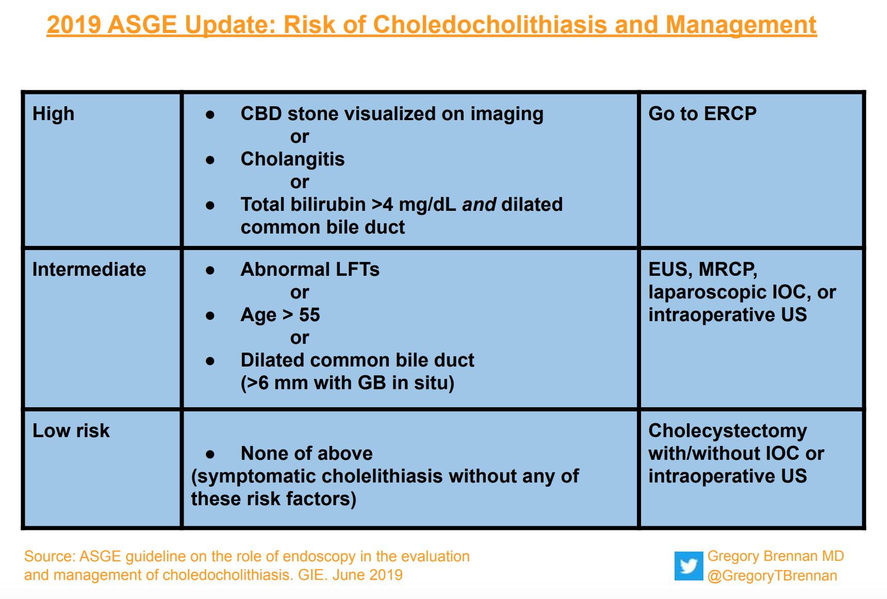
Management of Choledocholithiasis
ASGE guideline on the role of endoscopy in the evaluation and management of choledocholithiasis: 2019
In order to minimize the risk of diagnostic ERCP, we suggest the following HIGH-RISK criteria to directly prompt ERCP for suspected choledocholithiasis:

Slide 13
Acalculous Cholecystitis
Pathophysiology:
Dysfunction or hypokinesis of gallbladder emptying
Critically ill (ICU), fasting, TPN,
Increased viscosity and biliary stasis
Prevalence: 5% of patients with cholecystitis
Management: Similar to calculous cholecystitis but often too sick for surgery. Therefore, PC, EUS approaches

Slide 14
Case
40 year old man from Powell River is referred to your outpatient internal medicine clinic for 6 months of fatigue and weight loss. He denies pruritus and doesn’t look jaundiced to you. On ROS he reports intermittent hematochezia from known hemorrhoids. He saw his family physician a few weeks ago who ordered some lab work which returned yesterday showing an ALP of 200, GGT of 120. The rest of his liver enzymes (including bili) are normal. You check his CareConnect and note he had a positive ANA a few years ago
A. U/S
B. CT A/P
C. ERCP
D. MRCP
E. More Bloodwork

Slide 15
You’re not quite sure what’s going on so you repeat his liver enzymes and send a full
secondary work-up and arrange a CT A/P which shows mild bile duct wall thickening. Your
secondary work-up shows a positive ANA (1:80) but is otherwise normal. Unfortunately his
bilirubin has now risen to 40 and he is reporting some pruritus which he finds quite
bothersome. You arrange an MRCP which shows beading of the CBD and suspected
biliary stricture.

Slide 16
Primary Sclerosing Cholangitis (PSC)
Pathophysiology:
Immune-mediated chronic liver disease characterized by inflammation, fibrosis and destruction of intrahepatic and/or extrahepatic biliary ducts leading to cholestasis, bile duct strictures, and hepatic fibrosis
May progress to cirrhosis, portal hypertension, and hepatic decompensation
Can have overlap of PSC and other immune-mediated liver diseases( ex. AIH)
Prevalence:
M>>>F
50% - 70% of patients with PSC will have IBD (UC)
Presentation:
RUQ pain, pruritus, fatigue, jaundice, fever, and weight loss in 47-56% of patients.
Can be quite variable: No symptoms - incidental finding of abnormal liver biochemistry.
Cholangitis. Jaundice. Variceal bleeding and/or ascites from portal hypertension. Cholangiocarcinoma. Liver Failure
Diagnosis: Mainly radiographic. Liver biopsy is rarely required.

Slide 17
PSC Management
Management
Ursodeoxycholic acid: not recommended (Early studies noted improvement in liver biochemistry with low dose UDCA (10-15mg/Kg) but none in symptoms, liver histology, death, or transplantation)
Steroids: In patients with additional features of AIH or IgG4-related sclerosing cholangitis (IgG4-SC), corticosteroids may be indicated.
ERCP for management of dominant strictures
Pruritus: Cholestyramine, Rifampicin and naltrexone
Liver transplant: Refer once MELD>15
Monitoring
Unpredictable nature and progression of disease → everyone needs lifelong follow-up.
MRCP +/- CA 19-9 q1 year to screen for GB cancer and cholangiocarcinoma
Colonoscopy at diagnosis and q1-2 year if they also have IBD. If no IBD, Q3-5 years.
Variceal Screening if Cirrhosis

Slide 18
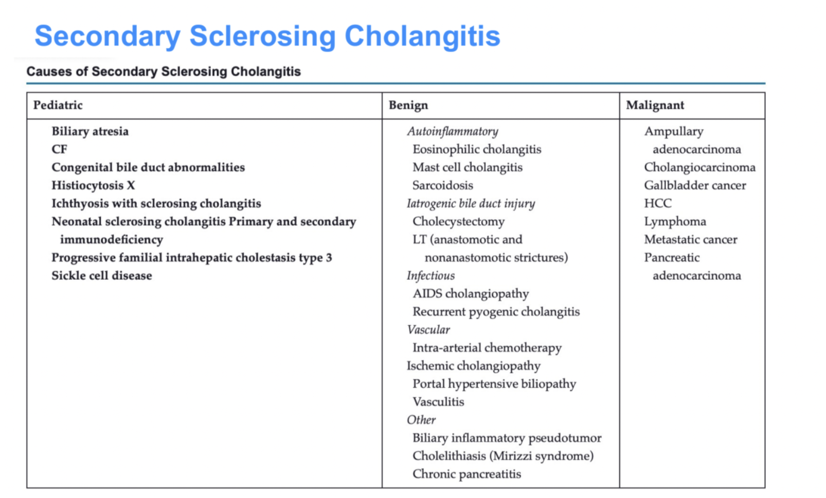

Slide 19
A 48-year-old woman presents with 8 months of progressive fatigue and pruritus. She has dry eyes and mouth. Exam shows excoriations and xanthelasma. Labs: ALP 420 U/L, GGT 310 U/L, AST/ALT mildly elevated, bilirubin normal. Viral hepatitis panel negative. Ultrasound shows no biliary dilation. MRCP is normal. Anti-mitochondrial antibody is positive at 1:320; IgM is elevated. What is the most likely diagnosis?

Slide 20
Primary Biliary Cholangitis
Pathophysiology: Autoimmune disorder leading to the gradual destruction of intrahepatic bile ducts, resulting in periportal inflammation and cholestatic biliary tree
Prevalence: Very rare: 100 cases per million. 95% Women, Majority Age 30-50
Presentation
Jaundice, pruritus, fatigue, isolated ALP
Associated with Sjogren’s, celiac disease, and autoimmune thyroid disease
Diagnosis
ALP 1.5x ULN, AMA >1:40 (95% sensitive, 98% specific), Liver Biopsy
Management: Ursodeoxycholic acid (Delays histologic progression and improves symptoms). Should be initiated as soon as the diagnosis is made, even if asymptomatic.

Slide 21
Primary Biliary Cholangitis
Management: PPAR agonists (Peroxisome proliferator-activated receptor)
Seladelpar, Elafibranor
Use after inadequate response to UDCA or as monotherapy if UDCA-intolerant

