Slide 1


Approach To Plasma Cell Dyscrasias
Dr. Christopher Venner
BC Cancer – Vancouver Centre

Slide 2
DISCLOSURES
Honoraria: Johnson and Johnson, Pfizer, Forus, Amgen, Sanofi,
Advisor: Paradox Immunotherapeutics

Slide 3
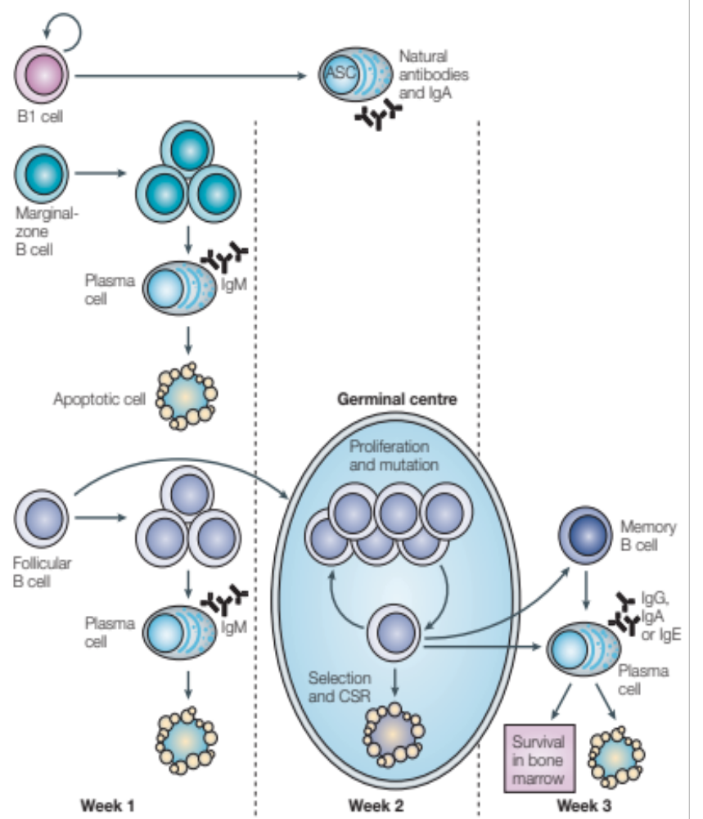
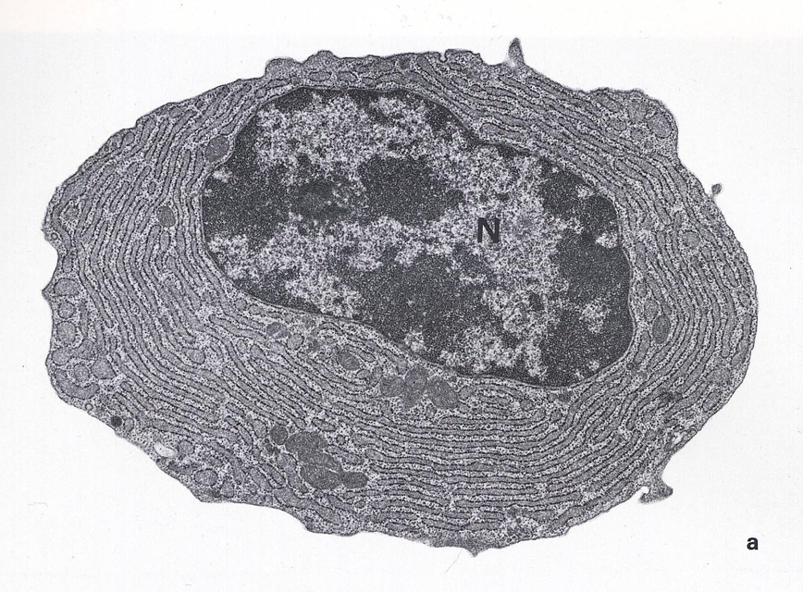
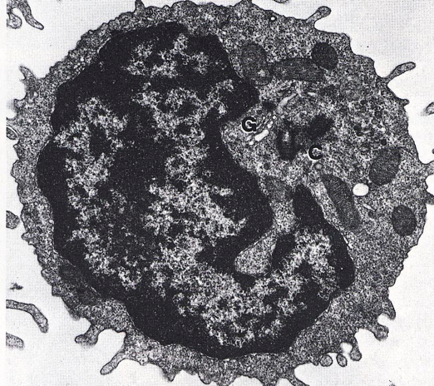
What is a plasma cell?
Fully developed mature B-cell
Refined antibody producing capabilities
Class switch has occurred and somatic hypermutation at the VDJ for Ag recognition sites
Antibody producing factories
High protein “stress”
Generally, requires “support” of marrow microenvironement
B-lymphocyte
Plasma Cell

Slide 4
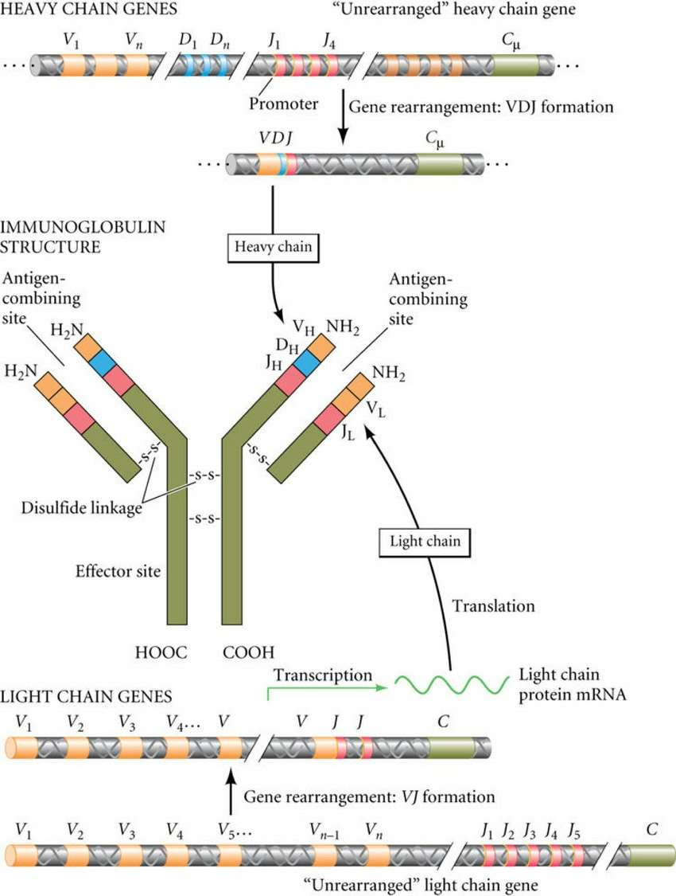
Early on in B-cell development it picks what flavour of light chain it will make
Class switch beyond IgM happens later
At time plasma cell clone development these switches have occurred and the clonal/malignant cell retains ability to produce only that HEAVY and LIGHT chain resulting in MONOCLONAL protein
Rarely can lose ability to make the heavy chain and thus get light chain producing only disease (~20-30% of MM and MGUS)
Later stages the entire Ab producing machinery can become faulty and can develop “non-secretory” disease

Slide 5
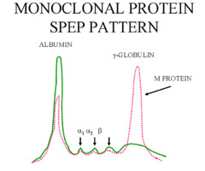
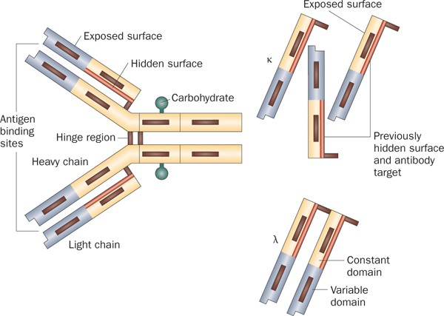
Response Assessment and Monitoring
M-protein in serum or urine
Serum FREE light chain levels

Slide 6
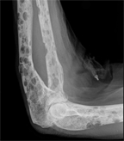
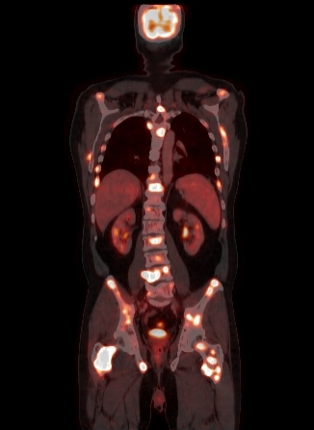
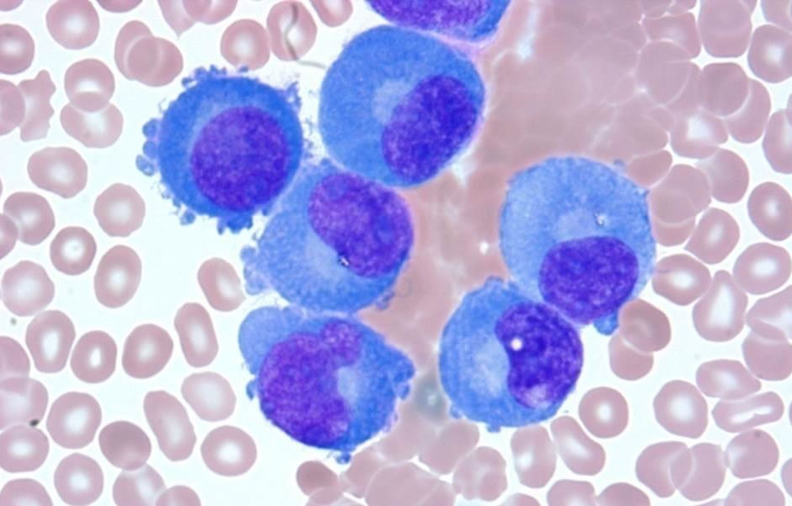
What is Myeloma?
It is cancer of the plasma cells that develop a clonal advantage over surrounding cells AND disrupt the normal marrow microenvironment
  The incidence is ~6/100,000
  ~350 new cases in BC per year
  ~2500 new cases diagnosed in Canada each year
This clonal population can result in widespread systemic problems
The disease remains incurable but… it is manageable!
Treatment is generally continuous with longterm disease control contingent upon the availability of new options as the disease recurs
http://myeloma.uams.edu/files/2014/06/what-is-multiple-myeloma.jpg

Slide 7
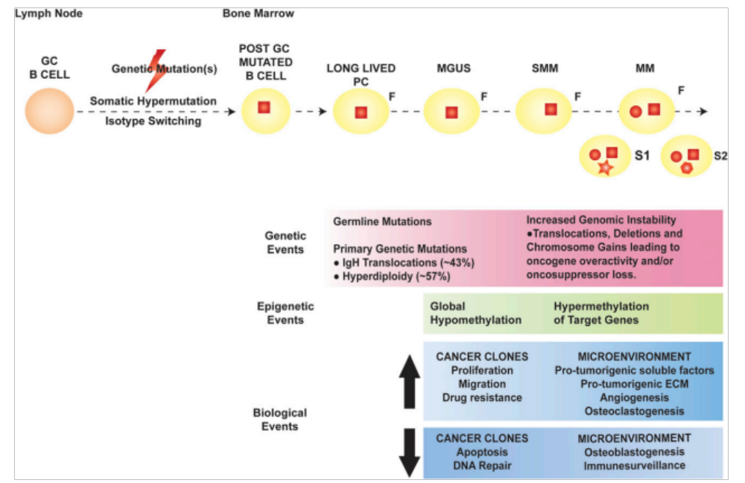
The Plasma Cell Dyscrasia Continuum
The clinical phenotype of the disease requires the development or imminent threat of end-organ damage
Bianchi and Munchi, Blood, 2015

Slide 8
Is there a problem here?
No problem at all
Maybe a small problem?
We have a real problem

Slide 9
Is there a problem here?
No problem at all
MGUS
Maybe a small problem?
Smouldering
Multiple Myeloma
We have a real problem
Multiple Myeloma

Slide 10
Is there a problem here?
No problem at all
MGUS
A small clone:
  <10% PCs
  AND
  M-protein < 30g/L
Maybe a small problem?
Smouldering
Multiple Myeloma
A slightly larger clone BUT no overt problem:
>10% PCs
AND/OR
M-protein > 30g/L
We have a real problem
Multiple Myeloma
ANY size clone AND a problem

Slide 11
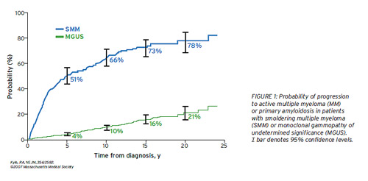

Slide 12
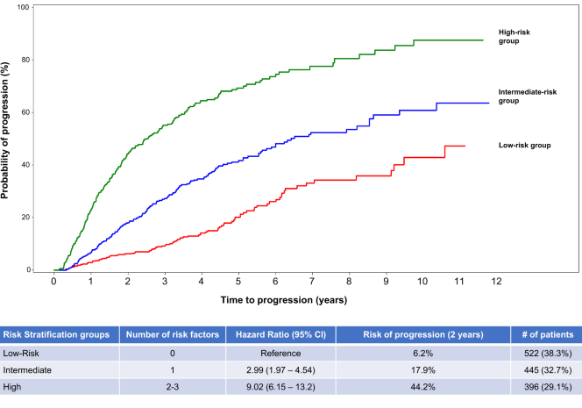
Smouldering MM
Factors:
M-protein (>20 g/L)
BMPCs infiltration (>20%)
The ratio of involved versus uninvolved sFLC (>20)

Slide 13
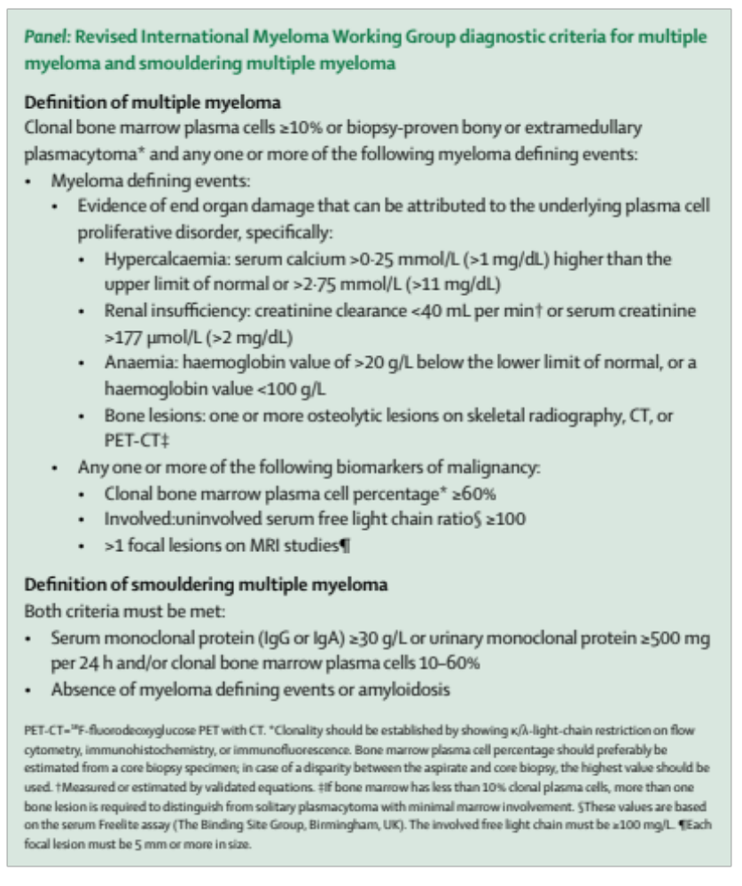
Diagnostic Criteria (IMWG - 2014)
S – Sixty % BMPC
Li – Light chain ratio > 100
M – MRI lesions (>1)
C - hyperCalcemia
R – Renal failure
A - Anemia
B – lytic Bone disease
Rajkumar et al, Lancet Oncology, 2014

Slide 14
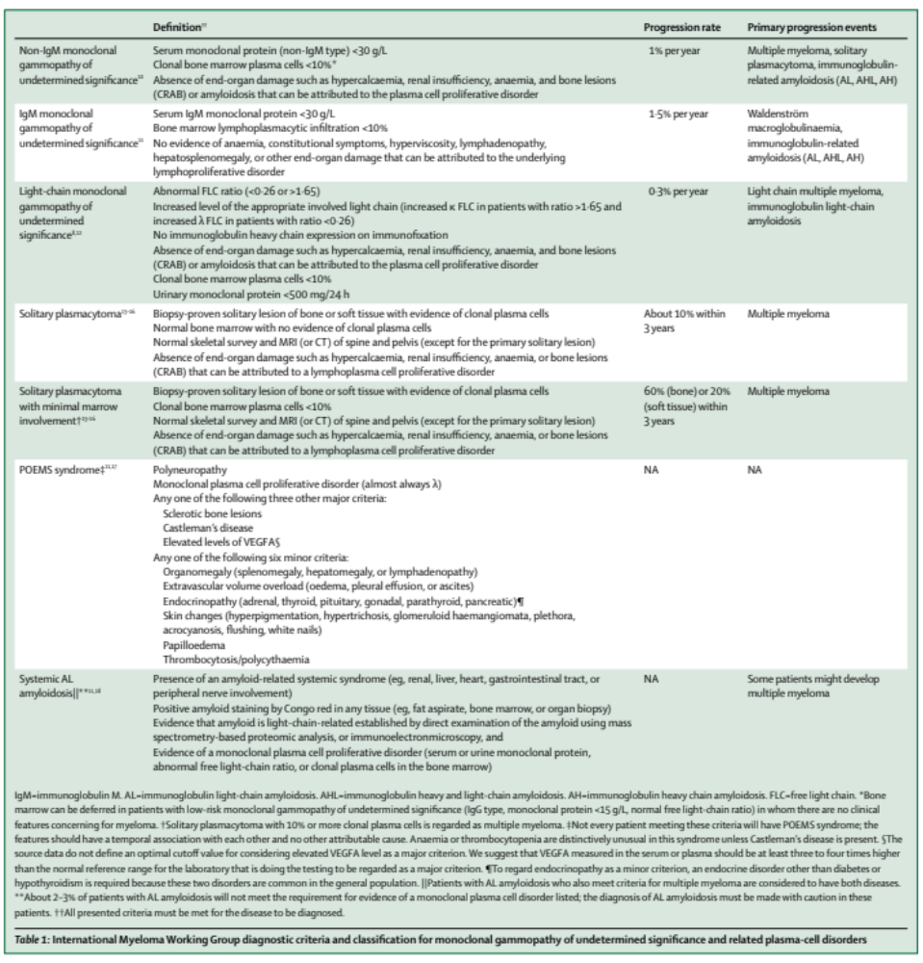
Rajkumar et al, Lancet Oncology, 2014

Slide 15
Rajkumar et al, Lancet Oncology, 2014

Slide 16
How to work these cases up
Think of these entities!!!
  SPEP, sFLC, UPEP part of any workup for:
    anemia
    AKI
  Pay attention to back/rib/”bone” pain and push for imaging
Follow up the tests you order and understand what they tell us about the pathophysiology
    UPEP with albuminuria is AL amyloid or other MGRS until proven otherwise
    Urinalysis with ++protein in “MGUS” is AL amyloid or other MGRS until proven otherwise
    Cast nephropathy needs lots of light chains
    Hypercalcemia is not as common as other features but don’t miss it
Consider these cases urgent and ensure you connect with us.
  Marrow not needed to confirm diagnosis… only staging/prognosis
  Can start treatment and simple things like steroids work
  We can get things moving quickly as chemo is “simple”
Give us a call if you are worried!!

Slide 17
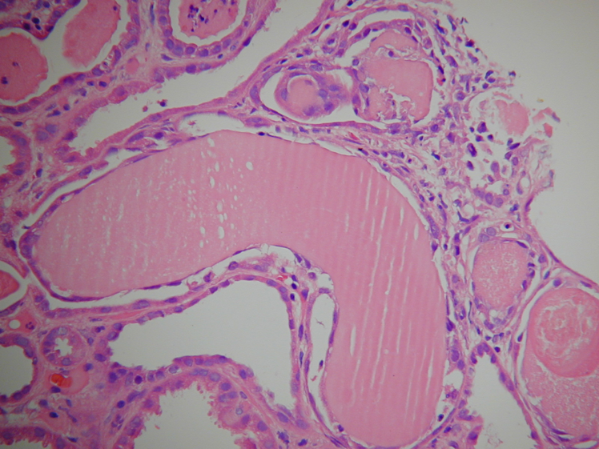
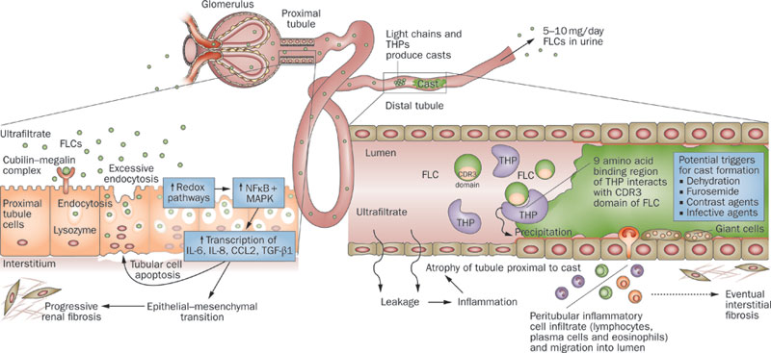
Myeloma, Light Chains and the Kidney
Management:
FLUIDS!!!!
Treat the cause

Slide 18
When to think of it?
Cast nephropathy requires enough LC to overwhelm the proximal tubules ability to deal with LC
Unlikely if iFLC < 500mg/L and generally requires it to be > 1000mg/L
Other causes of renal injury can be present related to m-protein or light chains but these are more rare and require biopsy to demonstrate

Slide 19
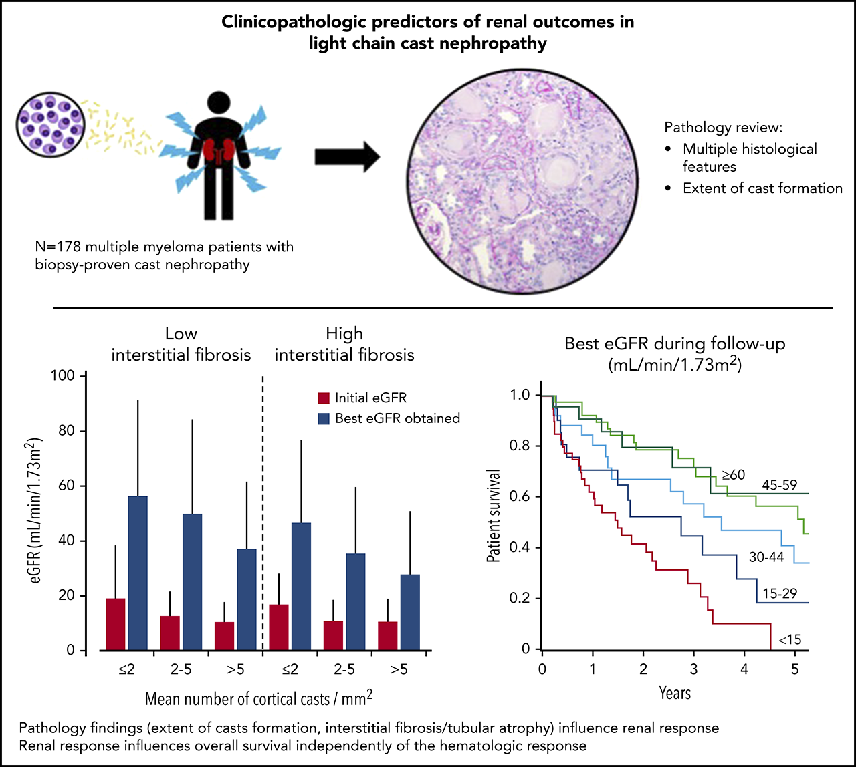

Slide 20
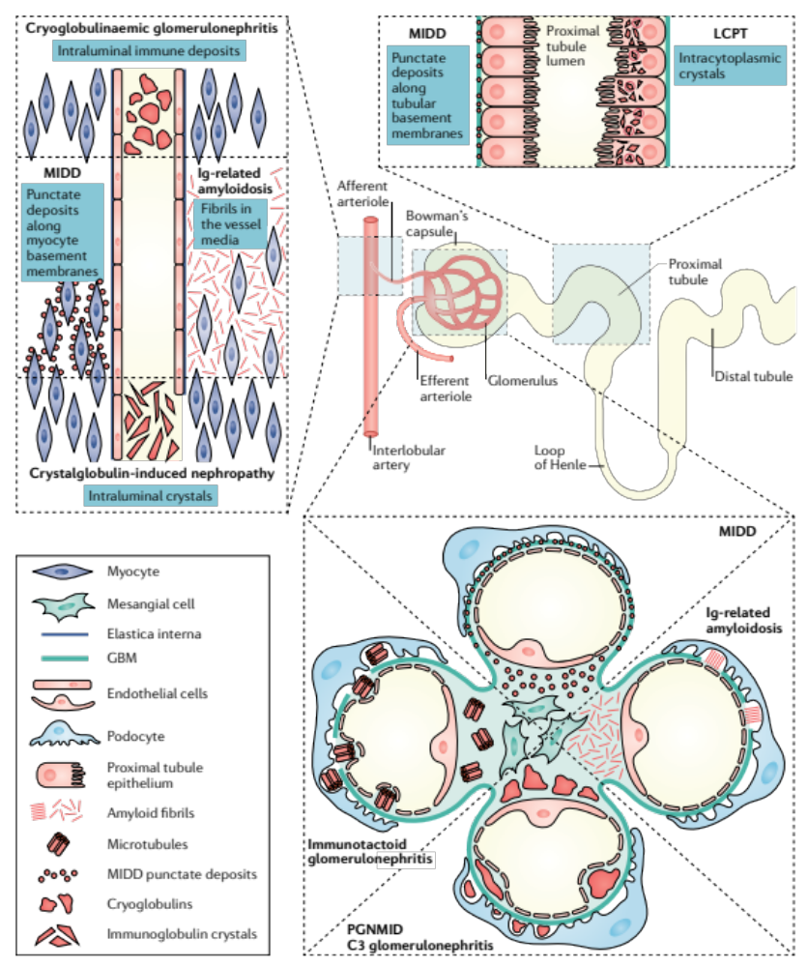
Monoclonal
Gammopathy of
Renal
Significance
Leung, N et al, Nature Reviews Neph, 2019

Slide 21
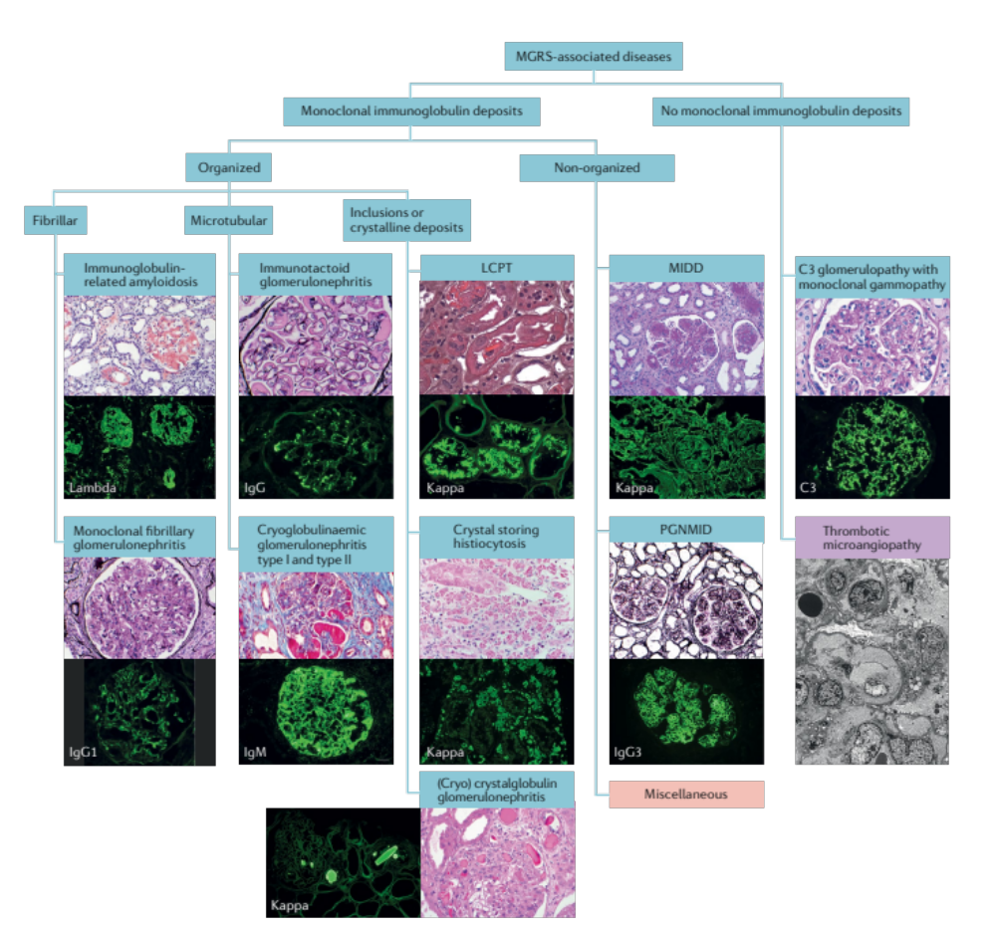
Monoclonal
Gammopathy of
Renal
Significance
Leung, N et al, Nature Reviews Neph, 2019

Slide 22
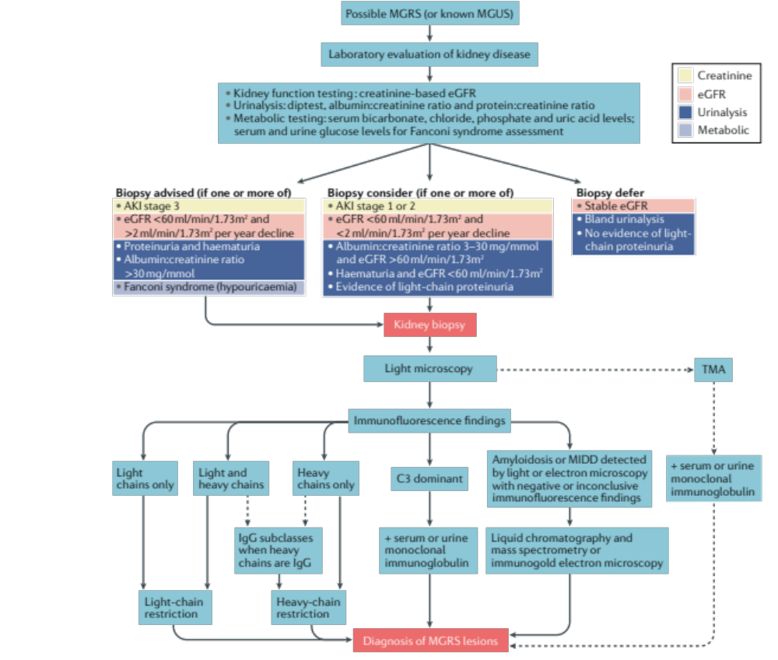
International Kidney and Myeloma Working Group (IKMG)
Monoclonal
Gammopathy of
Renal
Significance
Leung, N et al, Nature Reviews Neph, 2019

Slide 23
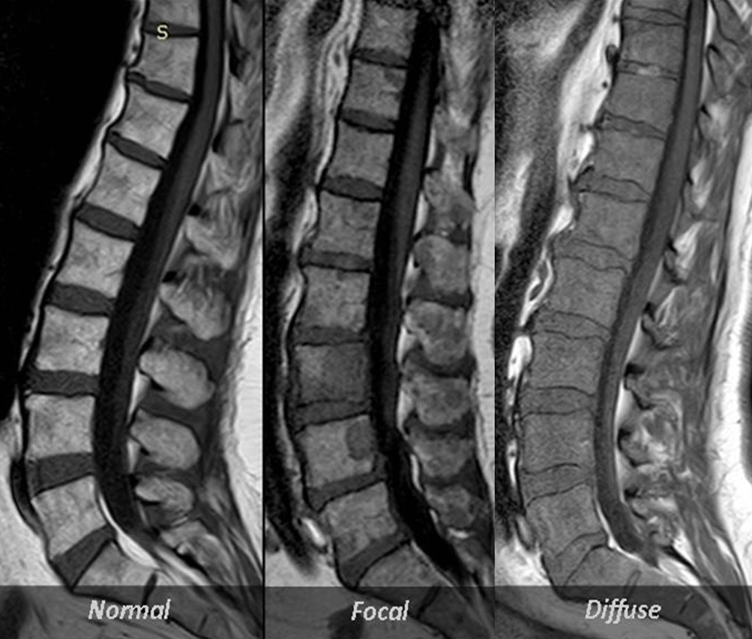
MM induced bone disease
http://www.cancernetwork.com/multiple-myeloma/asco-daratumumab-safe-multiple-myeloma
http://www.myelomapennstate.net/Contents/10a-BoneDis-PET.htm
http://posterng.netkey.at/esr/viewing/index.php?module=viewing_poster&pi=129181
CT skeletal survey is minimum (don’t order x-rays anymore)
PET ideal
MRI when needed for more localized concerns or to clarify MM vs non-MM lesions

Slide 24
MM induced fractures and plasmacytomas
Same root cause and can occur together but these are somewhat distinct from one another
Fracture:
  Like any fracture, they hurt in acute setting
  They can heal but takes 6-8 weeks minimum
  May lose “normal” anatomy and left with chronic pain
  Ongoing MM in region impairs healing
  RT less helpful as it deals with cells
  Vertebroplasty is can be very helpful but access in BC is a major challenge
Plasmacytoma:
  This is a cellular problem
  Chemo helps
  RT helps

Slide 25
MM induced fractures and plasmacytomas
Chronic pain management is tough and is long-lasting
  Opioids are needed and often long-term
  TCA helpful if neuropathic component
  Get patients MOVING and don’t worry about breaking them

Slide 26
Advances in therapy
Frontline treatment leads to many years of disease control
Novel T-cell based approaches are leading to unprecedented responses
Median OS is 10+ years for most patients

Slide 27
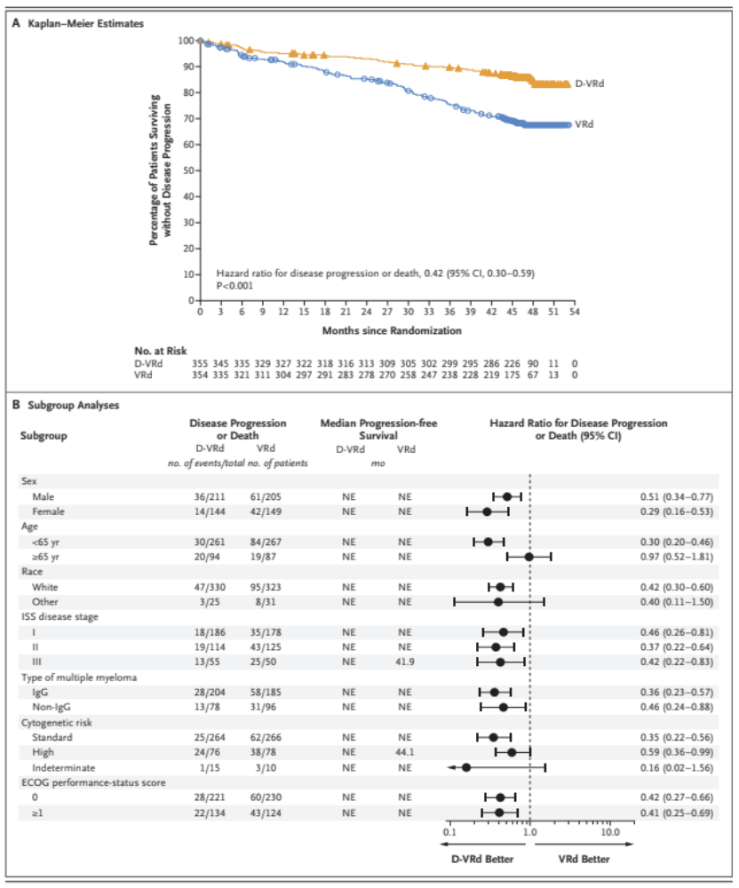
PERSEUS Trial:
Daratumumab + Lenalidomide + bortezomib + dex
Addition of dara to TEMM paradigm
D-RVD vs RVd for TEMM
Sonneveld, P et al, NEJM, 2023

Slide 28
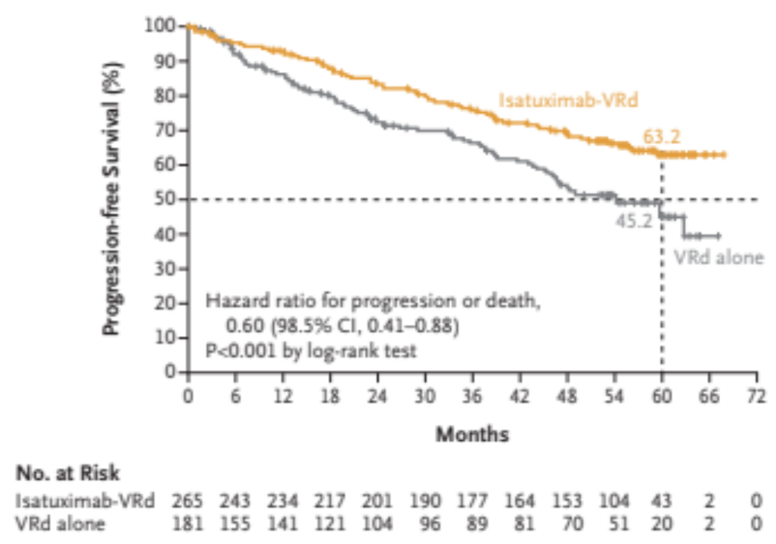
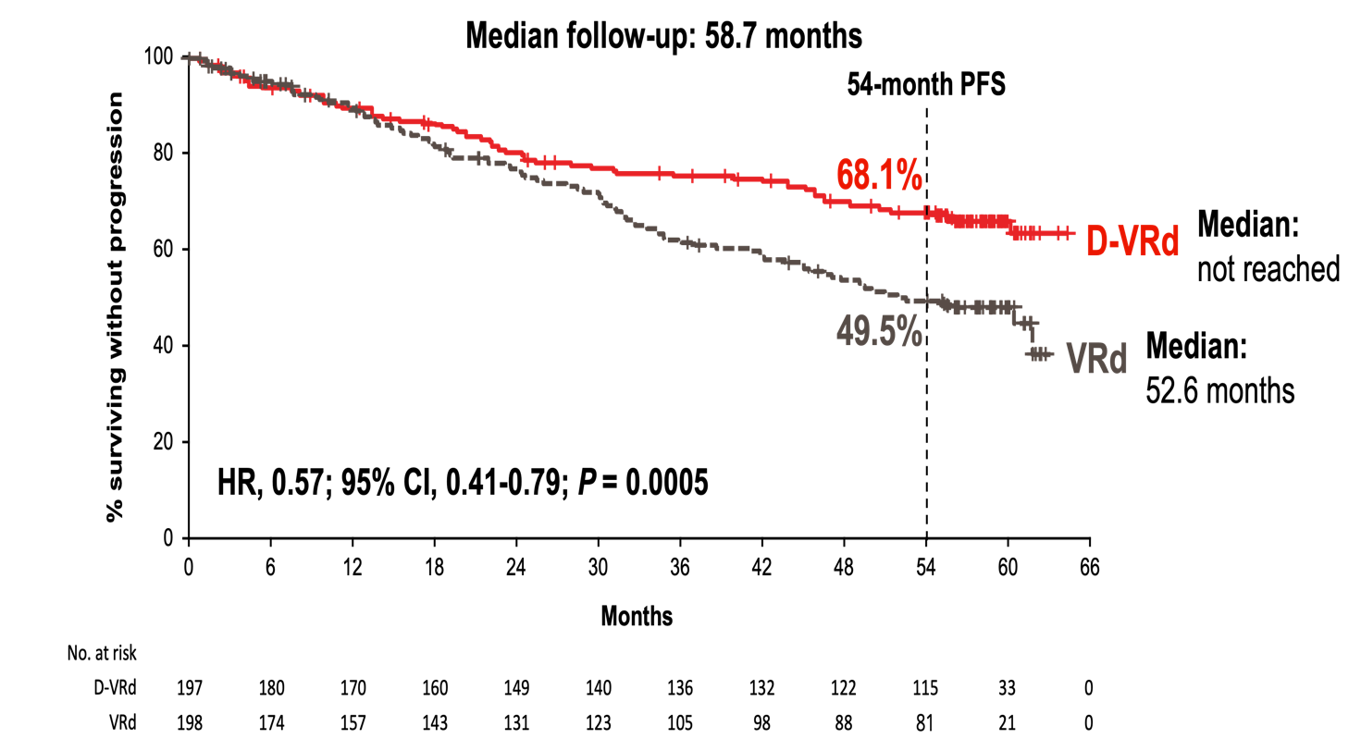
New frontline SOC - TIMM
IMROZ
CEPHEUS
Isatuximab + Lenalidomide + bortezomib + dex
Facon et al, NEJM 2024
Daratumumab + Lenalidomide + bortezomib + dex
Usmani et al, IMS 2024

Slide 29

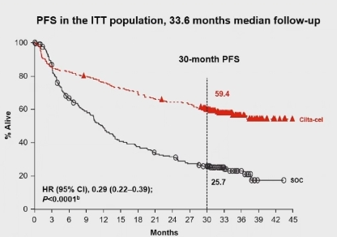
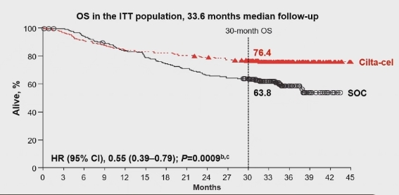
Minimal Residual Disease (MRD) Negativity in the Phase 3 Cartitude-4 Trial
Background
There is an increasing recognition of MRD as a primary clinical endpoint in MM as it is linked to improved PFS and OS.
In CARTITUDE-4, patients who were randomized to cilta-cel had:
  Significantly improved PFS vs SOC (HR [95% CI], 0.29 [0.22–0.39]; P<0.0001)
  Median PFS was not reached with cilta-cel
Cilta-cel also showed an OS benefit over SOC, with
  HR, 0.55 (95% CI, 0.39–0.79; P=0.0009
  Median OS was not reached.
Overall MRD negativity, a secondary endpoint, was also higher in patients randomized to cilta-cel vs SOC (62.0% vs 18.5%).
We report MRD-negativity outcomes, including overall and sustained MRD-negative ≥CR, at a median follow-up of 33.6 months in CARTITUDE-4.
R. Popat, et al. ASH 2024. A1032.

Slide 30
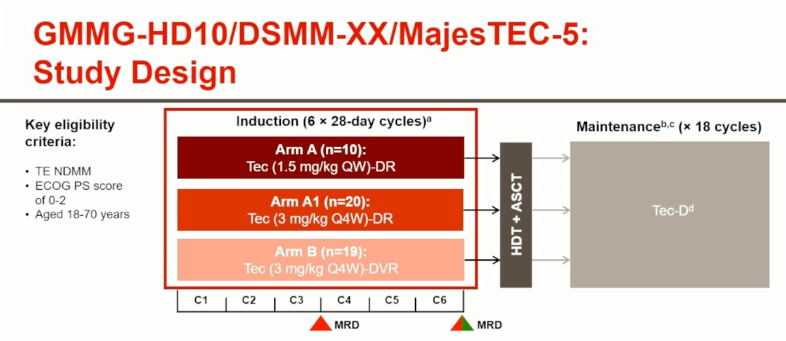
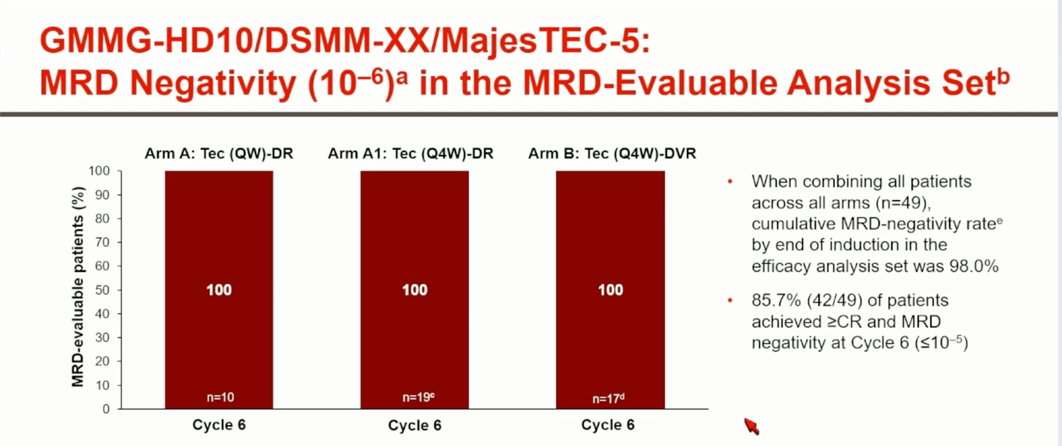
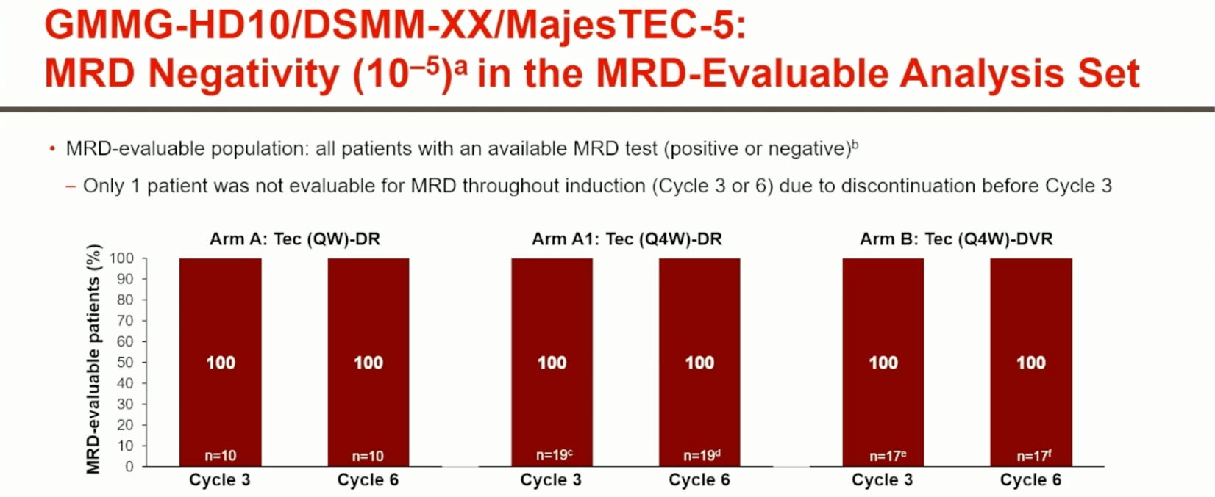
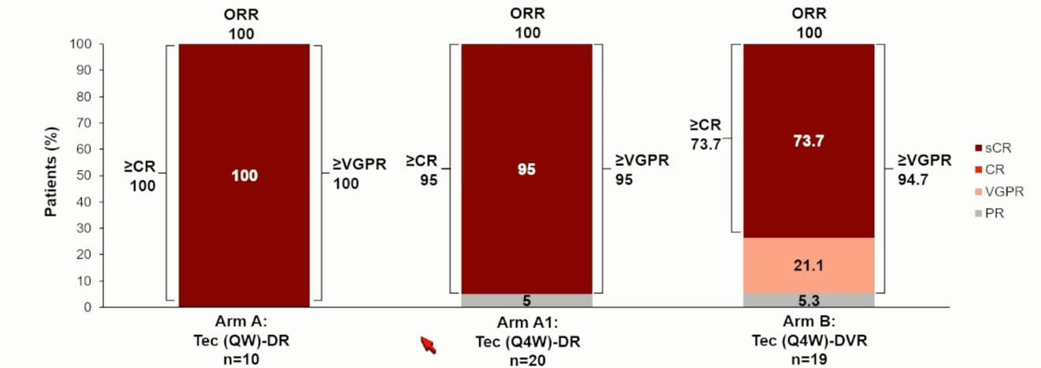

Slide 31
Management in the acute setting
Dexamethasone!
  High doses needed
  40mg PO daily or every other day x 4 doses
Daratumumab
  Great for dropping the light chain levels quickly
  Well-tolerated with minimal risk of infusion reactions now that we give sub-cutaneously
Bortezomib
  Safe and easy to give in context of renal failure
  Also, SC so no line required
Lenalidomide
  Easy to give as it is oral
  Renal dosing guidelines

Slide 32
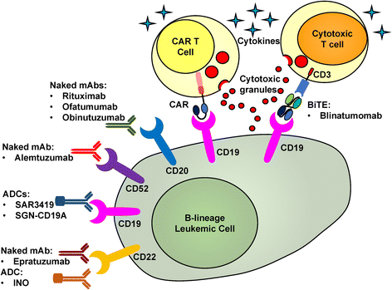
Cellular immunotherapy
While T-cells are designed to survey and rid the body of malignant cells tumors acquire features allowing them to evade this system
Goal: Re-engage the T-cells to destroy the malignant cell
Chimeric Antigen Receptor T-cells (CAR T-cells)
Bispecific T-cell engagers
Wei et al, J of Hematology & Oncology, 2017

Slide 33
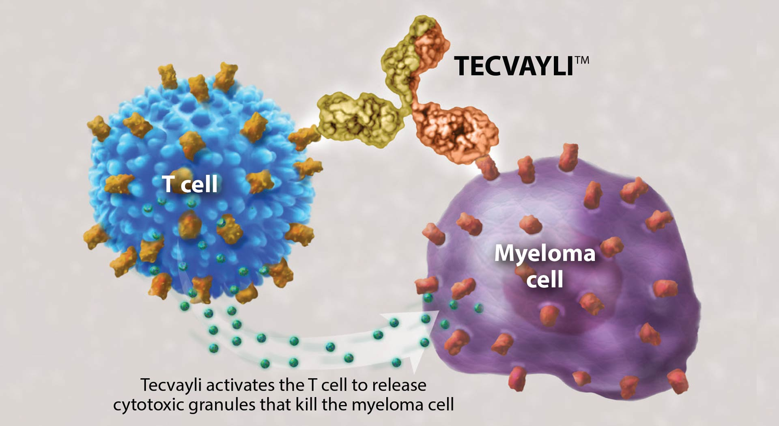
Bispecific T-cell Engagers
https://www.myeloma.org/blog/tecvayli-teclistamab-cqyv-receives-fda-approval

Slide 34
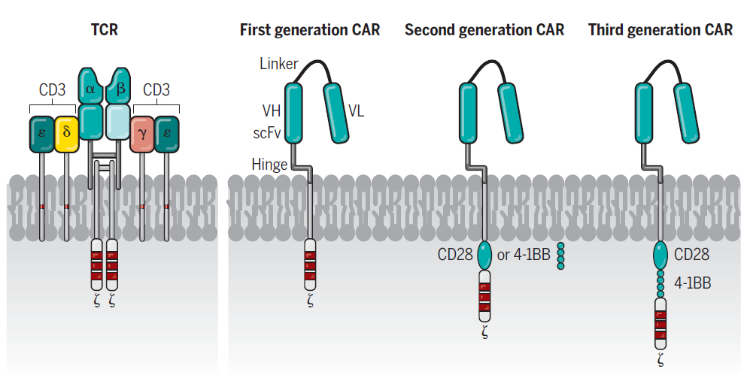
CAR T-cells
Adapted from Dr Michael Chu

Slide 35
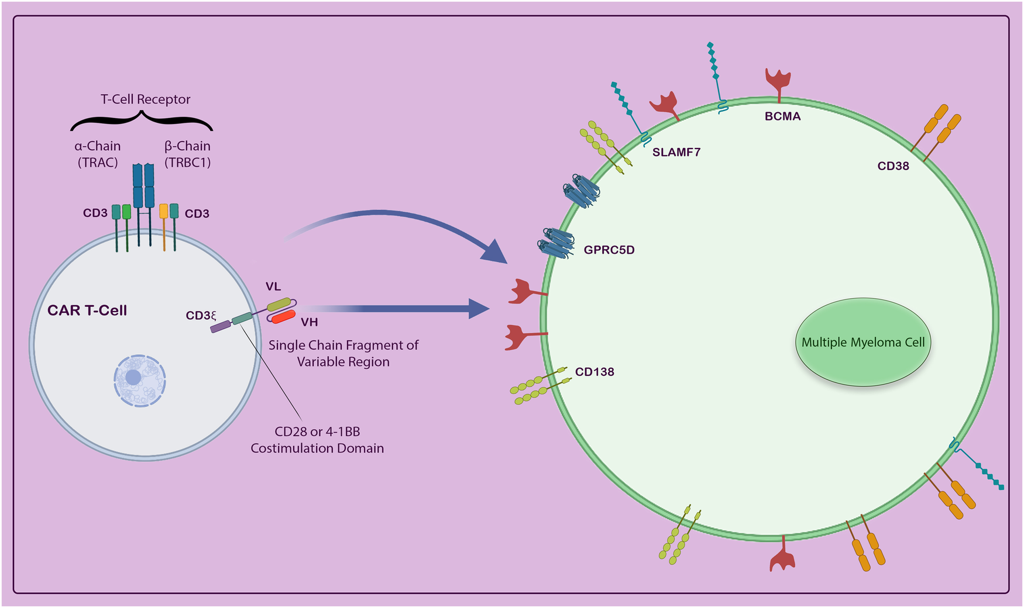
Chimeric Antigen Receptor T-cells

Slide 36
T-cell Redirecting Therapies: Toxicities

Slide 37
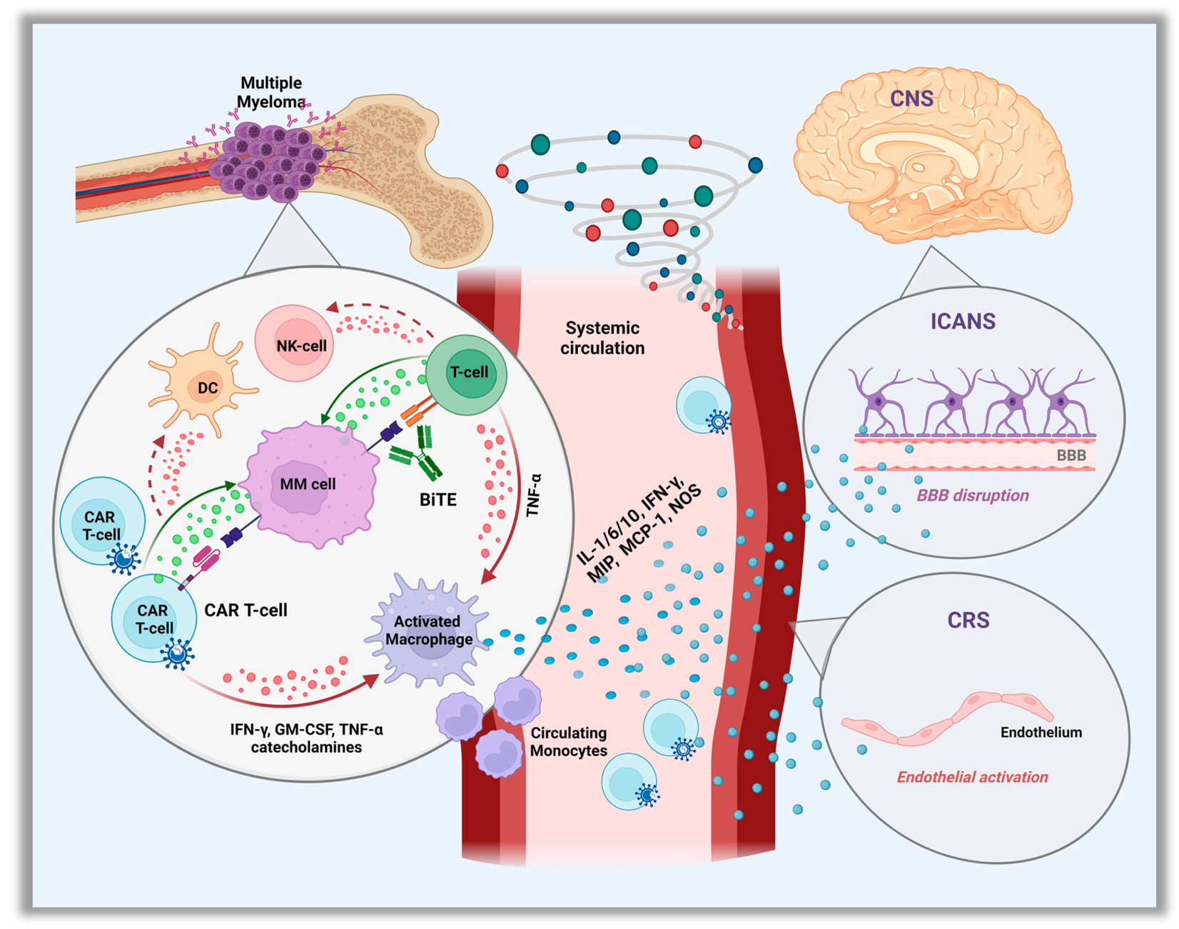
T-cell Redirecting Therapies Toxicities
Cytokine
Release
Syndrome
Immune effector
Cell
Associated
Neuro-
Toxicity
Syndrome
Markoulli, M et al Current Onc, 2023

Slide 38
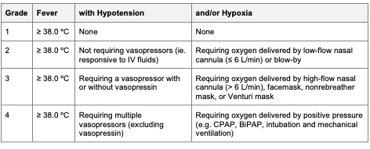
CRS

Slide 39
CRS treatment
https://www.bccancer.bc.ca/chemotherapy-protocols-site/Documents/Supportive%20Care/SCICANS_Protocol.pdfhttps://www.bccancer.bc.ca/chemotherapy-protocols-site/Documents/Supportive%20Care/SCICANS_Protocol.pdf
Acetaminophen
Tocilizumab (IL6 blockade)
Steroids
  dexamethasone 10 to 20 mg IV every 6 hours
  methylprednisolone 1 gram IV qdaily

Slide 40
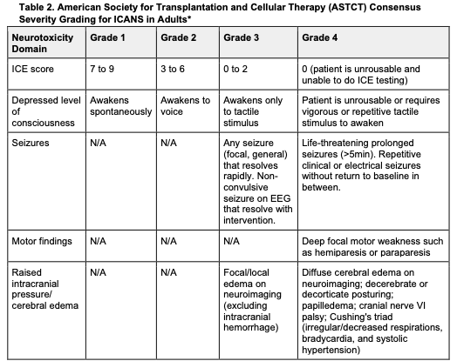
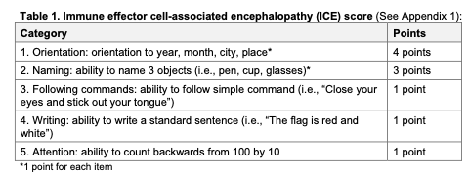
ICANS

Slide 41
ICANS treatment
https://www.bccancer.bc.ca/chemotherapy-protocols-site/Documents/Supportive%20Care/SCICANS_Protocol.pdf
Steroids
  dexamethasone 10 to 20 mg IV every 6 hours
  methylprednisolone 1 gram IV qdaily
Treat concurrent ICANS as per previous

Slide 42
CARTITUDE-4: CRS and CAR-T Cell–Related Neurotoxicity
AEs, n, % | As-treated patients (n=176)
 | Any grade | Grade 3/4 | Median time to onset, days | Median duration, days | Resolved, n
CRS | 134 (76.1) | 2 (1.1) | 8 | 3 | 134
Neurotoxicityª | 36 (20.5) | 5 (2.8)
ICANS | 8 (4.5) | ₀b | 10 | 2 | 8
Other^{c} | 30 (17.0) | 4 (2.3)
Cranial nerve palsy^{d} | 16 (9.1) | 2 (1.1) | 21 | 77 | 14
Peripheral neuropathy | 5 (2.8) | 1 (0.6) | 63 | 201 | 3
MNT | 1 (0.6) | 0 | 85 | - | 0
In the cilta-cel as-treated population:
30 patients had non-ICANS neurotoxicities^{c}
  16 cranial nerve palsies (14 recovered)
  5 peripheral neuropathies
  1 MNT (grade 1)
    Patient was refractory to DPd bridging therapy and had grade 2 CRS after cilta-cel infusion (risk factors for MNTs)
Lower incidence and severity of CRS, ICANS, MNTs, and some cytopenias^{e} observed with CARTITUDE-4 vs CARTITUDE-1
  Cilta-cel may be better tolerated when used earlier in treatment
  Effective bridging therapy enables better control of tumor burden prior to CAR-T infusion
  MNTs were lower likely related to patient management strategies implemented to mitigate this risk
ªThere were no fatal neurotoxicities. ^{b}Grade 3 syncope reported as a symptom of grade 2 ICANS. ^{c}Other neurotoxicities include AEs reported as CAR-T cell neurotoxicity that are not ICANS or associated symptoms. ^{d}Cranial nerve palsies most commonly affected cranial nerve VII; supportive measures included corticosteroids (14 patients). No clear risk factors for cranial nerve palsies have been identified, and the mechanism is not understood. ^{e}Data for cytopenias not shown.
AE, adverse event; CAR-T, chimeric antigen receptor T cell; cilta-cel, ciltacabtagene autoleucel; CRS, cytokine release syndrome; DPd, daratumumab, pomalidomide, and dexamethasone; ICANS, immune effector cell–associated neurotoxicity syndrome; MNT, movement and neurocognitive treatment-emergent adverse event.
14

Slide 43
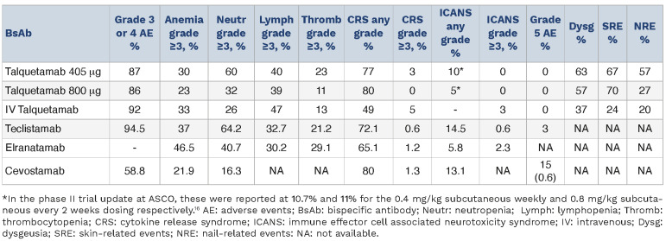
Liu, Krishnan Haematologica 2023

Slide 44
Immune Dysfunction With T-Cell Redirecting Therapy - Increased Infection Risk
Marked B-cell/plasma cell suppression
Prolonged suppression
With bispecifics can also get chronic tonic signaling of endogenous T-cells leading to T-cell exhaustion
So…
  No B-cells (lack of humoral immunity)
  No T-cells (lack of cellular immunity)

Slide 45
Immune Dysfunction With T-Cell Redirecting Therapy – Increased Infection Risk
Types of infections seen
  Sinus infections
    Chronic infections
  Lower respiratory infections
    Atypical organisms
    Viruses
    Chronic infections
  Systemic viral infections
    CMV
Need for prophylaxis:
  Valacyclovir
  Doxycycline or moxifloxacin
  Septra
Low threshold for treatment with broad spectrum Abx
  Atypical coverage
  Aim for complete eradication in context of limited immune system
  Re-assess frequently to ensure success
  Escalate therapy quickly if failing treatment

Slide 46

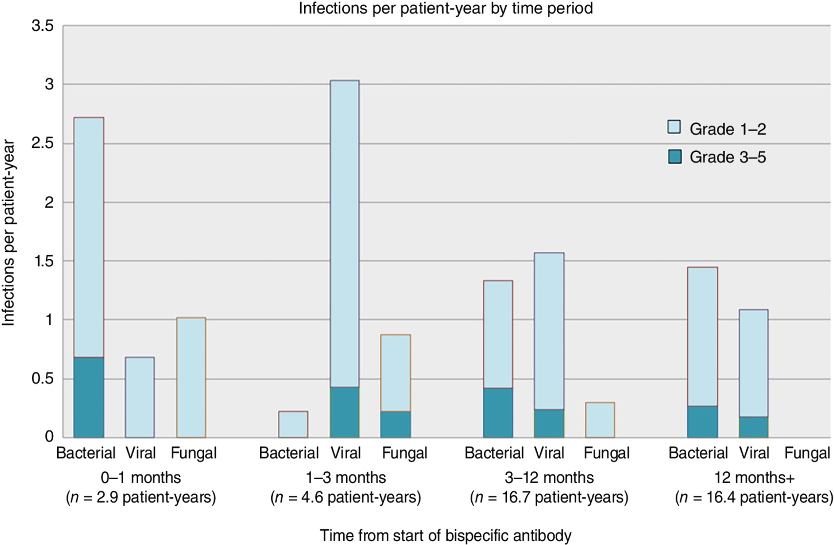
From: IVIg Use Associated with Ten-Fold Reduction of Serious Infections in Multiple Myeloma Patients Treated with Anti-BCMA Bispecific Antibodies
Blood Cancer Discov. 2023;4(6):440-451. doi:10.1158/2643-3230.BCD-23-0049
Date of Download: 11/3/2023
Copyright © 2023 American Association for Cancer Research. All rights reserved.
Notes:
Figure Legend:
Infection rates (per patient-year) at various time periods from the start of bispecific antibody therapy, divided by microbiology and severity.

Slide 47
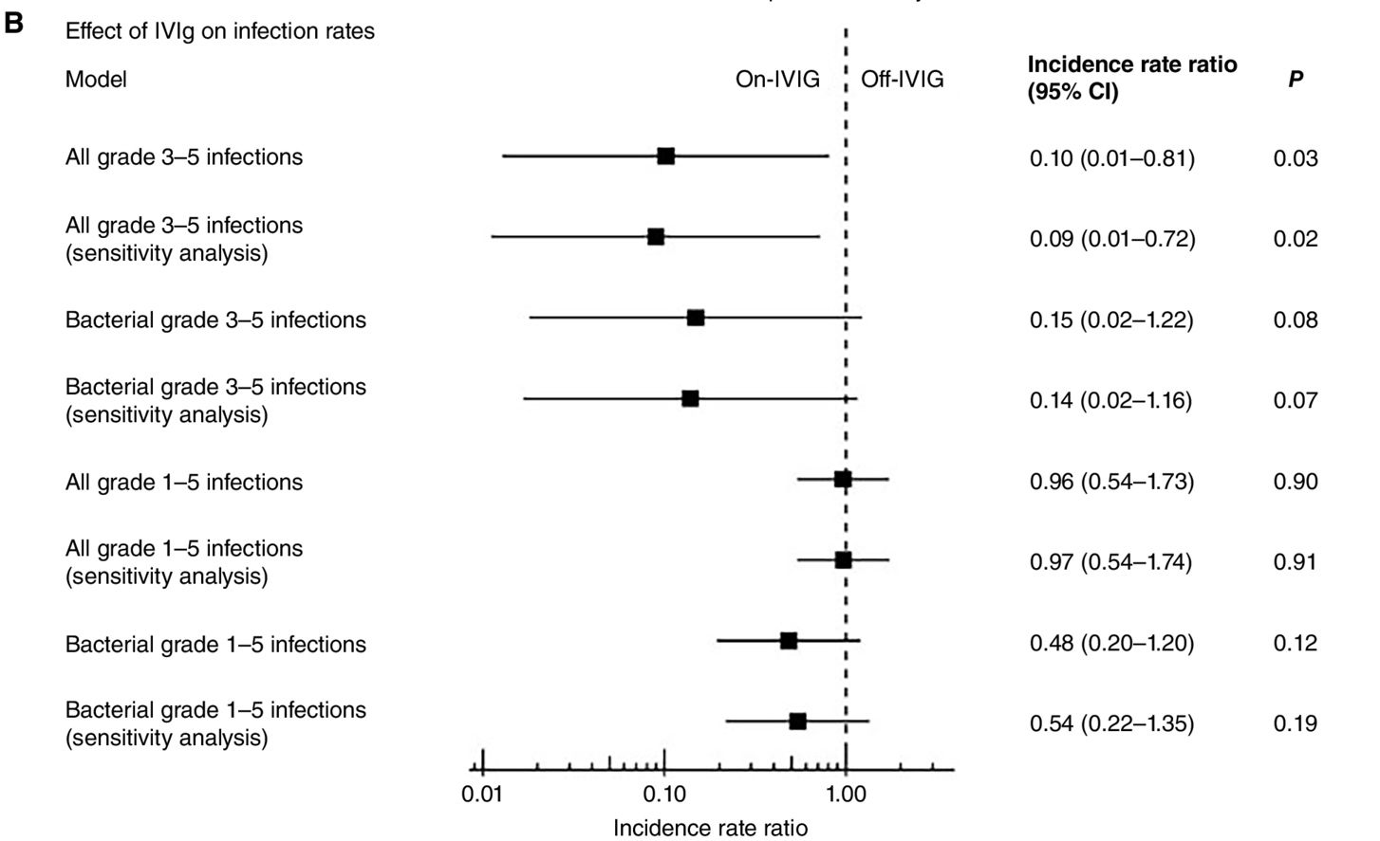
From: IVIg Use Associated with Ten-Fold Reduction of Serious Infections in Multiple Myeloma Patients Treated with Anti-BCMA Bispecific Antibodies
Blood Cancer Discov. 2023;4(6):440-451. doi:10.1158/2643-3230.BCD-23-0049
Importance of IG replacement
Date of Download: 11/3/2023
Copyright © 2023 American Association for Cancer Research. All rights reserved.
Notes:
Figure Legend:
A, Swimmer's plot for all grade 3–5 infections during the study period, divided into “on-IVIg” and “off-IVIg” periods. B, Forest plot showing the infection incidence rate ratios of “on-IVIg” versus “off-IVIg” periods for various infection categorizations, with P values derived from z-test on regression parameters in the self-controlled case series model. Sensitivity analyses excluded the first 30 days of bispecific antibody therapy to attempt to limit confounding risk factors for infection including uncontrolled myeloma, increased health care contact due to mandatory hospitalizations during step-up dosing, and cytokine release syndrome management.

Slide 48
Supportive care considerations
Acute:
  CRS management!
  Gain experience
  Define location of delivery and adapt program accordingly (i.e. inpatient vs outpatient)
  Consider evolving data around prophylaxis
Chronic:
  Infectious risk is primary issue
  Role of prophylactic antibiotics
    Septra
    Valacyclovir
    Doxycycline or equivalent (x 3 months)
  IVIG/SCIG
  Monitoring of viral reactivation
    Hepatitis where appropriate
    CMV!!
  Consider atypical organism:
    Odd bacteria
    Fungal
    CMV
    EBV

Slide 49
Summary
Think of these disorders
Refer early
Know they are treatable and long-term outcomes are excellent
Novel immune-based therapies are here
Supportive care is key to success
christopher.venner@bccancer.bc.ca

