Slide 1

Noon Report
Rush
Adam Pietrobon
VGH Lead Medical Resident
Notes:
Song is a clue
Only get what you ask
Participate :)

Slide 2
Anemia diagnostic schema
Acute anemia
Bleeding
Hemolysis
Critical illness
Dilution
Chronic anemia
Microcytic
MCV < 80
Normocytic
80 < MCV < 100
Macrocytic
MCV >100
Common
Iron deficiency
Anemia chronic disease
Fe deficiency
Uncommon
Lead poisoning
Sideroblastic anemia
↑ Reticulocyte
Bleeding
Hemolysis
Splenic seq
↓ Reticulocyte
Megaloblastic
B12 def
Folate def
Non-megalo
1º bone marrow failure
Reticulocytosis
Alcohol use
Liver disease
HypoTSH
Bone marrow infiltration
Malignancy (heme, solid organ), Infectious (mycobacterial, fungal)
1º Bone marrow failure
MDS, myelofibrosis, aplastic anemia, pure red cell aplasia
Bone marrow suppression
Anemia of chronic disease/inflammation

Slide 3
Anemia diagnostic schema
Acute anemia
Bleeding
Hemolysis
Critical illness
Dilution
Chronic anemia
Microcytic
MCV < 80
Normocytic
80 < MCV < 100
Macrocytic
MCV >100
Common
Iron deficiency
Anemia chronic disease
Fe deficiency
Uncommon
Lead poisoning
Sideroblastic anemia
↑ Reticulocyte
Bleeding
Hemolysis
Splenic seq
↓ Reticulocyte
Megaloblastic
B12 def
Folate def
Non-megalo
1º bone marrow failure
Reticulocytosis
Alcohol use
Liver disease
HypoTSH
Bone marrow infiltration
Malignancy (heme, solid organ), Infectious (mycobacterial, fungal)
1º Bone marrow failure
MDS, myelofibrosis, aplastic anemia, pure red cell aplasia
Bone marrow suppression
Anemia of chronic disease/inflammation

Slide 4
Hemolytic anemia diagnostic schema
Immune-mediated
DAT positive
Not immune-mediated
DAT negative
Autoimmune
Warm AIHA
Cold AIHA
Alloimmune
Transfusion Rx
Genetic
Infectious
Malaria
Bartonella
Clostridium
Toxic
oxidative stress
Drugs
Foods
MAHA
schistocyte positive
DIC
TMA
Mechanical (e.g. valves, pumps, Heyde’s)
Membrane defect
Hereditary elliptocytosis
Hereditary spherocytosis
Enzyme defect
G6PD deficiency
PK deficiency
Hemoglobinopathy
Sickle cell
Thalassemia
Complement
PNH

Slide 5
Mechanism of hemolysis
 | Intravascular hemolysis | Extravascular hemolysis
Pathophys | RBCs destroyed within blood vessels | RBC are destroyed outside vessels, mainly by splenic and hepatic macrophages in the reticuloendothelial system
Laboratory features | More dramatic lab parameters ↑ LDH (very high) ↓ Haptoglobin (very low) Indirect hyperbilirubinemia Hemoglobinuria | Less dramatic lab parameters Moderate ↑ LDH Mild ↓ Haptoglobin Indirect hyperbilirubinemia Splenomegaly
Example etiologies | Immune-mediated Cold AIHA Alloimmune MAHA Infectious Malaria Oxidative injury | Immune-mediated Warm AIHA Most genetic causes Membrane defect Enzyme defect Hemoglobinopathy Oxidative injury

Slide 6
Simplified approach to hemolytic anemia
Order your hemolysis screening labs
  LDH (best to trend)
  Bilirubin (lowest sensitivity)
  Haptoglobin (highest sensitivity)
If hemolysis screen positive, order additional labs to characterize
  DAT (i.e Coomb’s test) → positive = AIHA
  Peripheral blood smear → schistocytes = MAHA
  Reticulocyte count → low = concerning

Slide 7
Low SpO₂ not responsive to supplemental oxygen
Shunt (V/Q = 0)
  Pulmonary
  Extrapulmonary
Erroneous hemoglobin
  Carboxyhemoglobinemia
  Methemoglobinemia
ABG pH 7.48, pCO2 34, HCO3 22, pO2 230
metHgb 0.31 (ULN 0.015)

Slide 8
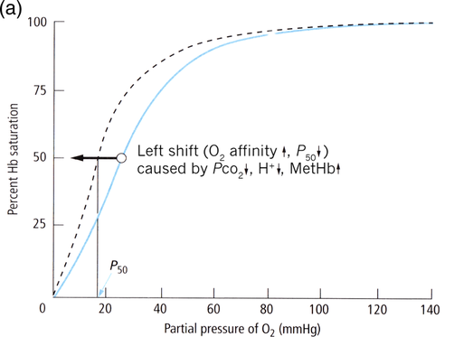
Methemoglobinemia
“met” comes from the Greek word for “change”
Oxidative stress oxidizes Hb-bound iron from ferrous (Fe²⁺) → ferric (Fe³⁺) state, forming methemoglobin
MetHb consequences
Unable to bind O2 effectively
Leftward shift of oxyHb dissociation curve (i.e. remaining normal Hb binds O2 more tightly & release less to tissues)
This leads to anemic hypoxia without hypoxemia

Slide 9
Methemoglobinemia
Symptoms of hypoxia
dyspnea, headache, fatigue, lethargy
Signs
Cyanosis out of proportion to PaO2
Chocolate-brown blood
SpO2 fixed at 85% regardless of oxygenation
Diagnosis
MetHb via co-oximetry or ABG
Management
All
  High flow O2
If MetHb > 20% or symptomatic
  Methylene blue
If severe
  Exchange transfusion, hyperbaric O2

Slide 10
Methemoglobinemia causes
MetHb occurs when
oxidative stress > homeostatic reducing capacity
↓ Reducing capacity
G6PD deficiency
PK deficiency
↑ Oxidative stress
Antibiotics: Dapsone, sulfonamides, nitrofurantoin
Local anesthetics: Lidocaine, benzocaine
Toxins: Nitrites (e.g. amyl nitrites), nitrates (well water, food preservatives)
Others: Rasburicase, metoclopramide

Slide 11
=
Oxidative stress
Reducing capacity

Slide 12
MetHb occurs when…
oxidative stress > homeostatic reducing capacity

Slide 13
???
>
Oxidative stress
Reducing capacity
DAT⊖ hemolytic anemia
Methemoglobinemia

Slide 14
G6PD def
>
Oxidative stress
Reducing capacity
DAT⊖ hemolytic anemia
Methemoglobinemia

Slide 15
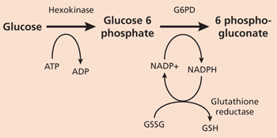
G6PD deficiency
pathophysiology
Glucose-6-phosphate dehydrogenase (G6PD) deficiency is an X-linked recessive enzymopathy that impairs the ability for cells to generate NADPH and handle oxidative stress
RBCs are particularly sensitive to G6PD deficiency because pentose phosphate pathway is only mechanism for producing NADPH (RBC lose mitochondria → no Krebs cycle)
Oxidative stress leads to the following:
Oxidative injury of RBC membrane → intravascular hemolysis
Oxidize globin → denatured Hb aggregate forming Heinz bodies → hepatosplenic macrophages consume forming bite cells → extravascular hemolysis

Slide 16
G6PD deficiency clinical features
Most common enzymatic RBC disorder worldwide, commonly males (X-linked)
High prevalence in Africa, Middle East, Mediterranean, and Southeast Asia
Manifests as episodic, DAT-negative hemolysis triggered by oxidative stress
Many triggers (i.e. anything that causes oxidative stress), teach patients to avoid fava beans (causes “favism”)
Treatment is supportive (no steroids)

Slide 17
???
G6PD def
>
Oxidative stress
Reducing capacity
DAT⊖ hemolytic anemia
Methemoglobinemia

Slide 18
Poppers
G6PD def
>
Oxidative stress
Reducing capacity
DAT⊖ hemolytic anemia
Methemoglobinemia

Slide 19
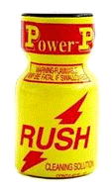
“Poppers” i.e. alkyl nitrites
Originally used as a vasodilator for angina
(inhaled alkyl nitrites → converted to NO →
smooth muscle relaxation and vasodilation)
Side effects include symptoms of hypotension
presyncope-syncope, headache, reflex tachycardia)
High doses can lead to oxidative load → metHb and/or DAT-negative hemolysis in susceptible host
Commonly used recreationally, particularly in queer community:
Enhanced sexual experience (anal/urethral sphincter relaxation)
Euphoric “rush”

Slide 20
Noon Report
Rush
Adam Pietrobon
VGH Lead Medical Resident

Slide 21
Methemoglobinemia
DAT⊖ hemolytic anemia
Relative amount
Time
Oxidative stress

Slide 22
Learning objectives
MSI3
Approach to anemia
JR/MSI4
Approach to hemolytic anemia
G6PD deficiency
SRs
Methemoglobinemia
Oxidative stress

