Slide 1
Hyperglycemic Emergencies & in patient DM Management

Slide 2
Objectives
Identify DKA, its precipitating factors and a differential diagnosis
Learn how to manage DKA
Differentiate DKA from HHS
Understand core principles of in-patient diabetes management including continuing or discontinuing oral agents, initiating or continuing insulin and titrating insulin on the wards

Slide 3
Case:
A 24 F with a history of T1DM presents to hospital with nausea and vomiting. Her labs show a pH of 7.14, bicarb 8, sodium 136, potassium 3.4, chloride 106, Cr 102, liver enzymes and lipase normal, WBC 8.2, Hgb 124, Plt 250. Her BOHB returns at 3.8 and her serum glucose is 21 mmol/L
What is your impression?

Slide 4
DKA
Hyperglycemia symptoms:
  Polyuria, polydipsia
Acidosis signs / symptoms:
  Nausea, vomiting and abdominal pain
  Altered LOC
  Kussmaul respiration

Slide 5
DKA – Precipitating Factors
New diagnosis of diabetes
Insulin omission
Infection
Myocardial infarction
Stroke
Thyrotoxicosis
Trauma
Drugs

Slide 6
Differential Diagnosis
AGMA: MUDPILES CAT
  Methanol
  Uremia
  DKA
  Paraldehyde
  INH
  Lactate
  Ethelene glycol
  Salicylates
  Carbon monoxide
  Aminoglycosides
  Theophylline

Slide 7
A note about other forms of ketosis
Starvation ketoacidosis
Alcohol ketoacidosis
Diabetic Ketoacidosis
BOHB higher in DKA (2-3)
>3 = more likely to be DKA

Slide 8
Management
ABCDEs
Monitored setting
At least 2 PIVs
On the monitor

Slide 9
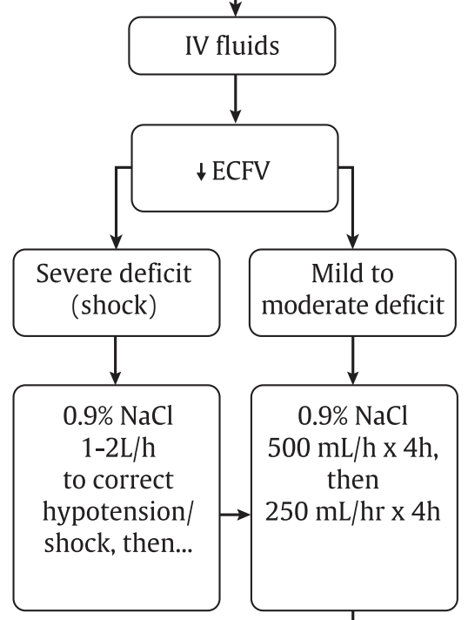
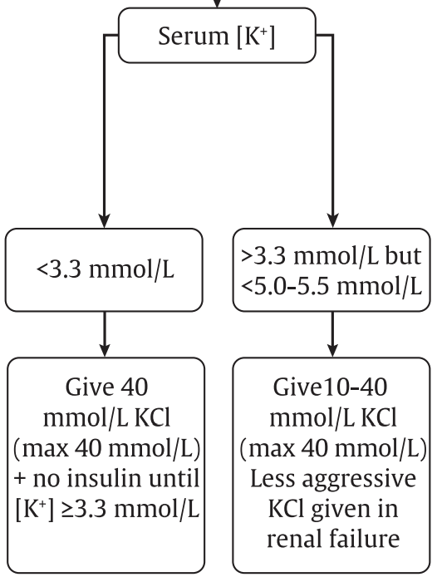
Management
Notes:
Labs q3-4h, glucose q1h

Slide 10
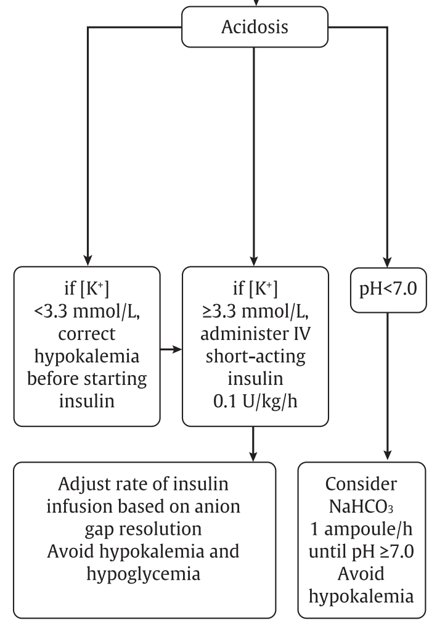
Once plasma glucose reaches 14.0 mmol/L, add glucose to maintain plasma glucose at 12.0 to 14.0 mmol/L
The insulin infusion is titrated to the…. GAP NOT THE GLUCOSE
Once gap is closed and patient is eating and drinking, transition with SC basal insulin (overlap by two hours with the infusion)

Slide 11
Sodium
Na levels vary in DKA
Most often see a dilutional hyponatremia with hyperglycemia due to the change in osmolality (vs more rarely hypernatremia from osmotic diuresis)
Rule of thumb, for every 3.5 mmol rise in glucose, you expect sodium to be lower (in appearance) by 1 mmol/L due to hyperglycemia

Slide 12
SC insulin?
Some recent evidence on management of DKA with subcutaneous insulin only, not insulin infusion
Won’t go into details but just to know this exists and you may see it but most of the time you will see infusion

Slide 13
Euglycemic DKA
Same presentation as DKA but glucose is NORMAL or only mildly elevated
Most commonly from SGLT2i BUT most often there is ALSO an additional precipitating factor (insulin omission, bariatric surgery or other surgery, alcohol, exercise, or low carbohydrate or reduced food intake)
Also reported in pregnancy
Treatment is the same
STOP the SGLT2i

Slide 14
Case:
A 62 M with a history of T2DM on metformin, sitagliptin, semaglutide who often forgets to take his medications brought in by his daughter after a few days of lethargy and much more difficult to rouse today. He reports excess thirst and urination, poor oral intake for a few days as well as a productive cough. His vitals show T 38.1, HR 105, BP 98/62, RR 22, O2 95% on RA. He is confused but rousable. Labs show sodium 148, K 4.2, Cr 210 (baseline 110), serum osm 355, pH 7.36, bicarb 22, serum glucose 42
What is your impression?

Slide 15
DKA vs. HHS
 | Key Features | Epidemiology | Glucose levels | Plasma osmolality
DKA | Ketoacidosis, pH <7.3 | More common | Anything | <320
HHS | ECFV depletion and hyperosmolarity, minimal acid / base disturbance | Less common | Usually very elevated >34 | >320

Slide 16
Management of HHS
Similar to DKA but these patients require much more volume
Focus on fluid resuscitation
Most of the time also start insulin infusion

Slide 17
In patient DM Management
Will go over core principles
Oral agents – when to hold?
Insulin – how to order / titrate

Slide 18
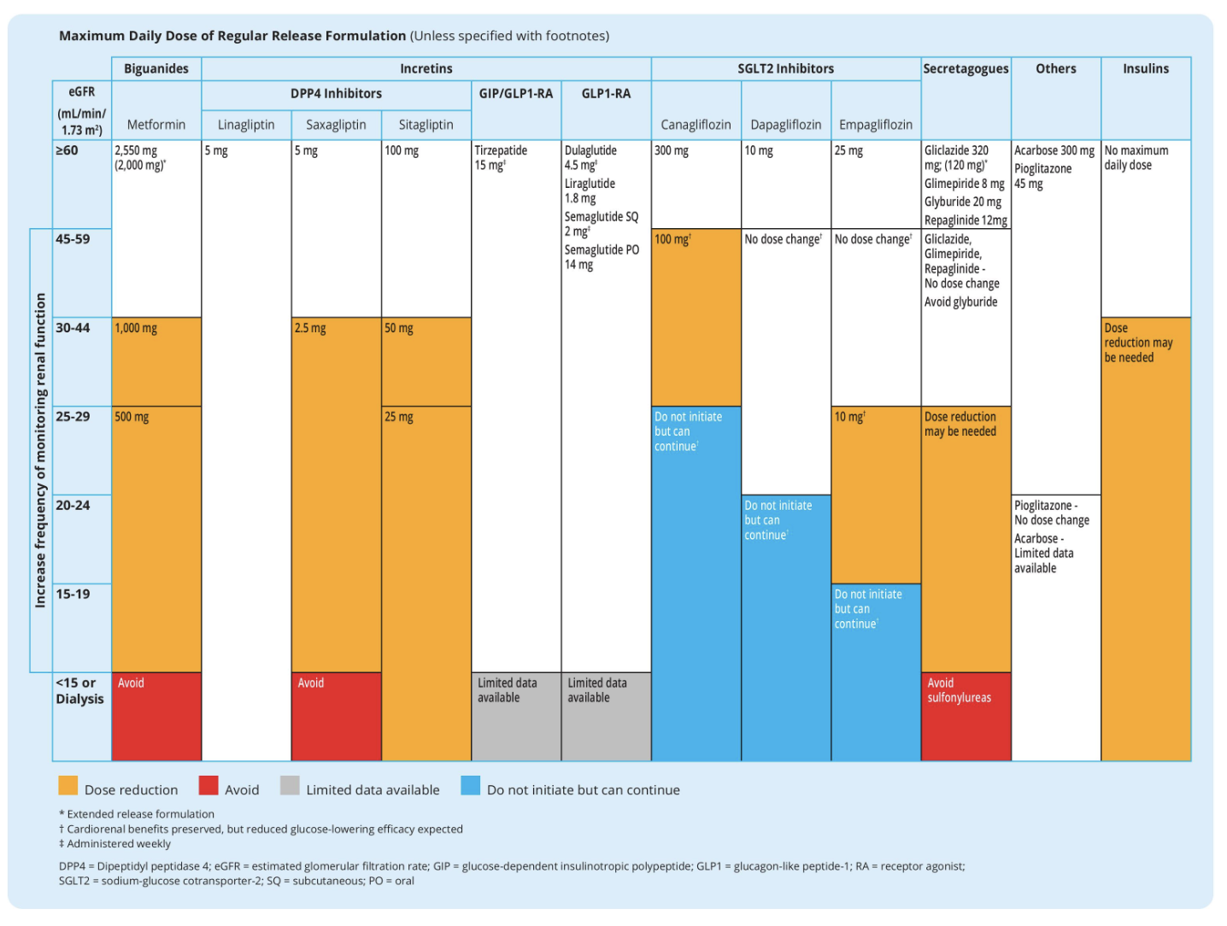

Slide 19
Oral Agents
Takeaways:
Hold metformin, SGLT2i, GLP1RA (also bc not on formulary) most of the time
SU – hold versus dose reduction
Most of the time safe to continue linagliptin (not other DPP4s)

Slide 20
Insulin
If on insulin at home… what to do with this?
It depends
Times when safe to continue home dose
Times when you should decrease the dose
Times when you should increase the dose

Slide 21
Case
65 M with T2DM, CKD, on Metformin 500 mg po BID, Linagliptin 5 mg po daily, Glargine 28 units qhs and Lispro 10 units TID with meals. His A1c last month was 7.9%. He presents to the ED with bilateral lower leg cellulitis. His vitals are T 36, HR 65, BP 136/82, RR 16, O2 99% on RA. Labs show WBC 10.2, Hgb 110 (baseline), Plt 300, Na 136, K 4.2, Cr 150 (baseline). He is admitted for IV antibiotics. His serum glucose on initial labs was 9.8.
What do you do with his insulin order?

Slide 22
Remember…
Short acting insulin (Lispro) onset ~15-30 mins, peak within 1-2 hours, lasts 3-4 hours
Long acting insulin (Glargine) onset 1.5-2 hours, peakless, lasts 18-24 hours
Sliding scale insulin is REACTIVE as opposed to scheduled mealtime insulin which is PROACTIVE
  TDD <40 = low, 40-100 = medium, >100 = high
  (Almost) never use regular sliding scale
  Given his PO intake in hospital is different, you resume his home Glargine at 28 units, and reduce his mealtime to lispro 5 units TID with a medium lispro sliding scale

Slide 23
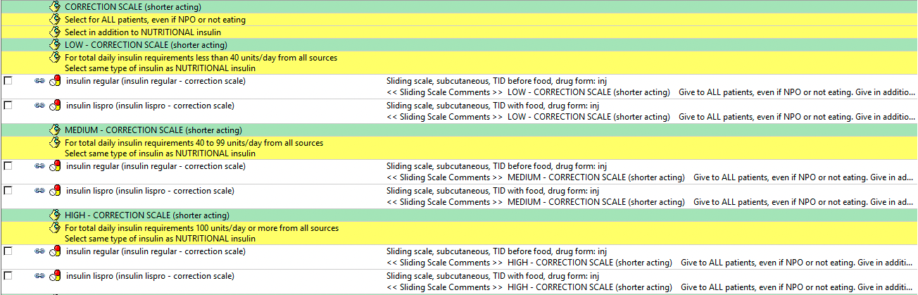

Slide 24
<< Sliding Scale Comments >>
MEDIUM - CORRECTION SCALE (shorter acting)
Give to ALL patients, even if NPO or not eating. Give in addition to NUTRITIONAL insulin
Blood glucose:
4 mmol/L or LESS - follow hypoglycemia protocol and call MD
4.1 to 8 mmol/L = 0 units
8.1 to 10 mmol/L = 2 units
10.1 to 12 mmol/L = 3 units
12.1 to 14 mmol/L = 4 units
14.1 to 16 mmol/L = 6 units
16.1 to 18 mmol/L = 8 units
above 18 mmol/L = 10 units and call MD
<< Sliding Scale Comments >>

Slide 25
Scenario:
 | acBreakfast | acLunch | acDinner | qhs
Day 1 | 10.2 (L5+3) | 12.0 (L5+3) | 8.1 (L5+2) | 11.8 (G28)
Day 2 | 11.4 (L5+3) | 12.6 (L5+4) | 7.6 (L5) | 13.3 (G28)
Day 3 | 12.5 (L5+4) | 13.7 (L5+4) | 8.0 (L5) | 16.0 (G28)
Day 4 | 13.9 (L5+4) | 15.9 (L5+6) | 7.8 (L5) | 14.2 (G28)
What are our in hospital glucose targets, both preprandial and random? (non-critically ill patient)
What pattern do you see?
What would you do?
Notes:
Preprandial 5-8
Random <10
Not increase basal, needs increased bolus at breakfast and dinner

Slide 26
Key principles:
Basal, bolus plus correction is usually the most effective management for in patient hyperglycemia
Often patients on oral agents only at home may need insulin in hospital when orals held
Look at evening and fasting to titrate the basal
Look at the acmeal to titrate mealtime
If NPO HOLD the scheduled mealtime insulin to avoid hypoglycemia
Most of the time, oral agents held

Slide 27
Questions?

Slide 28
References
Lipsombe L, Booth G, Butalia S, Dasgupta K, et al. Diabetes Canada 2018 Clinical Practice Guidelines for the Prevention and Management of Diabetes in Canada: Pharmacologic Glycemic Management of Type 2 Diabetes in Adults. Can J Diabetes 2018;42(Suppl 1):S88-S103.
Malcolm J, Halperin I, Miller DB, Moore S, Nerenberg KA, Woo V, Yu CH; Diabetes Canada Clinical Practice Guidelines Expert Committee. In-hospital management of diabetes. Can J Diabetes. 2018;42(Suppl 1):S115–S123.
Goguen J, Gilbert J; Diabetes Canada Clinical Practice Guidelines Expert Committee. Hyperglycemic Emergencies in Adults. Can. J. Diabetes 2018;42(Suppl 1):S109–S114.

