Slide 1

Noon Report
Ice Ice Baby
Adam Pietrobon
VGH Lead Medical Resident

Slide 2
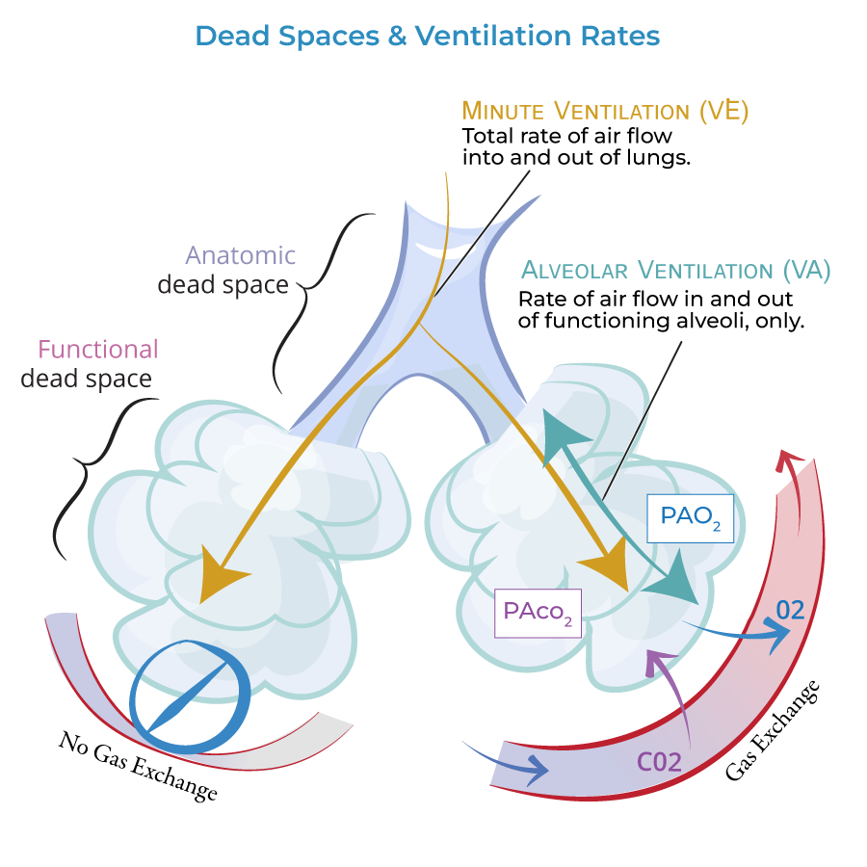
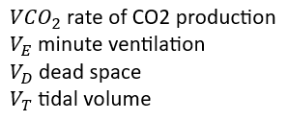
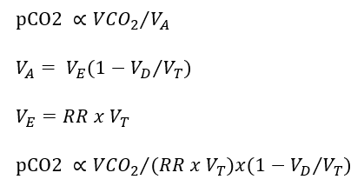
Hypercapnia (≃ Ventilatory failure)

Slide 3
Only 4 parameters increase pCO2
Decreased respiratory rate (“slow breaths”)
Decreased tidal volume (“shallow breaths”)
Increased dead space (“wasted breath”)
Increased CO2 production (“not the breath”)
#4 rarely causes clinically significant hypercapnia in isolation

Slide 4
A clinical framework - “Won’t breathe vs can’t breathe”
Won’t breathe
Central nervous system
Sedatives
OHS, central sleep apnea
Stroke
Encephalitis
Brainstem disease
Can’t breathe
Anatomical approach!

Slide 5
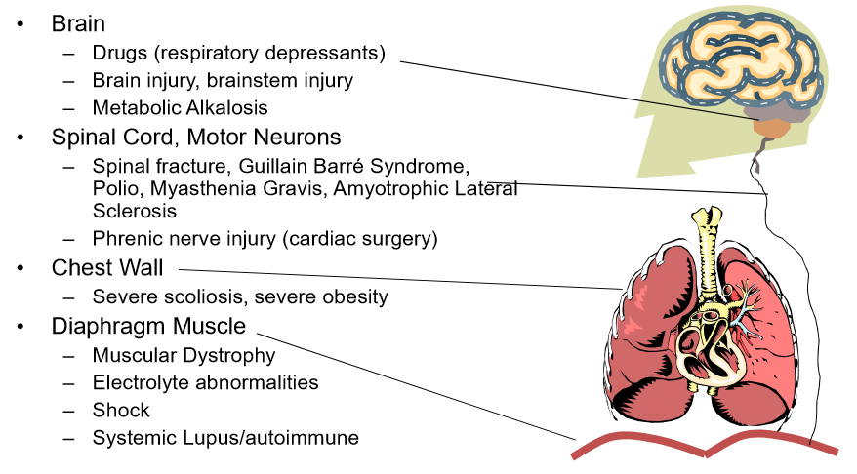

Slide 6
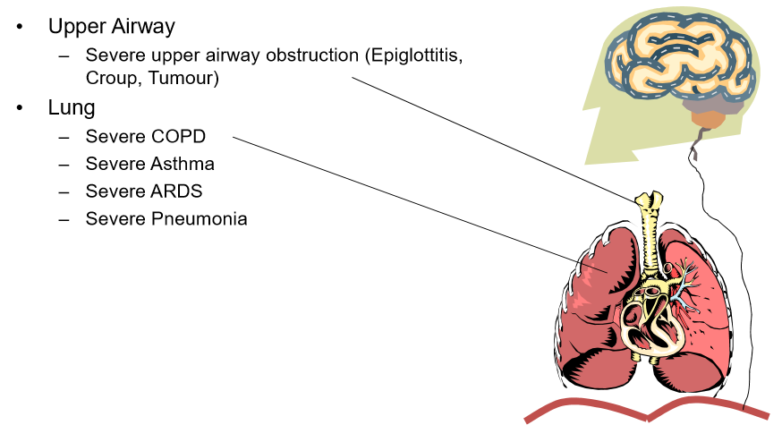

Slide 7
Even simpler… diagnostic schema of chronic hypercapnia by base rate
COPD
OHS (∓ OSA)
Sedatives
Neuromuscular disorders
Chest wall disorders
> 90% cases

Slide 8
ALS
Progressive neurodegenerative disorder involving both upper and lower motor neurons (median survival ~3-5 yrs, due to respiratory failure)
Manifestations include generalized weakness, respiratory weakness, bulbar symptoms (e.g. dysphagia, dysphonia, dysarthria), and a minority exhibiting cognitive changes (~10% develop frontotemporal dementia)
Sensory symptoms are usually absent or minimal
Disease-modifying therapy (e.g. riluzole, edaravone) show modest benefit. Treatment is primarily supportive:
  NIPPV (i.e. BiPAP)
  G tube
  Spasticity management (botox, OT/PT, etc.)

Slide 9
Sign | Upper Motor Neuron | Lower Motor Neuron
Tone | Increased "Spastic paralysis" | Decreased "Flaccid paralysis"
Bulk | Normal | Atrophy Fasciculations
Reflexes | Increased Clonus | Decreased/absent
Plantar response | Upgoing | Downgoing
Other | +/- Hoffman's Pyramidal weakness

Slide 10
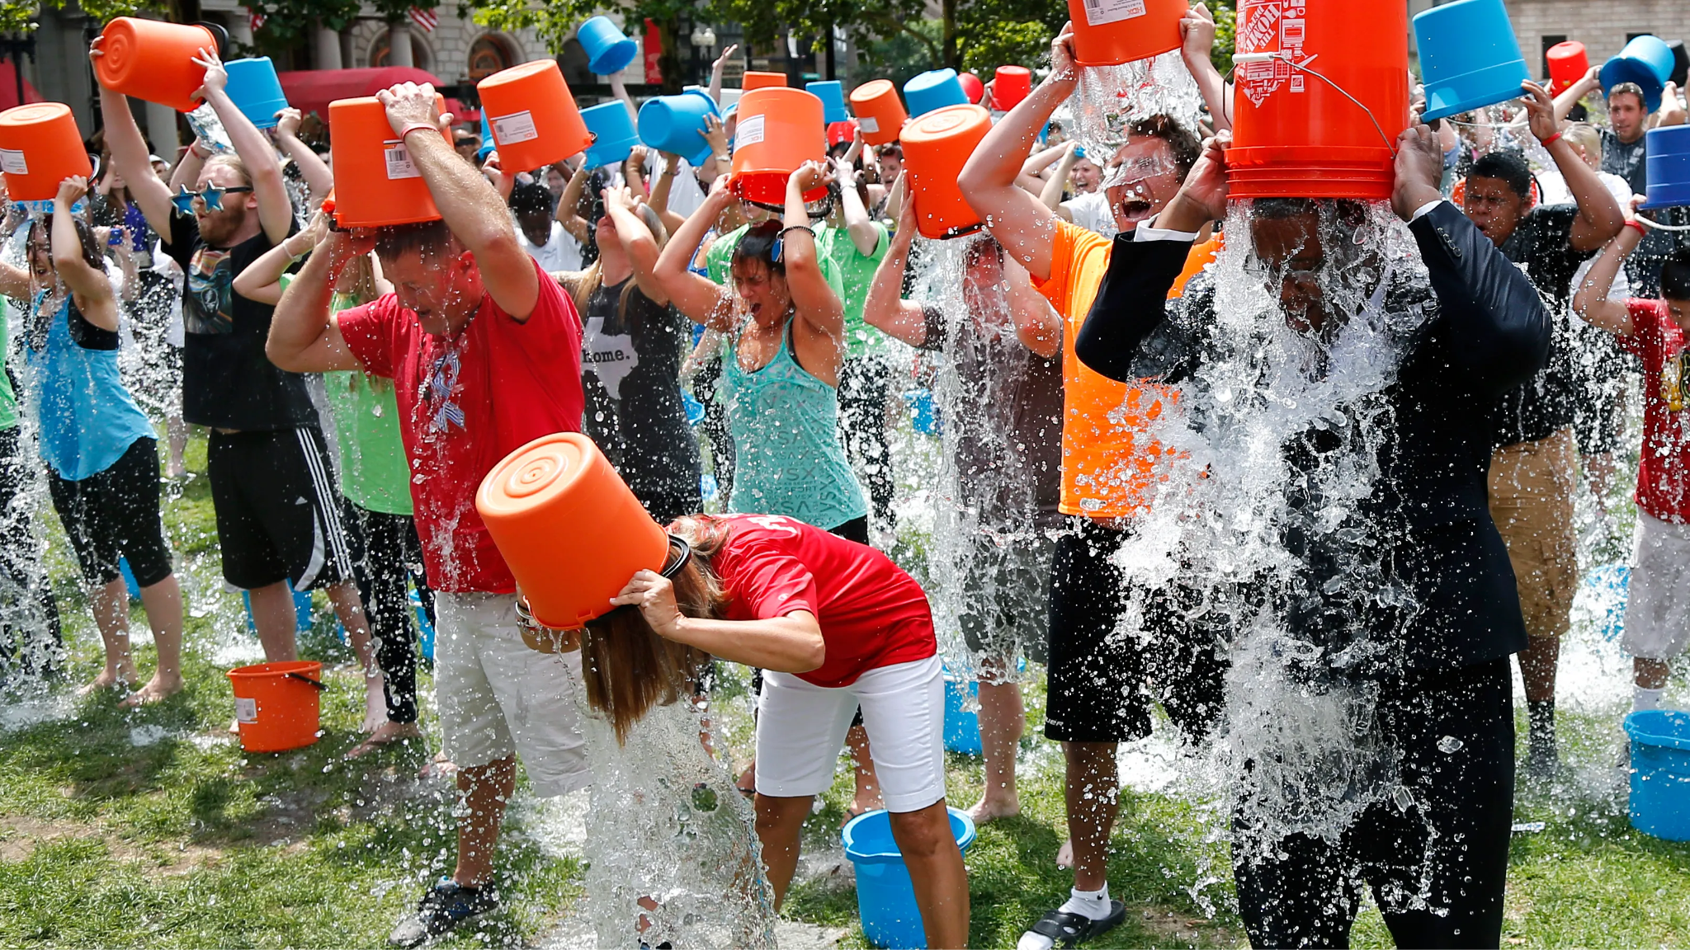

Slide 12
Learning
MSI
Approach to dyspnea
JR
Approach to hypercapnia
PFT interpretation
SRs
Identifying red flags
Problem representation

