Slide 1

Noon Report
Down Under
Adam Pietrobon
VGH Lead Medical Resident

Slide 2
Approach to fall
Causes “Multifactorial”
Acute precipitant
Intrinsic factors
  Non-modifiable
  Modifiable
Extrinsic factors
Consequences
Bone safety
Pain control
Reconditioning

Slide 3
Stroke etiologies
Ischemic stroke
Large Vessel Occlusion
Embolic
  Cardioembolic (e.g. AF, LV thrombus, IE, PFO)
  Artery-to-artery (e.g. carotids, aortic dissection)
Thrombotic
  Atherosclerotic plaque rupture
  Non-atherosclerotic thrombosis (e.g. vasculitis, dissection)
Vasospasm
Small Vessel Occlusion (“Lacunar strokes”)
Common
  chronic hypertension
Uncommon
  e.g. atherosclerotic plaque rupture, cerebral amyloid angiopathy (CAA), vasculitis, Moyamoya)
Hemorrhagic stroke
Intracerebral
Deep
  Hypertension
Lobar (i.e. cortex, subcortex)
  Structural vascular (e.g. aneurysm rupture, AVM, Moyamoya)
  CAA
Either
  Hemorrhagic transformation of ischemic stroke, trauma, coagulopathy, Vascularized tumor
Meninges-related
Subarachnoid
  Traumatic → Not a stroke
  Spontaneous
    Aneurysmal rupture (++ common)
    Other structural vascular (e.g. AVM, Moyamoya
    Coagulopathy, tumor bleeding, etc.
Subdural, epidural
  Traumatic → Not a stroke
  Spontaneous (rare)
    Coagulopathy, cerebral atrophy + minor trauma, hypotension, etc.

Slide 4
Standard stroke work-up
US carotid Dopplers (skip if CTA already)
TTE (+/- bubble)
ECG
Holter (24hr up to 14 day)
Lipid panel
HbA1c

Slide 5
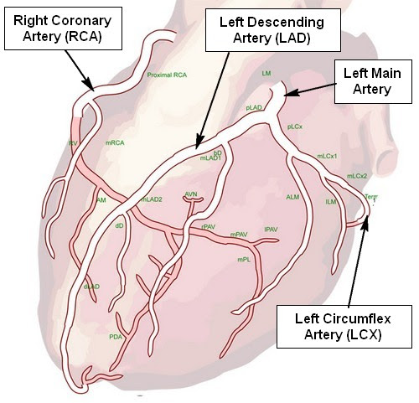

Slide 6
Arterial clots
When to think about an “extended” work-up for arterial clots
Clot in an uncommon patient demographic (e.g. stroke in young)
Clot in an uncommon location (e.g. renal infarction)
Multiple clots, especially if both arterial and venous

Slide 7
Clot diagnostic schema
Arterial clots
Thrombus
Atherosclerotic plaque rupture
Non-atherosclerotic disease (e.g. vasculitis, dissection)
Embolic
Venous clot with PFO
Cardioembolic (g. AF, LV thrombus, IE, PFO)
Artery-to-artery
Unusual (e.g. fat emboli, cholesterol emboli, air emboli)
Vasospasm
Arterial and/or venous clots
Hypercoagulable states
Thrombophilia (Antiphospholipid syndrome)
Myeloproliferative disorders (ET, PV, CML) and PNH
Malignancy (hematological and solid organ)
DIC, TMAs, HIT
Auto-immune (e.g. SLE, vasculitis)
Venous clots
Inherited thrombophilia
Genetic testubg (Factor V Leiden, Prothrombin mutation)
Activity testing i.e. deficient (Protein C, Protein S, Antithrombin)
Inflammatory states
E.g. Severe sepsis, COVID-19

Slide 8
Arterial clot work-up
TTE with bubble study (and/or TEE) & Holter
Blood culture / IE work-up
Thrombophilia testing
Autoimmune serology
MAHA work-up
Look for malignancy (SPEP/SLFC, panCT, PET)
Consider advanced imaging of the affect artery (CTA)

Slide 9
Antiphospholipid Antibody Syndrome (APS)
Caused by antibodies against phospholipid binding proteins (e.g. cardiolipin, ꞵ2-glycoprotein I)
  Name is a misnomer as there’s no direct binding to phospholipids
Clinical manifestations are primarily
  Thrombosis (arterial and venous) in any site
  Pregnancy complications
Etiology
  Primary
  Secondary → most commonly in association with SLE, but can be triggered by infection (e.g. syphilis, HIV, HCV) and drugs
Diagnosis is made using a combination of
  Laboratory criteria
  Clinical criteria
Treatment is anticoagulation in the form of warfarin

Slide 10
APS laboratory testing
Due to numerous possible interferences, diagnosis requires positive testing 12 weeks apart
“Triple positivity” portends a worse diagnosis
 | Anti-cardiolipin | Anti-ꞵ2-glycoprotein I | Lupus anticoagulant
Components | IgM and IgG to cardiolipin | IgM and IgG to ꞵ2-glycoprotein | Laboratory phenomenon caused by innumerable (some not yet identified) antiphospholipid antibodies, which interfere with phospholipid-dependent coagulation tests
Testing | Antigen-based ELISA |  | Functional assay
Interference | Transient elevation after infections, especially viral Autoimmune diseases can cause non-specific elevations (polyclonal gammopathy) |  | Anticoagulation dramatically interferes (usually prolongs) Low factor levels (e.g. liver disease) prolongs) Acute thrombosis and inflammation prolongs
Pearls | Low-positive results are not specific for APS |  | May or may not be associated with SLE (“lupus” is misleading) Prolongs aPTT (in vitro), but confers pro-thrombotic risk in vivo

Slide 11
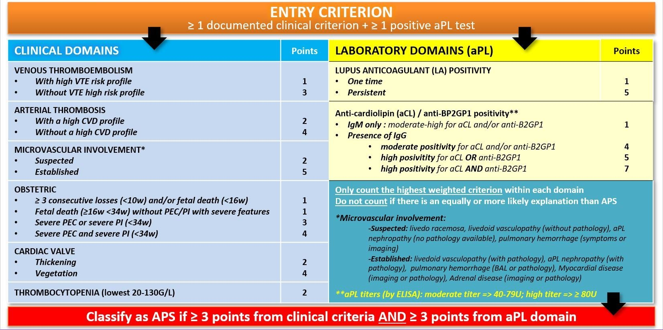
New APS research diagnostic criteria (ACR/EULAR 2023)

Slide 12
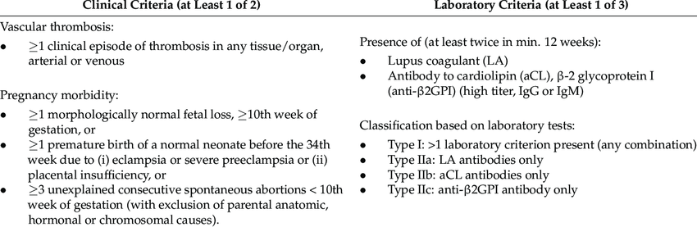
Conventional APS clinical diagnostic criteria

Slide 13

Sydney 2012 Criteria

Slide 15
Catastrophic antiphospholipid antibody syndrome (CAPS)
Rare, severe, life-threatening form of APS (mortality > 30-50%)
Characterized by rapid development of multiple thromboses in small vessels, often leading to multi-organ failure
Diagnosis (International Consensus 2003)
  Definite if meeting all 4 criteria
Involvement of ≥ 3 organs
Manifestations develop simultaneously or in < 1 week
Confirmation by histopathology in at least one orgran
APS lab confirmation
  Probable if < 4 criteria present (with criteria #3 often being substituted)
Management
  Anticoagulation
  Immunosuppression - steroids, rituximab
  PLEX

Slide 16
Learning
MSI3
Falls assessment
Etiology of stroke
JR/MSI4
Calling for help
Hypercoagulability work-up
SRs
Nuanced risk/benefit assessments for every treatment
APS and CAPS

