Slide 1
Endocrinology Case Rounds
GLOBAL HEALTH ROUNDS
Haruth Usabwimana & Connor Harrigan
August 12^{th,} 2025

Slide 2
Case Presentation

Slide 3
INITIAL PRESENTATION
  History of Presenting Illness:
    33-year-old male patient presenting with an 8-month history of progressive swelling of the face, abdomen, and lower extremities associated with increasing body weight, generalized muscle weakness and chest acne
  Review of systems:
    No fragility fractures, easy bruising, hair loss or mood changes
    No headache, vision changes, chest pain, shortness of breath, orthopnea, PND, cough, abdominal pain, nausea/vomiting, diarrhea, dysuria or polyuria
  Past Medical History:
    Otherwise healthy
    No prior history of prolonged steroid use, hypertension or diabetes.
  Medications:
    None

Slide 4
PHYSICAL EXAM
  Vitals: BP 144/80 mmHg. HR 80 bpm. SpO2 95% on room air. RR 20.
  General: the patient appeared unwell. He was obese.
  Inspection: dorsal fat pad, supraclavicular fat bilaterally, central obesity, purple striae on abdomen.
  CVS: tachycardic but regular pulse. Swollen bilateral lower limbs. Otherwise unrevealing.
  Resp: good air entry bilaterally with no adventitious sounds, with no work of breathing.
  GI: unrevealing.

Slide 5
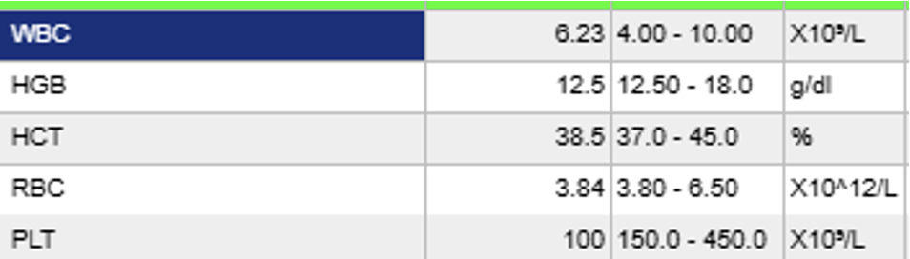
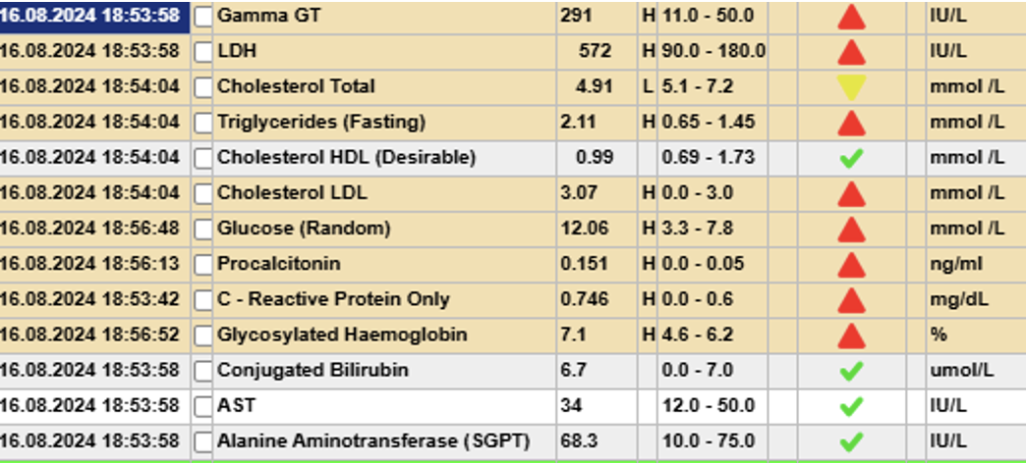
INVESTIGATIONS
  Potassium 1.7
  Lactate 10.8
  ABG: pH 7.59, pCO2 36, bicarbonate 34, pO2 61
    Metabolic alkalosis in in the setting of severe hypokalemia
Notes:
pH: 7.66 pCO2: 34 HCO3: 38.3 pO2: 67 Lact: 7.1 Na: 137 K: 1.6 Glu: 19.0 mmol/L Ca: 0.68,
VBG: PH 7.46 PCO2 37.3 PaO2 29 BICARB 27.1 SAT 60% Na 138 K 2.2 Glucose 229 HB 13.9 Ca 0.87
PH 7.403 PC02 31.3 PO2 38 HCO3 19.7 S02 73 NA 139 K 2.2 ICA 0.94 GLY 236 HCT 43 HB 14.6

Slide 6
SUMMARY
  Otherwise healthy 33-year-old with progressive swelling, weight gain and weakness found to have hypertension, dorsal fat pad and abdominal striae with severe hypokalemia and metabolic alkalosis.
  Approach?
  Presumptive diagnosis?
  Differential diagnosis?

Slide 7
NEXT STEPS
  What was the working diagnosis at that time?
  What was done by the team in UR?

Slide 8
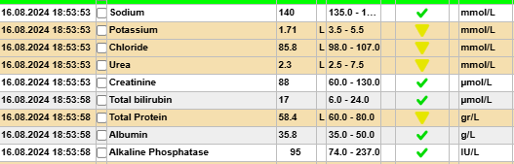
****ACTH level unable to be performed****

Slide 9
FURTHER INVESTIGATIONS
  Brain MRI: no obvious pituitary adenoma
  Abdominal MRI: diffuse bilateral adrenal gland hypertrophy
    Right 13 mm, Left 12 mm
  Chest CT scan: no suspicious/ectopic lesion in the chest
  Ask yourself:
  ACTH-dependent or independent? Diagnosis?

Slide 10
FURTHER INVESTIGATIONS
  Brain MRI: no obvious pituitary adenoma
  Abdominal MRI: diffuse bilateral adrenal gland hypertrophy
    Right 13 mm, Left 12 mm
  Chest CT scan: no suspicious/ectopic lesion in the chest
  Ask yourself:
  ACTH-dependent or independent? Diagnosis?
    Unfortunately, given an ACTH level was unable to be obtained, one cannot make a clear diagnosis.

Slide 11
HOSPITAL COURSE
  Cushing-specific treatment:
    The patient was started on spironolactone with increasing doses (25 mg OD→ 50 mg OD → 100mg BID)
    The patient was also started on fluconazole which was then switched to ketoconazole
  The following issues were also addressed during the patient’s admission:
    Hypokalemia – IV and oral supplementation
    Hypertension – amlodipine, losartan
    Hyperglycemia - insulin
    Psychiatric symptoms: aggression and hallucinations – haloperidol, midazolam

Slide 12
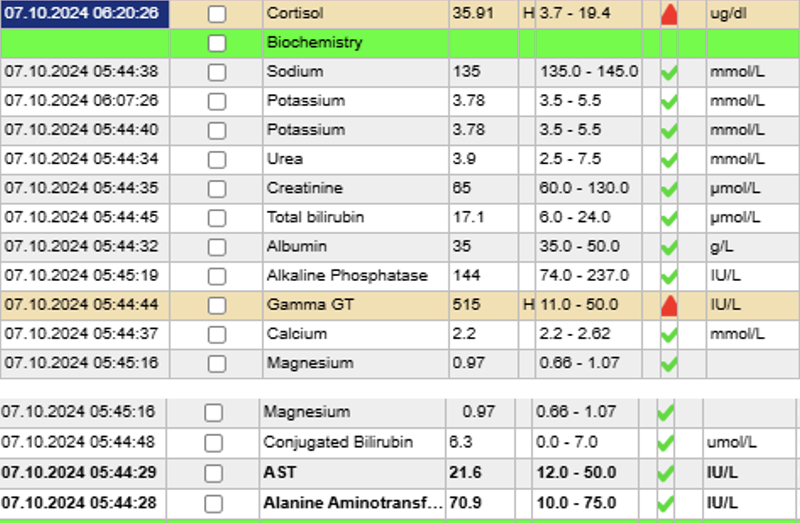

Slide 13
PLAN
  The patient was transferred to another hospital (the University Teaching Hospital of Kigali) to undergo bilateral adrenalectomy for a rapid effect on relieving hypercortisolism
  Key point from this case – instability of the patient:
    This patient presented with an endocrine emergency with florid hypercortisolism, with unstable vitals and electrolytes
      Required urgent treatment to address the life-threatening hypercortisolism before confirming the source of the ACTH / cortisol production
    However, most patients with Cushing syndrome are more stable
      Allows time to test, re-test, image and arrange dynamic testing

Slide 14
Cushing Syndrome
Teaching
  Definition
  Pathophysiology
  Causes
  Illness script
  Work-up and diagnosis
  Treatment

Slide 15
WHAT IS CUSHING SYNDROME
  Cushing syndrome is a clinical condition resulting from chronic exposure to excessive glucocorticoids
  There are both endogenous and exogenous causes
  Incidence of endogenous Cushing syndrome is approximately 2 to 3 per million people annually (although this number is likely higher)

Slide 16
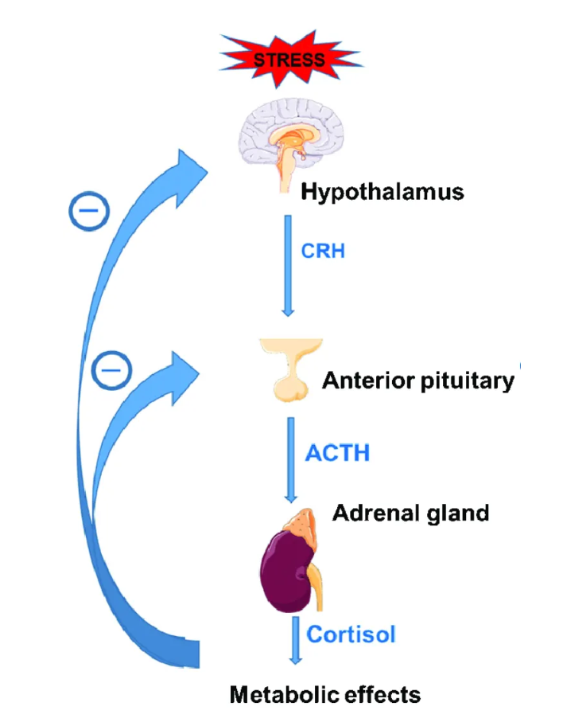
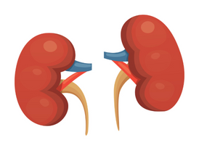
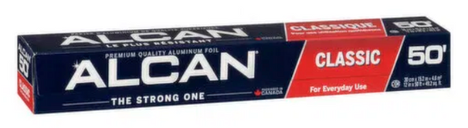
PHYSIOLOGY
  Regulation of cortisol is governed by the hypothalamic-pituitary-adrenal (HPA) axis
  Cortisol exerts negative feedback at both the hypothalamic and pituitary levels, suppressing further CRH and ACTH release
  The HPA axis maintains cortisol within a circadian rhythm
    Peaks early in the morning and nadirs at night
    Allows for acute stress responses via rapid upregulation of CRH and ACTH
  Memory tip:
    3 zones of adrenal cortex: zonas glomerulosa, fasciculata, and reticularis, which secrete aldosterone, cortisol, and androgens respectively
G-F-R
Al-C-An
Image: Bowden SA, Connolly AM, Kinnett K, Zeitler PS. Management of Adrenal Insufficiency Risk After Long-term Systemic Glucocorticoid Therapy in Duchenne Muscular Dystrophy: Clinical Practice Recommendations. J Neuromuscul Dis. 2019;6(1):31-41. doi: 10.3233/JND-180346. PMID: 30614808; PMCID: PMC6398538.

Slide 17
WHAT ARE THE CAUSES OF CUSHING SYNDROME?
Exogenous vs endogenous causes
  Exogenous is by far the most common
    **Steroids**
  Endogenous
    ACTH-dependent vs ACTH-independent
    Cushing disease is the most common endogenous cause of Cushing syndrome

Slide 18
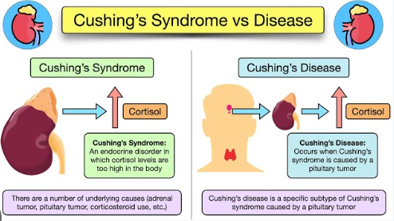
CUSHING SYNDROME VS DISEASE?
  Cushing syndrome: clinical state from chronic exposure to excessive cortisol
  Cushing disease: subset of Cushing syndrome caused by an ACTH-secreting pituitary adenoma
Image: Differences between Cushing's Syndrome and Cushing's Disease. MBBS NAIJA. YouTube.

Slide 19
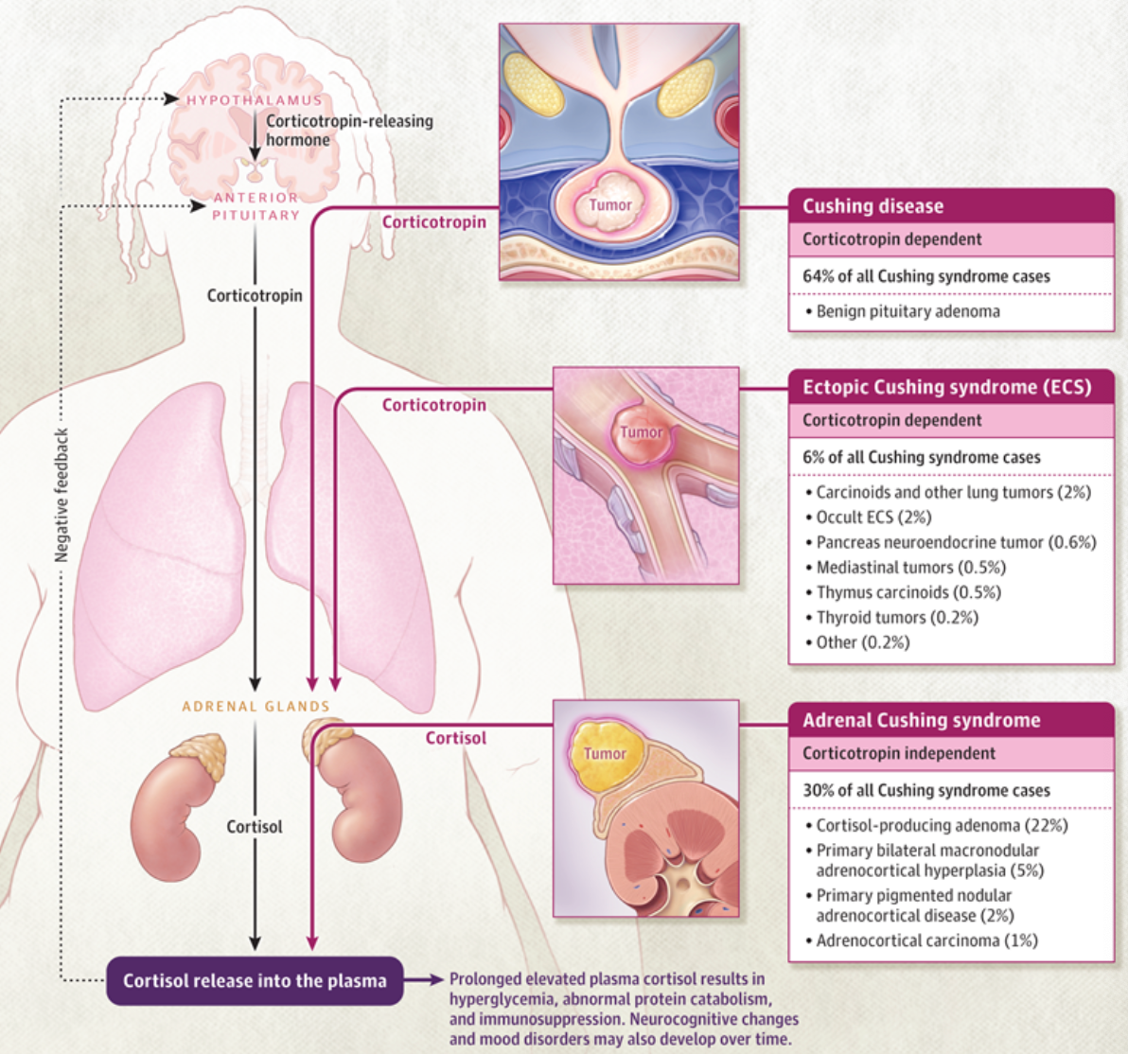
Image: Reincke M, Fleseriu M. Cushing Syndrome: A Review. JAMA. 2023;330(2):170–181. doi:10.1001/jama.2023.11305

Slide 20
ACTH-DEPENDENT CUSHING SYNDROME
3 main causes:
1) Cushing disease:
  Benign pituitary adenoma that oversecretes ACTH
  Often microadenomas (< 1 cm)
2) Ectopic ACTH
  Non-pituitary tumors that oversecrete ACTH
  Most common causes are neuroendocrine tumours of the lung, pancreas and thymus
3) Ectopic CRH
  Ectopic tumour oversecretes CRH
  Excessive cortisol is a result of excessive ACTH secretion
  Associated with bilateral adrenocortical hyperplasia
  Hallmark is either elevated or inappropriately normal levels of plasma ACTH

Slide 21
ACTH-INDEPENDENT CUSHING SYNDROME
2 main causes:
1) Exogenous steroids:
  Often prednisone, but can be caused by oral, injected, inhaled, topical, etc.
  Exogenous steroids inhibit CRH and ACTH secretion, causing bilateral adrenocortical atrophy
2) Adrenal nodules
  Cortisol-producing nodules zona fasciculata of adrenal cortex
  Nodules can be benign or malignant; unilateral or bilateral
  Excessive cortisol is NOT a result of excessive ACTH secretion
    ACTH-independent adrenal gland production of cortisol
  Hallmark is suppressed levels of plasma ACTH

Slide 22
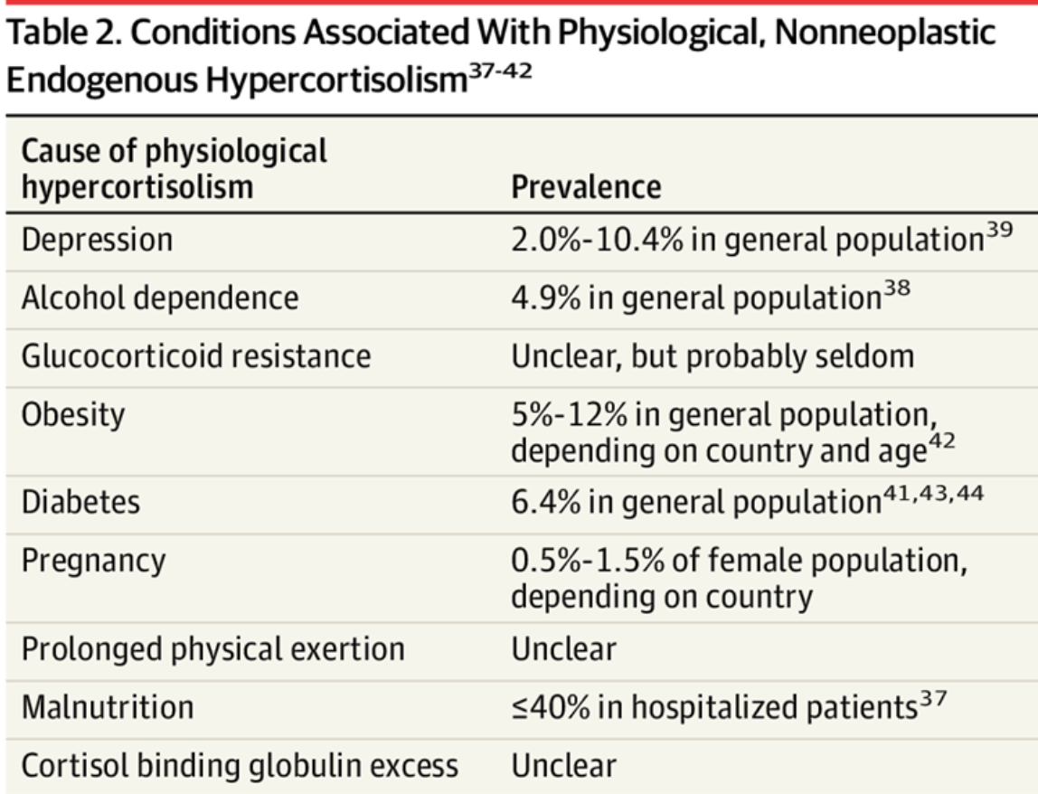
CUSHING SYNDROME MIMICS
  Conditions that cause mild increases in plasma cortisol can mimic Cushing syndrome
Image: Reincke M, Fleseriu M. Cushing Syndrome: A Review. JAMA. 2023;330(2):170–181. doi:10.1001/jama.2023.11305

Slide 23
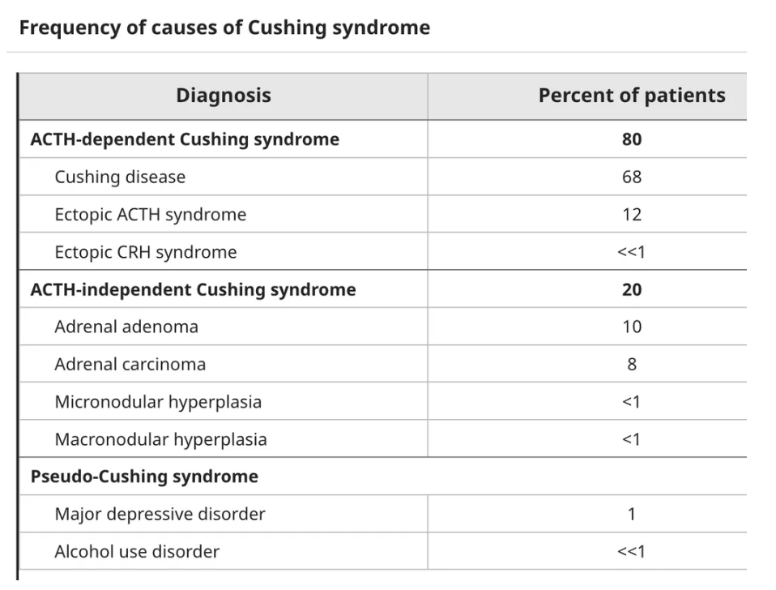
Image: Kirk LF Jr, Hash RB, Katner HP, Jones T. Cushing's disease: clinical manifestations and diagnostic evaluation. Am Fam Physician. 2000 Sep 1;62(5):1119-27, 1133-4. Erratum in: Am Fam Physician 2002 Feb 1;65(3):386. PMID: 10997535.

Slide 24
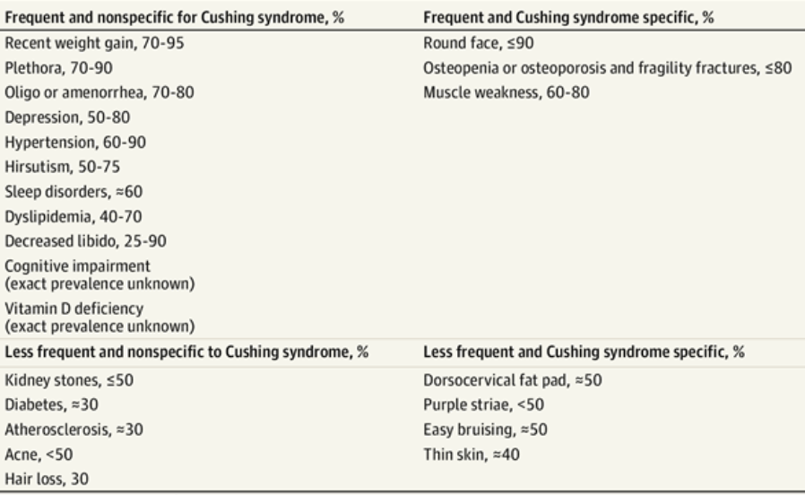
SIGNS AND SYMPTOMS
Image: Reincke M, Fleseriu M. Cushing Syndrome: A Review. JAMA. 2023;330(2):170–181. doi:10.1001/jama.2023.11305

Slide 25
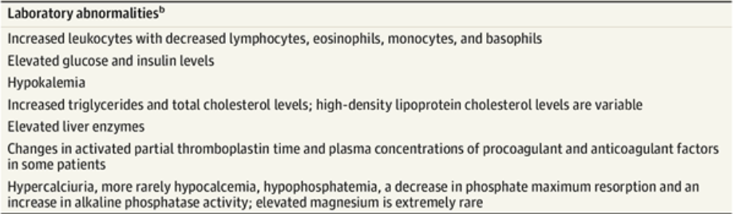
BLOOD WORK
Image: Reincke M, Fleseriu M. Cushing Syndrome: A Review. JAMA. 2023;330(2):170–181. doi:10.1001/jama.2023.11305

Slide 26
DIAGNOSIS
  First step is always to rule out exogenous steroid use
2. Then start with initial screening for endogenous hypercortisolism:
A) 1 mg overnight dexamethasone suppression test
B) 24-hour urinary free cortisol
C) Late-night salivary cortisol
Diagnostic criteria:
unequivocal biochemical evidence of endogenous hypercortisolism on at least two different tests, (interpreted in the context of the clinical presentation)

Slide 27
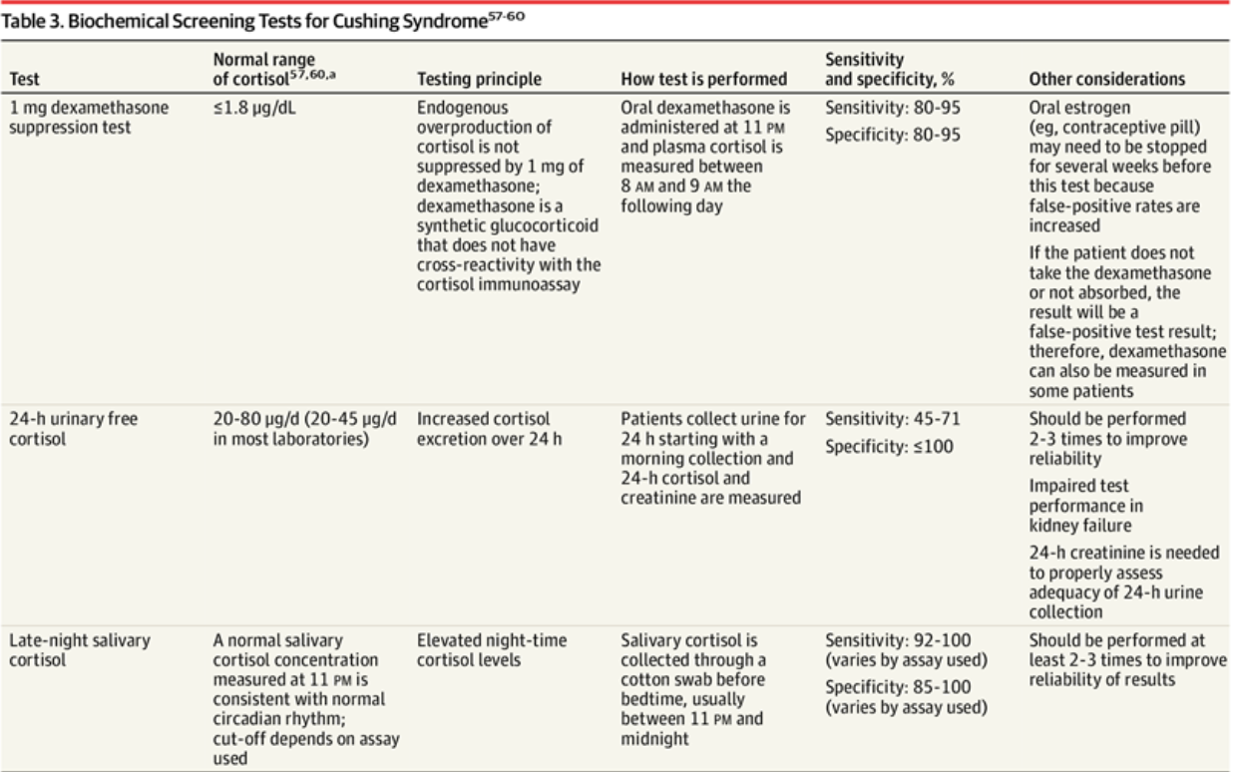
Image: Reincke M, Fleseriu M. Cushing Syndrome: A Review. JAMA. 2023;330(2):170–181. doi:10.1001/jama.2023.11305
Notes:
1 mg DST: 1.8 ug/dL = ~50 nmol/L cortisol
24h urinary free cortisol: 20-80 ug/dL = 550 – 2210

Slide 28
NEXT STEP: DETERMINE ACTH DEPENDENCY
  Test ACTH
    ACTH-dependent: high or inappropriately normal ACTH
    ACTH-independent: suppressed ACTH
  If ACTH-dependent, you must then determine the source of ACTH secretion (ie. is this Cushing disease or ectopic ACTH secretion?)
    Imaging
    Get a bilateral inferior petrosal sinus sampling (IPSS) to distinguish between Cushing disease and ectopic ACTH syndrome
      Gold standard

Slide 29
IMAGING
  Key point: order imaging that reflects the likely cause
  Cushing disease:
    Caused by a pituitary adenoma → order a pituitary MRI. If there is evidence of an adenoma, obtain an IPSS.
  Ectopic Cushing syndrome:
    Often caused by neuroendocrine tumours of the lung, pancreas and thymus → order a CT neck, chest, abdomen
  ACTH-independent:
    Caused by adrenal tumours or primary bilateral macronodular adrenal hyperplasia (PBMAH) → order adrenal imaging
      Unilateral adrenal adenomas are usually small, density values <10 HU, rapid contrast washout on contrast-enhanced CT scans
      Adrenocortical carcinoma has an inhomogeneous tissue pattern with necrosis, calcifications, and >10 HU, delayed contrast washout

Slide 30
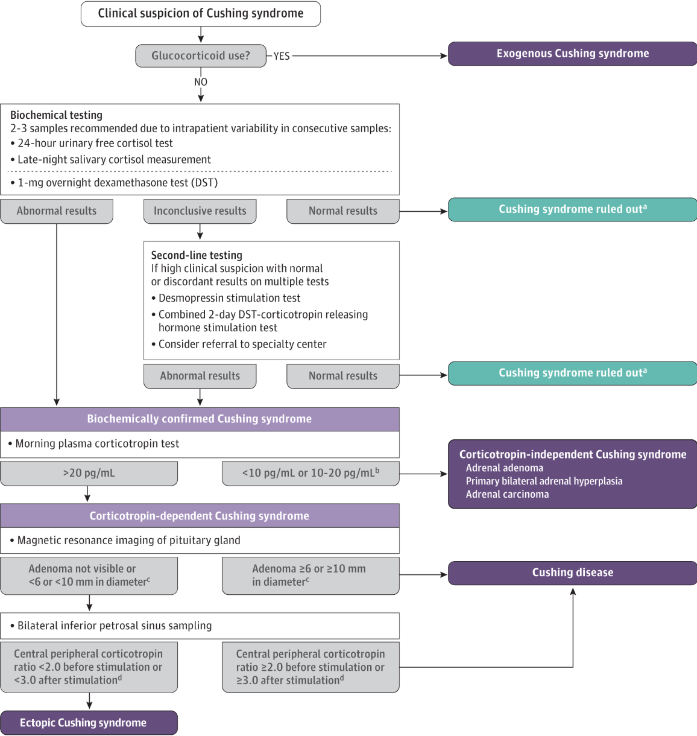
Image: Reincke M, Fleseriu M. Cushing Syndrome: A Review. JAMA. 2023;330(2):170–181. doi:10.1001/jama.2023.11305
Notes:
ACTH 20 pg/mL = 4.4
10 pg/mL = 2.2

Slide 31
MANAGENEMT
  Exogenous: taper the steroids (but caution with adrenal insufficiency)
  Endogenous: the primary aim is complete resection of the underlying tumour to remove the source of excess endogenous cortisol production
  Tumour removal +/- medications are first-line, but in cases of non-response then radiation therapy and bilateral adrenalectomy may be appropriate.
  Monitor for remission with prior screening tests (24h urinary free cortisol, late night salivary, DST)

Slide 32
SURGERY
  Cushing disease:
    Transsphenoidal pituitary surgery
    Central adrenal insufficiency develops postoperatively requiring supraphysiological glucocorticoid doses followed by slow tapering to avoid glucocorticoid withdrawal syndrome and secondary adrenal insufficiency
    Life-long clinical and biochemical follow-up is recommended for early detection of adenoma recurrence
  Ectopic Cushing syndrome:
    Tumor resection is the treatment of choice but is feasible only when the tumor is identified on imaging and can be safely resected
    Bilateral adrenalectomy is often recommended for patients with severe ectopic Cushing syndrome as it has an immediate effect on relieving hypercortisolism and can stabilize the patient, facilitating later oncological treatments.

Slide 33
MEDICAL AND RADIATION THERAPY
  Medical therapy:
    Use when surgery failed or is not feasible
    Inhibit adrenal steroidogenesis
      Beware of adrenal insufficiency given potent cortisol reductions
    Possible medications:
      Cushing syndrome: ketoconazole, metyrapone, and osilodrostat
      Cushing disease: osilodrostat, pasireotide (somatostatin receptor ligand), cabergoline (dopamine D2 receptor agonist)
      Adrenal cancer: mitotane
  Radiation therapy:
    Can be used as adjuvant treatment for patients with endogenous Cushing syndrome who do not achieve remission with surgery

Slide 34
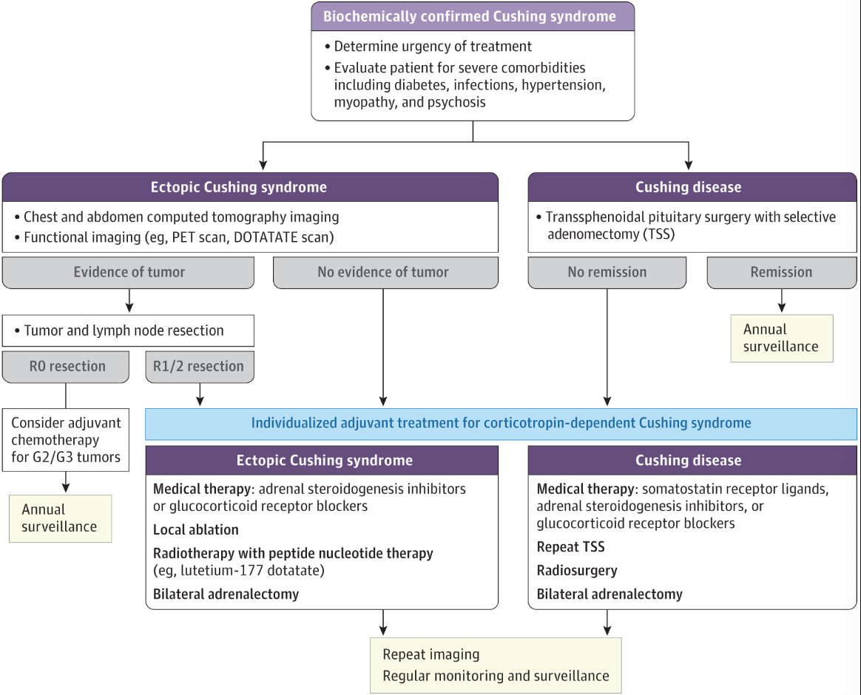
Image: Reincke M, Fleseriu M. Cushing Syndrome: A Review. JAMA. 2023;330(2):170–181. doi:10.1001/jama.2023.11305

Slide 35
REFERENCES
  Reincke M, Fleseriu M. Cushing Syndrome: A Review. JAMA. 2023;330(2):170–181. doi:10.1001/jama.2023.11305
  Gadelha M, Gatto F, Wildemberg LE, Fleseriu M. Cushing's syndrome. Lancet. 2023 Dec 9;402(10418):2237-2252. doi: 10.1016/S0140-6736(23)01961-X. Epub 2023 Nov 17. PMID: 37984386.
  Maness DL, Studebaker G, Knight CM. Cushing's Syndrome: Rapid Evidence Review. Am Fam Physician. 2024 Sep;110(3):270-280. PMID: 39283850.
  Nieman LK, Castinetti F, Newell-Price J, Valassi E, Drouin J, Takahashi Y, Lacroix A. Cushing syndrome. Nat Rev Dis Primers. 2025 Jan 23;11(1):4. doi: 10.1038/s41572-024-00588-w. PMID: 39848955.
  Bowden SA, Connolly AM, Kinnett K, Zeitler PS. Management of Adrenal Insufficiency Risk After Long-term Systemic Glucocorticoid Therapy in Duchenne Muscular Dystrophy: Clinical Practice Recommendations. J Neuromuscul Dis. 2019;6(1):31-41. doi: 10.3233/JND-180346. PMID: 30614808; PMCID: PMC6398538.

Slide 36
Thank you!

