Slide 1

Noon Report
Under pressure
Adam Pietrobon
VGH LMR

Slide 2
sympathomimetic toxidrome
causing
hypertensive emergency
causing
flash pulmonary edema

Slide 3
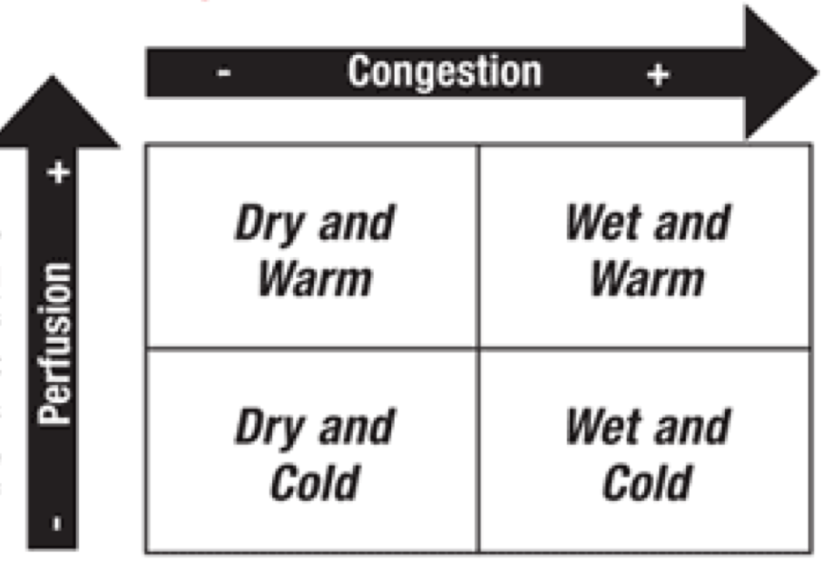
Phenotypes of heart failure
Why does this matter?
Guides therapy

Slide 4
Phenotypes of heart failure - Reclassifying
Acute decompensated heart failure (warm & wet)
AdHF with severe pulmonary edema (warm, wet OR dry)
Cardiogenic shock (cold, wet OR dry)
Isolated right ventricular failure

Slide 5
AdHF with severe pulmonary edema
~= flash pulmonary edema ~= sympathetic crashing acute pulmonary edema (SCAPE)
Features
Rapid onset pulmonary edema, rapid resolution
Usually caused by increased afterload (e.g. usually SBP > 160) → acute rise in LVEDP → pulmonary congestion
  Exceptions: e.g. acute mitral regurgitation → flash pulmonary edema != SCAPE
CVP often low, as right heart compensates acutely
Risk factors: diastolic dysfunction, hypertension
Principles of management (pressure problem, not volume problem)
Afterload reduction (e.g. nitroglycerin, BiPAP)
+/- volume removal

Slide 6
Toxidromes - Classification
By substance
Anticholinergic
Cholinergic
Sympathomimetic
Opioids
Sedatives
Psychotropic
  Serotonin syndrome
  NMS
Malignant hyperthermia
Mixed
Hyperthermic toxidromes
Sympathomimetic
Anticholinergic
Serotonin syndrome
Neuroleptic malignant syndrome
Malignant hyperthermia
Many tables available online for distinguishing toxidromes

Slide 7

Sympathomimetic vs Serotonin Syndrome
sympathomimetic = ↑ catecholamines
serotonin syndrome = ↑ serotonin (5-HT)
Shared clinical features: Agitation, diaphoresis, pupil dilation, tachycardia
Shared causes: MDMA, cocaine, dextromethorphan
Features that increase probability of serotonin syndrome
Predisposing medication (e.g. SSRi, MAOi)
Encephalopathy, severe autonomic instability
Clonus, hyperreflexia
Management very similar

Slide 8
Differential diagnosis for T wave inversions
Wellens pattern
NSTEMI
Raised ICP
Stress cardiomyopathy
Large PE
Benign repolarization

Slide 9
Stress cardiomyopathy
aka Takotsubo cardiomyopathy aka Broken Heart Syndrome
Transient, reversible non-ischemic cardiomyopathy
Characterized by acute LV systolic dysfunction and RWMAs that do not follow a single coronary territory
Suspected be caused by catecholamine surge, often triggered by physical or emotional stress
May present very similarly to ACS (chest pain, ECG changes, cardiac dysfunction), but find non-obstructive CAD

Slide 10
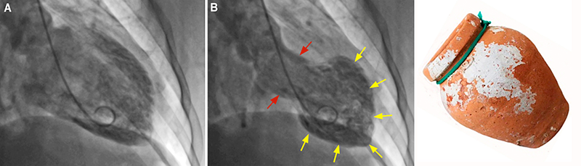
Stress cardiomyopathy - Investigations
ECG
  ST segment elevation and TWI (often anterior leads), Qc prolongation (Torsades risk)
Labs
  troponin elevation, NT-proBNP elevation
TTE
  Classic: LV apical a/hypokinesis +/- ballooning,
  with basal hyperkinesis
  LVEF reduced
Coronary assessment
  Normal or non-obstructive disease
Takotsubo =
Japanese octopus trap

Slide 11
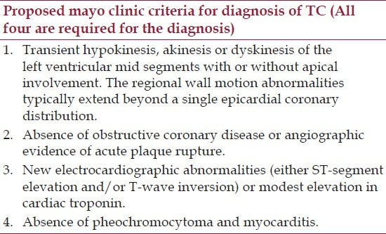
Stress cardiomyopathy - diagnosis of exclusion
TTE findings
ECG findings
Coronary assessment
Exclude other causes

Slide 12
Stress cardiomyopathy - management & prognosis
Management is focused on supportive therapy and treating complications (heart failure, shock, arrhythmias, LV thrombus, etc.)
Some evidence of ACEi/ARB on conferring 1 year mortality benefit; all other pharmacological agents (BB, antiplatelets, statins) controversial benefit unless concurrent indication (e.g. non-obstructive CAD)
Typically resolves within 1 - 4 weeks, with low risk of recurrence

