Slide 1


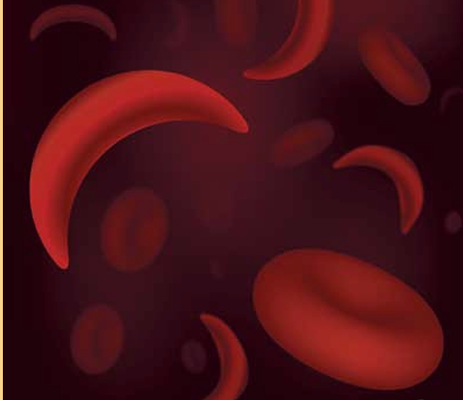
Sickle Cell Disease
UBC/UR Global Health Rounds
Jul 15, 2025
Presented by:
Davy Lau, PGY2 Internal Medicine, UBC
Ishimwe Epiphanie, PGY3 Internal Medicine, University of Rwanda
Supervised by:
Dr Hayley Merkeley, Dr Angelina Marinkovic, & Dr Vignesh Murthy
Hematologists, St Paul’s Hospital
Wjdan A. Arishi. (2021). Techniques for the Detection of Sickle Cell Disease. Micromachines , Volume 12, Article 519

Slide 2
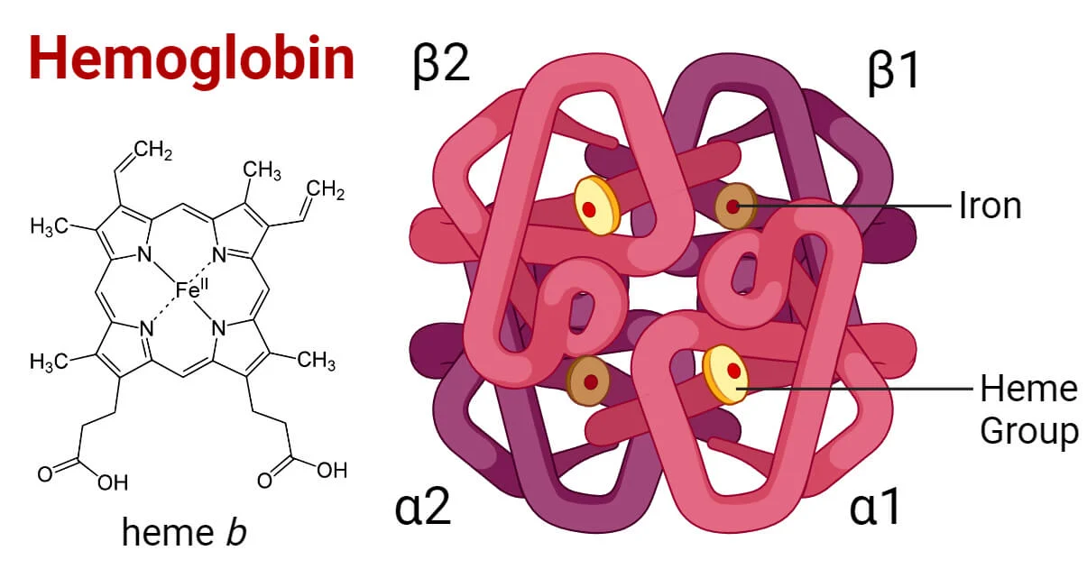
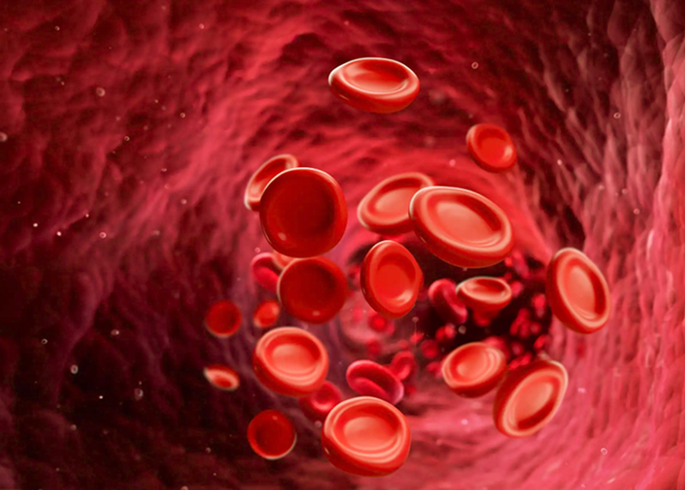
Normal hemoglobin structure
HbA (α2β2): 95-98% of adult Hb
HbA2 (α2δ2): 2-3% adult Hb
HbF(α2γ2): only trace in adult
Francisco Javier Borrayo López. (2023). Structural Effect of Gγ and Aγ Globin Chains in Fetal Hemoglobin Tetramer. american society of hematology, 2291.

Slide 3
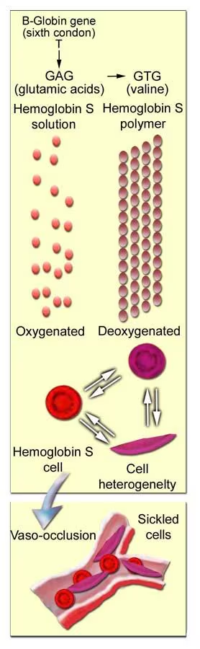
What is sickle cell disease (SCD)?
inherited group of disorders, autosomal recessive
mutations in the β-globin gene → abnormal forms of the β-subunit of haemoglobin
  e.g. E6V mutation → glutamate changed to valine → HbS
HbS under deoxygenated conditions:
decreased solubility
increased viscosity
polymer formation
🡪 leads to sickling formation
Hallmark of SCD = painful vaso-occlusion and hemolytic anemia
Assaf P. Oron1, D. (2020). Caring for Africa’s sickle cell children: will. BMC Medicine, 18:92.
Kato G. et al. Nature Reviews Disease Primers 4,18010 (2018
Notes:
HbSS refers to having two copies of the gene mutation, hence both mutated genes produce a sickle cell

Slide 4
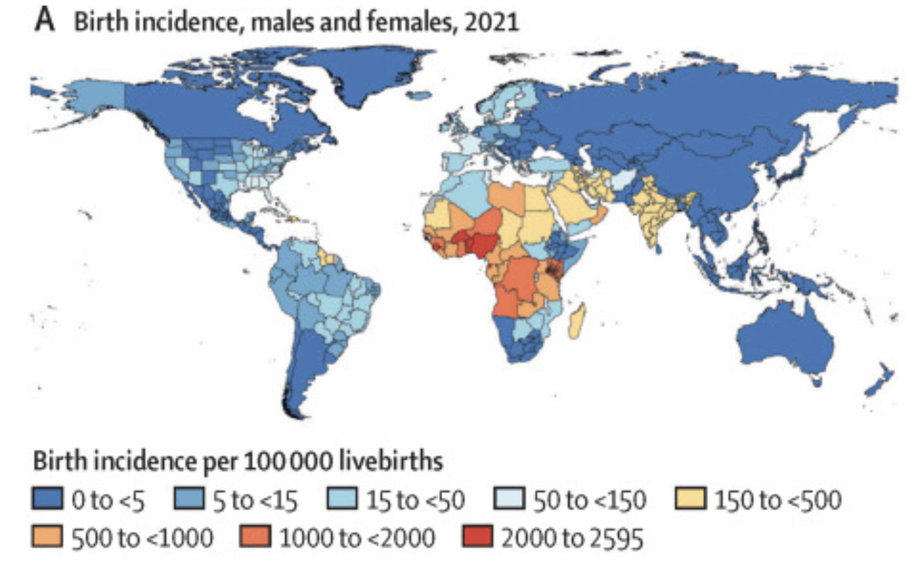
Global Epidemiology
Most prevalent in:
  Sub-Saharan Africa
  Central America, South America, Caribbean
  Saudi Arabia
  India
  Mediterranean countries - Turkey, Greece, and Italy
Sickle cell trait (HbAS) = evolutionary adaptation to malaria
2000-2021
  Birth prevalence increased by 13%
  all-age prevalence increased from 5.46 million to 7.74 million
  total sickle cell disease mortality: 11x higher
  12th leading cause of mortality in < 5 y/o
Thomson, Azalea M. "Global, regional, and national prevalence and mortality." Lancet Haematol 2023, 2023: 585-99
Notes:
Mechanism of evolutionary adaptation: Malaria enters hemoglobin → sickling → RBC dies before infection can spread
Sources: https://sickle-cell.com/clinical/malaria

Slide 5

SCD in Rwanda
Limited data, but…
In 2012: < 5 y/o prevalence
- HbSS (sickle cell anemia): 0.13%
- HbAS (sickle cell trait): 2.8%
2021 estimate: 135,000 SCD patients
  Prevalence: 1.01%
Childhood mortality in Africa = 50-90% under the age of 5
Joseph Kawuki, T. H. (2019). Sickle Cell Disease in East African Countries: Prevalence, Complications and Management. journal of Advances in Medicine and Medical Research, 30(8): 1-9,.
UWIZEYIMANA, G. (2022, april 28). Retrieved from MIT solve: https://solve.mit.edu/solutions/62808
Grosse SD, Odame I, Atrash HK, Amendah DD, Piel FB, Williams TN. Sickle cell disease in Africa: a neglected cause of early childhood mortality. Am J Prev Med. 2011 Dec;41(6 Suppl 4):S398-405. doi: 10.1016/j.amepre.2011.09.013.

Slide 6

SCD in Canada / BC
Canada
  8000 SCD patients
  Prevalence: 0.015%
  Incidence: 1 in 2500 newborns
  Life expectancy = 25-30 yrs less than non-SCD pts
BC:
  300 SCD patients
  Prevalence: 0.005%
Sickle cell anemia. The Sickle Cell Disease Association of Canada. (2025). https://sicklecelldiseasecanada.com/sickle-cell-anemia/
Surviving sickle cell disease. BC Children’s Hospital Research Institute. (2025). https://www.bcchr.ca/news/surviving-sickle-cell-disease
Addressing the Health Equity Gap in Sickle Cell Disease in Ontario. https://www.sicklecellanemia.ca/Articles/public/health-equity-gap-in-sickle-cell-disease-in-ontario-canada

Slide 7
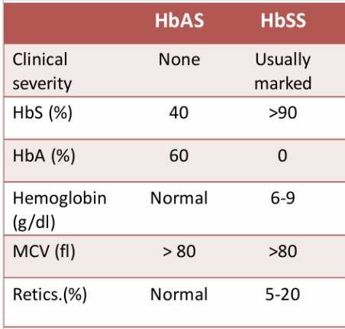
Sickle Cell Trait vs Sickle Cell Anemia
Notes:
Those with sickle cell trait are generally asymptomatic (except) sickling at high altitudes, and even though they have almost 50/50 sickle hemoglobin, their overall Hb level should be normal

Slide 8
Labs of an SCD Patient
CBC: low hemoglobin, low haematocrit, possibly high platelets (asplenia)
MCV: Normocytic or macrocytic (if taking hydroxyurea)
Hemolysis:
  Low haptoglobin
  High LDH
  High indirect bilirubin
  High retics
Hemoglobin electrophoresis (HbA, HbA2, HbF, HbS in percentages)

Slide 9
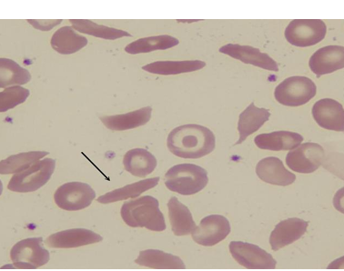
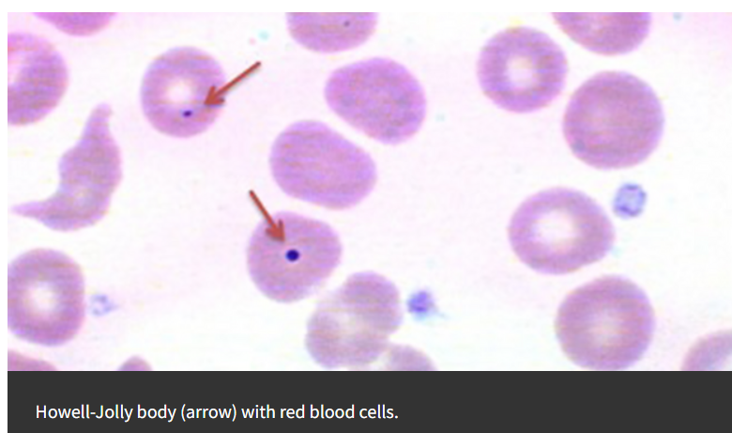
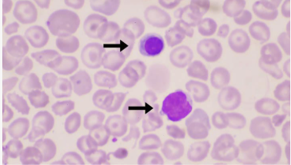
Peripheral blood film in HbSS
– Sickle cells
– Normochromic, normocytic
– Polychromasia → immature RBCs
– Target cells → Asplenia
– Howell-Jolly bodies (HJB) → Asplenia
– High WBC +/- High plts
Wjdan A. Arishi. (2021). Techniques for the Detection of Sickle Cell Disease. Micromachines , Volume 12, Article 519
Polychromasia. Cleveland Clinic. https://my.clevelandclinic.org/health/diseases/25128-polychromasia
Notes:
Polychromasia is blue (immature)
High WBC etiology, not totally clear, may be increased stimulus for erythropoiesis or related to asplenia

Slide 10

Diagnosis of SCD
Hemoglobin Electrophoresis
Genetic testing with Sanger Sequencing
Wjdan A. Arishi. (2021). Techniques for the Detection of Sickle Cell Disease. Micromachines , Volume 12, Article 519

Slide 11
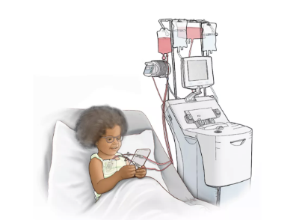
Transfusions in SCD
Simple Transfusion
  Transfusing donor HbA to the patient
  Good if Hb down from baseline
Exchange Transfusions
  Removing HbS from the patient via apheresis machine
  Transfusing donor HbA to the patient
  Use if Hb at baseline but having end-organ dysfunction
Wjdan A. Arishi. (2021). Techniques for the Detection of Sickle Cell Disease. Micromachines , Volume 12, Article 519

Slide 12
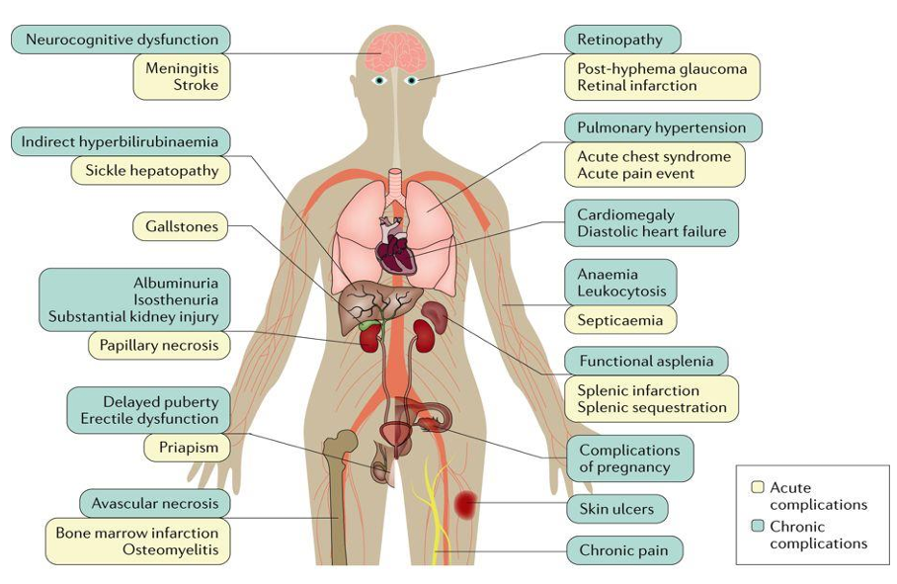
Sickle cell disease clinical complications
Kato G. et al. Nature Reviews Disease Primers 4,18010 (2018
Notes:
Davy’s Slide
Point out ones that the patient had

Slide 13

Rule out other causes!
Non-Sickle Cell Differential
Acute Coronary Syndrome (MI)
Pneumothorax
Dissection
PE
Esophageal Rupture
Sickle Cell Differential (Acute Complications)
Vaso-occlusive crisis
Acute Chest Syndrome (ACS) and its causes
Splenic sequestration (more pediatric)

Slide 14

Symptoms
Sudden onset chest pain, retrosternal, radiating to bilat shoulders and neck
Previous pain crises are same location/quality, usually attenuates with ketorolac
No dyspnea/URTI symptoms, no pleuritic chest pain, no n/v/abdo pain
Triggers?
No infectious symptoms, no dehydration, no prolonged exercise/high altitude, no cold weather
Exam
No resp distress. Normal heart sounds. Clear lungs. No abdo tenderness. No unilateral leg swelling or tenderness
Investigations?

Slide 15
Acute SCD Complications
Relevant in this patient
Vaso-Occlusive Crisis
Acute Chest Syndrome
Head-to-Toe
Stroke
Splenic Sequestration
Bacterial Infections (asplenia)
Priapism
Acute Aplastic Crisis
Wjdan A. Arishi. (2021). Techniques for the Detection of Sickle Cell Disease. Micromachines , Volume 12, Article 519

Slide 16
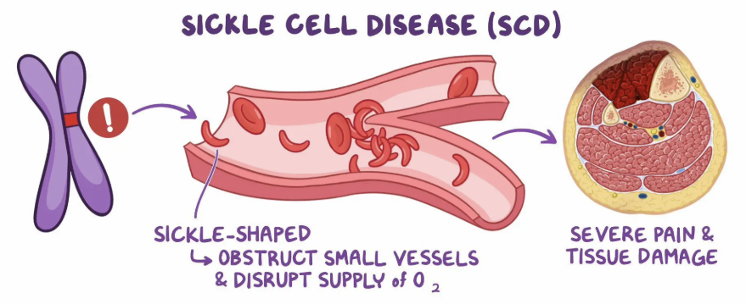
Acute Painful Episodes (Vaso-Occlusive Crisis)
Pain: most common clinical complication in SCD
Cycles of ischemia and reperfusion
Pain is commonly from bone infarcts and ischemia in the microvasculature (capillaries)
most commonly in the extremities, chest, and back
sudden, sometimes gradual onset, hrs-days
Majority of pain episodes are managed at home
– 1/3 have daily pain
– Triggers: hypoxemia, dehydration, cold, pain, stress, infection, pregnancy/menses
Kato G. et al. Nature Reviews Disease Primers 4,18010 (2018)
Sickle cell disease. Osmosis. https://www.osmosis.org/learn/Sickle_cell_disease:_Clinical_sciences
Notes:
Cells tend to sickle more in areas of hypoxia (hence why sickling occurs more in microvasculature) and dehydration
Pain for other reasons can trigger sickle cell pain crises

Slide 17
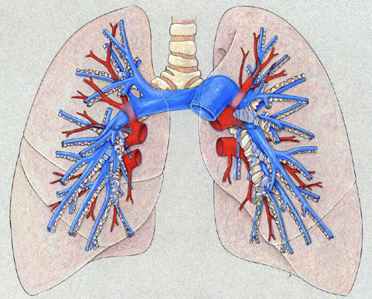
2. Acute Chest Syndrome (ACS)
Definition: ACS = acute illness characterized by fever and/or respiratory symptoms accompanied by new pulmonary infiltrate on CXR
  Hypoxemia → predicts severity & outcome
Vaso-occlusion can lead to localized hypoxia, ischemia, and infarction of lung tissue
Onset: usually within 24-72 h of acute pain episode → can occur days into admission!
Causes:
  Pneumonia (Chlamydophila & Mycoplasma, viral) - 30%
  Fat embolus from bone infarct - 10%
  PE
  Evolution of VOC
  Atelectasis, e.g. from poor respiratory effort due to pain, opioids
Pulmonary vasculature. Introduction to Radiology. https://introductiontoradiology.net/courses/rad/cxr/anatomy6chest.html. (2021)

Slide 18
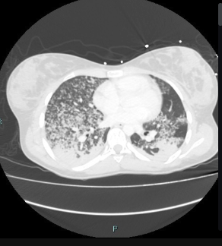
2. Acute Chest Syndrome (ACS) con’t
most common cause of death in adults with SCD
  4.3% mortality in adults
Cannot differentiate ACS from pneumonia
Acute Chest Syndrome is ischemia in the pulmonary microvasculature; not to be confused with as Acute Coronary Syndrome (e.g. STEMI)...However, MI would be important to rule out
Workup: CXR, ECG, septic workup +/- Chest CT Scan (can see PE/fat embolism)
Acute Chest Syndrome. StatPearls. https://www.ncbi.nlm.nih.gov/books/NBK441872
Pulmonary fat embolism. Radiopaedia. https://radiopaedia.org/articles/pulmonary-fat-embolism. (2024)
Notes:
Fat embolus on CT: Lots of ground glass, alveolar edema, septal thickening, inflamed image

Slide 19
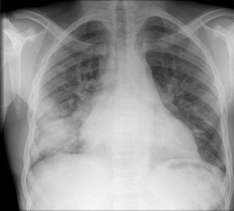
CXR for ACS CXR for Pneumonia

Slide 20
CXR for ACS CXR for Pneumonia
Notes:
Yes they are the same image

Slide 21
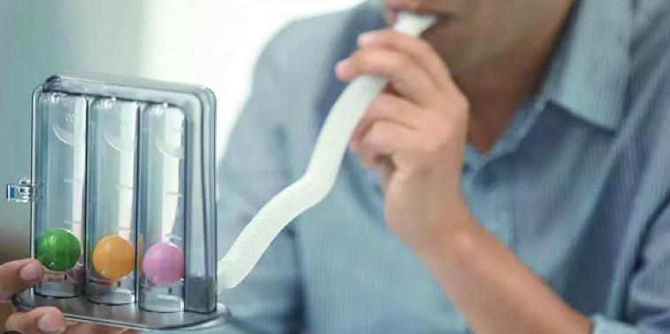
Management of ACS
Oxygen to maintain SpO2 > 95% with 4hrly monitoring
Euvolemia → give iv fluids until able to drink orally
Analgesia
  Caution with opioids: overdose → hypoventilation → worse hypoxemia
- IV antibiotics: broad spectrum + atypicals
- e.g. CTX & Azithro
- **Incentive spirometry → atelectasis prevention
(>10 maximum inspirations q2h while awake)
When to transfuse?
  Depends on severity of hypoxemia/ACS, if O2 requirements increasing, etc.
  Exchange transfusion preferred over simple, esp if the ACS is severe
British Journal of Haematology, 2015, 169, 492–505
American Society of Hematology 2020 Guidelines for SCD Transfusion Support
Notes:
Pain relief is vital → Atelectasis from pain worsens hypoxemia, which worsens sickling!

Slide 22
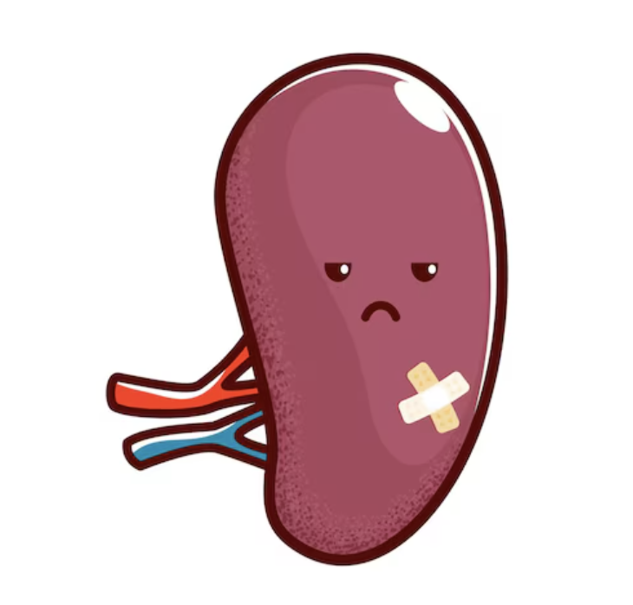

Splenic sequestration
sudden enlargement of the spleen and reduction in Hb concentrate on by at least 2 g/dL below the baseline value
Only occurs in patients with functional spleens, so usually in pediatrics only
Presentation:
- LUQ pain, fullness, tenderness
-reticulocytosis
- Splenomegaly
Treatment
Hypovolemia → IV fluids
severe anemia→ transfusion (max 1u at a time due to risk of desequestering blood → hyperviscosity → risk of stroke)
recurrent events → consider splenectomy

Slide 23
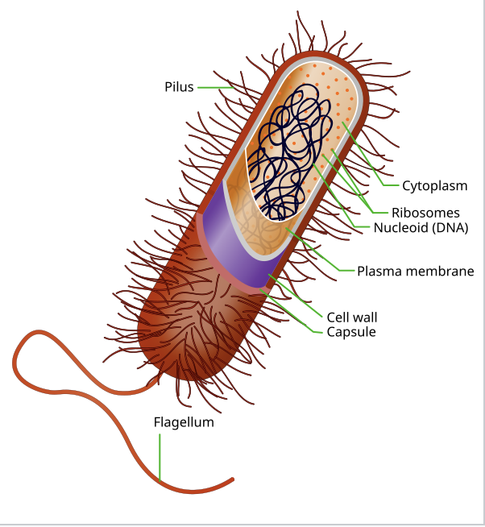
Bacterial Infections
Functional asplenia develops by age 2-3 months (spleen is infarcted due to sickling)
Risk of encapsulated bacterial infections especially Streptococcus pneumonia
Also susceptible to: Salmonella, Haemophilus influenza b, N meningitidis, Mycoplasma
Septicemia, meningitis, osteomyelitis
Decreased childhood mortality due to
– Newborn screening (e.g. heel prick)
– Conjugate pneumococcal vaccine
– Penicillin prophylaxis (oral pill every day until 5 years old)
*recommended by American Academy of Pediatrics*
Gaston et al. NEJM. 1986. 314:1593

Slide 24
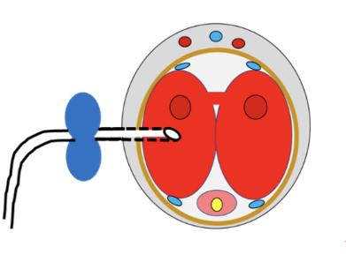
Priapism
Always ask!!!
Sustained, unwanted, painful erection lasting > 4 hours
Veno-occlusion causing decreased venous outflow
Severe or recurrent priapism can lead to permanent erectile dysfunction
Life-time prevalence in boys and men: 29 – 89%
Treatment
– Supportive: IV hydration, pain management
– Oral vaso-active agents: eg. Pseudoephedrine
– Prolonged: Urology consult, relieve compartment syndrome, improve blood flow. E.g. intracavernosal shunt in our patient

Slide 25
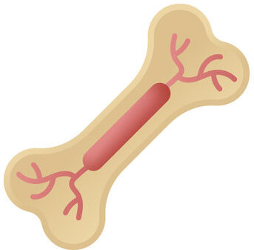
Acute aplastic crisis
Due to a viral (e.g. Parvovirus B19) infection
More common in children with HbSS
Presentation: Gradual onset of fatigue, dyspnea, fever, syncope
Hemoglobin 3-6 g/dl down from baseline, Hematocrit down
Decreased reticulocytes from normal
  Normally 8-20% retics in SCD patients
Treatment: Supportive red blood cell transfusions (simple)

Slide 26

Stroke
Bimodal prevalence: children & older adults
High prevalence: 4.01% of SCD pts
High recurrence rate: 50% within 2 yrs, 66% within 9 yrs
In adults: more commonly hemorrhagic (from aneurysm/neovascular malformation) but ischemic too
Management
Acute: Hot stroke activation, Exchange transfusion, SpO2 > 95%
  Limited data for thrombolytics in SCD patients, case-by-case
  Hemorrhagic: Supportive management, rarely surgical
Rule out non-SCD causes! E.g. AFib
Secondary prevention
  In Canada: Exchange transfusions as an outpatient
  Lipid lowering, diabetes control, hypertension control
Kassim et al. (2015). How I treat and manage stroke in sickle cell disease. Blood.doi: 10.1182/blood-2014-09-551564

Slide 27
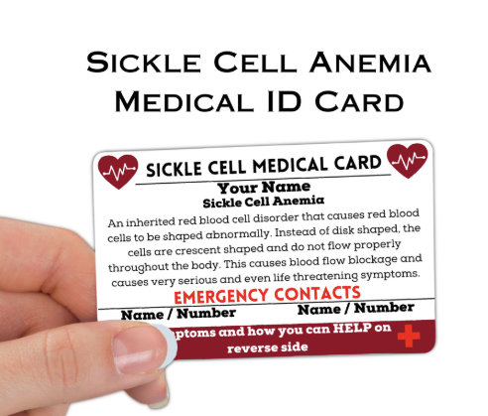
Pain Management in Vaso-Occlusive Crisis
Rapid pain control:
-rapid pain assessment and analgesia selection
-initiate analgesic therapy within 30 minutes of triage
-Non-pharmacological therapies: e.g. massage, yoga, distraction, heat
- Address triggers
  PO/IV Hydration
  Rule out infection
  Oxygen if hypoxemic
Blood transfusion: not indicated in uncomplicated painful episodes
BC: Regular tylenol, NSAIDs (ketorolac), hydromorphone PO q4h PRN, IV q1h PRN. Ketamine if severe pain & concerned about opioid toxicity. *See SCD patient care plan*
Rwanda: NSAIDs (diclofenac IM/PO, ibuprofen PO, piroxicam PO); morphine IV q4h/PRN
PCA pumps are an option too!
Brandow et al. Blood Advances, 2020. 4(12)2656-2701
Notes:
Talk about vicious cycle: Pain begets worse sickling leading to more pain

Slide 28


Slide 29
When to transfuse?
NEVER transfuse a sickle cell patient without consulting Hematology!
Why? Risks of transfusing:
  Iron overload → Liver
  Hyperviscosity → patient’s baseline Hb is low, increasing their Hb even to a “normal” level may lead to hyperviscosity → stroke risk
  Allo-immunization → limits blood donors
  Delayed hemolytic transfusion reactions
  **Acute hyperhemolysis! (rapid hemolysis of donor & recipient RBCs)
    Antibodies may not always be present!

Slide 30
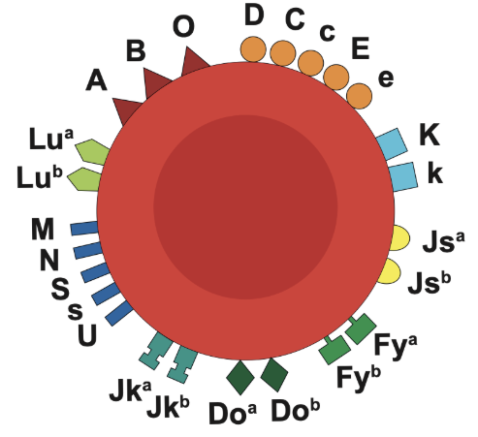
How do we safely transfuse?
Exchange transfusions to avoid hyperviscosity
  Takes away HbS in exchange for donor HbA
BC: Group and screen (to detect antibodies) with extended matching
  Determining RBC antigen profile of the patient (beyond ABO/RhD)
  Cross-matching antigen profile with donor blood
Rwanda: No patient antibody/antigen screen available, but screen donor blood for antigens

Slide 31
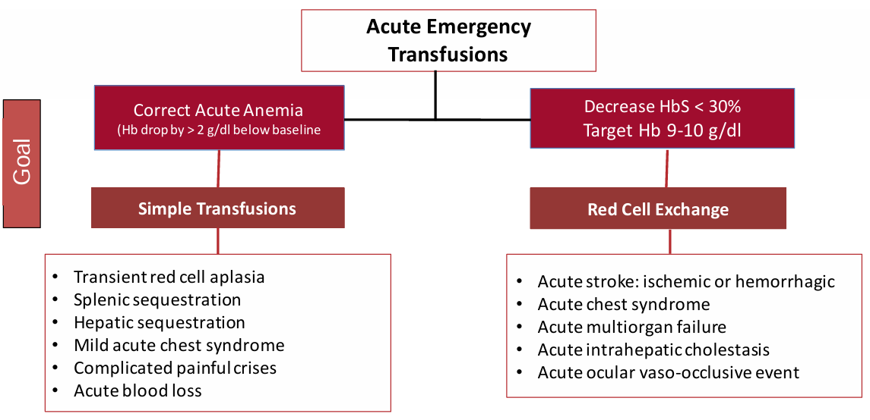
Hematology Am Soc Hematol Educ Program (2021) 2021 (1): 696–703.

Slide 32
Treatment of SCD
General medical care
- Vaccinations (pneumococcal)
- Annual eye exam for retinopathy
- Nutrition
- Pain management: Acute and Chronic
- Screen for and manage acute and chronic complications (heart failure, Fe overload, avascular necrosis)
Therapies
**Hydroxyurea
In Canada: Exchange transfusions as outpatient, e.g. q4wks to target HbS < 30%
L-glutamine
Crizanlizumab
Curative Therapies
In Canada: Stem cell transplantation
Gene Therapy

Slide 33
Sickle cell disease clinical complications
Kato G. et al. Nature Reviews Disease Primers 4,18010 (2018
Notes:
Davy’s Slide
Reminder that there are head-to-toe complications of sickle cell disease, both acute and chronic, many of which we did not go over!

Slide 34
Thanks for listening!
UBC/UR Global Health Rounds
Jul 15, 2025
Presented by:
Davy Lau, PGY2 Internal Medicine, UBC
Ishimwe Epiphanie, PGY3 Internal Medicine, University of Rwanda
Supervised by:
Dr Hayley Merkeley, Dr Angelina Marinkovic, & Dr Vignesh Murthy
Hematologists, St Paul’s Hospital

