Slide 1

ACUTE CARE GERIATRICS
Gurmeet Sohi, MD FRCPC Geriatric Medicine

Slide 2
OBJECTIVES
Incorporating principles of Geriatric Medicine into acute care
Practical tips incorporating Geri friendly evidence
Language matters
Review aging physiology
Approaches to some “Geri Giants”

Slide 3
CASE
95 year old male, recent hospital admission with GI bleed, referred with “weakness/failure to thrive, needs admission for further rehab”

Slide 4
History
PAST MEDICAL HISTORY
  Atrial fibrillation, CHADS5
  Cerebrovascular disease, posterior circ stroke 2008
  HFpEF
  Severe TR
  HTN
  Recent admission for lower GI bleed
MEDICATIONS
  Apixaban 2.5mg BID
  Metoprolol 37.5 mg BID
  Ramipril 1.25mg PO BID
  Atorvastatin 10mg daily
  Vitamin D3 1000IU
  PEG 17g PO daily
  Sennosides 12mg daily
SOCIAL HISTORY
  Lives with daughter and her family – she works full time.
  No smoking/EtOH/recreational daughter
  Speaks Cantonese only
FUNCTIONAL HISTORY
  Baseline: Independent with ambulation with quad cane or 2ww
  ADLs: independent
  IADLs: supported by family

Slide 5


Recent hospitalization
Came in with hematochezia and hemoglobin dropped
  Started on IV PPI
  Refused colonoscopy, had CT colonography → polyps
  Case reviewed with GI → high risk for colonoscopy/polypectomy → monitor
    Given daily anusol rectal suppositories to take for a week
  Given IV iron x2 doses – didn’t get third because felt wheezy with 2nd dose
    Previously hasn’t tolerated PO iron
  Discussion about resuming apixaban in context of bleeding risk vs stroke risk (CHADS:5)
  Cleared by PT/OT and daughter okay to take home with additional home supports

Slide 6


What would you do RE: ANTicoagulation?
DO WE HAVE ANY OTHER OPTIOnS?

Slide 7
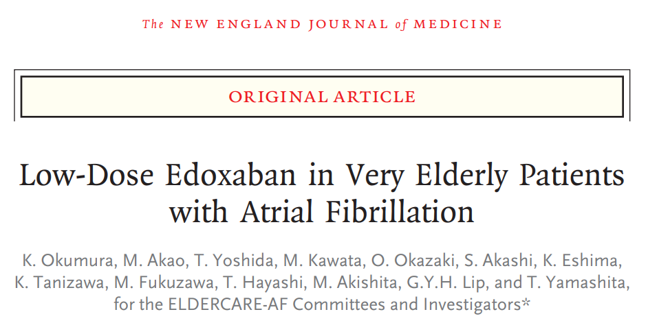
Do we have any other options?
Phase 3, multicenter, randomized, double-blind, placebo controlled event driven trial
Compare edoxaban 15mg daily with Placebo in Japanese patients >80 years of age with non-valvular atrial fibrillation who were considered to not be appropriate candidates for oral anticoagulant therapy at doses approved for stroke prevention
Primary end point: composite stroke or systemic embolism
Primary safety end point: major bleeding
Notes:
In very elderly Japanese patients with nonvalvular atrial fibrillation who were not appropriate candidates for standard doses of oral anticoagulants, a once-daily 15-mg dose of edoxaban was superior to placebo in preventing stroke or systemic embolism and did not result in a significantly higher incidence of major bleeding than placebo.
CHADS2:2 or higher, mean age 86
Eligible patients were also considered to be inappropriate candidates for oral anticoagulants (i.e., warfarin, dabigatran, rivaroxaban, apixaban, or edoxaban) at the recommended therapeutic strength (in the case of warfarin) or at approved doses for one or more of the following reasons: - a low creatinine clearance (15 to 30 ml per minute)
a history of bleeding from a critical area or organ or gastrointestinal bleeding
low body weight (≤45 kg)
continuous use of nonsteroidal antiinflammatory drugs (NSAIDs), or current use of an antiplatelet drug.
We used a 15-mg dose of edoxaban in this trial on the basis of data from the ENGAGE AF-TIMI 48 trial, which compared two doses of edoxaban (60 mg and 30 mg) with warfarin. If patients in either edoxaban group met criteria for dose reductions, the 60-mg dose was reduced to 30 mg, and the 30-mg dose was reduced to 15 mg. Among patients who received the 15-mg reduced dose, the risk of major bleeding was lower than that among patients who received warfarin (1.5% vs. 4.9%), and the incidence of stroke or systemic embolism did not differ significantly between these groups (2.4% among patients who received 15 mg of edoxaban and 2.2% among patients who received warfarin).24

Slide 8

Back to the case, what else do you want to know, a DAY LATER?

Slide 9

More history
After getting home yesterday, initially okay but in the evening became very weak and couldn’t ambulate and was “dead weight”
Couldn’t go to sleep, he slept on the couch sitting up all night with daughter propping him up with pillows around him
Chronic cough, productive white cough – no change to sputum.
No fevers/chills, no urinary symptoms,
N/V after dinner and decreased appetite, no hematemesis, no hematochezia/melena
Daughter feels he was more confused yesterday at night, at baseline no significant cognitive concerns

Slide 10
PHYSICAL EXAM
36.1 HR80 BP 134/69 94%RA RR20-24
CV: irregularly irregular, JVP 4cm ASA, bilaterial + pitting edema
Resp: quiet air entry bilaterally, mild crackles at right lower base
Abdo: soft, non tender
Neuro: oriented to month/year, not place

Slide 11
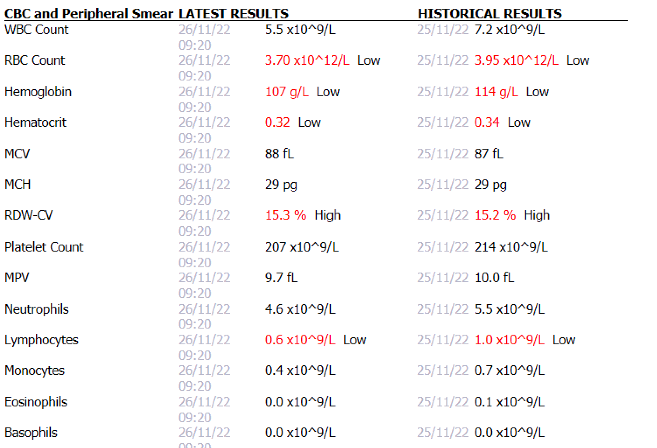

Slide 12
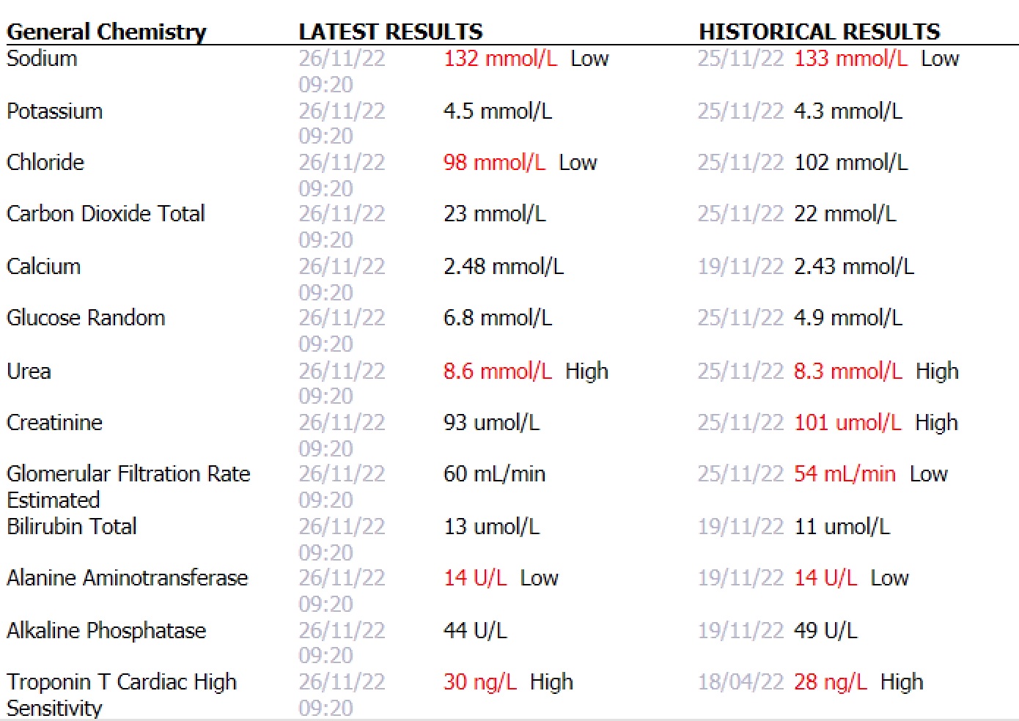

Slide 13

Any more investigations?

Slide 14
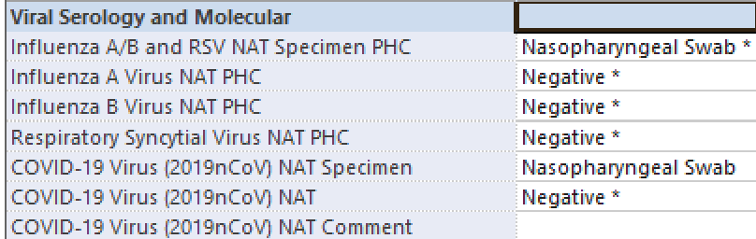
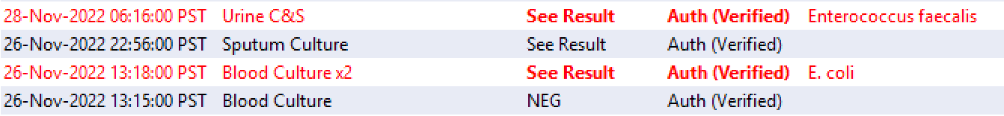
Investigations

Slide 15
Case outcome
Heart failure 2/2 e. coli bacteremia (presumed urinary or GI source)
  Gave IV Lasix 40mg x1 → significant improvement to breathing, RR decreased, sats improved by the next morning
  Eventually stepped down to Lasix 20mg daily to maintain euvolemia
  Completed course of ceftriaxone
Delirium
  Improved with treatment of infection and underlying constipation
Plan for D/C home with supports

Slide 16
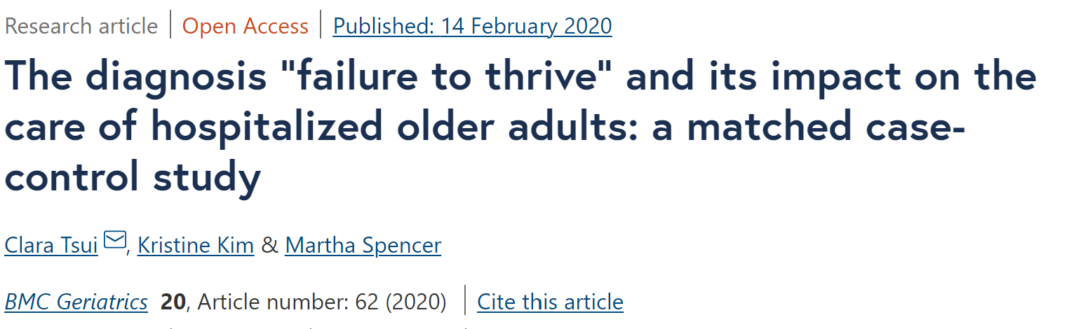
“Failure to thrive”
Notes:
Retrospective matched cohort study conducted at a tertiary care hospital in Vancouver, BC. Cases identified were adults aged ≥65 years admitted to acute medical wards with an admission diagnosis of “failure to thrive”, “FTT”, “failure to cope”, or “FTC”, between January 1, 2016 and November 1, 2017 (n = 60, median age 80 years). Age-matched controls met the same inclusion criteria with admission diagnoses other than those of interest (n = 60, median age 79 years).

Slide 17
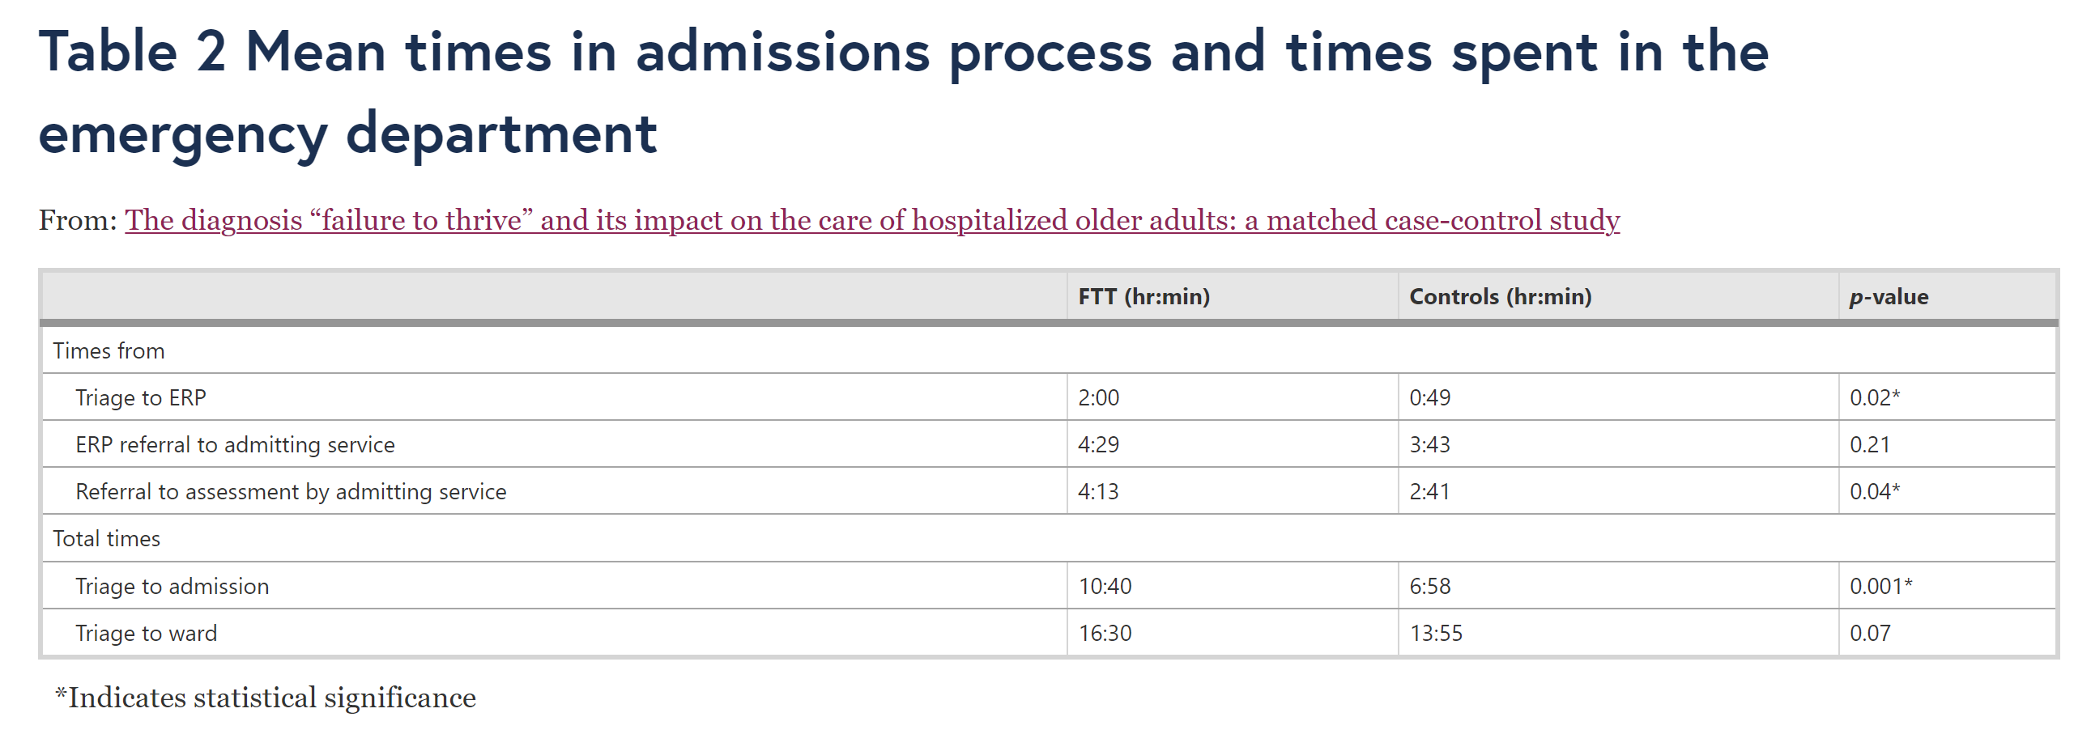
Notes:
The total time from triage to admission for older adults admitted with FTT and associated diagnoses was 10 h 40 min, compared to 6 h 58 min for controls (p = .02).

Slide 18
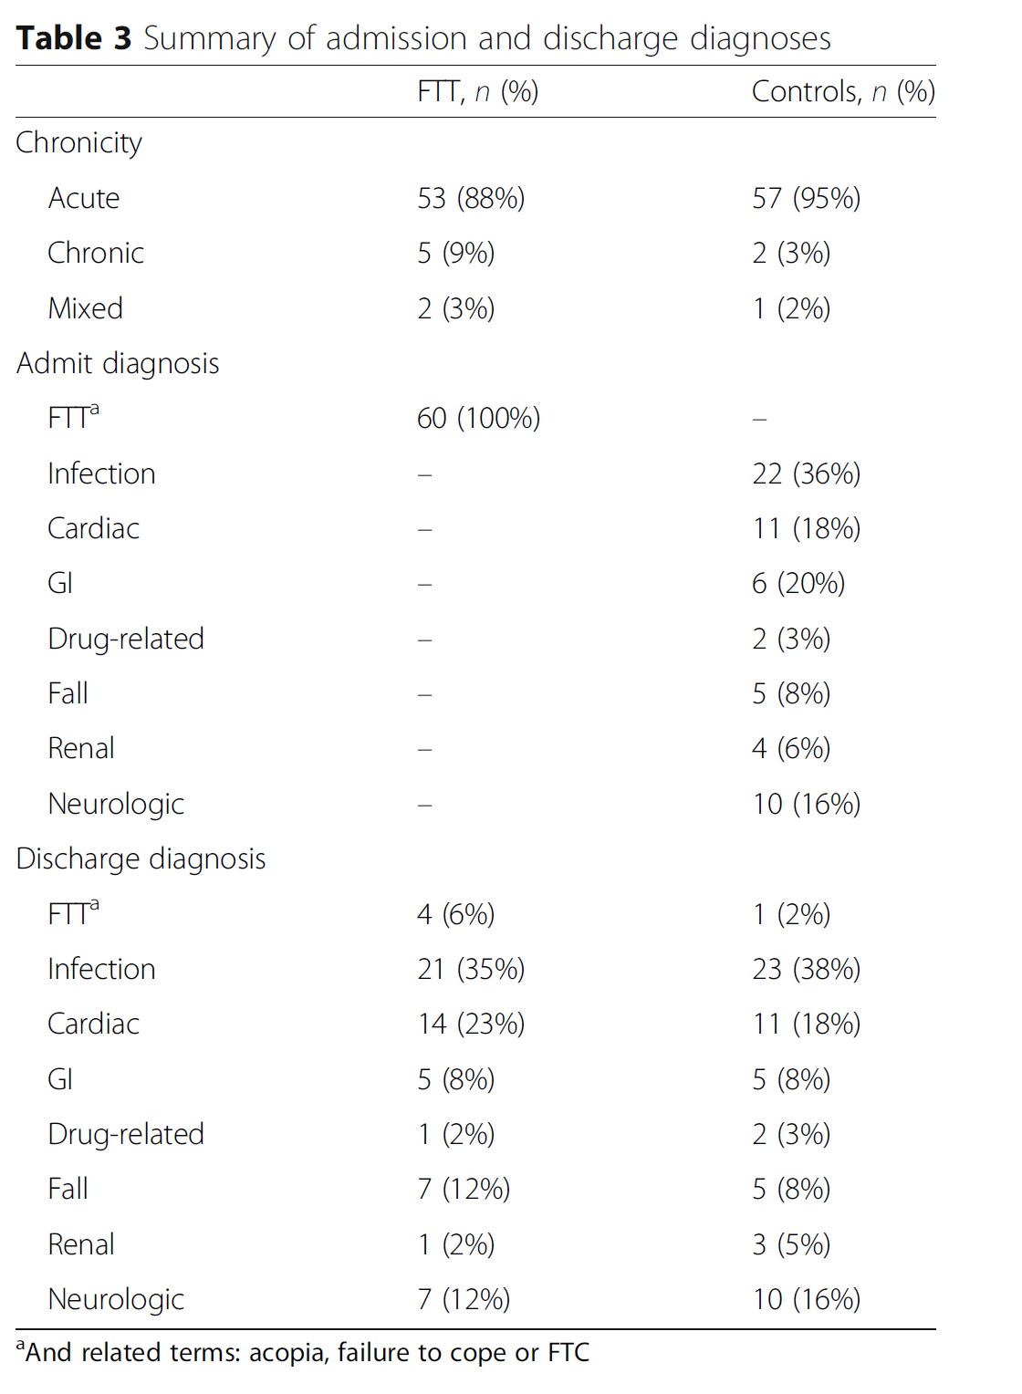
88% of the “failure to thrive” cohort had an acute medical diagnosis at time of discharge
Notes:
Concordance of admission and discharge diagnoses was only 12% for the “failure to thrive” cohort, and 95% for controls. Notably, 88% of the “failure to thrive” cohort had an acute medical diagnosis at the time of discharge. Patients in this cohort stayed 18.3 days in hospital compared to 10.2 days (p = .001).

Slide 19
Approach to “weakness”
Go back to basics, whatever mnemonic you prefer
Systems based approach
  Infection
  Cardiovascular/Hydration
  Cerebrovascular/Neurologic
  Metabolic
  Endocrine
  MSK/Rheumatologic
  Malignancy
  Heme/Anemia
  Medications/Polypharmacy

Slide 20
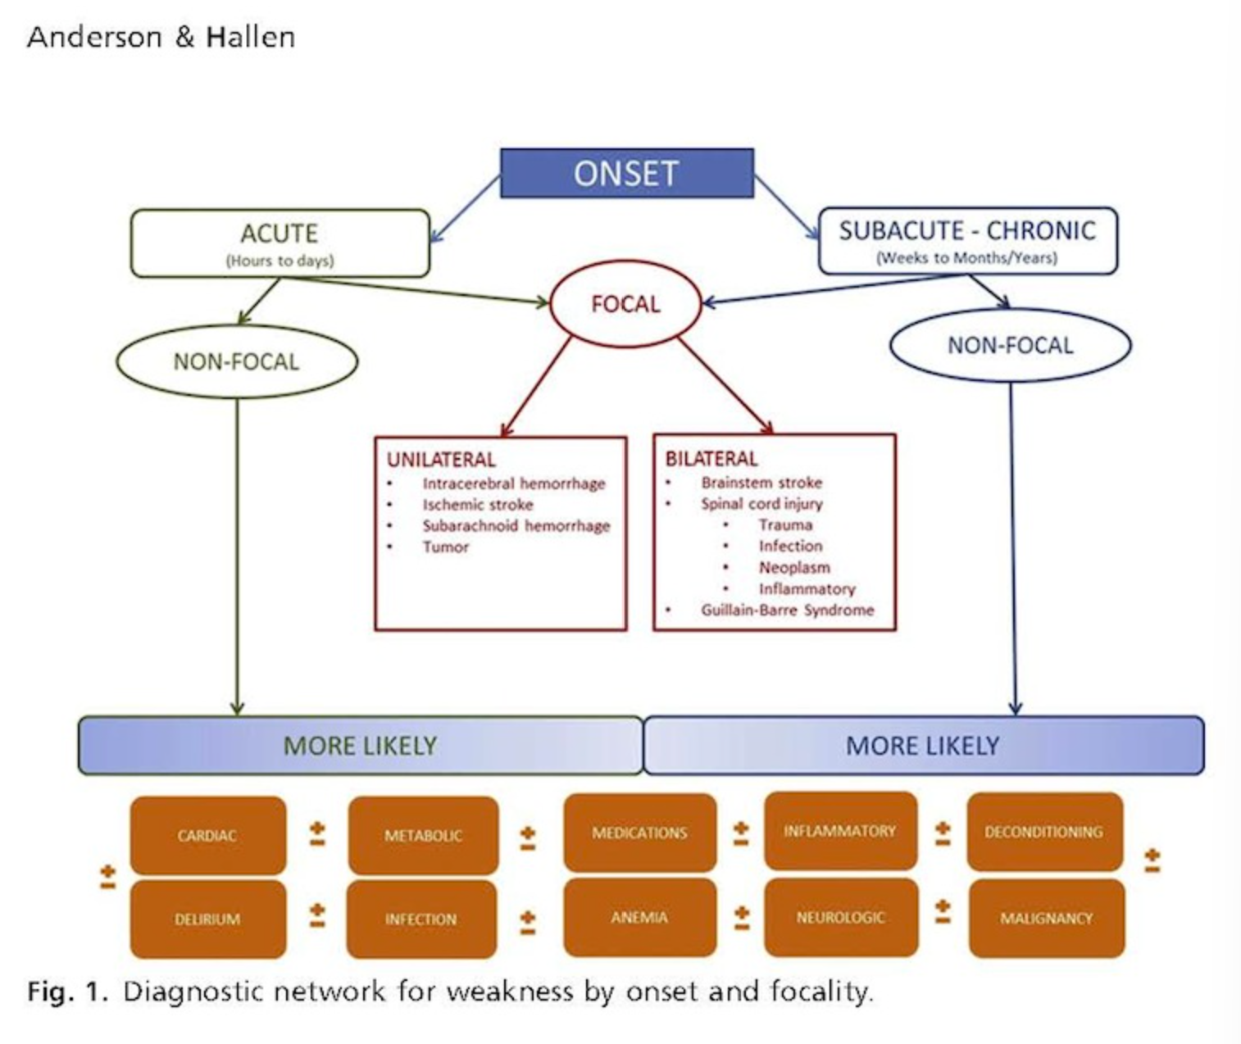

Slide 21
Case #2
78 year old man presents to ED with recurrent falls

Slide 22
History
MEDICATIONS
  Insulin glargine 14U qhs
  Metformin 500mg BID
  Glyburide 10mg BID
  Lasix 40mg PO daily
  Levothyroxine 125mcg daily
  Amlodipine 5mg daily
  Ramipril 2.5mg daily
  Tamsulosin 0.8mg daily
  Finasteride 5mg daily
  Paroxetine 20mg daily
  Trazadone 50mg PO qhs
  ASA 81mg PO daily
PAST MEDICAL HISTORY
  Insulin dependent Type 2 diabetes, most recent HgbA1C 8.7
  Hypothyroidism
  Hypertension
  CHFpEF
  BPH
  Anxiety/Depression
  Insomnia
SOCIAL HISTORY
  Lives with wife in a 2 level house
  Retired mechanic
  Quit smoking 10 years ago, drinks a beer or two daily
FUNCTIONAL HISTORY
  Baseline: Independent with ambulation with no gait aids
  ADLs/IADLs: independent

Slide 23

Approach to falls?

Slide 24
Approach to falls
CAUSES
Acute precipitant?
Intrinsic factors
  Modifiable
  Non-modifiable
Extrinsic factors
CONSEQUENCES
Bone safety
Home safety
Pain control
Reconditioning

Slide 25
Causes
Acute precipitant: as per previous approach to weakness
Intrinsic factors
  Non-modifiable: age, sex, previous falls
  Modifiable
    Medications
    Chronic diseases and their sequelae
    Visual/hearing impairment
    Deconditioning/balance
    Fear of falling
Notes:
Women are more at risk

Slide 26
Causes – extrinsic factors
  MEDICATIONS!!
    CNS active drugs
      Neuroleptics
      Benzos
      Antidepressants
    Antihypertensives
      Vasodilators
  Substance use/EtOH
  Environmental factors
  Footwear
  Gait aid use

Slide 27
FIRST STEPS
Differentiate falls vs syncope from clinical history
Physical exam
Investigations

Slide 28
FIRST STEPS
Differentiate falls vs syncope from clinical history
Physical exam
  ORTHOSTATIC VITALS
  Neurological exam → sensory!
Investigations
  CBC, chemistry, urea, creatinine, liver enzymes - ? Anemia, ? Hyponatremia ? Hepatic disease
  TSH, vitamin B12, CBGs
  ECG
  History relevant investigations → septic workup/cardiac labs
  CT head → depending on history/exam + ? Consequences
  Bone mineral density test – assess fracture risk

Slide 29
What is orthostatic hypotension?
Notes:
Orthostatic hypotension occurs because of an inability to maintain normotension against the effects of gravity on cardiovascular haemodynamics in the upright posture (figure 1).

Slide 30
What is orthostatic hypotension?
Do orthostatic vitals yourself!
Drop in SBP >20, drop in DBP >10 + symptoms of cerebral hypoperfusion
Prevalence in those over 75 = 20%
Inability to maintain normotension against effects of gravity on cardiovascular hemodynamics
Notes:
Orthostatic hypotension occurs because of an inability to maintain normotension against the effects of gravity on cardiovascular haemodynamics in the upright posture (figure 1).

Slide 31
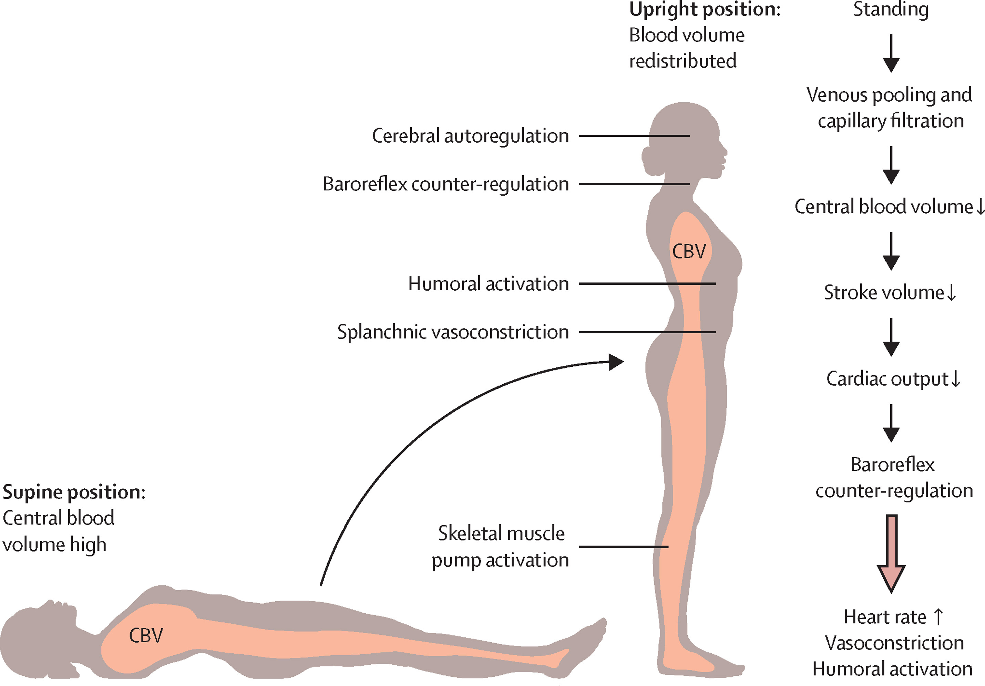
PHYSIOLOGY
Notes:
Orthostatic hypotension typically occurs when the compensatory responses are insufficient or overwhelmed, often due to failure of the arterial baroreflex.
Orthostatic stress → shift of blood from chest to below diaphragm = venous pooling → rapid decrease in central blood volume which is then compounded by capillary filtration of plasma due to increased hydrostatic pressure in legs
= decreases cardiac filling + stroke volume
Health people: increase HR on standing but not enough to compensate for reduction in stroke volume so CO decreases and so mechanisms kick in
Arterial baroreflex mediated constriction of arterioles → increase SVR = maintain normotension + get increase in skeletal muscle/abdo tone which increases venous return through skeletal pump
Normal people: minimal drop in SBP and increase in DBP

Slide 32
How to classify orthostatic hypotension
OH without neurological component
1
OH with central neurological component
2
OH with peripheral neurological component
3

Slide 33
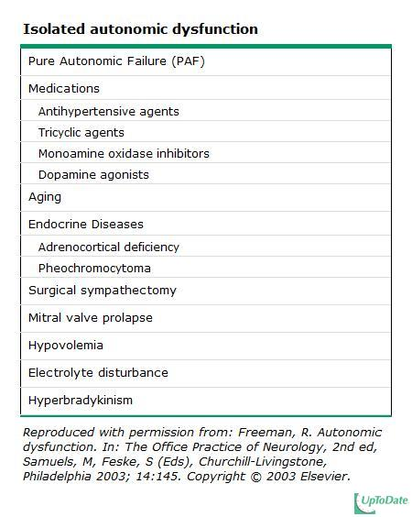
OH without neurological components

Slide 34
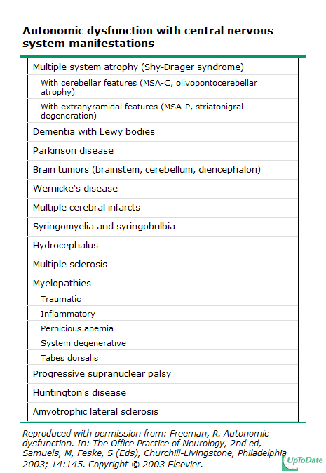
OH with CENTRAL Neurological COMPONENT

Slide 35
OH with peripheral neurological component
Diabetes
Connective tissue disease (Sjogren, SLE, RA)
Alcoholic neuropathy
Hepatic disease
Uremia
Paraneoplastic neuropathies
Amyloid
Chronic inflammatory polyneuropathy
Toxic neuropathies
Infectious neuropathies

Slide 36
History
MEDICATIONS
  Insulin glargine 14U qhs
  Metformin 500mg BID
  Glyburide 10mg BID
  Lasix 40mg PO daily
  Levothyroxine 125mcg daily
  Amlodipine 5mg daily
  Ramipril 2.5mg daily
  Tamsulosin 0.8mg daily
  Finasteride 5mg daily
  Paroxetine 20mg daily
  Trazadone 50mg PO qhs
  ASA 81mg PO daily
PAST MEDICAL HISTORY
  Insulin dependent Type 2 diabetes, most recent HgbA1C 8.7
  Hypothyroidism
  Hypertension
  CHFpEF
  BPH
  Anxiety/Depression
  Insomnia
SOCIAL HISTORY
  Lives with wife in a 2 level house
  Retired mechanic
  Quit smoking 10 years ago, drinks a beer or two daily
FUNCTIONAL HISTORY
  Baseline: Independent with ambulation with no gait aids
  ADLs/IADLs: independent

Slide 37
History – OH RISK FACTORS
PAST MEDICAL HISTORY
  Insulin dependent Type 2 diabetes, most recent HgbA1C 8.7
  Hypothyroidism
  Hypertension
  CHFpEF
  BPH
  Anxiety/Depression
  Insomnia
SOCIAL HISTORY
  Lives with wife in a 2 level house
  Retired mechanic
  Quit smoking 10 years ago, drinks a beer or two daily
FUNCTIONAL HISTORY
  Baseline: Independent with ambulation with no gait aids
  ADLs/IADLs: independent
MEDICATIONS
  Insulin glargine 14U qhs
  Metformin 500mg BID
  Glyburide 10mg BID
  Lasix 40mg PO daily
  Levothyroxine 125mcg daily
  Amlodipine 5mg daily
  Ramipril 2.5mg daily
  Tamsulosin 0.8mg daily
  Finasteride 5mg daily
  Paroxetine 20mg daily
  Trazadone 50mg PO qhs
  ASA 81mg PO daily

Slide 38
OH Management
Non-pharmacological
Pharmacological

Slide 39
OH Management
Non-pharmacological
  Compression stockings + abdo binders
  Head of bed 30 deg
  Isometric exercises
  Avoid large meals, alcohol
  Increase salt/water intake (caution in HF)
  Oral water bolus
Pharmacological
  Midodrine (alpha agonist)
  Fludrocortisone → care in heart failure!

Slide 40
What to do about the Anti-hypertensives?

Slide 41
What to do about the Anti-hypertensives?
Don’t just stop/decrease the BP meds because of OH – common mistake!
Hypertension itself results in orthostatic hypotension!
  Long term hypertension desensitizes baroreceptor reflex
  Residual sympathetic output in setting of hypersensitive adrenergic receptors
Bedtime dosing of antihypertensives with daytime dosing of midodrine

Slide 42
History – FALLS RISK FACTORS
PAST MEDICAL HISTORY
  Insulin dependent Type 2 diabetes, most recent HgbA1C 8.7
  Hypothyroidism
  Hypertension
  CHFpEF
  BPH
  Anxiety/Depression
  Insomnia
SOCIAL HISTORY
  Lives with wife in a 2 level house
  Retired mechanic
  Quit smoking 10 years ago, drinks a beer or two daily
FUNCTIONAL HISTORY
  Baseline: Independent with ambulation with no gait aids
  ADLs/IADLs: independent
MEDICATIONS
  Insulin glargine 14U qhs
  Metformin 500mg BID
  Glyburide 10mg BID
  Levothyroxine 125mcg daily
  Amlodipine 5mg daily
  Ramipril 2.5mg daily
  Tamsulosin 0.8mg daily
  Finasteride 5mg daily
  Paroxetine 20mg daily
  Trazadone 50mg PO qhs
  ASA 81mg PO daily

Slide 43
dRUGS + FALLS - CLINICAL PEARLS
Avoid sulfonylureas in older adults for diabetes management because of increased risk of hypoglycemia and risk of falls, especially glyburide (gliclazide is a better option)
  Usually DPP4 inhibitor like linagliptin are preferred second line oral agents
Amlodipine + tamsulosin → peripheral edema
Notes:
When linagliptin added to insulin, better control without risk of hypoglycemia
Canagliflozin → increased risk of amputation and fracture

Slide 44
Causes
  Medications
  Chronic diseases and their sequelae
    DM – peripheral neuropathy, orthostatic hypotension, hypo/hyperglycemia
    HF – peripheral edema
    Hypothyroidism – neuropathy, OH
    Hypertension – OH
  Visual/hearing impairment
  Deconditioning/balance
  Fear of falling
  Alcohol →
Notes:
Women are more at risk

Slide 45
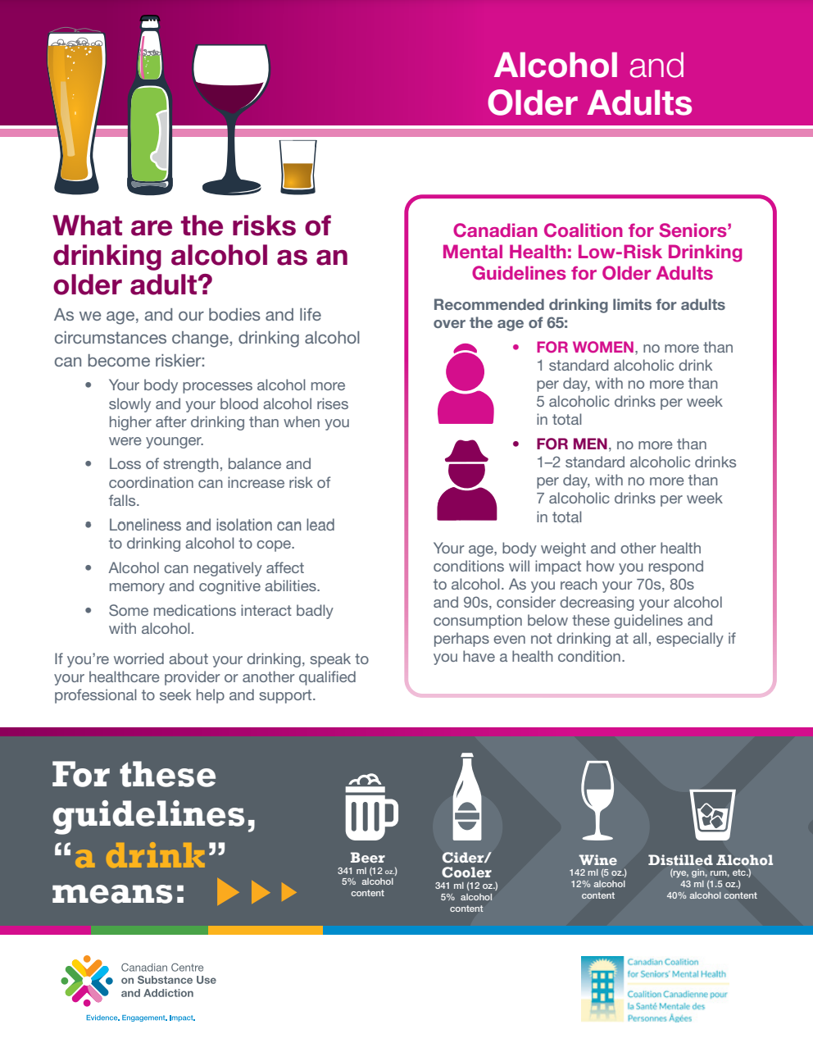
Alcohol GUIDELINES for older adults

Slide 46
Falls – general management
Vitamin D supplementation can independently decrease risk of falls in older adults
Physiotherapy referral – strengthening, balance exercises
Occupational therapy – gait aids, home safety assessment
LifeLine – safety mechanism
Bone safety – early recognition of osteoporosis → if compression/fragility fractures, start on treatment!
Encourage dietary calcium → calcium supplements constipating

Slide 47

Questions/comments?

Slide 48
References
Wouter Wieling, Horacio Kaufmann, Victoria E Claydon, Veera K van Wijnen, Mark P M Harms, Stephen P Juraschek, Roland D Thijs, Diagnosis and treatment of orthostatic hypotension, The Lancet Neurology, Volume 21, Issue 8, 2022, Pages 735-746.
Diabetes Canada Clinical Practice Guidelines Expert Committee. Diabetes Canada 2018 Clinical Practice Guidelines for the Prevention and Management of Diabetes in Canada. Can J Diabetes. 2018;42(Suppl 1):S1-S325.
Tsui C, Kim K, Spencer M. The diagnosis "failure to thrive" and its impact on the care of hospitalized older adults: a matched case-control study. BMC Geriatr. 2020 Feb 14;20(1):62. doi: 10.1186/s12877-020-1462-y. PMID: 32059639; PMCID: PMC7023702.
Okumura K, Akao M, Yoshida T, Kawata M, Okazaki O, Akashi S, Eshima K, Tanizawa K, Fukuzawa M, Hayashi T, Akishita M, Lip GYH, Yamashita T; ELDERCARE-AF Committees and Investigators. Low-Dose Edoxaban in Very Elderly Patients with Atrial Fibrillation. N Engl J Med. 2020 Oct 29;383(18):1735-1745. doi: 10.1056/NEJMoa2012883. Epub 2020 Aug 30. PMID: 32865374.

