Slide 1

Pancreatitis: the good, the bad and the ugly
Hyun Jae (John) Kim, PGY-6 therapeutic fellow
Notes:
Now I put that as the title, but it is quite misleading as there is no way you can learn all about pancreatitis in an hour period. Pancreatitis is a very broad topic which you will be exposed to in acute hospital medicine but also as outpatient. We will be focusing on more acute medical care side of things which includes the severe and necrotizing types.

Slide 2
Overview
Epidemiology of pancreatitis and nomenclature
Pathophysiology
Investigation/diagnosis
Prognostication
Management
  Acute phase
  Late phase

Slide 3
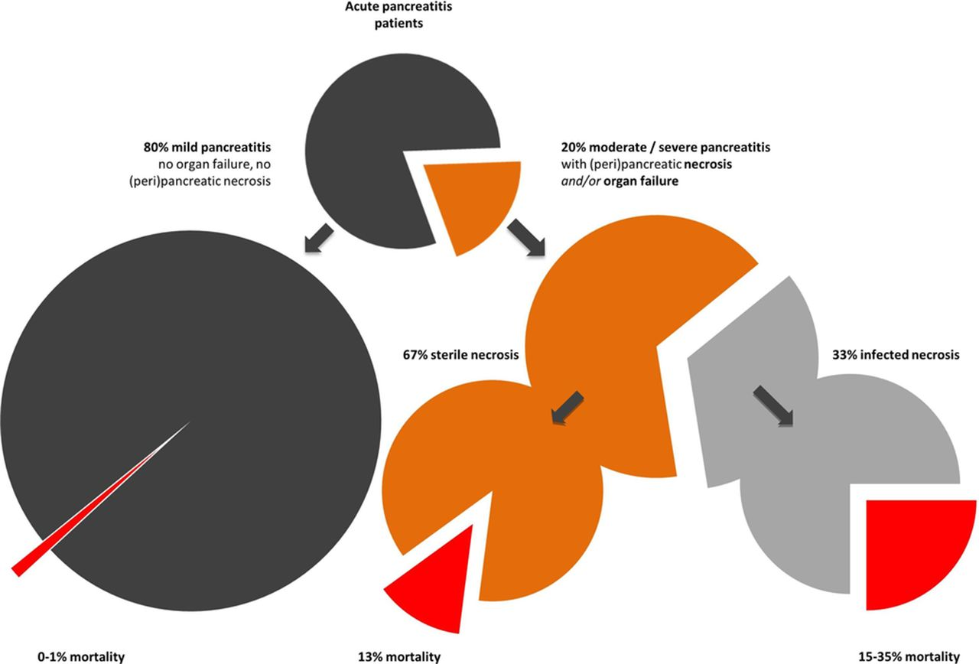
Are all pancreatitis same?
van Dijk. Gut 2024.

Slide 4
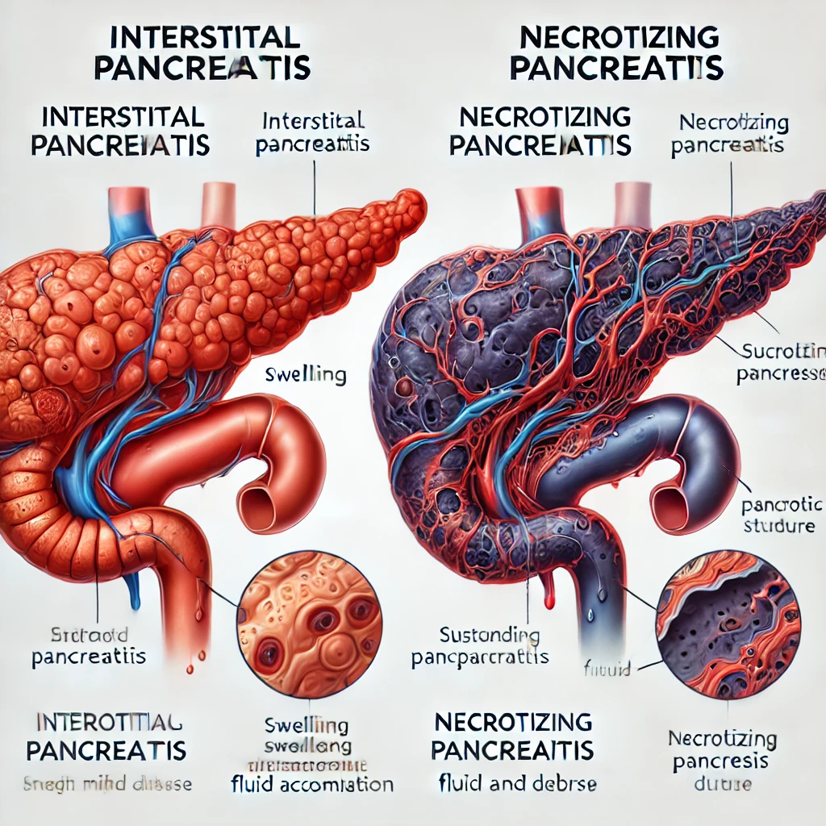
Are all pancreatitis same?
Pancreatitis involves a wide spectrum of disease presentation and severity.
Important to distinguish and categorize pancreatitis properly.
  Acute pancreatitis (AP)
    Interstitial vs necrotizing
    Mild, moderate vs severe
  Chronic pancreatitis (CP)
Notes:
No. There is a huge variation and that is why terminology and categorizing or prognosticating them is different.
“The overall mortality of acute pancreatitis is approximately 1 to 2%; however, severe acute pancreatitis carries a much higher mortality rate.” from NCBI

Slide 5
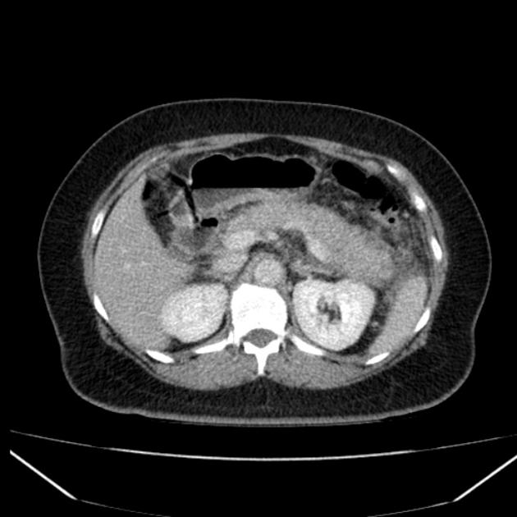
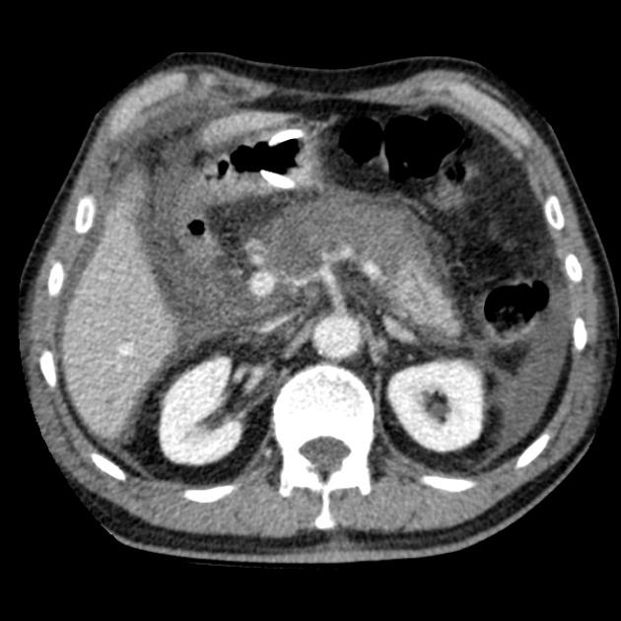
Acute interstitial pancreatitis
Necrotizing pancreatitis
Notes:
Interstitial panreatitis. Pancreas is boggy and enlarged. It just looks inflamed and engorged. But you don’t see significant fluid tracking around the pancreas and importantly the pancreas is enhancing meaning bright on contrast enhanced CT scan.
In contrast, necrotizing pancreatitis, you can see

Slide 6
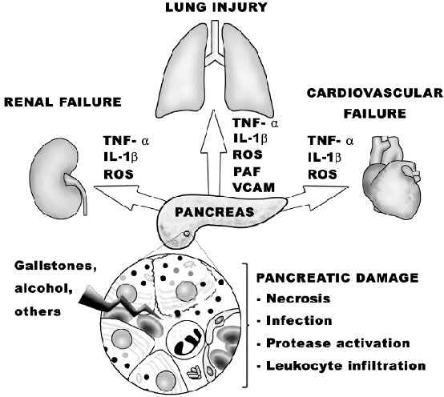
Pathophysiology
Premature activation of digestive enzymes resulting in local pancreatic acinar cell destruction +/- distant organ dysfunction.
  SIRS, ARDS, renal failure, VTE, etc.
Pancreatic ischemic injury can result in pancreatic tissue necrosis with associated local complications.
Notes:
The pathophysiology of acute pancreatitis is based on the premature activation of the enzymes zymogen and trypsinogen, resulting in local pancreatic destruction and activation of the inflammatory cascade, which causes the systemic inflammatory response syndrome (SIRS).

Slide 7
What can go wrong?
Multi organ failure
Peripancreatic fluid/necrotic collections
Bacterial translocation, sepsis, cholangitis*
Gastrointestinal bleeding – i.e. pseudoaneurysm, hemosuccus pancreaticus
Chronic pancreatitis, endocrine/exocrine pancreatic insufficiency
Thrombosis (splanchnic vein thrombosis, DVT, and PE)
Ileus

Slide 8
Diagnosis of pancreatitis
At least two of the following three criteria for diagnosis:
  Abdominal pain consistent with the disease
  3xULN increase in serum amylase or lipase levels
  Imaging findings consistent with acute pancreatitis*
In majority of the cases, you do not need imaging right away and will not change management acutely. US can be helpful if diagnostic uncertainty.

Slide 9
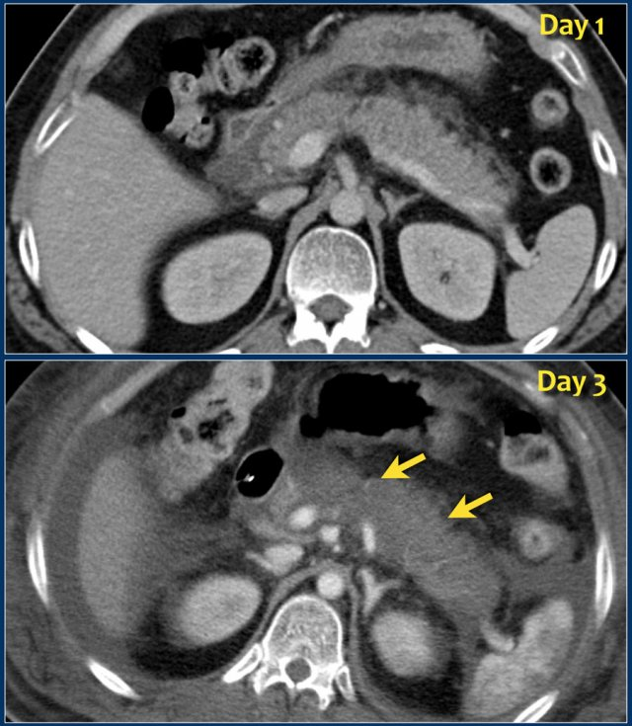
Why wait to get cross-sectional imaging?

Slide 10
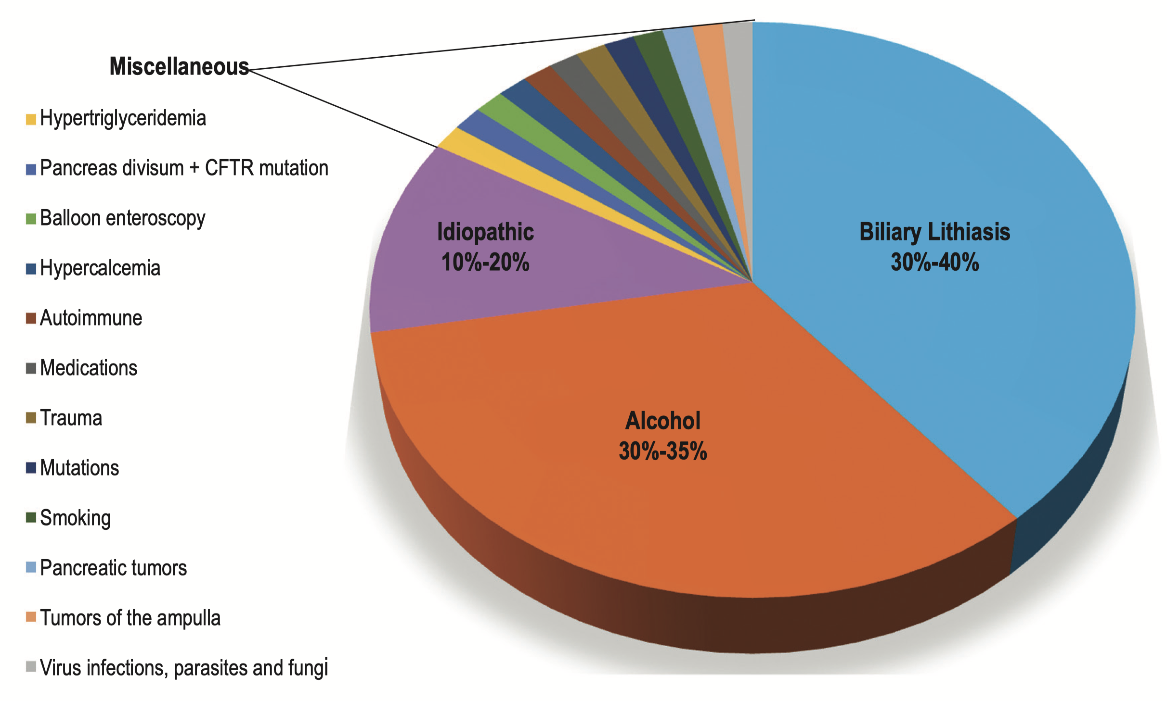
Investigations – finding the etiology
GET-SMASHED, TIGAR-O are some acronyms used to remember etiologies.
  Toxins – alcohol, smoking, drugs
  Idiopathic
  Genetic
  Autoimmune
  Recurrent pancreatitis
  Obstructive – pancreatic cancer, IPMN
Once pancreatitis starts, it is going to take its course. Identifying etiology is more helpful to try to prevent further episodes.

Slide 11
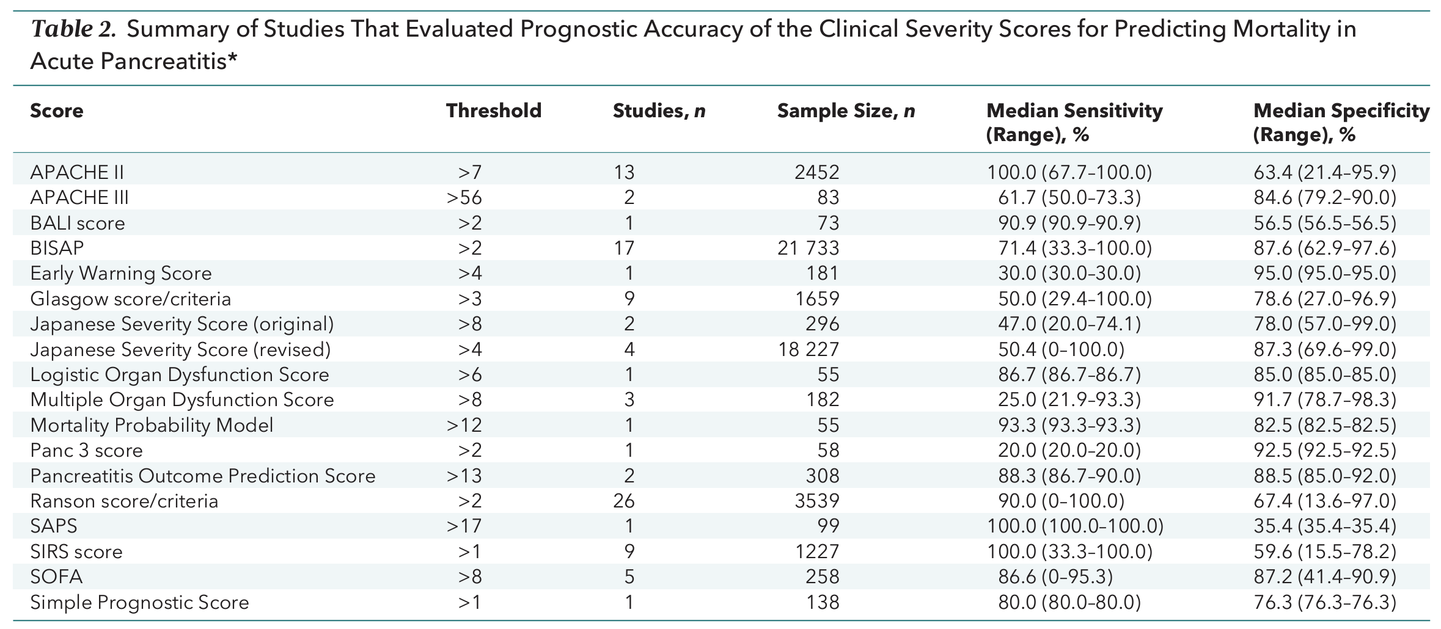
Prognosticating pancreatitis
Several clinical/radiographical scoring systems exist (APACHE II, Ranson criteria, CTSI); however, the real-world clinical value remains unclear.
Two key determinants of mortality appears to be persistent organ failure and infected pancreatic necrosis (reported mortality rate up to 30%).
Di. Ann Intern Med 2016.
Notes:
However, clinical scoring systems may not be as helpful in real clinical situations as ICU team will not admit a patient preemptively because of high risk of severe disease. But rather base their decisino on real-time clinical status of the patient which comes down to organ failure, SIRS, etc.

Slide 12
Management
Early phase
  1. Fluids
  2. Analgesia
  3. Nutrition
Late phase
  1. Local peripancreatic collection
  2. Splanchnic vein thrombosis

Slide 13
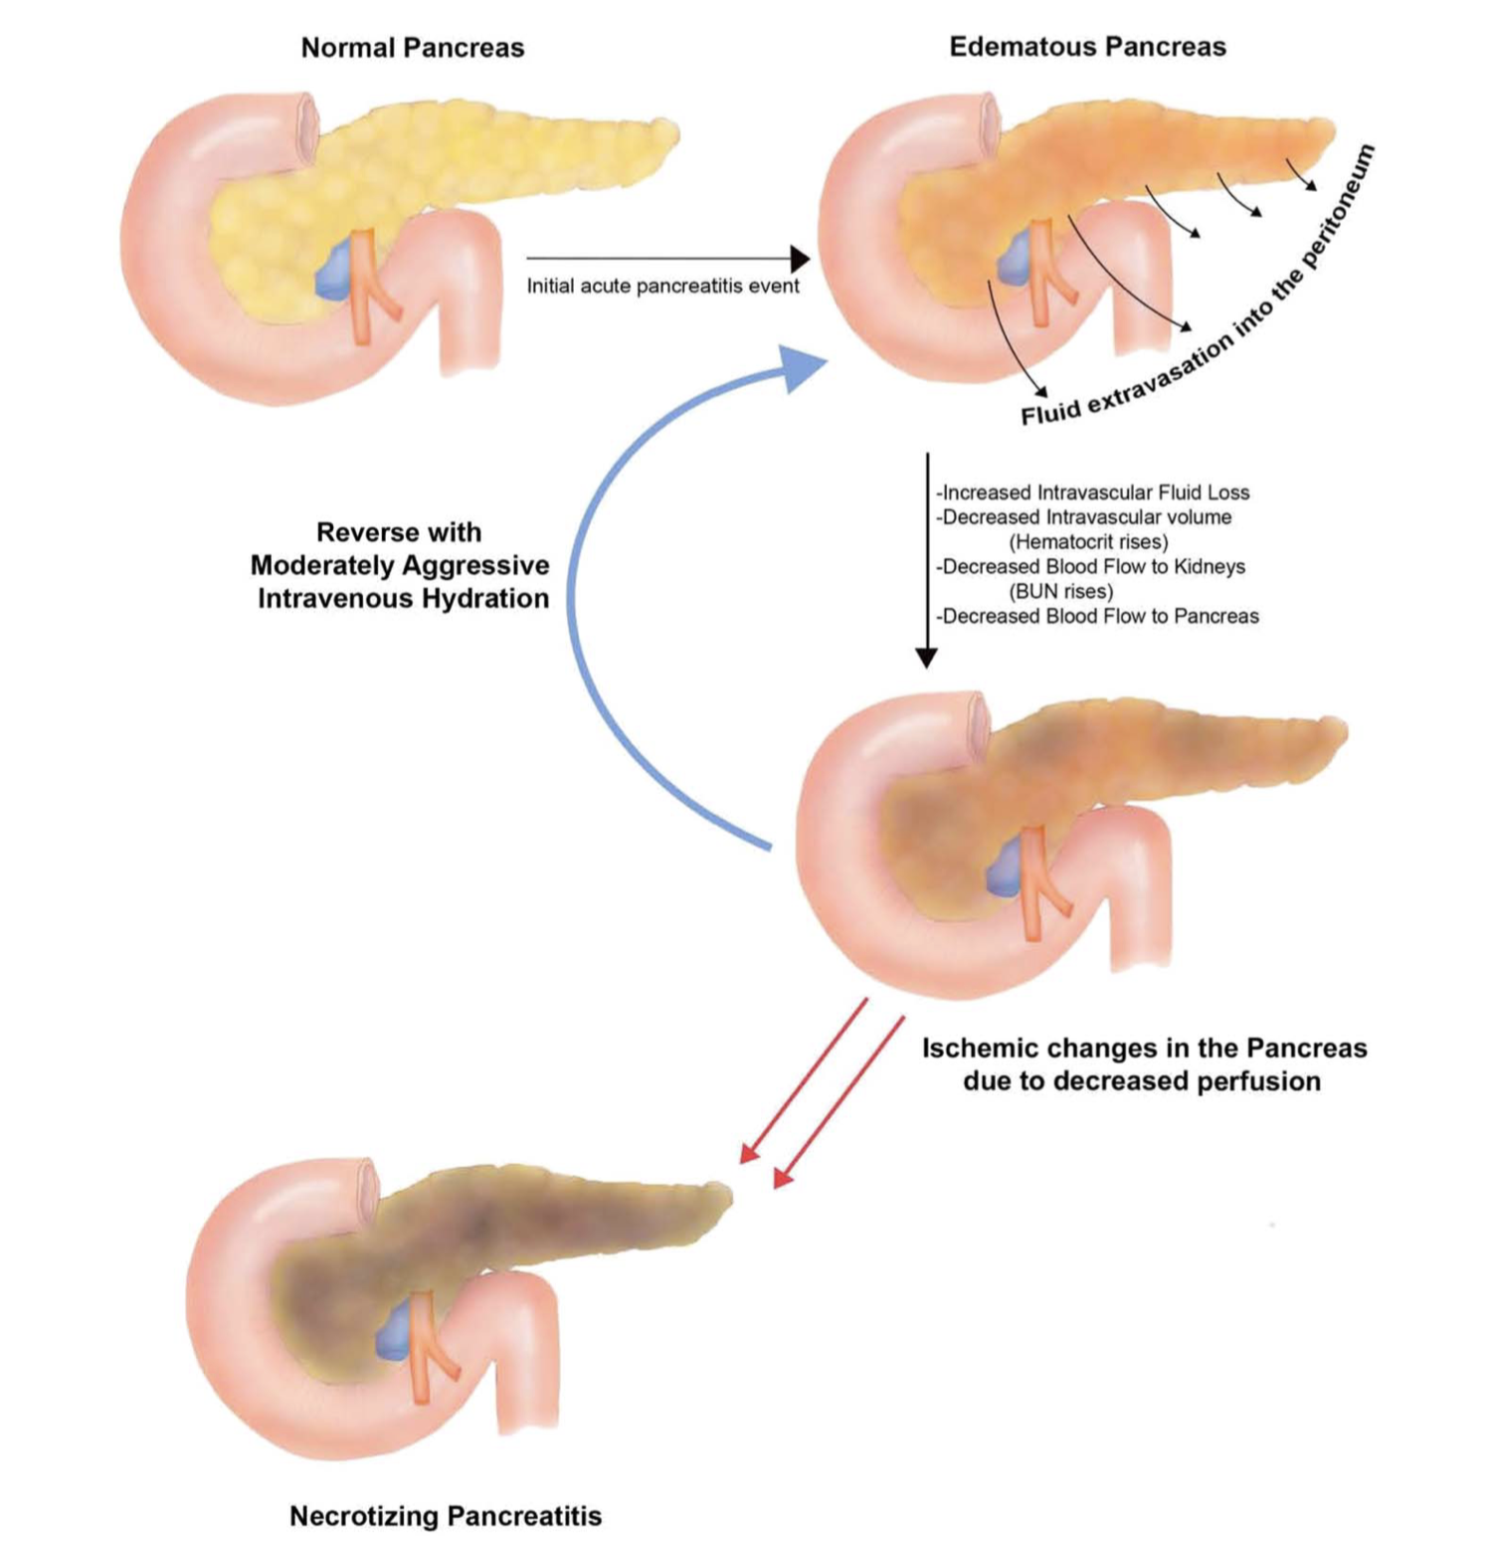
Early phase treatment
Fluids
  Ringer’s lactate is the fluid of choice^{1.}
  Rate of fluid administration still debated but overly aggressive resuscitation is probably not better.
    WATERFALL trial²
    Best to go for goal directed resuscitation (i.e. Hct, BUN, urinary output)
Analgesia
¹Wu. CGH 2011; de-Madaria. UEGJ 2018.
²de-Madaria. NEJM 2022.
Notes:
It looks like lactated ringer’s has more anti-inflammatory effect with improved SIRS response and CRP compared to NS based on RCTs.
Multiple RCT including Waterfall trial have looked at rate of fluid administration and I believe the global message is massive fluid infusion especially if kept going for more than initial 24-36 hours can likely harm patient - abdominal compartment syndrome, fluid overload, mechanical ventilation, even mortality. Best approach is to goal-directed fluid strategies using clinical parameters like HR, MAP, urinary output with focus on fluid resuscitation within the first 24-36 hours is key. Most expert would recommend 100-150mL/hr (1.5mL/kg/hr) within the first 24 hours and slow down the fluid afterwards.
Analgesia - Uncontrolled pain likely has negative impact on microvascularization and possibly induction of necrosis (Bachmann 2013 Crit Care).

Slide 14
Early phase treatment
Nutrition
  Enteral feeding >> parenteral nutrition.
  On-demand enteral feeding on admission is key.
  Step-up diet is not required → start low-fat solid diet if not anorexic.
  If not tolerating by 72 hours, strongly consider NG/NJ feeding.
  NG is equivalent to NJ.
Notes:
Historical practice was to wait until pain subsides before oral feeding can be started. And it would usually start from clear fluids to sfot then low fat solid diet.
It has been subsequently recognized that oral feeding maintains gut mucosal integrity and prevents translocation of bacteria from the gut lumen into the inﬂamed/ necrosed pancreatic tissue, predisposing to the serious complication of infected pancreatic necrosis.
Several randomized controlled trials and meta-analyses have demonstrated the superiority of enteral feeding over parenteral nutrition with respect to complications, need for surgery, and mortality.
Randomized trials have not demonstrated a significant difference between nasogastric and nasojejunal feeding.

Slide 15
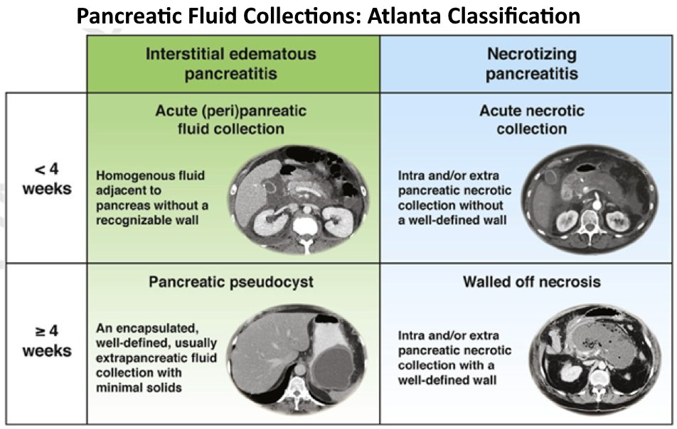
Managing peripancreatic collection
Banks. Gut 2012.

Slide 16
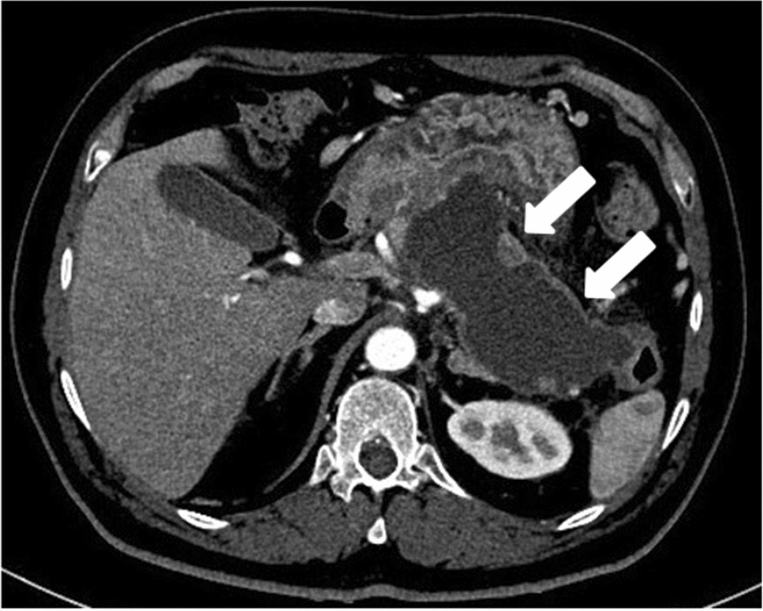
Managing peripancreatic collection
As bad as they look, they do not all require drainage!
Indications to drain are:
  Infected collection
  Persistent organ failure
  Symptomatic collection
  Disconnected pancreatic duct
Notes:
“Asymptomatic WON do not warrant any intervention regardless of the size and extension of the collection as they may spontaneously resolve over time.”

Slide 17
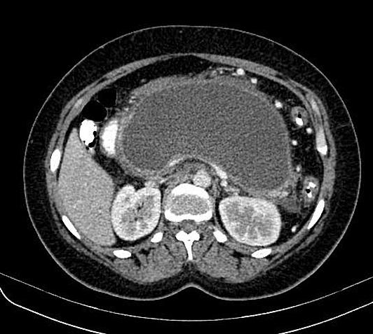
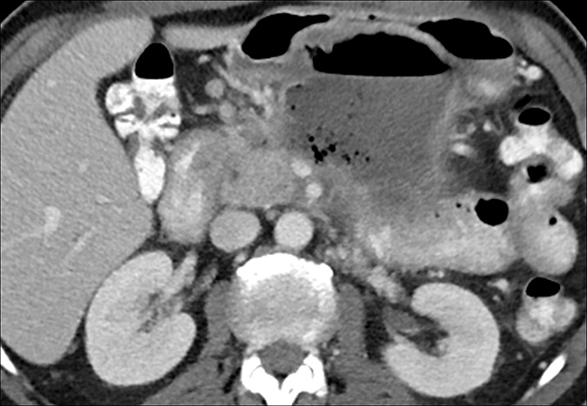
Which is more worrisome?

Slide 18
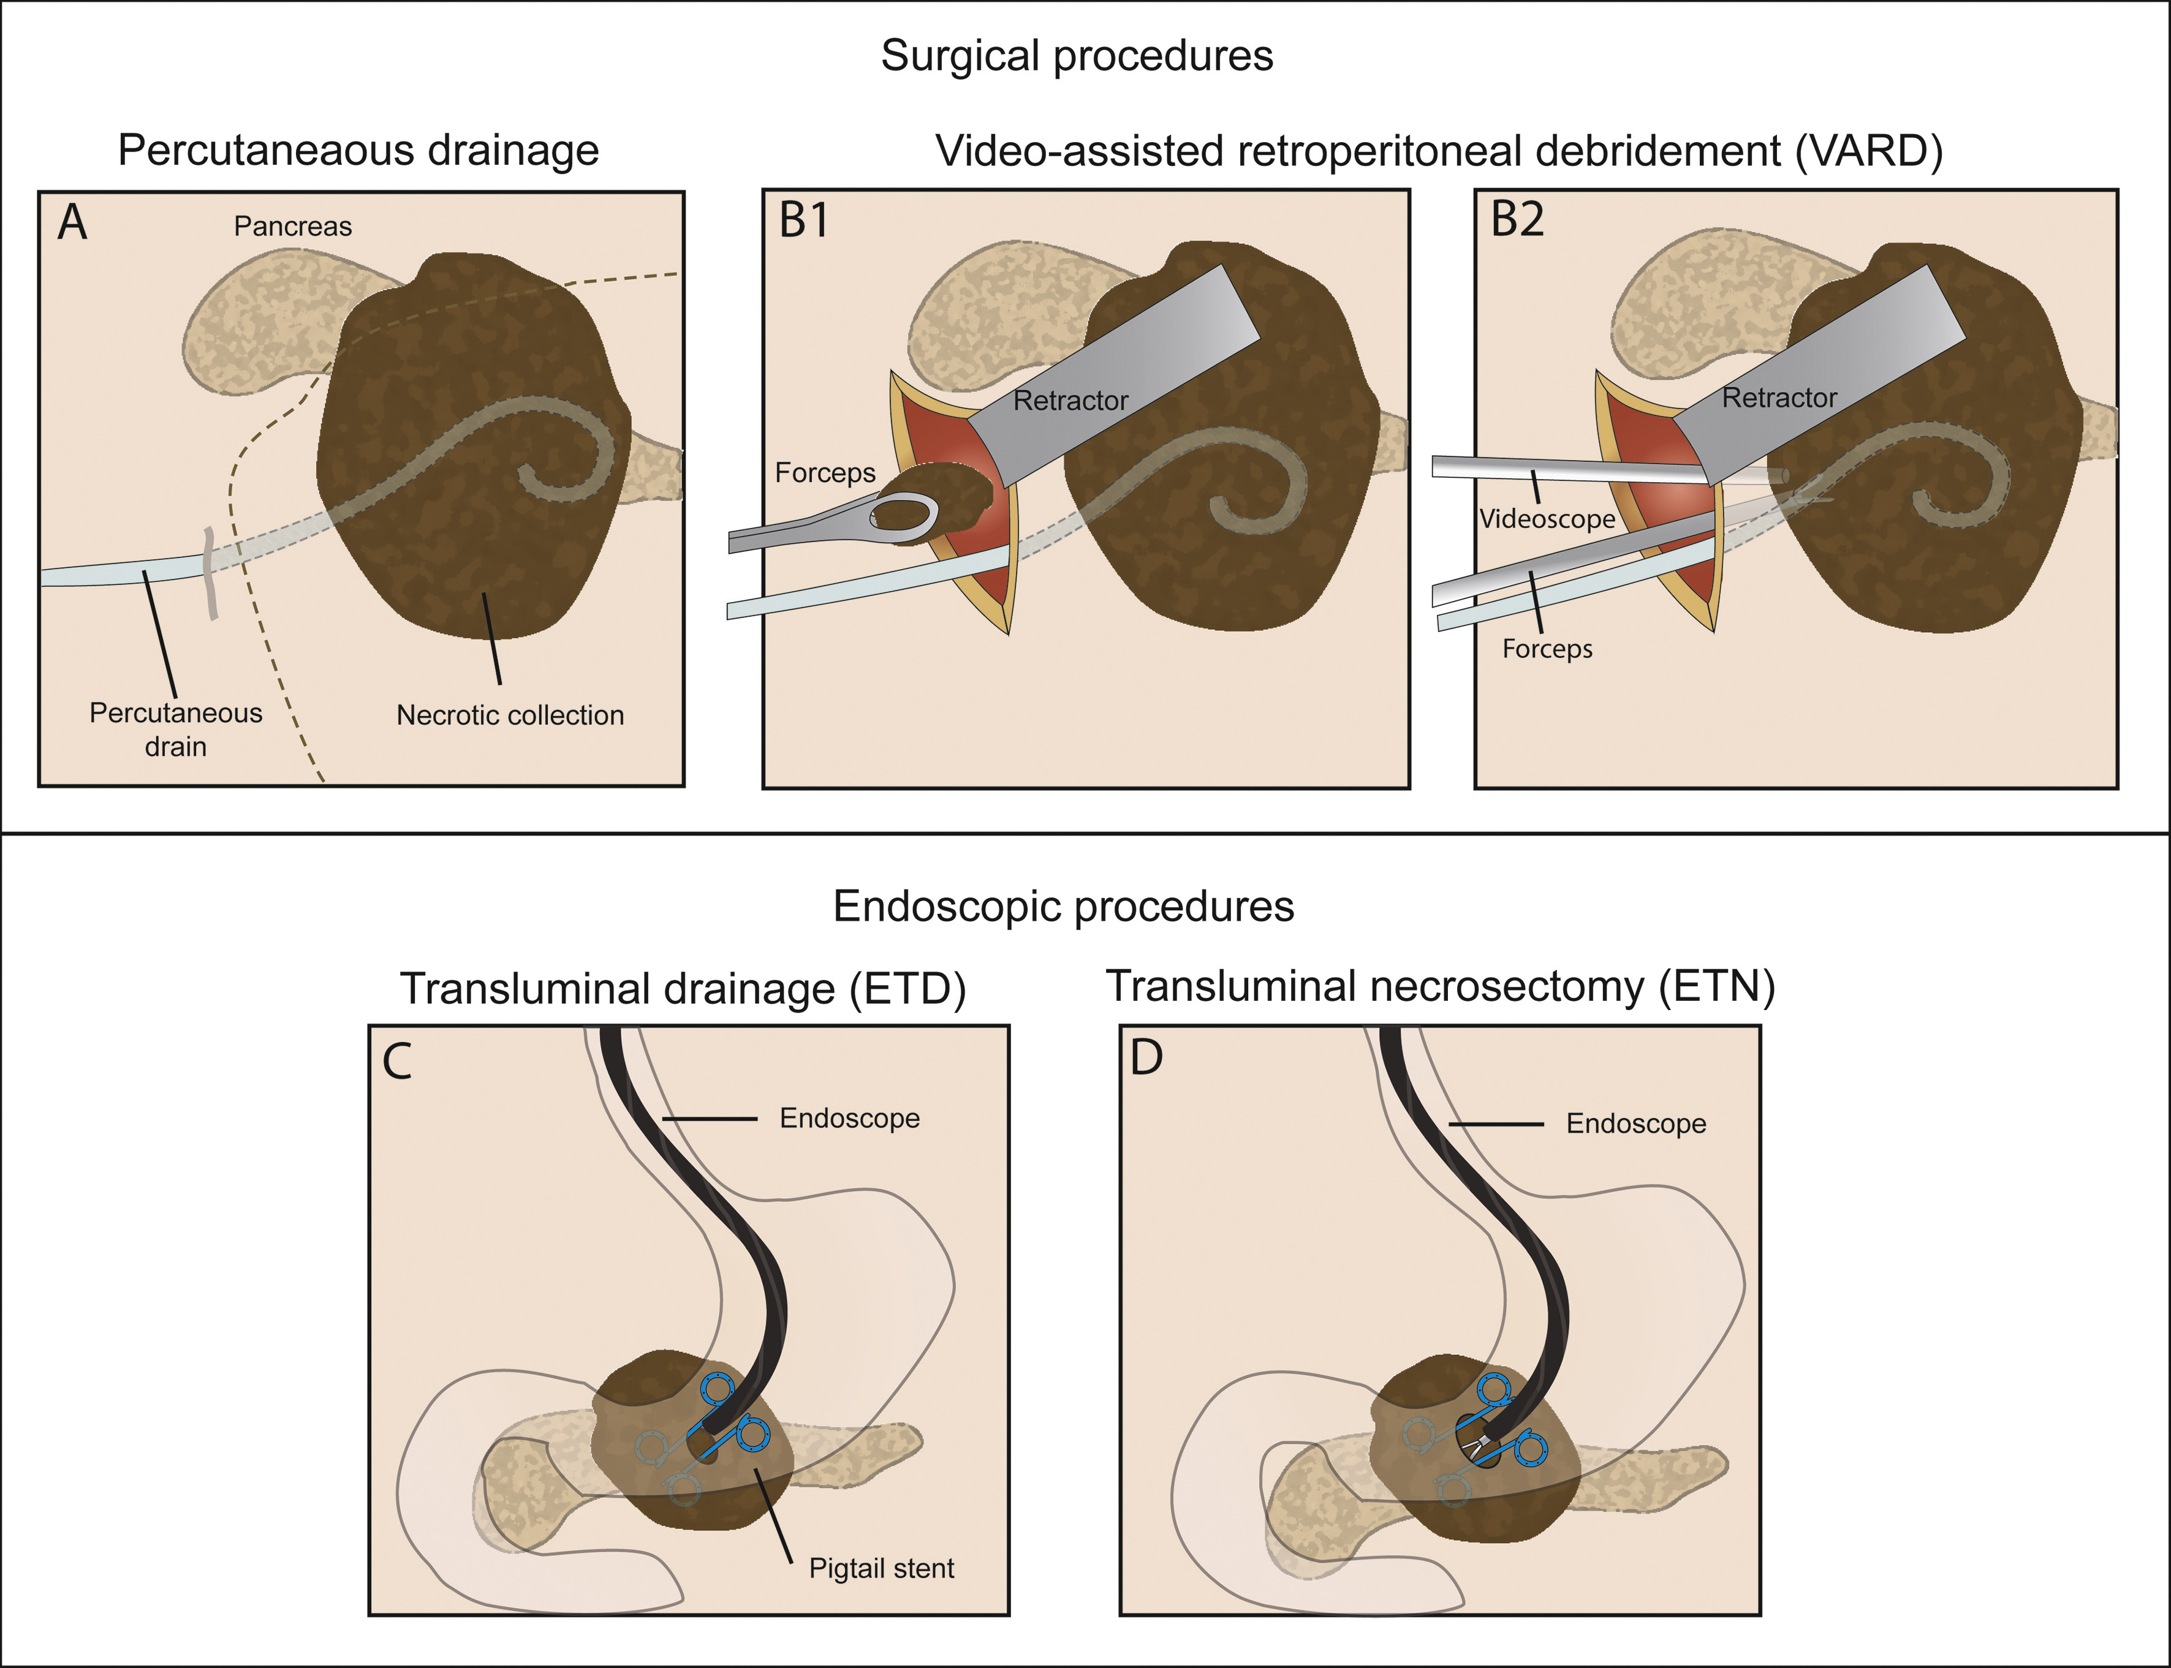
How and when should we drain the collection?
Banks. Gut 2012.

Slide 19
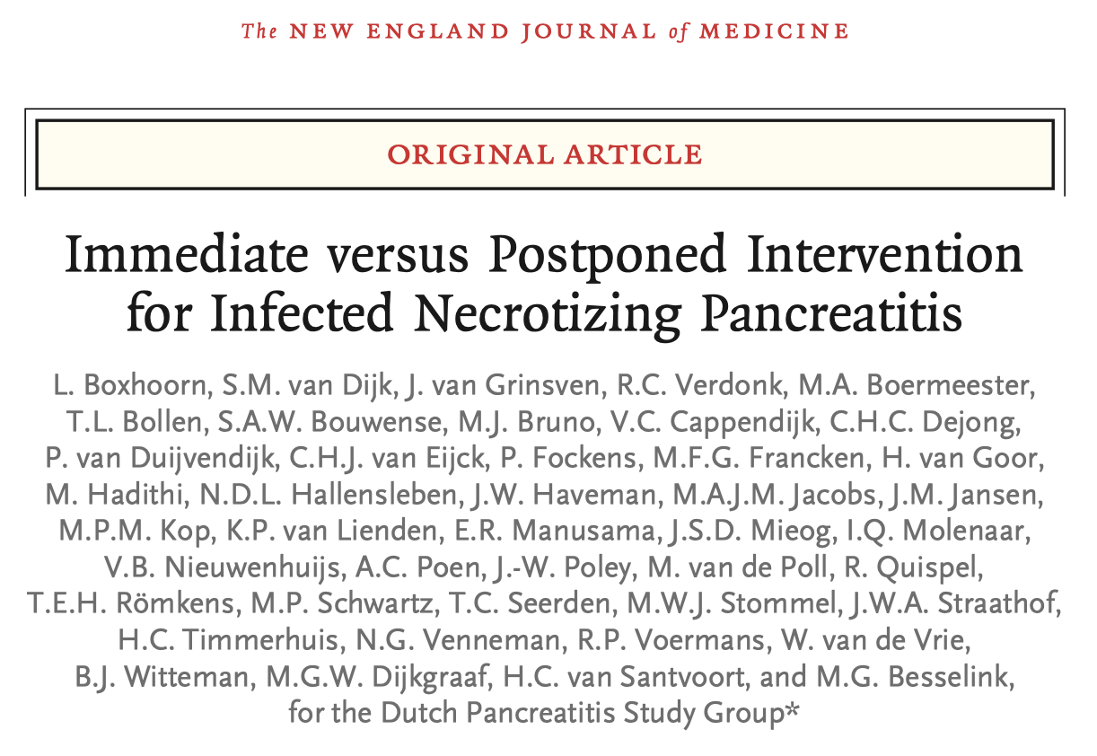
How and when should we drain the collection?
RCT showed no benefit to early (<4 weeks) drainage.
Ideally, it is best to wait ~4 weeks (after onset of pancreatitis) for collections to mature for endoscopic drainage.
IR guided perc drain is a valuable treatment especially in critically ill patient needing emergent drainage <4 weeks.
Boxhoorn. NEJM 2021.

Slide 20
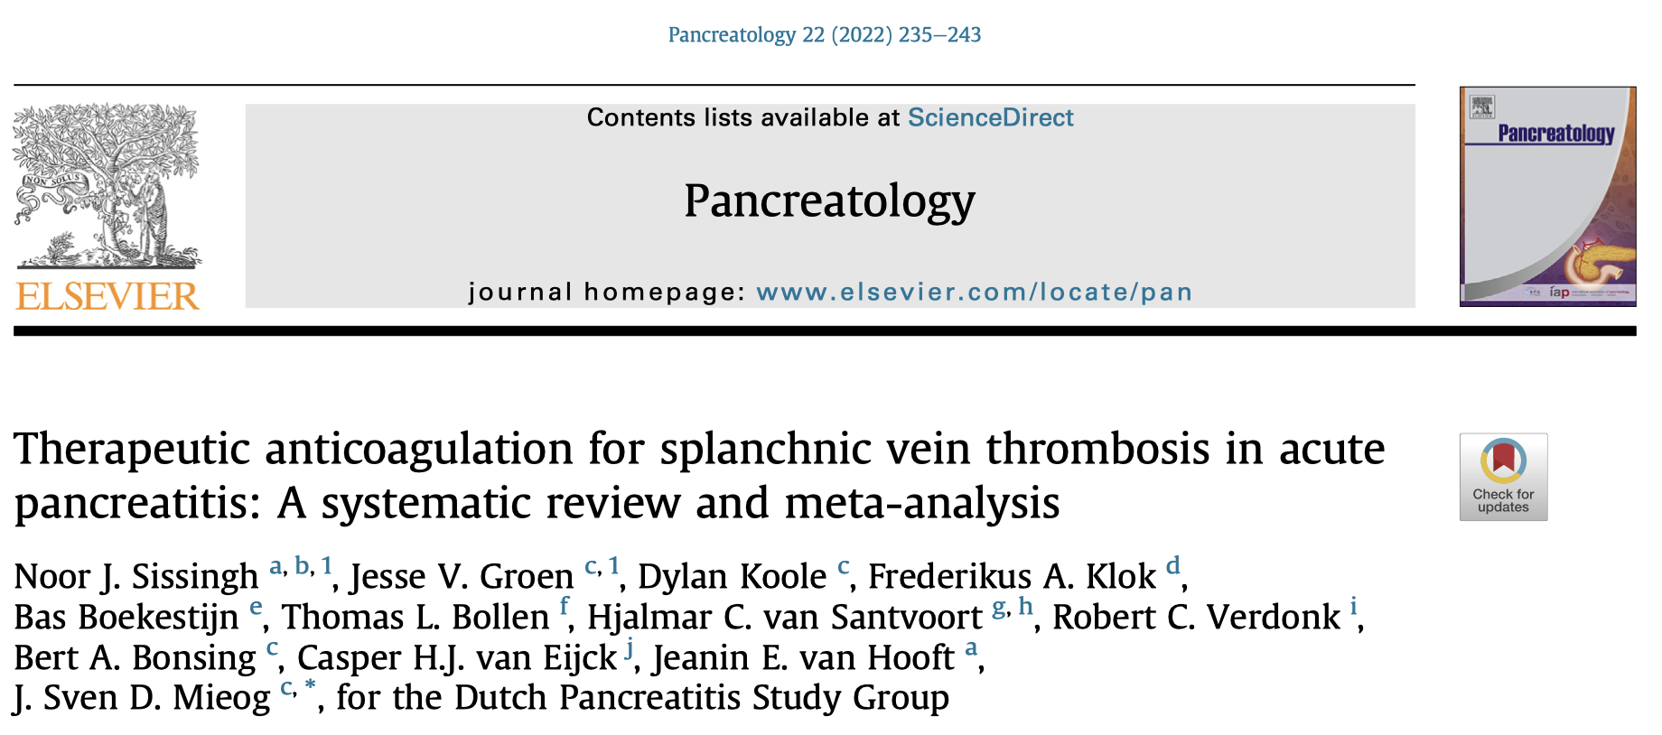
Splanchnic vein thrombosis
Splanchnic vein thrombosis (SVT) is common in pancreatitis (10-15%).
Management is controversial
  Portal vein/SMV thrombus? Treat.
  Extension of thrombus? Treat.
  Isolated stable splenic vein thrombus? Monitor*
Notes:
Splanchnic vein thrombosis refers to thrombosis occurring within the portal vein, splenic vein, SMV which is very common in acute pancreatitis. It can happen to 10-15% of pancreatitis cases. Although the pathophysiology is incompletely understood, it is believed that the inﬂammatory state, along with the direct mass of ﬂuid collections, facilitate venous stasis and activation of coagulation, leading to thrombosis.
Management is controversial. Theoretical benefit to treating include increased recanalization rate, preventing ischemia but at risk of bleeding risk.
Meta-analysis on major pancreas journal more recently still could not provide clear answer. However, based on expert opinion, the current practice GI society recommends are to treat any SVT that is extending beyond just isolated splenic vein thrombus.
Treatment usually involves 3-6 months of anticoagulation.

Slide 21
Thank you!
Please feel free to email for any questions (hyunjae.works@gmail.com)
We are always reachable at VGH bile phone.

