Slide 1

“Brainstorming” Approaches
Seizures, Status Epilepticus and EEG Essentials
Jasmyne Kassam
Adult Neurology PGY3
VGH Internal Medicine Noon Rounds
May 23, 2025

Slide 2
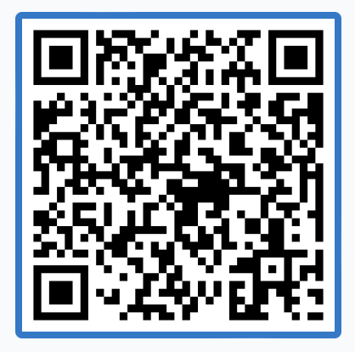
Outline
Part 1: Outpatient/ER “Spell Evaluation” | Part 2: Inpatient/ward “Altered Mental Status” | Part 3: Critical Care “Status Post-Status”
Seizures vs other spells Diagnosing epilepsy Role of EEG ASM basics Safety/driving counselling | “Delirium” red flags EEG for diagnostic clarification Recognizing NCSE Treating status | Ongoing evaluation of status in ICU High-risk EEG patterns Neuroprognostication
PollEv.com/jasmynekassa337

Slide 3
Spell Evaluation
Sample Scenario:
“40F in the ED had a transient loss of consciousness with some jerking limb movements, and is now back to baseline. - what happened?”
Part 1: Outpatient/ER

Slide 4
Approach to first seizure
Was it a seizure?
Was it provoked?
Have they had other seizures?
Do they have epilepsy?
Do they need treatment?

Slide 5
Spell Characterization
Was it a seizure?
Was it provoked?
Have they had other seizures?
Do they have epilepsy?
Do they need treatment?
Generally-speaking a broad ddx:
Seizure
Non-epileptic/functional seizure (PNES)
Syncope
Transient Ischemic Attack (TIA)
Migraine
Sleep disorder
Movement disorder
…and many more…

Slide 6
History, history, history!
…and videos!!! 📹
Seizure | Stereotyped, quick progression, brief (<2 min), often disoriented after
Non-epileptic events | Prolonged (5-30 mins), physiologically inconsistent (retained awareness despite generalized shaking, waxing/waning), panic/derealization
Syncope | Situational trigger, presyncopal Sx, orthostasis, quick onset/offset
TIA | Negative Sx at onset, aware of deficits, unlikely stereotyped, vascular RF
Migraine | Headache, N/V, positive Sx (visual aura), prolonged (hours-days)
Sleep Disorder | Variable/complex behaviours, leaves room, multiple events/night, >10 min

Slide 7
Question #1
Which of the following features on history reliably help distinguish between seizure and syncope?
Eye deviation
Jerking limb movements
Lateral tongue bite
Urinary incontinence

Slide 8
Question #1
Which of the following features on history reliably help distinguish between seizure and syncope?
Eye deviation - most helpful if versive, associated with head turn
Jerking limb movements - myoclonus nonspecific, prolonged tonic distinguishing
Lateral tongue bite (LR = 8)
Urinary incontinence - nonspecific

Slide 9
Why did they seize?
Was it a seizure?
Was it provoked?
Have they had other seizures?
Do they have epilepsy?
Do they need treatment?
Provoked = drug, toxin, metabolic, etc.
ASMs: check trough levels!
E.g. keppra, VPA, phenytoin, carbamazepine, lamotrigine, lacosamide, clobazam
**but treat clinically
Acute symptomatic = acute intracranial process
E.g. acute stroke, TBI, anoxic encephalopathy (w/in 1 week), initial identification of SDH, active phase of CNS infection/inflammation, severe metabolic/drug (w/in 24h)
Remote symptomatic = remote intracranial process → treat as unprovoked

Slide 10
Approach to first seizure
Was it a seizure?
Was it provoked?
Have they had other seizures?
Do they have epilepsy?
Do they need treatment?
Convulsions: memory gaps, waking up with myalgias/tongue bite/incontinence
Generalized onset: myoclonus, staring spells
Focal onset: any stereotyped paroxysmal Sx

Slide 11
Question #2
Which of the following are NOT typical aura symptoms for mesial temporal seizures?
Deja vu
Anxiety/panic
Epigastric rising
Unusual smell
Unusual taste
Auditory phenomena

Slide 12
Question #2
Which of the following are NOT typical aura symptoms for mesial temporal seizures?
Deja vu
Anxiety/panic
Epigastric rising
Unusual smell
Unusual taste
Auditory phenomena - lateral/neocortical temporal
}
Mesial temporal
High yield to ask about as auras or isolated focal aware seizures

Slide 13
Approach to first seizure
Was it a seizure?
Was it provoked?
Have they had other seizures?
Do they have epilepsy?
Do they need treatment?
Epilepsy = at least one unprovoked seizure + high seizure recurrence risk
Risk factors for seizure recurrence after 1st unprovoked seizure:
Abnormal EEG
  Epileptiform discharges
Prior brain insult
Abnormal neuroimaging
  Epileptogenic lesion
Seizure from sleep
Family history

Slide 14
EEG Essentials: Outpatient
EEGs most often show a sample of background + interictal brain activity (not seizures)
Common outpatient EEG findings:
Epileptiform discharges = irritable brain/predisposition to seizures
  Inter-ictal finding. Can be either focal or generalized.
Focal slowing/dysrhythmia = nonspecific dysfunction in that region
  Structural abnormality (e.g. stroke, lesion, atrophy)
  Functional abnormality (e.g. post-ictal, migraine)
Absence of epileptiform discharges does NOT rule out seizure or epilepsy
→ 10% of adults with epilepsy will never have epileptiform discharges on scalp EEG
Presence of epileptiform discharges does NOT rule in seizure or epilepsy
→ Also seen in 1-5% of healthy adults! Only specific in correct clinical context

Slide 15
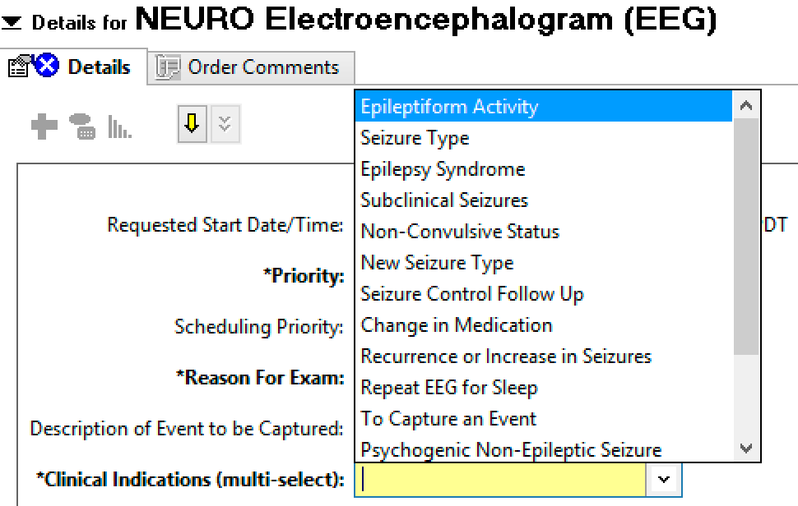
EEG Essentials: Outpatient
Ordering tips:
Please briefly describe the spell in “reason for exam”
E.g. “5 min GTC”, “amnestic”, “deja vu then GTC”, etc.

Slide 16
EEG Essentials: Outpatient
Sleep-deprived EEGs increase yield of epileptiform discharges by 1) lowering the seizure threshold and 2) capturing sleep during the recording
Pts w/epilepsy: approx 50% will have epileptiform abnormalities on 1st EEG → up to 80-90% after 4 routine studies or 24h recording
Sleep deprived EEG can reveal epileptiform discharges in ~13% of patients without epileptiform activity on routine studies
Consider ordering a sleep-deprived study if:
Intermediate/high suspicion for epilepsy, initial EEG negative
Suspicious indeterminate findings on initial EEG (e.g. “sharp transients”)
As initial study if higher suspicion for epilepsy, long wait times

Slide 17
Approach to first seizure
Was it a seizure?
Was it provoked?
Have they had other seizures?
Do they have epilepsy?
Do they need treatment?
Yes, if epilepsy (or otherwise short-term high seizure recurrence risk)
Specifically, treat if 1st seizure +
Epileptiform EEG
Remote symptomatic cause
Abnormal neuro exam beyond postictal period
Epileptogenic lesion on neuroimaging
?1st seizure from sleep
Acute symptomatic seizure with ongoing precipitant

Slide 18
Approach to Antiseizure Medications: SOS
Speed of action
IV (status) vs rapidly-up titratable oral vs oral requiring slow uptitrati
Seizure Onset
Sodium channel blockers = good for focal/GTC, bad for myoclonic, absence
Side effects
IV (status) vs rapidly-uptitratable oral vs oral requiring slow uptitration
Sodium channel blockers = good for focal/GTC, bad for myoclonic, absence
Non-sodium or multiple mechanisms = broad-spectrum
Comorbidities, pharmacokinetics, teratogenicity, affordability, etc.

Slide 19
ASM Mini-Primer
 | 😍 | 😭
Levetiracetam (Keppra) | No med interactions, well-tolerated, easy start | Mood side effects, renal dosing, **not covered 1st line (SA)
Phenytoin (Dilantin) | Once-daily dosing, cheap, readily available | Narrow therapeutic window, enzyme inducer, long term SEs
Valproic Acid (Divalproex) | Powerful broad-spectrum, mood-stabilizing | Endocrine and metabolic SEs, enzyme inhibitor, teratogenic
Lamotrigine (Lamictal) | Well-tolerated, mood stabilizing, good in pregnancy | Slow start (2-3 mos) - SJS risk, interacts w/OCP

Slide 20
Safety: Seizure Precautions
General:
No swimming alone
Showers over baths
Avoid heights and heavy machinery
Driving restrictions***
Screen other patient-specific hazards
Trigger awareness
During a seizure:
Clear environment
Recovery position,
Nothing in the mouth
Call 911 if:
  Seizure > 5 mins
  Cluster of 2-3+ seizures, not returning to normal
  Any injury
If/when to use rescue medication (lorazepam, midazolam)

Slide 21
Question #3
Which of the following driving restriction periods for non-commercial drivers in BC following a single paroxysmal event is INCORRECT?
Syncope (vasovagal, atypical or unexplained) - 1 week
Stroke - 30 days
Provoked seizure - 3 months
Provoked seizure with structural brain abnormality - 6 months (since stabilization)
Unprovoked seizure (epilepsy) - 6 months + on treatment
Focal aware seizures or seizures from sleep - 12 months stable pattern

Slide 22
Question #3
CCMTA Medical Standards with BC guidelines
Which of the following driving restriction periods for non-commercial drivers in BC following a single paroxysmal event is INCORRECT?
Syncope (vasovagal, atypical or unexplained) - 1 week
Stroke - 30 days **per Canadian Stroke Best Practices
Provoked seizure - 3 months (provoking factor resolved, low recurrence risk)
Provoked seizure with structural brain abnormality - 6 months (since stabilization)
Unprovoked seizure (epilepsy) - 6 months (**min 3 per neuro) + on treatment
Focal aware seizures or seizures from sleep - 12 months stable pattern

Slide 23
Summary: “Spell Characterization”
Seizures can look like almost anything, but tend to be brief, stereotyped events
Epilepsy = ongoing high recurrence risk of (unprovoked) seizures
Both seizures and epilepsy are CLINICAL diagnoses, though neurodiagnostics can help
→ Treat the patient, not the EEG!
Epileptiform discharges are specific in the right population, but not sensitive
Keppra is a great drug, but please fill out the special authority forms :)
(Lamotrigine also great if you have the time to uptitrate)
Always counsel around safety (seizure precautions) and driving restrictions

Slide 24
“Altered Mental Status”
Sample Scenario:
“75M on the ward has been confused for several days and all the DIMS workup is negative so far - what now?”
Part 2: Inpatient

Slide 25
Delirium+
Delirium = acute, fluctuating disorientation (hypoactive/hyperactive/mixed)
When is it not “just” delirium?:
Aphasia, abulia, bradyphrenia, catatonia, more persistent/static cognitive deficits
→ detailed mental status exam!
Think about seizure if:
Risk factors (seizure history, active neurologic disorder)
Discrete episodes, abnormal movements, abN exam (ddx = delirium + mvt disorder)
Sudden, persistent or prolonged change otherwise unexplained

Slide 26
How can EEG help you?
In a sicker patient population, EEG can answer a broader set of questions
Does my patient make normal background brain activity or are they encephalopathic?
Could they have structural brain pathology not already identified?
Are they at short-term risk for seizure?
Are their ongoing events seizures?
Are they in non-convulsive status?

Slide 27
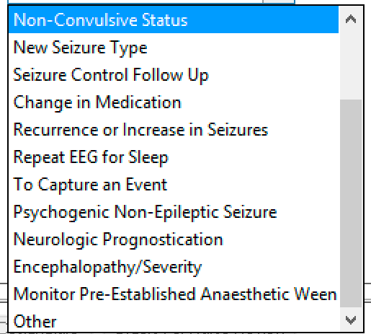
How can you help the EEG reader?
Clearly state the indication(s) + some accompanying history
Probably delirious but making sure → “Encephalopathy”
Maybe seizure at some point? → “Epileptiform Activity”
Is this movement a seizure? → “To Capture an Event”*
If truly concerned → “Non-Convulsive Status”*
*Please consult neurology first
Help obtunded/delirious patients be as awake as possible
Request to schedule EEG during time of day when
patient likely to be most alert
Rouse/stimulate patient during the study (or request this)

Slide 28
EEG Essentials (Inpatient)
Common Inpatient EEG findings:
Diffuse slowing = nonspecific “diffuse cerebral dysfunction” = encephalopathy
e.g. infection, toxic/metabolic, medications, neurodegenerative, multifocal intracranial lesions, (more rarely) high ICP
Generalized rhythmic delta activity (GRDA) = (worse) encephalopathy
Triphasic waves = metabolic/toxic encephalopathy (especially hyperammonemic)

Slide 29
Question #4: Alternate Scenario
75M admitted under CTU with colorectal cancer (s/p FOLFOX cycle #2, plts = 25), pneumonia and left SDH is initially “pleasantly confused” on admission. When you round on him this morning, eyes and head are fully deviated to the right. He has no verbal output and does not follow commands. When you lift up his blankets, you see subtle ongoing twitching of his right hand.
What is the most likely diagnosis?
What is your first step in management?

Slide 30
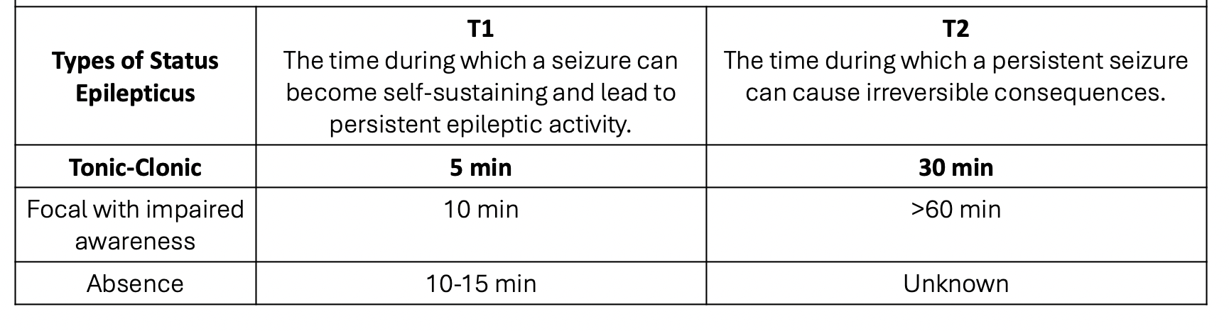
Status Epilepticus
Definition: persistent seizure activity, most often a single seizure > 5 mins or a cluster of 2+ seizures without return to baseline
Delayed recognition and treatment = higher risk of neuronal injury and death

Slide 31
Non-Convulsive Status Epilepticus (NCSE)
Definition: status epilepticus with minimal to no motor manifestations
Historical clues:
Prior seizures or immediately following convulsive status
Otherwise unexplained obtundation (not following commands or fluctuating)
Acute supratentorial intracranial pathology
Examination clues:
Speech abnormalities (e.g. mutism, not following commands)
Eye movement abnormalities (e.g. sustained lateral gaze deviation, nystagmus)
Subtle motor activity (particularly synchronous facial/periorbital myoclonus)
Automatisms (e.g. lip-smacking, chewing)

Slide 32
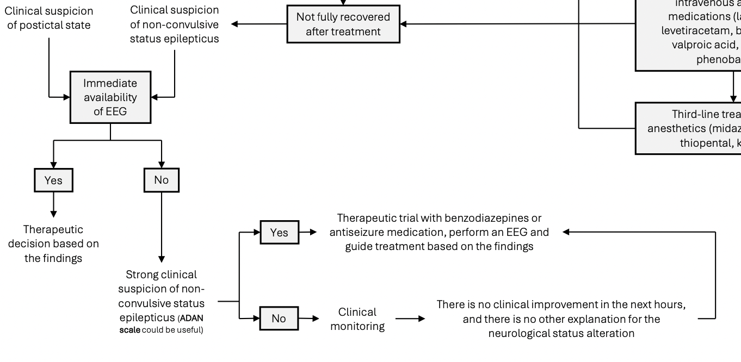
Initial ward management of ?NCSE
In practice, EEG almost never immediately available
If suspicious, do NOT let EEG delay treatment trial
Monitor for improvements in focal neurologic findings and mental status over minutes up to hours/days
Especially if airway at risk, can follow the same treatment algorithm as for convulsive status
Espinosa-Jovel, et al. Seizure emergency code strategy: Improving treatment times and hospital outcomes for patients with urgent epileptic seizures. Epileptic Disord, 2024.

Slide 33
Question #5
For the patient in the previous scenario, what would you order for initial management?
You’re guessing they weigh around 70 kg, this morning’s bloodwork was ok, and you’re not immediately concerned about their airway
Lorazepam 2mg IV x1
Lorazepam 2mg IV x1, repeat x1 at 5 mins if not improving
Lorazepam 4mg IV x1, then keppra 2g IV x1 if not improving after 5 mins
Lorazepam 4mg IV x1 (repeat x1 at 5 mins if not improving) then keppra 4.5g IV x1
Keppra 3g IV x1

Slide 34
Question #5
For the patient in the previous scenario, what would you order for initial management?
You’re guessing they weigh around 70 kg, this morning’s bloodwork was ok, and you’re
not immediately concerned about their airway
Lorazepam 2mg IV x1
Lorazepam 2mg IV x1, repeat x1 at 5 mins if not improving
Lorazepam 4mg IV x1, then keppra 2g IV x1 if not improving after 5 mins
Lorazepam 4mg IV x1 (repeat x1 at 5 mins if not improving) and keppra 4.5g IV x1
Keppra 3g IV x1
Benzos first - hit hard and fast!
Lorazepam IV - 0.1mg/kg, up to 8mg (2-4 mg/dose)
Even if benzos work, still need to load a maintenance ASM

Slide 35
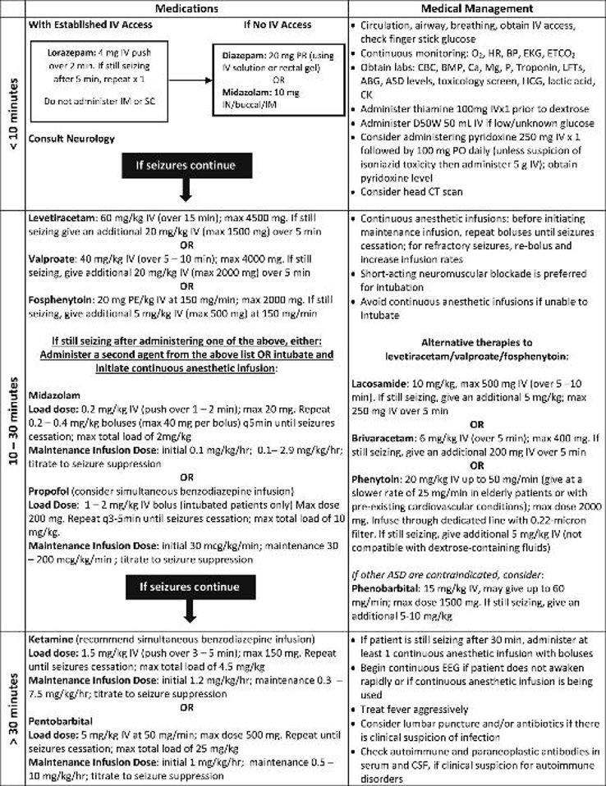
Status Epilepticus:
Treatment Algorithm

Slide 36
Status Epilepticus: Treatment
First 10 minutes:
Lorazepam IV 4 mg IV push over 2 mins
If still seizing at 5 mins, repeat x1
(or 0.1mg/kg IV, max dose 8 mg)
If no IV access: midazolam 10mg IN/buccal/IM
If no other benzos:
Diazepam 5 mg IV q3min (max 20 mg) or 20 mg PR
Benzodiazepines are 1st line for status
Upfront, adequate doses give best chance of stopping a seizure quickly (In practice often under-dosed)
Evidence does NOT suggest that benzos for status hasten respiratory depression/need for intubation

Slide 37
Status Epilepticus: Treatment
10 minutes → 30 minutes
Load 2nd line antiseizure medication (order STAT, give whenever arrives)
Keppra 60 mg/kg IV, max 4.5 g (>75 kg)
VPA 40 mg/kg IV, max 3 g (>75 kg)
Phenytoin 20 mg/kg IV, max 1.5 g (>75 kg)
Risk of hypotension, arrhythmia
Avoid in known generalized epilepsy, may worsen myoclonic status
Lacosamide 10mg/kg IV, max 600 mg
Always manage airway first if needed!
If keppra is not available, use whatever you can access most quickly
Ketamine 1mg/kg IV may be reasonable as an initial 2nd line agent to buy time
Equipoise r.e. loading an additional 2nd line agent vs. immediately proceeding to infusions
If still seizing as approach 30 mins, load at least 1 continuous anesthetic infusion
(propofol, ketamine, midazolam) → initial bolus, then maintenance

Slide 38
Summary: “Altered Mental Status”
Not your garden-variety delirium = red flag for more detailed investigation
EEG in an inpatient setting can help clarify encephalopathy and seizure risk and definitively diagnose non-convulsive status (NCSE)
Subtle motor manifestations, speech disturbance are most obvious clues to NCSE
Status epilepticus is a neurologic emergency and should be treated promptly (mainly clinically, often empirically)
Don’t underdose benzos/other ASMs for status! Large doses upfront most effective

Slide 39
Status Post-Status
Sample Scenario:
“28M intubated for status epilepticus and admitted to the ICU - what next?”
Part 3: Critical Care

Slide 40
The post-status intubated patient
Make sure that the patient 1) received a loading dose of antiseizure medication and
2) has maintenance doses ordered
→ e.g. IV Keppra 60mg/kg x1 then 1 g NG/IV BID; IV dilantin 20mg/kg x1 then 100 mg IV TID
Use EEG to make sure seizures are actually stopping!
Minimum target cessation of status, may specifically target burst suppression
Post-status on infusions = most important indication for long-term EEG monitoring (at minimum need urgent spot EEG with rapid reporting if LTM unavailable)
After a period of sustained sedation, wean infusions with EEG guidance

Slide 41
Refractory Status
Optimize maintenance antiseizure medications
Lacosamide (Vimpat) is an excellent 2nd line IV ASM (watch for AV block)
VPA, phenytoin available IV but messier w/drug interactions
May need prolonged/multiple infusions - GABA-ergic therapy (i.e. midazolam) less helpful as status continues
New Onset Refractory Status Epilepticus (NORSE)
No clear cause. Ultimate Dx autoimmune > paraneoplastic > infectious
Aggressive, protocolized, empiric treatment with early immunotherapy (steroids, +/- IVIG or PLEX) + ketogenic diet, 2nd line immunotherapies, etc.

Slide 42
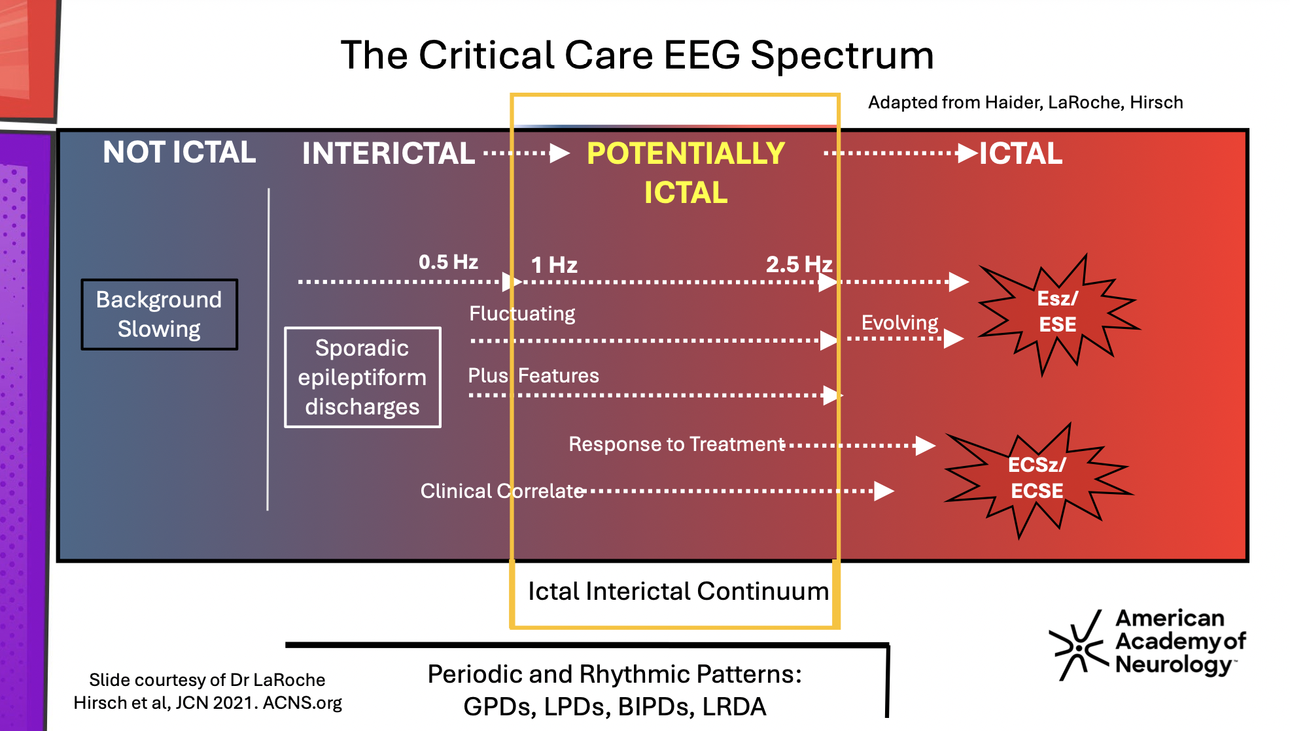

Slide 43
EEG Essentials: ICU
Periodic and rhythmic patterns = “sick brain”
Lateralized periodic discharges (LPDs)
Bilateral independent periodic discharges (BIPDs)
Lateralized Rhythmic Delta Activity (LRDA)
Generalized periodic discharges (GPDs)
“Seizure-ish”: often on ictal/interictal continuum, sometimes form NCSE
Sometimes may cause neuronal injury beyond just reflecting underlying dysfunction
High risk patterns are often indications for continuous EEG monitoring

Slide 44
Question #6
Which of these EEG findings does NOT convey a risk for seizure?
BIRDs
LPDs
LRDA
GPDs
GRDA

Slide 45
Question #6
Which of these EEG findings does NOT convey a risk for seizure?
BIRDs = Brief Interictal Rhythmic Discharges
LPDs
LRDA
GPDs
GRDA = Generalized Rhythmic Delta Activity
→ like an electrographic seizure
but too short
→ encephalopathy pattern

Slide 46
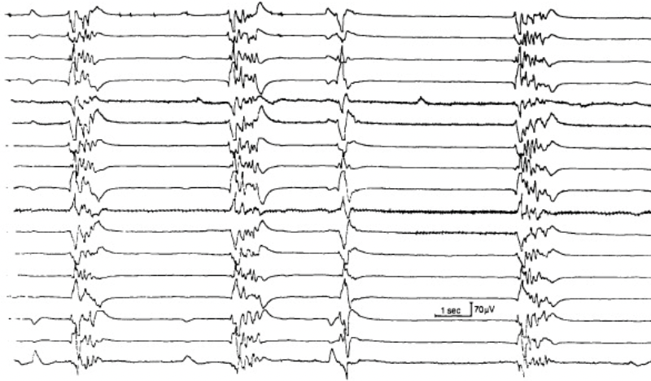
EEG Essentials: ICU
Patterns of severe encephalopathy and coma:
Burst suppression - infusions, anoxia, other nonspecific encephalopathy
Various other specific coma patterns (e.g. beta, alpha, theta, delta, spindle coma) can give clues to coma etiology and prognosis

Slide 47
EEG in neuroprognostication
General Principles:
Able to achieve a more benign EEG pattern early = more likely to recover**
Still making a more malignant EEG pattern later = less likely to recover**
**recorded OFF sedation
Benign | Malignant
Continuous Normal voltages Reactive to stimuli No extra bursts/discharges | Burst suppression Very low voltages (suppressed) Non-reactive Frequent periodic discharges

Slide 48
Neuroprognostication: Anoxic Brain Injury
EEG at 24-48h per guidelines, +/- PRN for seizure monitoring
Specific findings suggestive of poor prognosis (<5% false positive rate):
Myoclonic status epilepticus
Suppressed background (including complete + burst suppression
Generalized periodic discharges (GPDs) on a suppressed background
→ Integrated into multimodal neuroprognostication
Early status epilepticus, seizures also often indicate poor prognosis
CCS 2023 Neuroprognostication Position Statement

Slide 49
Summary: Status Post-Status
Don’t forget about maintenance ASMs in intubated patients!
EEG is crucial to rule out ongoing status when not (or no longer) convulsive and guide infusion weans
Sick brains make various high-risk EEG patterns (e.g. LPDs, LRDA, GPDs) which may become ictal and require close monitoring
EEG can provide important neuroprognostic information (e.g. post-arrest)

Slide 50
Conclusion
Seizures, epilepsy and status epilepticus remain clinical diagnoses
If you are suspicious for non-convulsive status, consider trialing empiric treatment while arranging for an EEG
Treat recognized status as an emergency, hard + fast
EEG is essential to some diagnoses (e.g. non-convulsive status) but generally more of an ancillary test
(Almost always) treat the patient, NOT the EEG
If in doubt, ask your neurology friends :)

Slide 51
Thank You!
Feel free to email jasmynek@student.ubc.ca with ongoing neurology-related questions
Come rotate with us :)

