Slide 1
The Trainee Approach to Cardiogenic Shock
Feb 28, 2025
Cardiology Topic Review
Joban Phulka
VGH LMR

Slide 2
Case
38-year-old male is brought to the emergency department by paramedics after experiencing progressive dyspnea, near-syncope, and palpitations over the past two days. Over the past six months, he has noticed worsening exercise intolerance and occasional leg swelling but attributed it to being out of shape.
Today, he collapsed at home while trying to stand up from bed. He had no preceding chest pain but reported a brief sensation of dizziness and “racing heart” before collapsing. His wife reports he has had no recent fevers, cough, or sick contacts, and there is no history of alcohol, drug use, or prior cardiac disease.

Slide 3
Case
In the emergency department the patient appear diaphoretic, pale, and cool to touch.
Vitals: BP 91/52 (MAP 65 mmHg), HR 130 bpm (irregular), RR 24, 93% on 4L, T36.7, GCS 14 (drowsy but follows commands)
ERP notes a JVP that is at the angle of the jaw, bibasilar crackles, diminished peripheral pulses and pitting edema. POCUS shows a reduced LVEF. No pericardial effusion but IVC is dilated and non-collapsing.
Labs
  CBC: WBC 10.2, HgB 125, Plt 180
  CHEM7: Na 133, K 5.2, Cl 98, HCO3 19, BUN 10.5, Cr 180, Glu 7.2, Lactate 4.2
  Liver Panel: AST 110, ALT 75, ALP 90, Total Bili 18, Alb 29
  NT-proBNP: 12,500, Trop 240, TSH 2.1
  VBG: 7.21/44/19

Slide 4
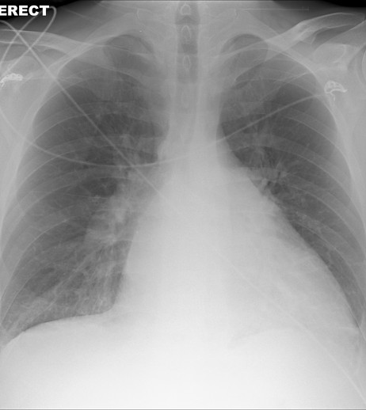

Slide 5
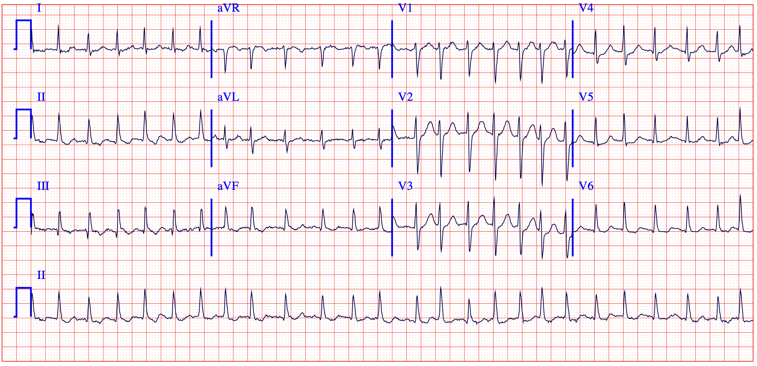

Slide 6
Case
Past Medical History
  Depression
Medications
  Escitalopram 10 mg daily
Allergies
  None
Social History
  No smoking, alcohol use, or recreational drug use
  Married, no kids
  Works at a desk job
Family History
  Father died at age 41
  Mom is healthy
  No siblings

Slide 7
Case
You are doing your community rotation in Terrace and the ERP calls you as they are worried the patient is in acute heart failure or cardiogenic shock
What is your approach to this patient?

Slide 8
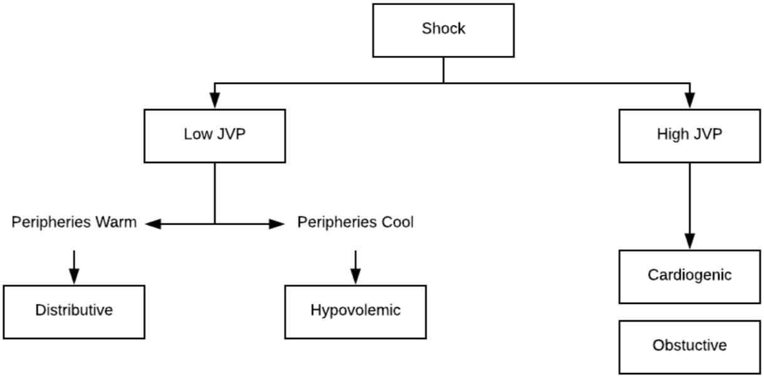
Shock Differential

Slide 9
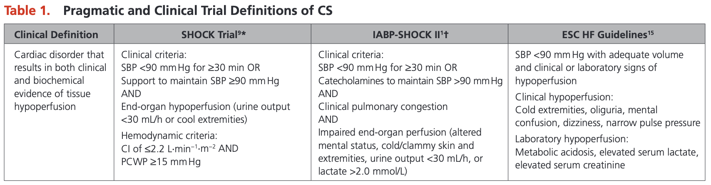
Cardiogenic Shock Definition

Slide 10
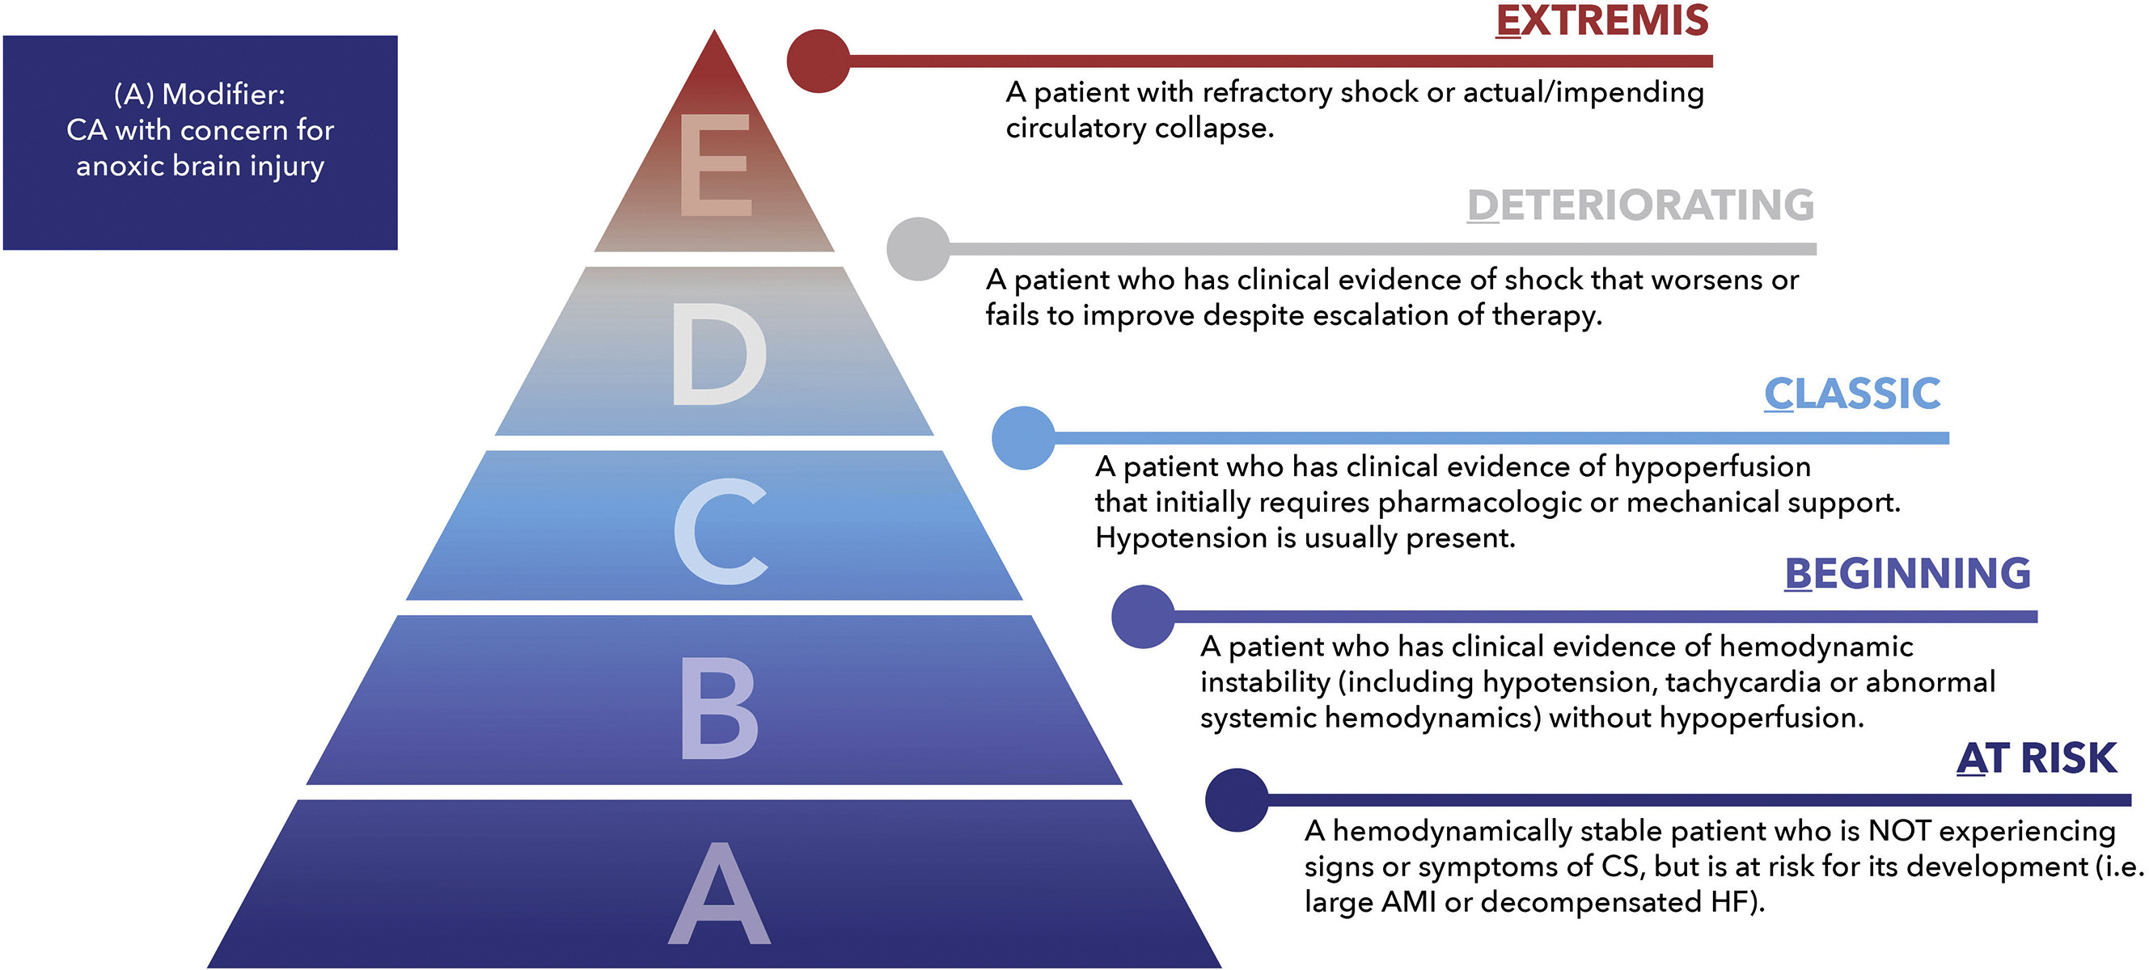
SCAI Stages

Slide 11
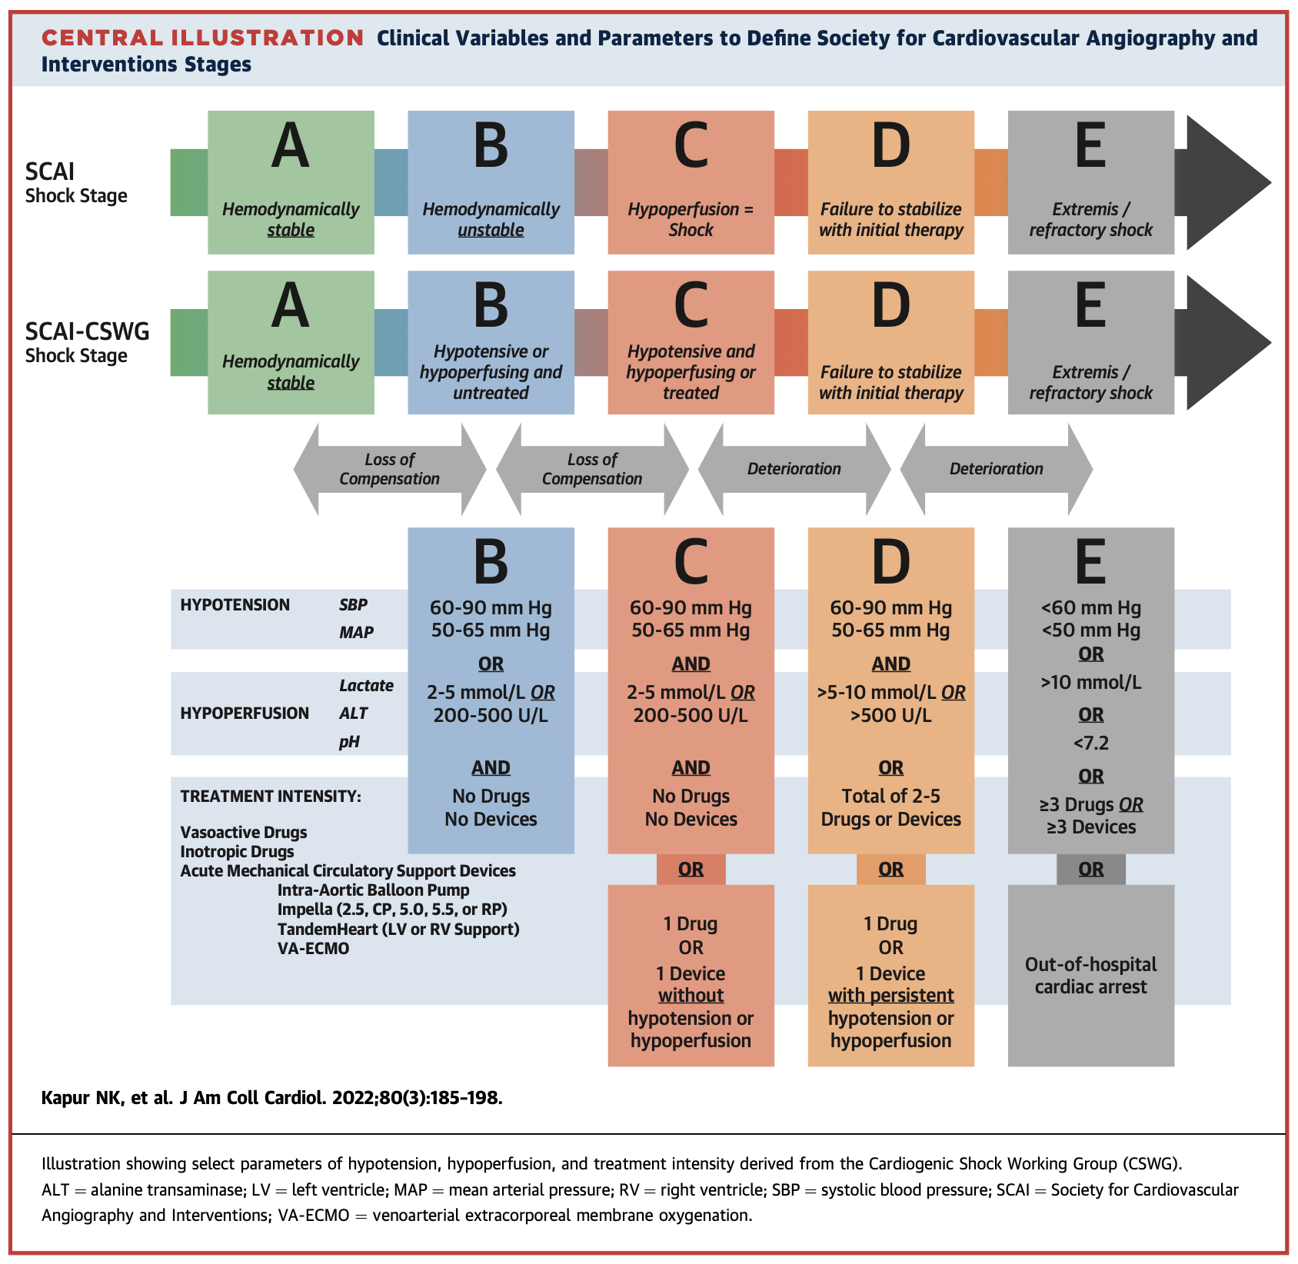
SCAI Stages

Slide 12
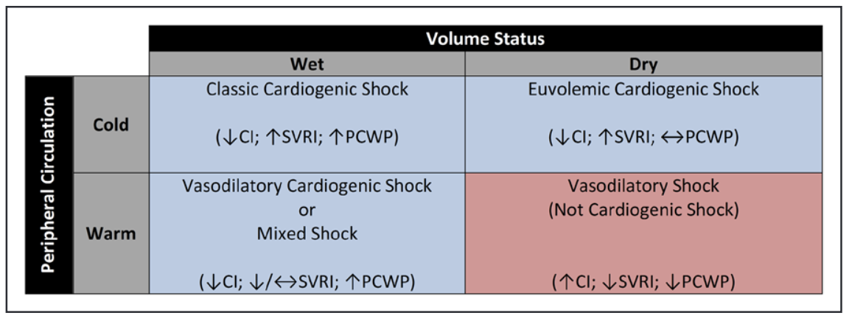
AHA Cardiogenic Shock Hemodynamic Profiles
Notes:
The gold standard of the diagnosis of cardiogenic shock is a pulmonary catheter.

Slide 13
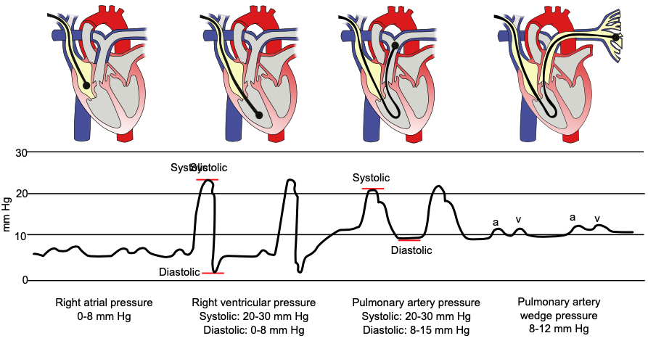
Pulmonary Artery Catheter
Notes:
The catheter is inserted through a large central vein, usually the IJ or subclavian but can also be through the femoral vein. From there it is treated through the RA, the RV, and subsequently the pulmonary artery. Monitoring of the catheter location can be done by dynamic pressure readings from the catheter tip or with the aid of fluoroscopy. Once at the end of the pulmonary artery the balloon at the end of the catheter is inflated and is “wedged” in a small pulmonary vessel. So wedged, the catheter can provide an indirect measurement of the pressure in the left atrium of the heart, showing a mean pressure referred to as the PCWP/PAWP.

Slide 14
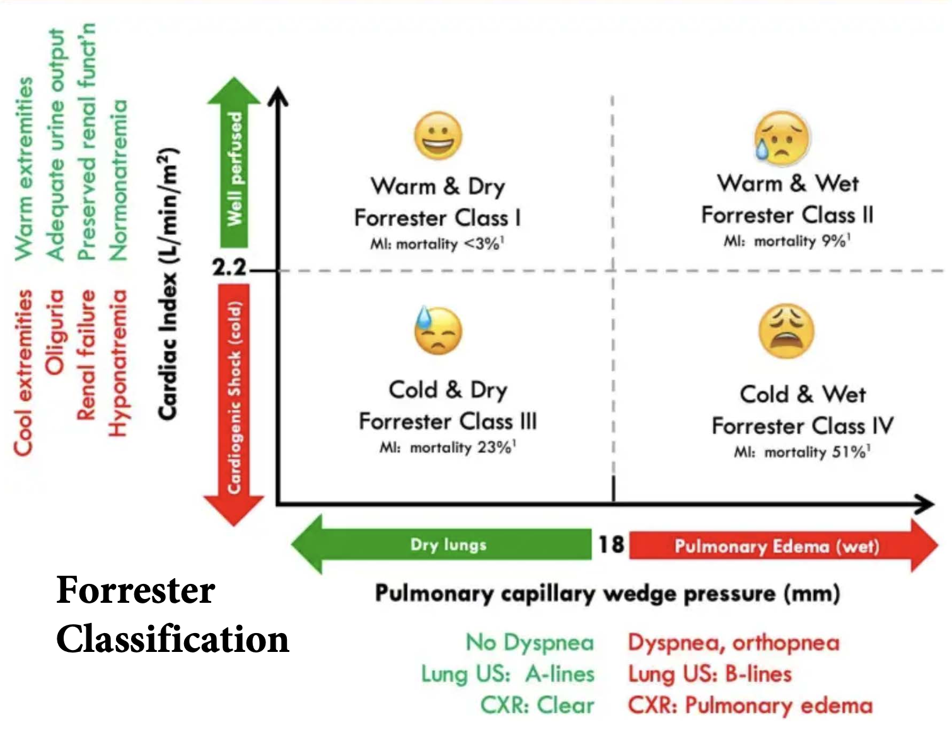
Forrester Classification

Slide 15
Management Principles
Cardiogenic shock is complex to manage
No single clinical or laboratory parameter should used in isolation to manage patients or make decisions
Once the diagnosis of CS is established patients should be placed in monitored setting and an arterial line placed for invasive hemodynamic monitoring and frequent blood draws along with a central line
Trend for the the first 4-6 hours the following labs q1-2 hours
  Lactate, CHEM-7, ABG/VBG, Liver panel
  Pressor requirements
  Urine output
  LOC
Central line measurements
  CVP: 2-6 mmHg
  SvO2: 60-65%
    >80% corresponds to a high flow state (ie, sepsis)
    <60% corresponds to a low flow state (ie, cardiogenic shock)
 | Mixed Venous Gas | Central Venous Gas
Term | SvO2 | ScvO2
Origin | PA Catheter | Central Line
Source | SVC & IVC | SVC
Strengths | Accuracy | Connivence
Limitations | PA Rupture | Accuracy
Normal | 65-70% | 60-65%
Notes:
The mixed venous blood gas reflects true systemic venous oxygen saturation because it includes blood returning from both the superior and inferior vena cava and the coronary sinus. However, the central venous blood gas reflects only the oxygen saturation of venous return from the upper body, missing contributions from the coronary sinus and lower body

Slide 16
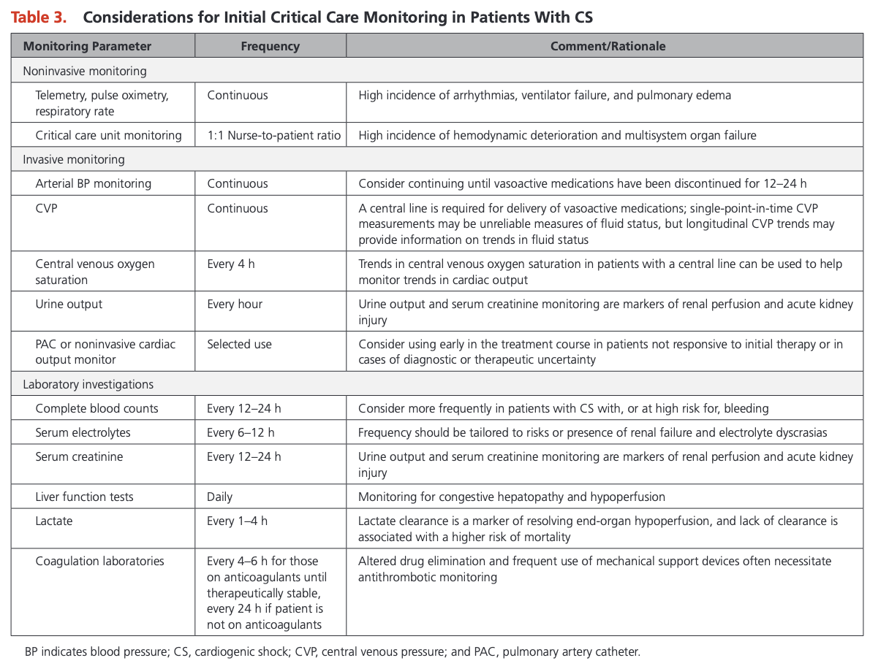
Management Principles

Slide 17
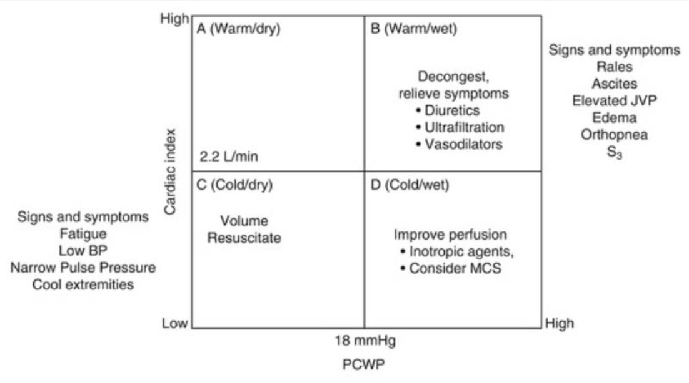
Management Principles
Plot patient on your Forrester Classification and treat accordingly

Slide 18
Respiratory Support in Cardiogenic Shock
Consider BiPAP or intubation if clinically indicated
Why does BiPAP work in CS?
  Cardiac preload and afterload?

Slide 19
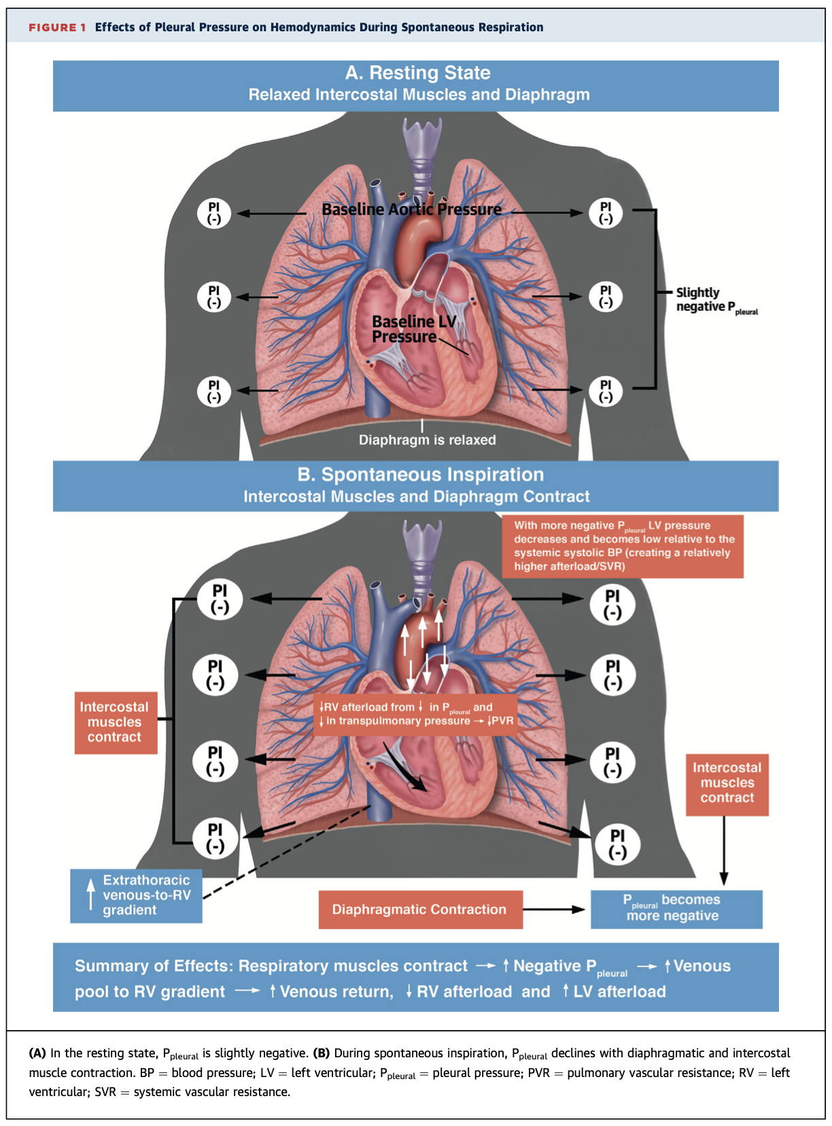
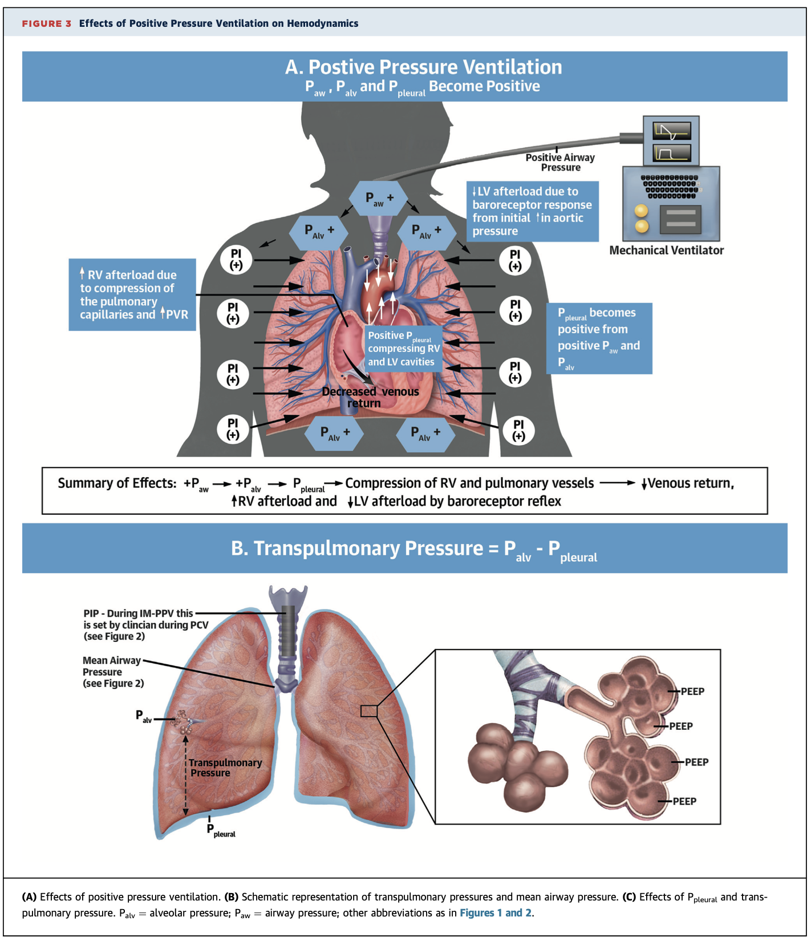
Spontaneous Breathing vs. PPV
Notes:
Spontaneous breathing relies on negative intrathoracic pressure to pull air into the lungs. This affects both afterload and preload. Let's start with afterload during spontaneous breathing, negative intrathoracic pressure increases the transmural pressure across the left ventricle (LV). Which is essential the LV intracavitary pressure minus the intrathoracic pressure. When intrathoracic pressure becomes more negative, this increases the transmural gradient, making it harder for the LV to eject blood into the high-pressure systemic circulation (higher afterload). Higher afterload = Increased myocardial work and oxygen demand → This is particularly bad in cardiogenic shock, where the LV is already struggling.
In terms of preload in spontaneous breathing. The more negative intrathoracic pressure sucks blood back to the heart, increasing venous return to the right ventricle (RV). This increased RV preload translates to higher LV end-diastolic pressure (LVEDP) and higher pulmonary capillary wedge pressure (PCWP). Worsens pulmonary edema and oxygenation.
Now why BiPAP or PPV works is it applies and positive intrathoracic pressure and changes CV dynamics. PPV reduces the transmural pressure gradient by increasing intrathoracic pressure and decreasing the transmural gradient and lowering LV afterload. This reduces LV wall stress and myocardial oxygen demand, making it easier for the failing LV to eject blood into the systemic circulation. In terms of preload the PPV reduces venous return to the heart because positive intrathoracic pressure compresses the vena cava and decreases the pressure gradient driving blood into the right atrium (RA).

Slide 20
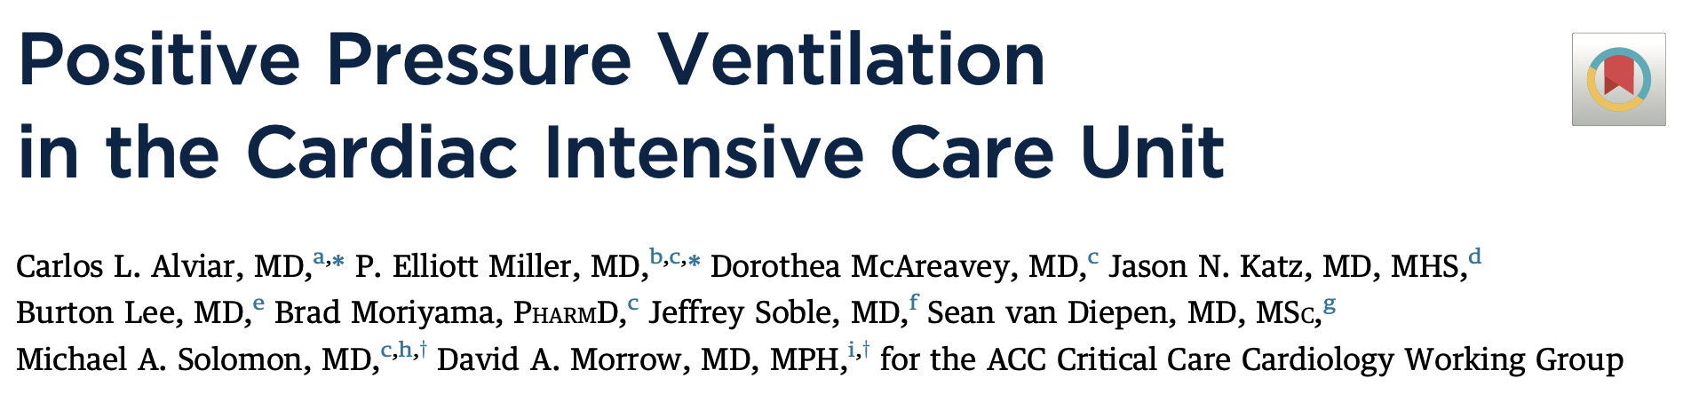
Spontaneous Breathing vs. PPV Key Points
Spontaneous breathing
  Negative intrathoracic pressure increase venous return (preload) and LV afterload making it harder for the failing heart to function
BiPAP
  Applies positive pressure which reduced both preload and afterload, improving CO and pulmonary congestion

Slide 21
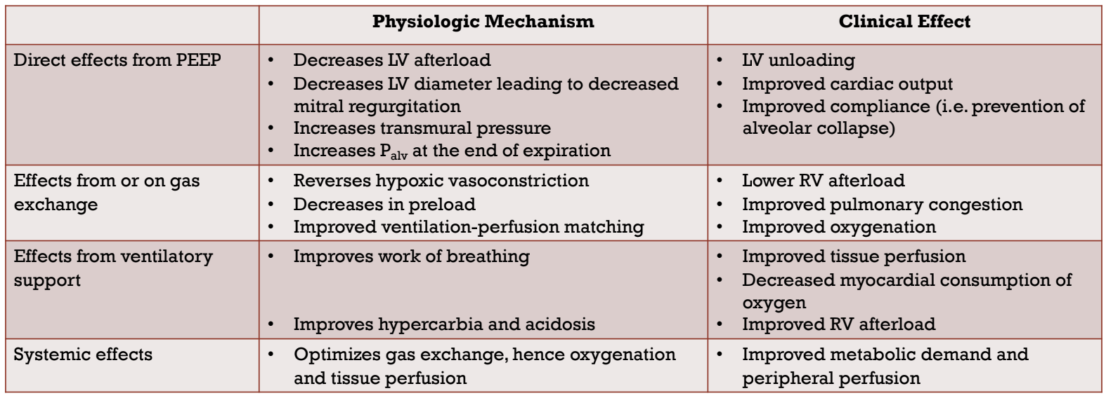
Cardiovascular Effects of PPV

Slide 22
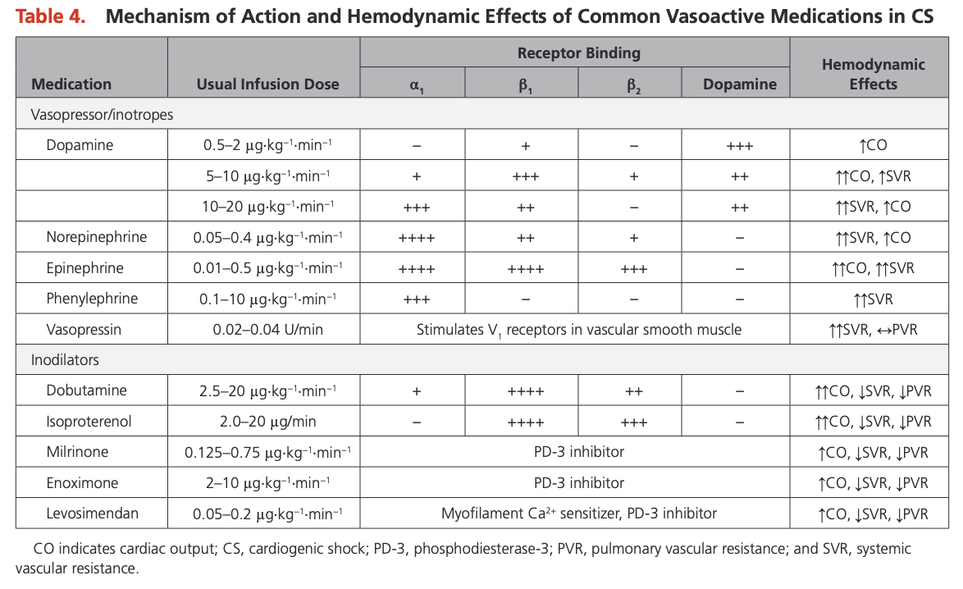
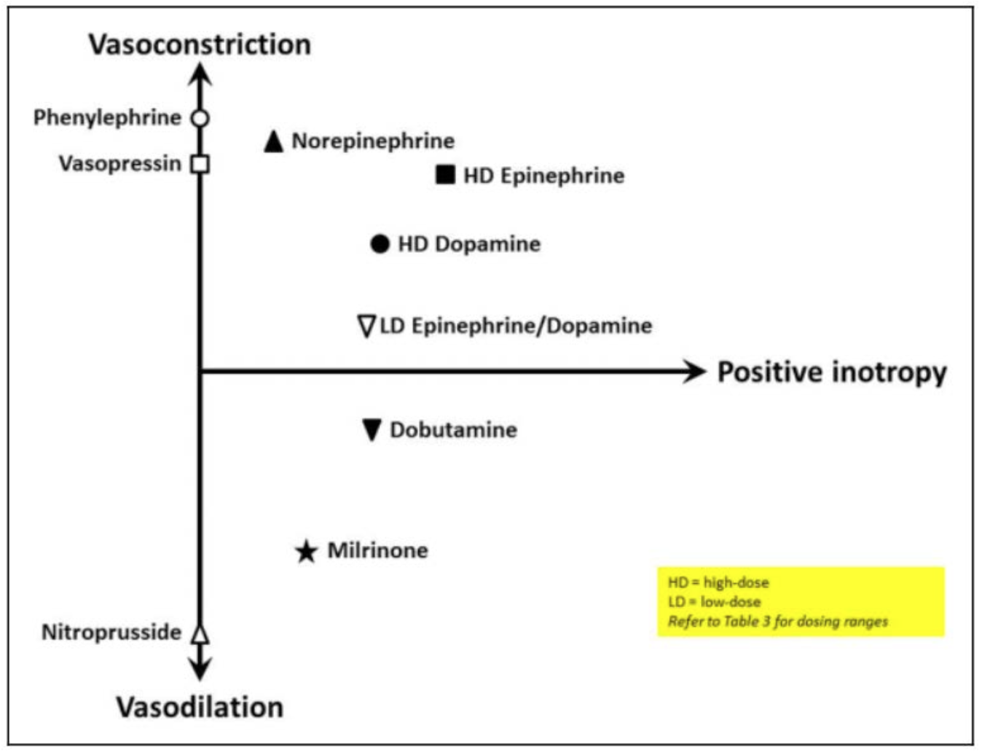
Optimize the MAP in Cardiogenic Shock
Target a MAP of 60-65 mmHg for adequate perfusion
  Avoid excessive afterload
Norepinephrine is a good first agent to start as acts on both the alpha and beta receptors
Starting with an inodilator (ie, dobutamine or milrinone) will likely drop blood pressure as significant vasodilatory effects

Slide 23
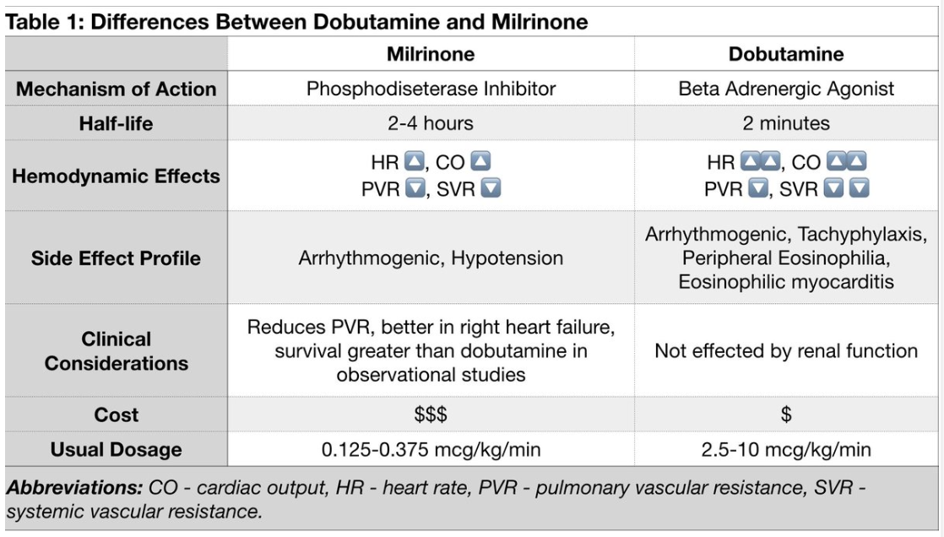
Choice of Inodilator in Cardiogenic Shock
Most common choices are dobutamine and milrinone
Stimulate β1 receptors leading to increased myocardial contractility and CO
DOREMI Trial (NEJM, 2021)
  Compared milrinone and dobutamine in patients with cardiogenic shock and found no significant difference in primary outcome of in-hospital death, any cause, resuscitated cardiac arrest, receipt of a cardiac transplant or mechanical circulatory support, nonfatal myocardial infarction, transient ischemic attack or stroke diagnosed by a neurologist, or initiation of renal replacement therapy

Slide 24
Optimize Volume
Patient may benefit from a fluid challenge if hypoperfusion and no pulmonary congestion
Use CVP to guide
Diuresis with Lasix if significant systemic/pulmonary congestion
  If refractory, consider augmentation with metolazone or acetazolamide
Patients with advanced CS may require CRRT to assist with volume removal

Slide 25
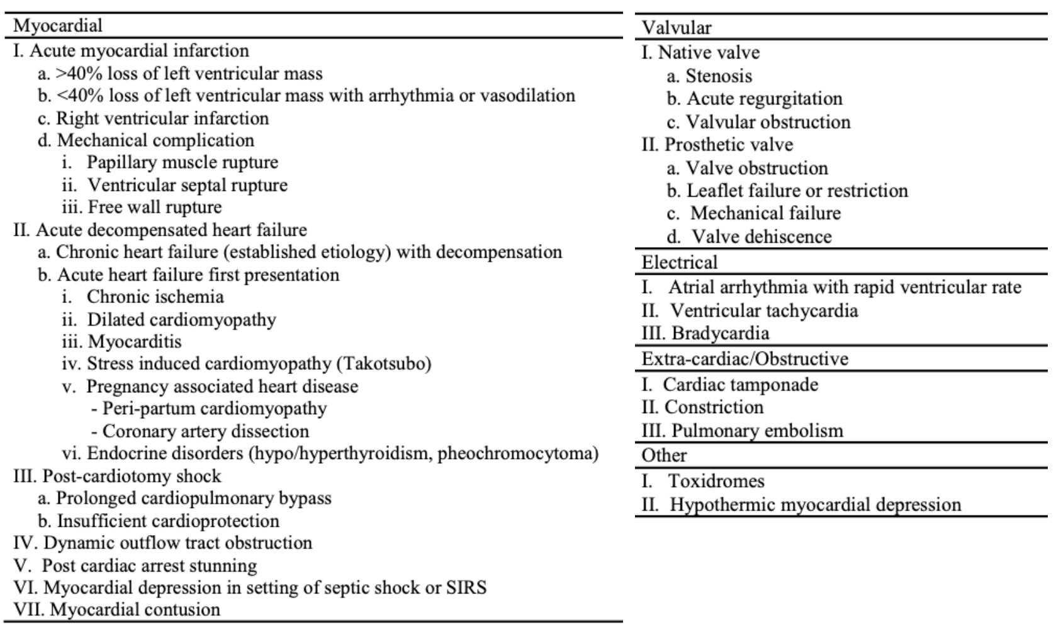
Identify Underlying Etiology
Identify the etiology for the patient’s cardiogenic shock
Tailor treatment and hemodynamic management approach to etiology

Slide 26
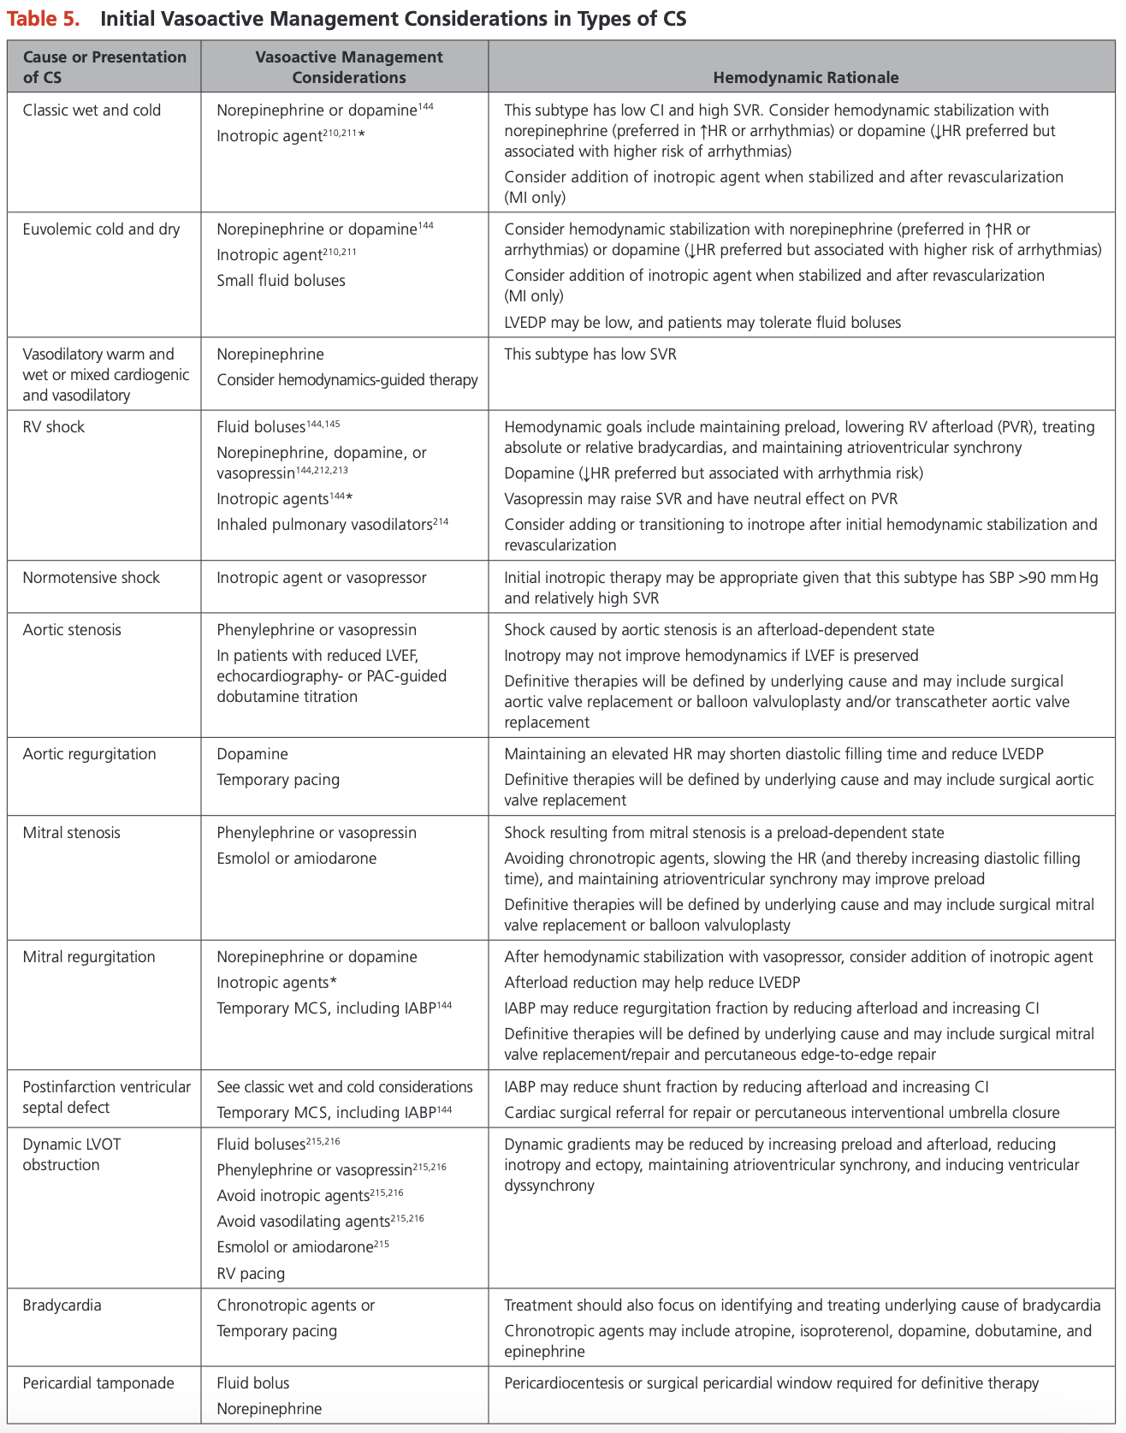

Slide 27
Transition Management
Patients that are doing better and their shock is improving we will consider starting them on ACEi/ARB which have vasodilatory effects and beta-blockers which have negative inotropic effects
Will add small doses of these medications (ie, ramipril 2.5 mg BID and bisoprolol 1.25 mg daily) while patients still on inotropes and then wean vasoactive agents and titrate GDMT
Consider isosorbide dinitrate or nitroglycerin path and hydralazine in those with renal failure unable to be start on ACEi/ARB

Slide 28
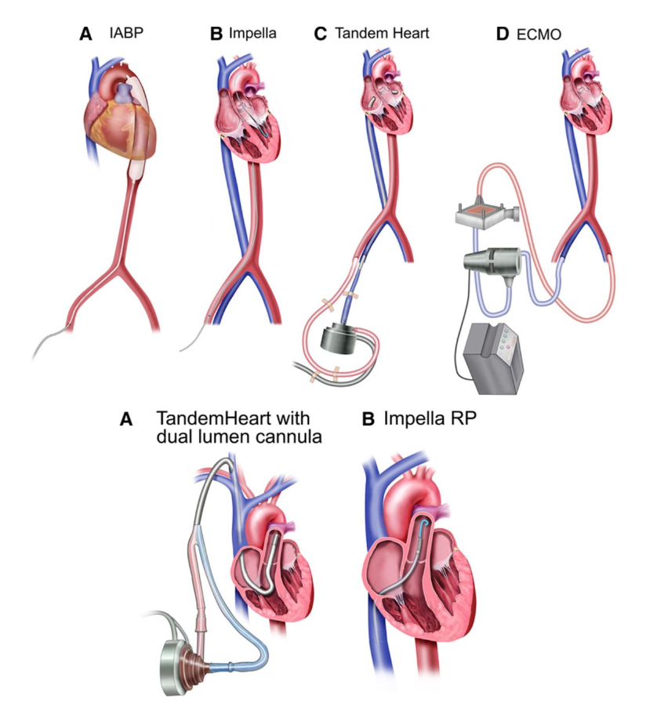
Mechanical Circulatory Support
Consider in patients with persistent organ failure
Device of choice is patient/institution specific
Evidence is limited in cardiogenic shock but promising area of research
DanGer Shock Trial (2024)
  Routine use of a microaxial flow pump with standard care in the treatment of patients with STEMI-related cardiogenic shock led to a lower risk of death from any cause at 180 days than standard care alone
  Higher rates of adverse events in MCS group compared to standard of care

Slide 29
Case Synopsis
The patient was admitted to the ICU in terrace and received excellent initial management of his cardiogenic shock
His ECHO showed severe LV dysfunction (LVEF 20%) with global hypokinesis, biatrial enlargement, and TR
He was transferred to VGH for ongoing care including appropriate hemodynamic support including being placed on VA-ECMO which he was eventually able to be deescalated from and initiated on appropriate GDMT
He received an angiogram that showed no obstructive CAD
He then received a CMR which showed late gadolinium enhancement in the mid-myocardium concerning for a LMNA cardiomyopathy
He underwent genetic testing which confirmed a diagnosis of LMNA cardiomyopathy
He received an ICD for primary prevention and his first-degree relatives should be offered genetic testing
Rate and rhythm controlled for AF, anticoagulated regardless of CHADS65 score
LVEF improved to 35% on repat ECHO and maintained on GDMT

Slide 30
Thank you for listening!
Questions and Discussion

