Slide 1
Biochemical investigation of
Endocrine Disorders in BC
Mar 14, 2025
Andre Mattman, MD, FRCPC
Medical Biochemist
SPH / VGH

Slide 2
Disclosures
I view healthcare from a Planetary Health perspective
From this:
  Low value testing = small gain in Global QALY / High GEEP
    GEEP = Global Extraction of resources, Emissions and Pollution

Slide 3
Topics:
Lab test artefacts in Endocrinology
Lab testing in:
  Hypertension
    Cushing
    Primary aldosteronism
  Adrenal Insufficiency
  Polydipsia Polyuria Syndrome
  Hypercalcemia / Hypocalcemia
  Graves disease

Slide 4
Topics:
Lab test artefacts in Endocrinology
Lab testing in:
  Hypertension
    Cushing
    Primary aldosteronism
  Adrenal Insufficiency
  Polydipsia Polyuria Syndrome
  Hypercalcemia / Hypocalcemia
  Graves disease

Slide 5


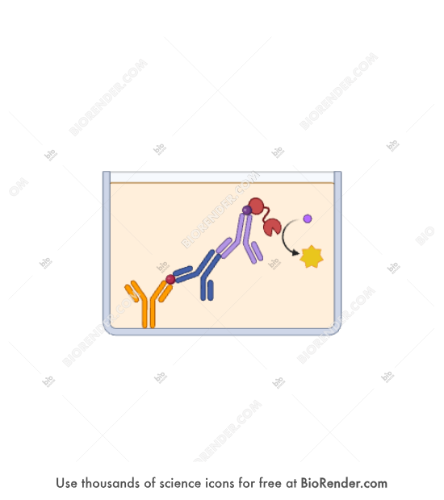
Lab Artefacts in Endocrinology
How to spot Immunoassay errors

Slide 6
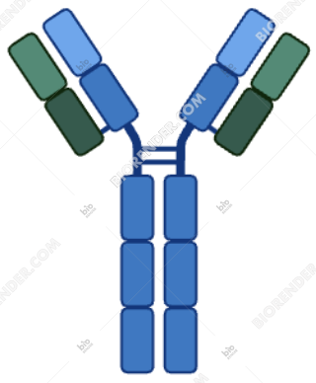
Endogenous immunoglobulins
Common (1:1000) cause of spurious (often large) errors
Heterophil (positive or negative, steroid or protein, enzyme, peptide)
Macro (positive, protein, enzyme or peptide)

Slide 7
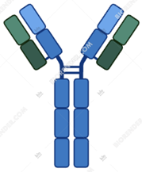
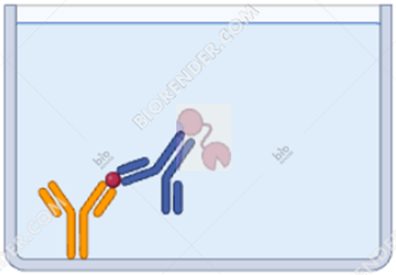
Endogenous immunoglobulins
Common (1:1000) cause of spurious (often large) errors
Heterophil (positive or negative, steroid or protein, enzyme, peptide)
  Eg Estrogen, PTH, insulin

Slide 8
Endogenous immunoglobulins
Common (1:1000) cause of spurious (often large) errors
Macro (positive, protein, enzyme or peptide)
  Macroprolactin, MacroTSH, MacroCPK

Slide 9
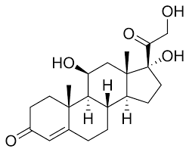
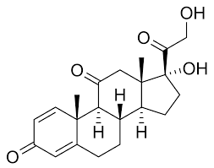
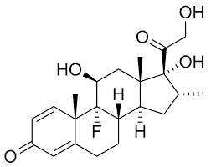
Other immunoassay interferences
Endogenous immunoglobulins
Heterophil
Macro
__________________________________________________________________________________________________________________________________________________________________
Other common errors
Cross Reactivity
  Cortisol
  Prednisone (60%)
  Dexamethasone (0%)

Slide 10
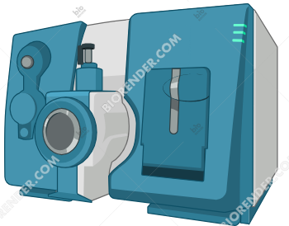
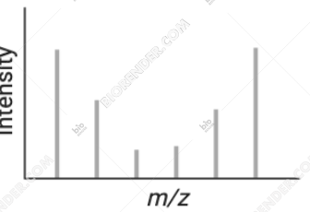
How to avoid immunoassay interferences
Mass Spectrometry
Eg Aldosterone, Cortisol, Testosterone, 17OH progesterone, Androstenedione, thyroglobulin

Slide 11
Other test artefacts – pre-analytic
In hospital - acute phase
  ACTH, Cortisol axis
  Non-thyroidal illness syndrome
  Aldosterone / Renin
Medication effect
  Dexamethasone suppression test and Aldosterone / Renin ratio
Pregnancy
  Pregnancy physiological changes affect expected values
    TSH
    Renin and aldosterone
    Fasting glucose
    Total Calcium etc

Slide 12
Other test artefacts – post analytic (genetics)
Thyroid
  Familial resistance to thyroid hormone
Calcium
  Familial Hypocalciuric Hypercalcemia
Aldosterone
  Pseudohypoaldosteronism
  Syndrome of mineralocorticoid excess
Cortisol
  Resistance to cortisol hormones
Testosterone
  Androgen insensitivity
Many esoteric
  Familial HCG syndrome

Slide 13
Unexpected test results:
Contact the lab when results are unexpected and signal a major change in Dx/Rx

Slide 14
Topics:
Lab test artefacts in Endocrinology
Lab testing in:
  Hypertension
    Cushing
    Primary aldosteronism
  Adrenal Insufficiency
  Polydipsia Polyuria Syndrome
  Hypercalcemia / Hypocalcemia
  Graves disease

Slide 15
Endocrine Hypertension
Cushing syndrome
Primary aldosteronism
Pheochromocytoma

Slide 16
Cushing syndrome
Midnight
Salivary Cortisol
Dexamethasone suppression test
Laboratory Investigations
ACTH dependent?
24h urine free cortisol

Slide 17
1 mg Dexamethasone suppression test
Laboratory Investigations
Cushing’s
Mass spectrometry
Sensitive rule out
Cortisol < 50 nmol/L
Mass spectrometry
Specific rule in
Cortisol > 140 nmol/L

Slide 18
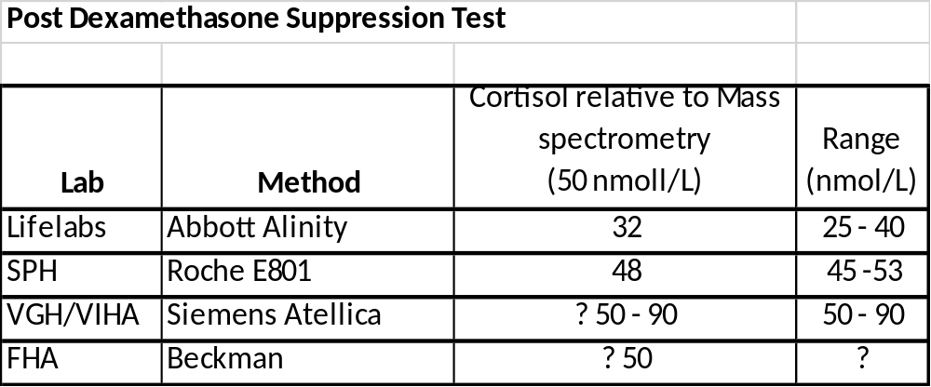
1 mg Dexamethasone suppression test
Laboratory Investigations
Cushing’s
Mass spectrometry
Sensitive rule out
Cortisol < 50 nmol/L
Mass spectrometry
Specific rule in
Cortisol > 140 nmol/L
Atkins JS, Hawley JM, Owen LJ, Clayton J, Scargill J, Keevil BG. Serum cortisol assay performance following the 1 mg overnight dexamethasone suppression test. Ann Clin Biochem. 2023 Nov;60(6):386-395. doi: 10.1177/00045632231179560. Epub 2023 Jun 30. PMID: 37208338.

Slide 19
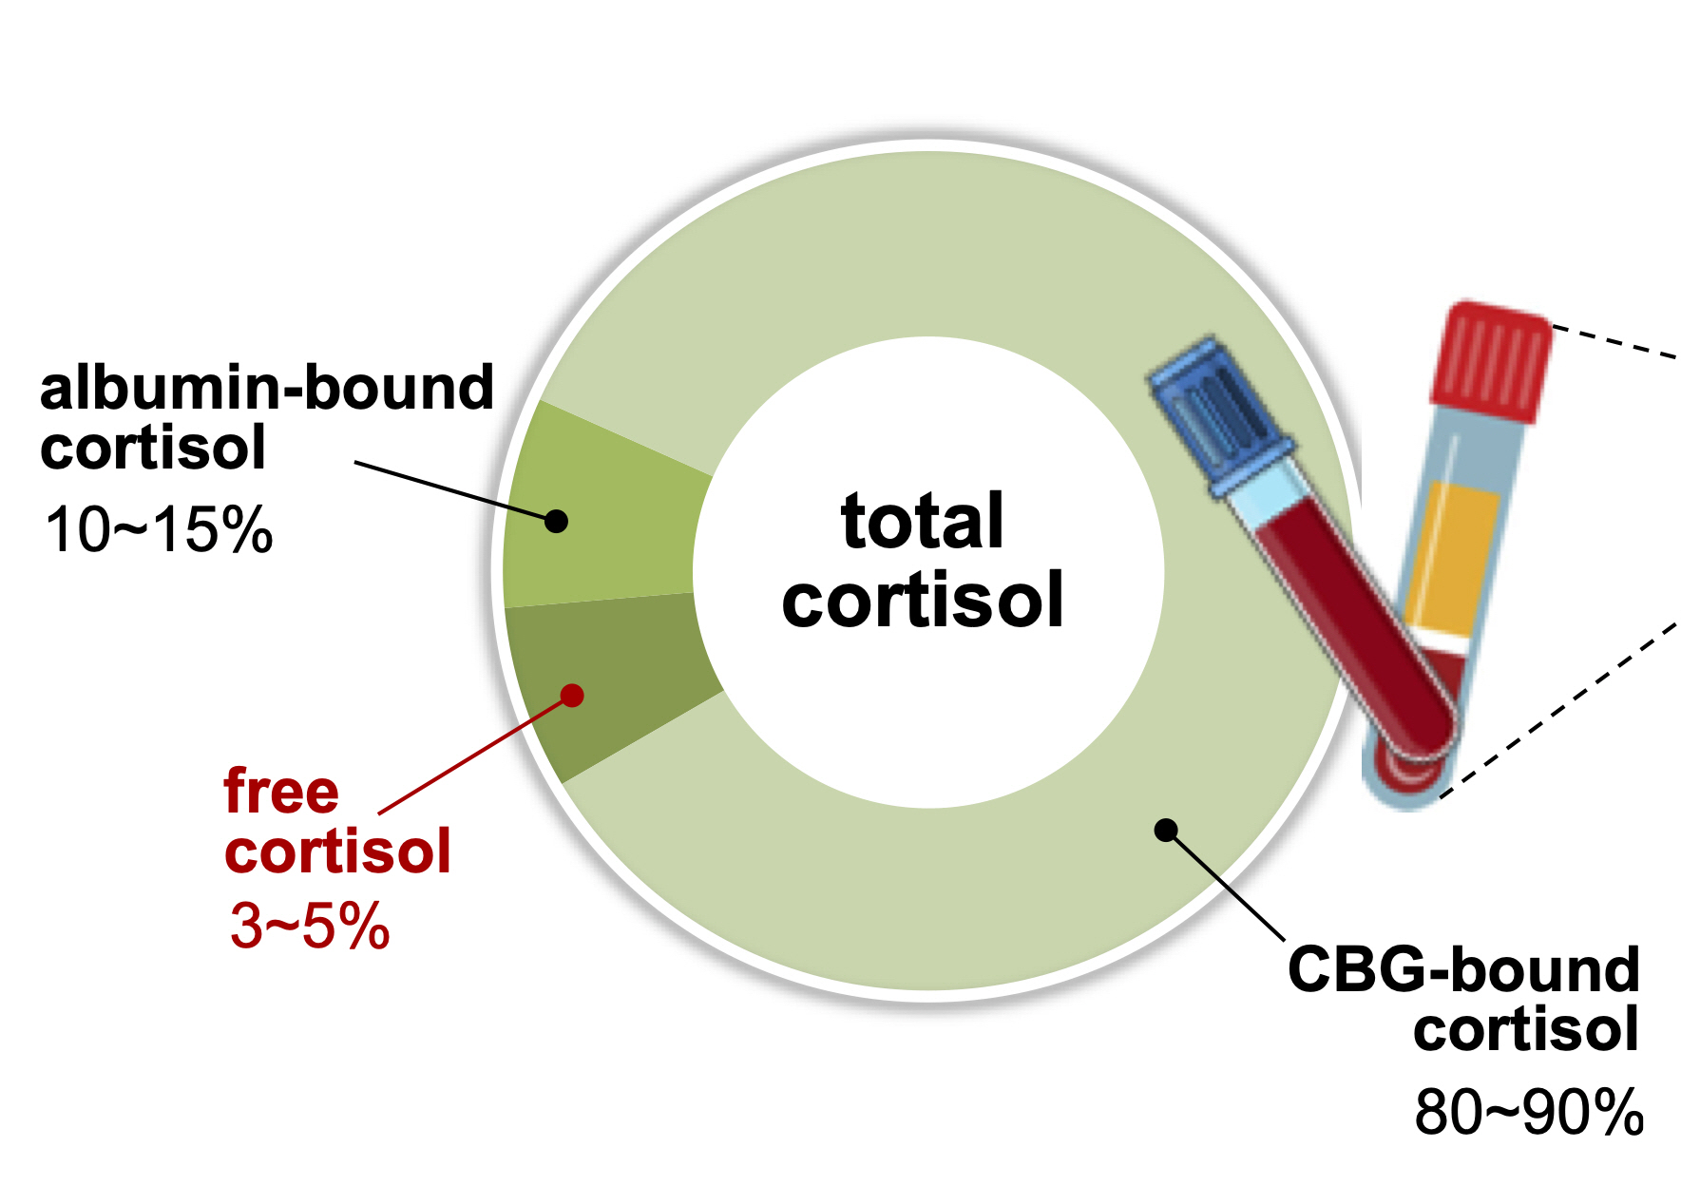
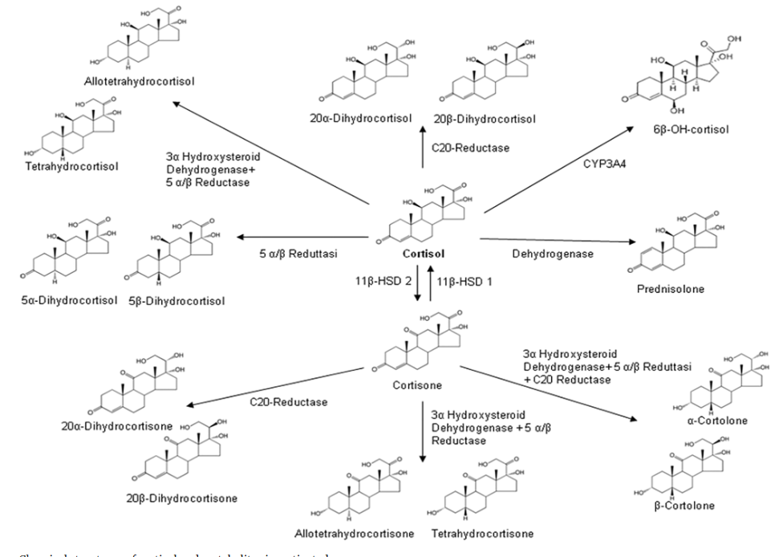
1 mg Dexamethasone suppression test
Laboratory Investigations
Cushing’s

Slide 20
Midnight Salivary Cortisol
Laboratory Investigations
Cushing’s
Vancouver
Normal value*
Cortisol < 2.8 nmol/L
General Hospital
Mass spectrometric method reference interval for 23:00 – 24:00 sample collection for an individual with a typical circadian rhythm.
Abnormal value is a sensitive and specific indicators for Cushing syndrome.

Slide 21
24 hour urine free* cortisol
Laboratory Investigations
Cushing’s
Free =
  Non-CBG, non-albumin
  Non-conjugated
  No metabolite interference if performed by mass spectrometry (All labs in BC)

Slide 22
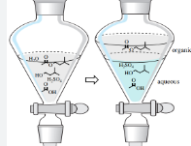
24 hour urine free* cortisol
Laboratory Investigations
Cushing’s
* Free =
  Non-CBG, non-albumin
  Non-conjugated
  No metabolite interference if performed by mass spectrometry (All labs in BC)

Slide 23
Primary aldosteronism
Aldosterone suppression test:
Saline suppression test
  necessary?
Aldosterone to
Renin Ratio (ARR):
Is renin suppressed?
Laboratory Investigations
Adrenal Venous Sampling
- If surgical therapy contemplated
Aldosterone suppression test:
Oral Salt suppression test
  ? Necessary

Slide 24
Renin activity vs Renin mass
Laboratory Investigations
Primary Aldosteronism
SPH Mass Spec
Suppressed renin activity
<< 0.20 ng/L/s
3h incubation Angiotensin-I gener’n*
Typical < 0.05 ng/L/s
Lifelabs immunoassay*
Suppressed renin mass
< 5 ng/L

Slide 25
When to calculate:
Aldosterone to renin ratio (ARR)?
Laboratory Investigations
Primary Aldosteronism
High suspicion:
Hypokalemic hypertension that persists in spite of medication. Do not stop medication.
Do not test concurrently with dexamethasone suppression test
Low suspicion:
Discontinue medications that predispose to false negatives
  Mineralocorticoid receptor blocking agents
  ACE I, ARB

Slide 26
How to calculate:
Aldosterone to renin ratio (ARR)?
Laboratory Investigations
Primary Aldosteronism
Pre-analytic:
  Morning collection:
    Before 10 am after 1 h ambulation
  Preferably on an unrestricted salt diet
  Random (sitting for 15 minutes)
  No Dexamethasone
Analytic:
Lifelabs: Diasorin Liaison LX
  Renin mass and aldosterone immunoassay
SPH: Mass spectrometry
  Renin activity via Ang-1 generation
  Aldosterone
  Cortisol (not reported, guides interpretation, no drug interference aside from prednisolone)

Slide 27
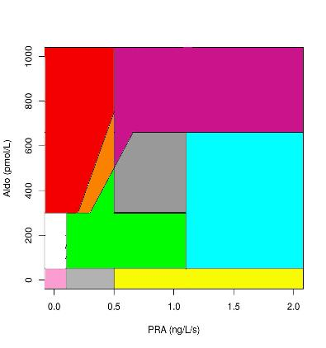
Interpretation:
Aldosterone to renin ratio (ARR)?
Laboratory Investigations
Primary Aldosteronism
Renal Artery Stenosis
Renal Parenchymal
Reninoma
Bartter/Gitelman
Laxitive/Diuretic Abuse
Aldosterone Blockers
PA
+
PA
+/-
Probably
Normal
Context
Dependent
Medication Effects
ACE/ARB
CCB
Diuresis
Vasodilators
PA w hypoK
(among other things)
Normal
Prolonged Recumbence
IV Fluid
Mineralocorticoid HTN (non-Aldo)
Diabetic Nephropathy
NSAID Exposure
Addison’s/Post-op Adrenalectomy
Treated Addison’s
(among other things)

Slide 28
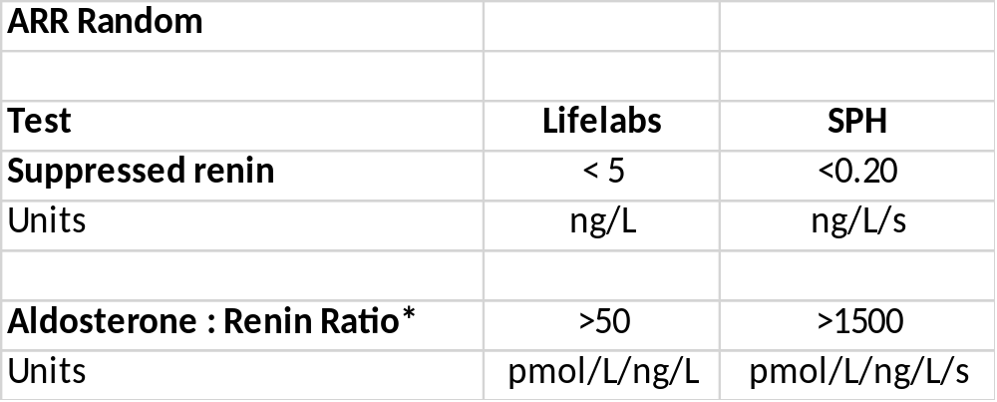
Interpretation:
Aldosterone to renin ratio (ARR)?
Laboratory Investigations
Primary Aldosteronism

Slide 29
Aldosterone suppression test:
- Seated Saline suppression test
Laboratory Investigations
Primary Aldosteronism
Pre-analytic:
  No MRA medications
  Seated
  Potassium replete
  Tolerant of 2L of NS over 4 hours
  Collection: Baseline and 4 hours post Renin/Aldosterone/Cortisol
Analytic:
SPH: Mass spectrometry
  Renin activity (Ang-1 generation), Aldosterone, Cortisol

Slide 30
Aldosterone suppression test:
- Seated Saline suppression test
Laboratory Investigations
Primary Aldosteronism
Interpretation:
Did Renin suppress < 0.05 ng/L/s (or < 0.20 ng/L/s)?
And
Did Cortisol decrease?
No
Invalid Test
Yes
Did Aldosterone suppress?
  < 73 pmol/L sensitive rule out*
  > 162 pmol/L specific rule in*
*Stowasser M, Ahmed AH, Cowley D, Wolley M, Guo Z, McWhinney BC, Ungerer JP, Gordon RD. Comparison of seated with recumbent saline suppression testing for the diagnosis of primary aldosteronism. The Journal of Clinical Endocrinology & Metabolism. 2018 Sep 18;103(11):4113-24

Slide 31
Aldosterone suppression test:
- Oral Salt suppression test
Laboratory Investigations
Primary Aldosteronism
Pre-analytic:
  Replete K
  No MRA medications
  High salt diet plus oral salt tablets prn for 3 days
  Collect urine 24h starting on the third day
Analytic:
  St Paul’s Hospital
    Urine aldosterone by mass spectrometry

Slide 32
Aldosterone suppression test:
- Oral Salt suppression test
Laboratory Investigations
Primary Aldosteronism
Interpretive:
  If 24h urine Na > 200 mEq, then
  Urine aldosterone <= 32 pmol/L => Rules out primary aldosteronism
  Urine aldosterone > 32 pmol/L => Confirms pathologic hyperaldosteronism*
*Pathologic condition may be primary or secondary aldosteronism

Slide 33
Adrenal Venous Sampling
Laboratory Investigations
Primary Aldosteronism
Pre-analytic:
  Proceed to adrenal venous sampling directly when:
    Clinical syndrome of primary aldosteronism plus
      Aldosterone > 550 pmol/L and Renin activity < limit of detection
      OR
      Hypokalemia and hypertension prior to MRA therapy
        plus adrenal adenoma
  Stop MRA medication far enough in advance of procedure to allow renin activity suppression prior to procedure
    Prolonged complete block of aldosterone activity can prevent recognition of aldosterone secretion lateralization

Slide 34
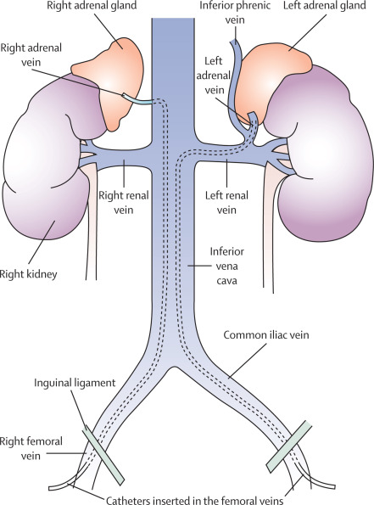
AVS: Pre-analytic
Simultaneous or sequential sampling of baseline and post-ACTH (250 µg) for aldosterone and cortisol
  Peripheral IVC
  Right adrenal vein
    Success rate 64%
    Easy to miss; short, acute with various angle
    Drains into IVC (90%) or hepatic accessory vein (10%)
  Left adrenal vein
    Success rate >98%
Figure from Monticone et al. (2015) Lancet Diabetes & Endocrinology 3(4):296-303. Rossi et al. (2014) Hypertension. Expert Consensus Statement 63:151-160.
Notes:
Aldosterone pulsatile - Artificial gradients when sequential technique is used
ACTH stimulation
Increase PCC gradient between adrenal and IVC → increase SI
Reduce stress induced fluctuations in cortisol and aldosterone during sequential AVS
Increase aldo secretion from APA
there is no conclusive evidence that cosyntropin stimulation leads to a better outcome than unstimulated AVS

Slide 35
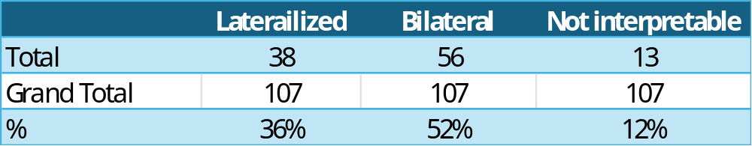
AVS: Pre-analytic
Simultaneous or sequential sampling of baseline and post-ACTH (250 µg) for aldosterone and cortisol
  Peripheral IVC
  Right adrenal vein
    Success rate 64%
    Easy to miss; short, acute with various angle
    Drains into IVC (90%) or hepatic accessory vein (10%)
  Left adrenal vein
    Success rate >98%
Data from the past 12 months in BC
Figure from Monticone et al. (2015) Lancet Diabetes & Endocrinology 3(4):296-303. Rossi et al. (2014) Hypertension. Expert Consensus Statement 63:151-160.
Notes:
Aldosterone pulsatile - Artificial gradients when sequential technique is used
ACTH stimulation
Increase PCC gradient between adrenal and IVC → increase SI
Reduce stress induced fluctuations in cortisol and aldosterone during sequential AVS
Increase aldo secretion from APA
there is no conclusive evidence that cosyntropin stimulation leads to a better outcome than unstimulated AVS

Slide 36
Topics:
Lab test artefacts in Endocrinology
Lab testing in:
  Hypertension
    Cushing
    Primary aldosteronism
  Adrenal Insufficiency
  Polydipsia Polyuria Syndrome
  Hypercalcemia / Hypocalcemia
  Graves disease

Slide 37
Adrenal insufficiency
Morning cortisol
ACTH stimulation
Laboratory Investigations
Hypolgycemic stimulation

Slide 38
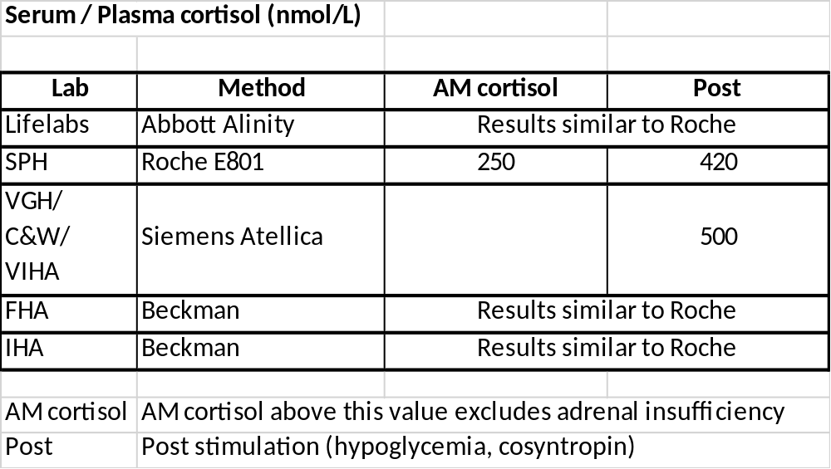
Morning and Post stimulation cortisol
Laboratory Investigations
Adrenal insufficiency
Notes:
Supports 420 on Roche Cort II
(411 mass spec; 425 Cortisol II)
Okutan S, Jørgensen NT, Pedersen LE, Borresen SW, Hilsted L, Hansen LF, Feldt-Rasmussen U, Klose M. Determination of cortisol cut-off limits and steroid dynamics in the ACTH stimulation test: a comparative analysis using Roche Elecsys Cortisol II immunoassay and LC-MS/MS. Endocrine. 2024 Jul;85(1):321-330. doi: 10.1007/s12020-024-03752-0. Epub 2024 Mar 9. PMID: 38460071; PMCID: PMC11246257.
Supports 420 (414 for Cort II at 30 min)
El-Farhan N, Pickett A, Ducroq D, et al. Method-specific serum cortisol responses to the
adrenocorticotrophin test: comparison of gas chromatography-mass spectrometry and
five automated immunoassays. Clin Endocrinol 2013;78:673–80.
Husni H, Abusamaan MS, Dinparastisaleh R, Sokoll L, Salvatori R, Hamrahian AH. Cortisol values during the standard-dose cosyntropin stimulation test: Personal experience with Elecsys cortisol II assay. Front Endocrinol (Lausanne). 2022 Aug 18;13:978238. doi: 10.3389/fendo.2022.978238. PMID: 36060940; PMCID: PMC9433864.
Morning cortisol of >354 nmol/L rules out primary adrenal insufficiency
Kumar R, Carr P, Wassif W. Diagnostic performance of morning serum cortisol as an alternative to short synacthen test for the assessment of adrenal reserve; a retrospective study. Postgrad Med J. 2022 Feb;98(1156):113-118. doi: 10.1136/postgradmedj-2020-138514. Epub 2020 Oct 29. PMID: 33122342.

Slide 39
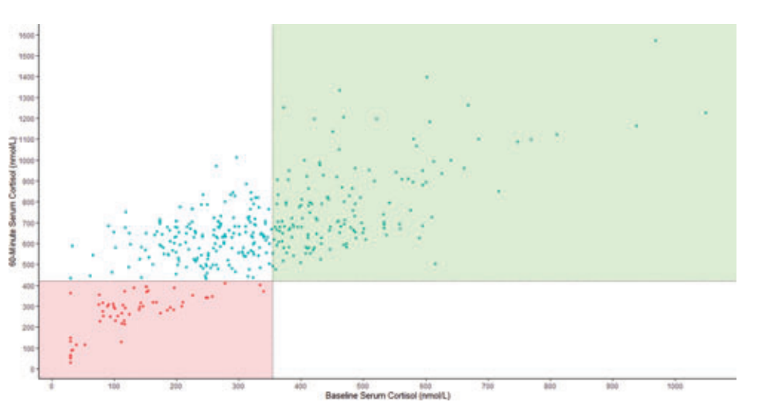
Morning cortisol to predict:
Post stimulation cortisol > 420 nmol/L
Laboratory Investigations
Adrenal insufficiency
Approximate Likelihood ratio:
60 min cortisol < 420 nmol/L
22 15 8 2.3 0.6 <0.2
Roche Cortisol:
Morning cortisol > 354 nmol/L
rules out relatively low 60 minute cortisol
60 min post ACTH cortisol (nmol/L)
420
Kumar R, Carr P, Wassif W. Diagnostic performance of morning serum cortisol as an alternative to short synacthen test for the assessment of adrenal reserve; a retrospective study. Postgrad Med J. 2022 Feb;98(1156):113-118. doi: 10.1136/postgradmedj-2020-138514. Epub 2020 Oct 29. PMID: 33122342.
0 100 200 300 400 500 600 700 800 900 1000
Morning Cortisol (nmol/L)
Notes:
.

Slide 40
Topics:
Lab test artefacts in Endocrinology
Lab testing in:
  Hypertension
    Cushing
    Primary aldosteronism
  Adrenal Insufficiency
  Polydipsia Polyuria Syndrome
  Hypercalcemia / Hypocalcemia
  Graves disease

Slide 41
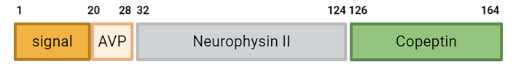
Polydipsia Polyuria Syndrome
Value of Copeptin testing

Slide 42
Polydipsia Polyuria & Copeptin
Clinical syndrome:
  Polydipsia / Polyuria
  AVP Insufficiency or AVP Resistance
    Hypovolemic hypernatremia/hyperosmolality
      with restriction of water
Historical Gold standard test
  Water deprivation test
New test
  Copeptin interpreted wrt hypernatremia/hyperosmolality

Slide 43
Polydipsia Polyuria & Copeptin
Scenario | Serum Na | Serum Osmolality | Urine osmolality | Serum copeptin | Follow-up (if clinical symptoms persist)
No water restriction | Normal | Normal | Elevated relative to serum | N/A | No follow up
No water restriction | Normal | Normal | Equivalent to serum | N/A | Wate restriction of greater or lesser duration based on severity
Post water restriction | Normal | Normal | Equivalent to serum | N/A | Greater water restriction
Post water restriction | >= 147 mmol/L | > 295 mOsm/kg | < 600 mOsm/kg | <3.0 | AVP deficiency syndrome
Post water restriction | >= 147 mmol/L | > 295 mOsm/kg | < 600 mOsm/kg | >21.4 | AVP resistance syndrome
Post water restriction | >= 147 mmol/L | > 295 mOsm/kg | < 600 mOsm/kg | 3.0 – 21.4 | Hypertonic saline-stimulated copeptin
Post op Day 1 Pituitary Sx | Not specified | Not specified | Not specified | <2.5 – Deficiency >3.4 - Sufficiency | Post surgical AVP deficiency
Choy KW, Wijeratne N, Chiang C, Don-Wauchope A. Copeptin as a surrogate marker for arginine vasopressin: analytical insights, current utility, and emerging applications. Crit Rev Clin Lab Sci. 2025 Jan;62(1):24-44. doi: 10.1080/10408363.2024.2383899. Epub 2024 Jul 31. PMID: 39086073.

Slide 44
Topics:
Lab test artefacts in Endocrinology
Lab testing in:
  Hypertension
    Cushing
    Primary aldosteronism
  Adrenal Insufficiency
  Polydipsia Polyuria Syndrome
  Hypercalcemia / Hypocalcemia
  Graves disease

Slide 45
Investigation of Calcium abnormalities
Use of Albumin correction formulae?

Slide 46
Corrected Calcium
Laboratory Investigations
Calcium abnormalities
Corrected Calcium = (0.08 * (40- Pt's Albumin)) + Serum Ca
This formula assumes:
Normal pH and temperature
No protein abnormalities besides low albumin
Assays used to measure calcium and albumin similar to derivation cohort
In fact:
Multiple studies done to repeat original 1973 study have failed to find a linear way to relate total calcium and albumin to ionized calcium
Total Ca OK for screening, monitoring
iCa prior to diagnosis, treatment

Slide 47
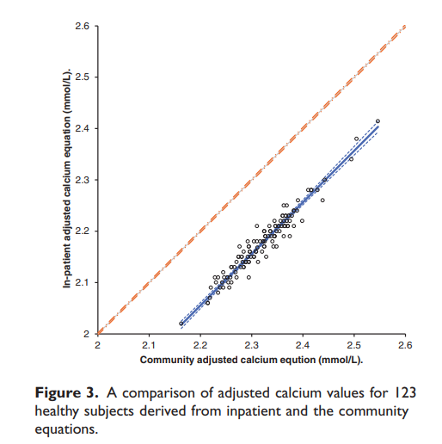
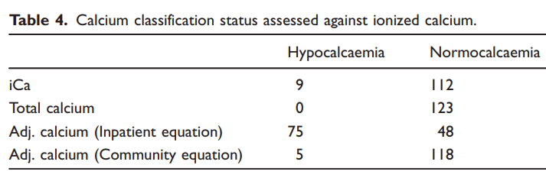
Limitations of Calcium Correction Equations
Jassam N, Hayden K, Dearman R, Allgar V, Barth JH. Prospective study comparing the outcome of a population-specific adjusted calcium equation to ionized calcium. Ann Clin Biochem. 2020 Jul;57(4):316-324. doi: 10.1177/0004563220926542. Epub 2020 Jun 4. PMID: 32340478.
Simons J.
https://thischangedmypractice.com/myth-of-calcium-correction/

Slide 48
Topics:
Lab test artefacts in Endocrinology
Lab testing in:
  Hypertension
    Cushing
    Primary aldosteronism
  Adrenal Insufficiency
  Polydipsia Polyuria Syndrome
  Hypercalcemia / Hypocalcemia
  Graves disease

Slide 49
Grave’s Disease
Value of TSHRa testing
Interpretation

Slide 50
When to order TSHRa?
Hyperthyroidism with suppressed TSH +/- FT4 or FT3 elevation
Ophthalmologic findings of Graves ophthalmopathy
  With or without clinical/ophthalmologic features of hyperthyroidism
Maternal history of Grave’s disease
  Test the mother in third trimester
  Test the newborn at birth if antibody titre positive in the mother

Slide 51
Interpretation of TSHRa?
>1.7 – Specific rule in for Grave’s disease
<0.7 – Sensitive rule for Grave’s disease
0.7 – 1.7
  Indeterminate
  Consistent with autoimmune thyroid disease including Grave’s

Slide 52
TSHRa test – is it activating or blocking?
Unable to determine with the SPH Roche method in BC
Require cAMP stimulation test in a cell based assay exposed to patient serum
  Not routinely required

